Slide 1


Slide 2

GROW YOUR OWN TEACHER PROGRAM
RELATIONSHIPS
RELEVANCE
RIGOR

Slide 3
RELATIONSHIPS
POST SECONDARY PARTNER
LOCAL TEACHER

Slide 4

POST SECONDARY PARTNER

Slide 5
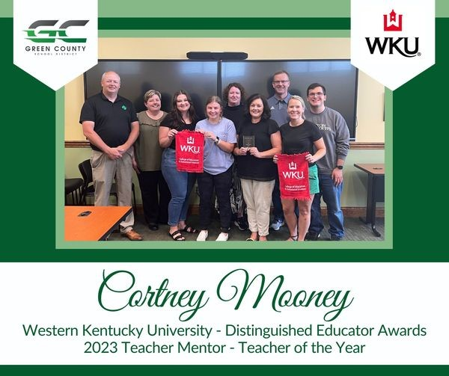
LOCAL TEACHER

Slide 6
RELEVANCE
ELEVATE
INCENTIVIZE

Slide 7
ELEVATE

Slide 8

INCENTIVIZE

Slide 9
RIGOR
Successful organizations articulate clearly the knowledge, skills, and attributes needed to make the change and provide opportunities for collaborative learning to occur.

Slide 10
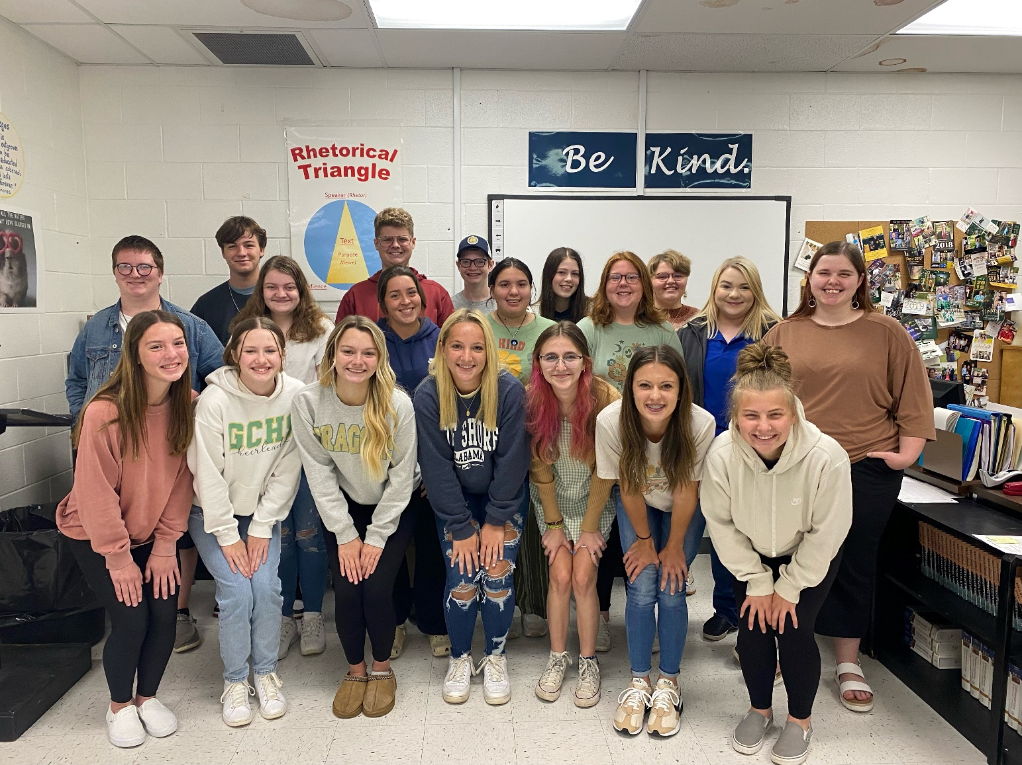

Slide 11


