Slide 1
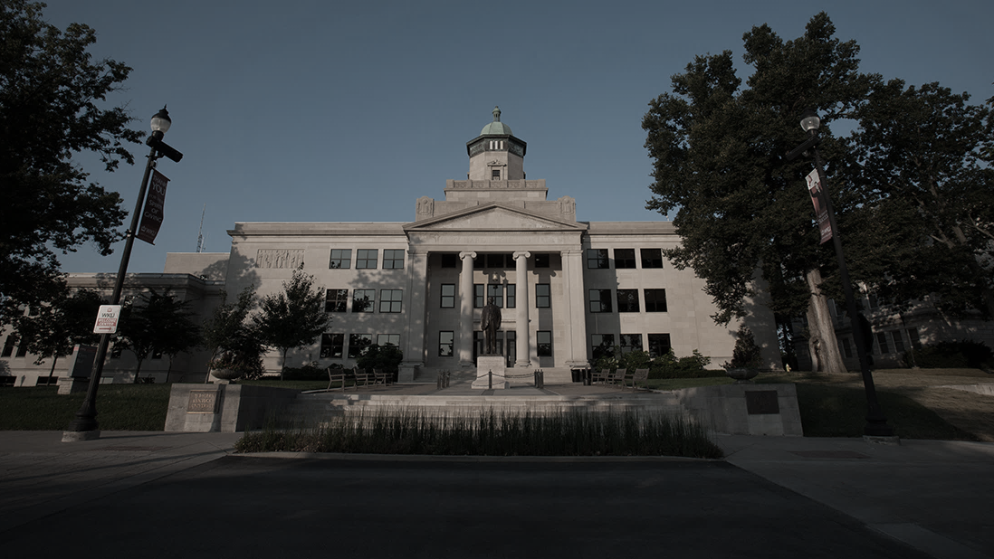
The Kentucky Teacher Apprenticeship
Developing Outstanding Teachers with Community Roots

Slide 2
Districts Need Teachers Who:
Have strong ties to schools and the community.
Want to be a teacher.
Demonstrate significant potential to be a successful educator.
Are collaboratively taught and mentored by the District and an Education Preparation Provider.
Will stay.

Slide 3
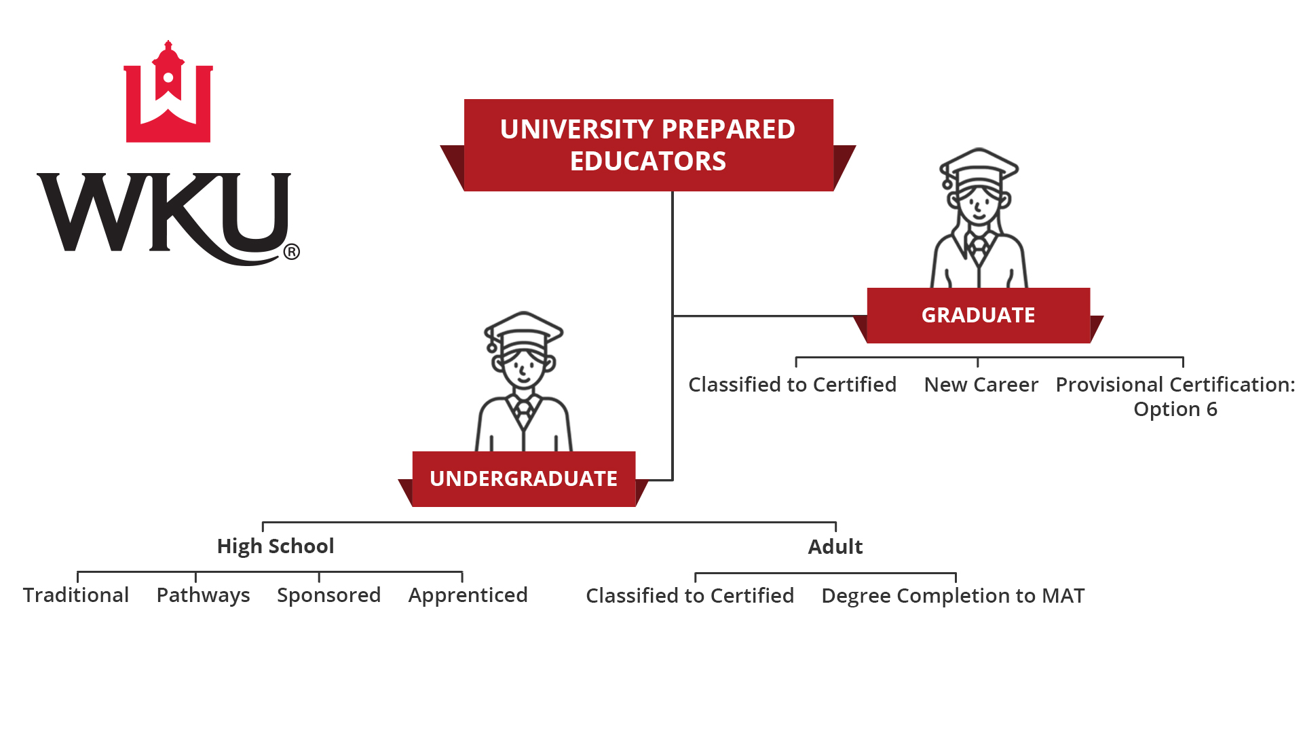
Educator Preparation Programs

Slide 4
USDOL Apprenticeship K-12 Teacher
O*NET-CODE
RAPIDS CODE
25-3099.0
3024B
An apprentice is “a paid employee, who participates in structured on-the-job learning to prepare for a successful career apprentices earn a progressive wage as their skills and productivity increase.” –Apprenticeship USA
Notes:
Provide a brief history on Tennessee and model growth throughout the country.
An organized and systematic form of instruction designed to provide the apprentice with knowledge of the theoretical and technical subjects related to the apprentice’s occupation.

Slide 5
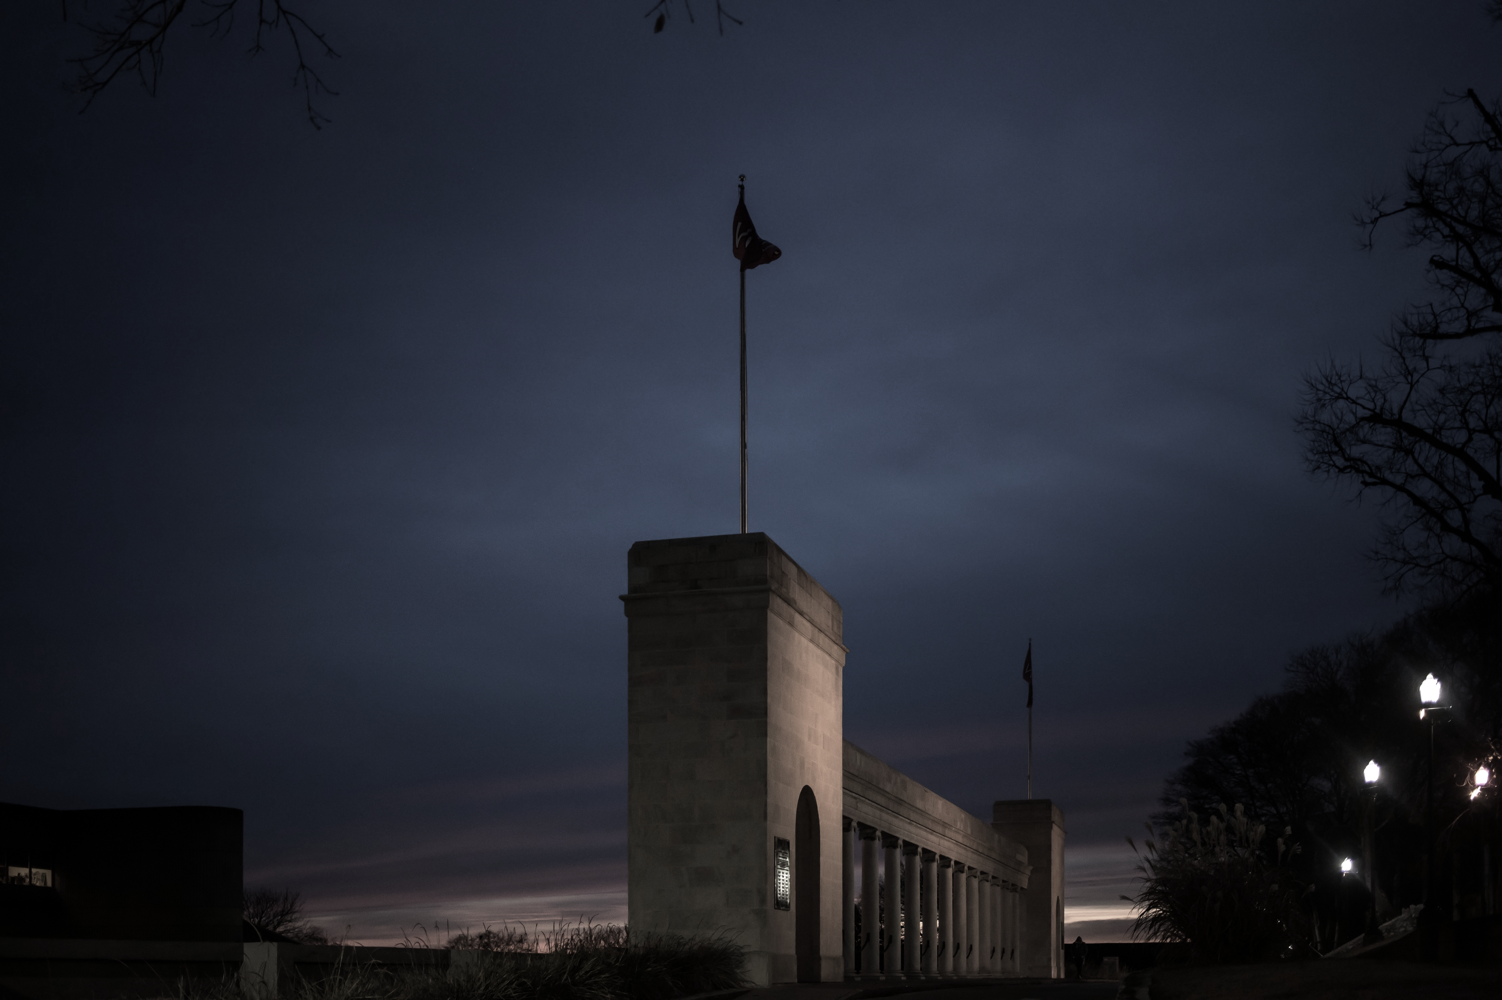
K-12 Teacher Apprenticeship Program Components
DOL Work Process
(competency-based mentoring in the field)
Dual Credit Coursework
University Coursework
Student Teaching
The Spirit Makes The Master
Notes:
On the Job Learning aka Earn and Learn
Apprentices receive sufficient experience to become fully proficient in each domain/category

Slide 6
APPRENTICESHIP PARTNERS
preK-12 School District (District)
University Educator Preparation Program (EPP)
Community & Technical College (CTC)
Kentucky Office of Employer and Apprenticeship Services (OEAS)
The Spirit Makes The Master
Notes:
On the Job Learning aka Earn and Learn
Apprentices receive sufficient experience to become fully proficient in each domain/category

Slide 7
Contribution by Partner
-Slide Courtesy of NCPS
Notes:
Mention OEAS as the approving body for the work process and sponsor applications.

Slide 9
Approved “Work Process Schedule”
Professionalism
Planning
Environment
Instruction
The Spirit Makes The Master
Notes:
On the Job Learning aka Earn and Learn
Apprentices receive sufficient experience to become fully proficient in each domain/category

Slide 10
Curriculum Mapping – Foundational Pathway
Teaching and Learning Pathway Courses | Aligns with WKU Teacher Education Courses
331030 The Learning Community | EDU 250 Discover Teaching (3)
331031 The Learner-Centered Classroom | EDU 260 Classroom Assessment (3)
331032 The Professional Educator | EDU 350 Student Diversity and Differentiation (3)
331033 Collaborative Clinical Experiences | EDU 360 Behavior and Classroom Management (3)

Slide 11
Curriculum Mapping – Developing the Career Pathway
District Review –
Do they offer the Teacher CTE Pathway
Do they offer additional internship opportunities for high school students in district classrooms (e.g. Ed Collab @Nelson)
Map the apprenticeship work process to the internship and pathway courses
Identify the dual credit partner
University Review –
Internship activities mapped to additional undergraduate educator coursework
Map the apprenticeship work process to university coursework
Memorandum of Understanding
Articulating full extent of the undergraduate degree with who, how, where, & when

Slide 12
NCPS Payment Structure
Pre- and Youth Apprentices
Student Must Be Enrolled at ECTC to complete Gen Ed Requirements
Students maintain a portfolio demonstrating mastery of identified competencies and learning experiences aligned to DOL Work Processes
Senior Year: Apply for Youth Apprenticeship (interview & application process), a paid $8/hour student work experience with a single mentor teacher
Transition to Adult Apprentice (Upon graduation)
Credit for Prior Learning review by WKU for Ed coursework
Recommendation of Interview Committee
Paid, two-year “student teaching style experience.” Work as an instructional assistant under a mentor teacher
Cannot be the teacher of record or work outside direct supervision of the master teacher
-Slide Courtesy of NCPS
Notes:
Six actual apprentices. We have 45 enrolled in the Ed. Collab pathway who serve as the pipeline. Each year, we have ten or more completers. At present, we will be able to serve only two or three per completing class as paid apprentices. We will do this by converting existing instructional assistant positions to apprentice titles. The number and types of these positions are limited, primarily serving kindergarten, and will not address the highest areas of need in math and science at the middle and high school levels.

Slide 13
Apprenticeship Maturation Timeline – High School
First 6 Months
Next 6 Months
Year 2
Year 3
Years 4 & 5
*
Assess Starting Point
Application to OEAS & Student Recruitment
High School Juniors begin Dual Credit Coursework & Field-based Pathway Competencies*
High School Seniors continue Dual Credit Coursework & Field-based Pathway Competencies*
University Students Complete Upper Division Coursework, Student Teaching, and Licensure
Curriculum Mapping & GAP Analysis
Notes:
Year 2 – Mentor Training for Competency Assessment and Document
Year 3 Into 4 – Students graduate and have their portfolio of competencies assessed for transcriptable credit at the university: 9-12 credits will be awarded on top of the dual credits earned. Some Students enter year 4 with as many as 60 credits earned. Students completing community college dual credit coursework may enter the university general education certified meaning that aspect of the undergraduate degree is considered complete.

Slide 14
NCPS and WKU Progress Update
WKU/Nelson/ECTC develop career pathway
Fall 2022
Nelson Registers with OEAS as Sponsor and K-12 Teacher Occupation
Spring 2023
Nelson/WKU Recruits, Reviews, Accepts Students (7)
Late Spring 2023
Nelson Students Begin Career Pathway & Dual Credit Courses
Fall 2023
District Students Hired as Youth Apprentices, Take Dual Credit & Continue Career Pathway
High School Graduation & District Employs Student as Registered K-12 Teacher Apprentice
Teacher Apprentice Matriculates to EPP
Teacher Apprentice Works in District & Completes Upper Division Bachelor’s Requirements
Teacher Apprentice Earns Bachelor’s, Passes Licensure Exams, and Joins District Faculty
Notes:
Six actual apprentices. We have 45 enrolled in the Ed. Collab pathway who serve as the pipeline. Each year, we have ten or more completers. At present, we will be able to serve only two or three per completing class as paid apprentices. We will do this by converting existing instructional assistant positions to apprentice titles. The number and types of these positions are limited, primarily serving kindergarten, and will not address the highest areas of need in math and science at the middle and high school levels.

Slide 15
Program Costs
Apprenticeship Wages
Mentor Renumeration
University Curriculum Delivery Model Redesigns
Apprenticeship Coordinators – District & University
Student Tuition, Materials, Exams, & Fees – Dual Credit & EPP

Slide 16
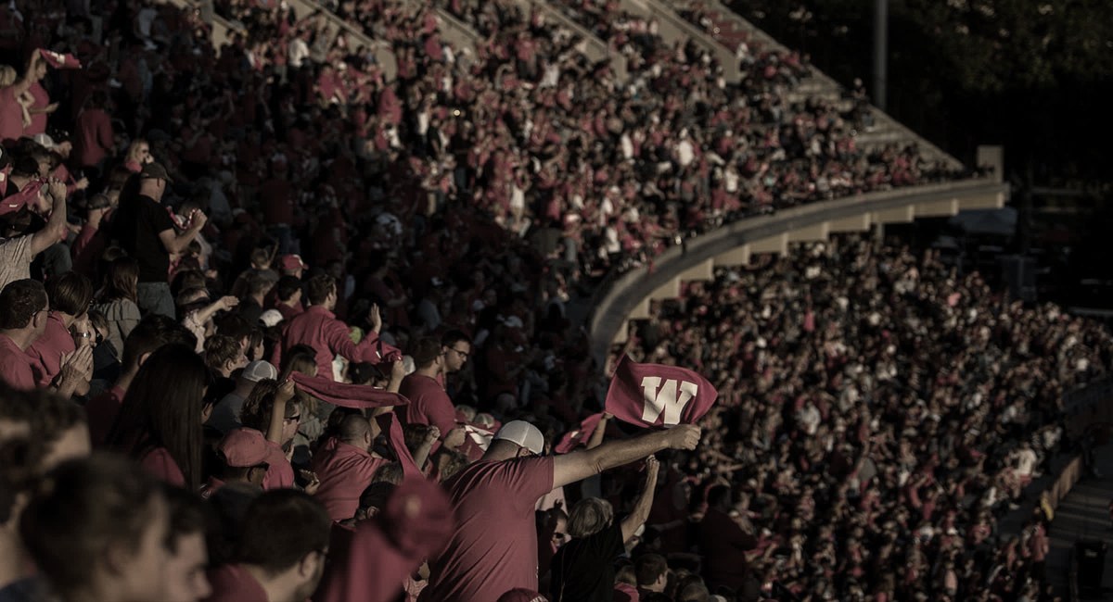
Opportunity Cost
Increasing Net Staff

Slide 17
Funding Sources
Converting Existing Instructional Assistance Lines
Reallocating Title II Funding
External Grant Support +
Commonwealth Seed Funding +
USDOL Funding +

Slide 18
Reestablish Education as a
First Choice Profession
Elevating the Visibility of Education Through Apprenticeship Programs
Notes:
Final comment

Slide 19
Scaling Up - National Tidal Wave
2023 WKU Apprenticeship Summit – June 22, 2023
130+ attendees; 30+ districts; 10+ epps; 10+ ctcs
16+ states now engage the model
National Center for Grow Your Own & Apprenticeship USA
Opportunities: STEM, Secondary, and Special Education

Slide 20
Grayson and WKU Progress Update
WKU/Grayson develop career pathway
Spring 2023
Grayson Registers with OEAS as Sponsor and K-12 Teacher Occupation
Spring 2023
Grayson Recruits, Reviews, Accepts Students
Late Spring 2023
Grayson Students Begin Career Pathway & WKU Courses at BG Campus
Fall 2023
District Employs Students as Registered K-12 Teacher Apprentice, Continue Coursework
Greyson Students Graduate
Teacher Apprentice matriculates to EPP
Teacher Apprentice Works in District & Completes Upper Division Bachelor’s Requirements
Teacher Apprentice Earns Bachelor’s, Passes Licensure Exams, and Joins District Faculty

Slide 21
Hancock and WKU Progress Update
WKU/Hancock develop career pathway
Summer/Fall 2023
Hancock County Registers with OEAS as Sponsor and K-12 Teacher Occupation
Fall 2023
Hancock Recruits, Reviews, Accepts Students
Spring 2024
Hancock Students Begin Career Pathway & WKU Courses at BG Campus
Fall 2024
Hancock Students Graduate
District Employs Student as Registered K-12 Teacher Apprentice
Teacher Apprentice Matriculates to EPP
Teacher Apprentice Works in District & Completes Upper Division Bachelor’s Requirements
Teacher Apprentice Earns Bachelor’s, Passes Licensure Exams, and Joins District Faculty

Slide 22
Apprenticeship Maturation Timeline – Adult Learner
First 6 Months
Next 6 Months
Year 2-3
Year 2-3
Years 3
*
Assess Starting Point
Application to OEAS & Student Recruitment
District Classified Staff ”Hired” as Apprentices and Begin Field-Based Pathway Competencies*
Apprentices complete field-based pathway, lower division and upper division coursework
Apprentices Complete Upper Division Coursework, Field, and Student Teaching
Curriculum Mapping & GAP Analysis
Notes:
Year 2 – Mentor Training for Competency Assessment and Document
*Year 3 Into 4 – Students graduate and have their portfolio of competencies assessed for transcriptable credit at the university: 9-12 credits will be awarded on top of the dual credits earned.
Could be as fast as 3 years (1 year development; 2 year completion) depending on the coursework already accomplished by the

Slide 23
Apprenticeships Provide:
Collaboration between Districts and EPPs
DISTRICT
Purposeful and Mentor–Based Clinical Experiences
Earn and Learn Opportunities for Kentucky Residents
Opportunities to Build Affiliation and Bond to the Community
RETENTION
Highly Trained, Professional, and Committed Teachers

Slide 24
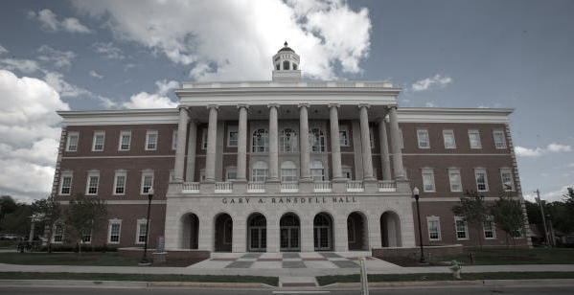
On behalf of Nelson County & WKU,
Thank you!
Corinne M. Murphy, Ph.D., BCBA-D

