Slide 1
JCPS Future State:
Leading the Way on
Student Achievement
Interim Joint Committee on Education
August 1, 2023

Slide 2
Common Themes
Improved Student Attendance
Improved Student Experience
Improved Student Outcomes

Slide 3
New for 2023-2024 School Year
New Student Assignment Plan
Differentiated Start Times
Weapons Detection Systems
Updated Facilities
Districtwide Curriculum
Literacy & Math

Slide 4
Student Assignment Plan
Choice Zone
Enhanced & Equitable Student & Staff Resources
Every Student Can Choose a School Close to Home
Streamlined Feeder Patterns
Focus on Student & Parent Choice
Magnet Options
Academies of Louisville

Slide 5
Start Smart
Addresses Shortage of Bus Drivers
Addresses Loss of Instructional Time
Increases Choices for Families
25-30K adolescents will get more sleep time in AM

Slide 6
Facilities
Four new JCPS school buildings in 22-23 & 23-24
More than in the last 20 years combined
Next decade will see more than 20 new schools buildings and nearly 20 major renovations
New playgrounds for 20 elementary schools
New outdoor athletic facilities across the district

Slide 7
Weapons Detection System
Enhances JCPS Existing School Safety Plan
Utilizes Artificial Intelligence to detect threats
Moves Students Quickly and with Minimal Disruption
Similar Districts Saw a 90% Decrease in Weapons Found

Slide 8
JCPS Literacy:
Leading the Way with a Focus on Foundational Skills!

Slide 9
What is Literacy?
What: The creative and analytical ability to identify, understand, interpret, create, compute, and communicate, using visual, audible, and digital texts across disciplines.
How: The development of literacy skills is on a continuum allowing for individuals to utilize it over varying contexts and with varying abilities.
Why: Literacy is a moral imperative because it gives humans the ability to articulate our experiences and interact with others to improve the world around us.

Slide 10
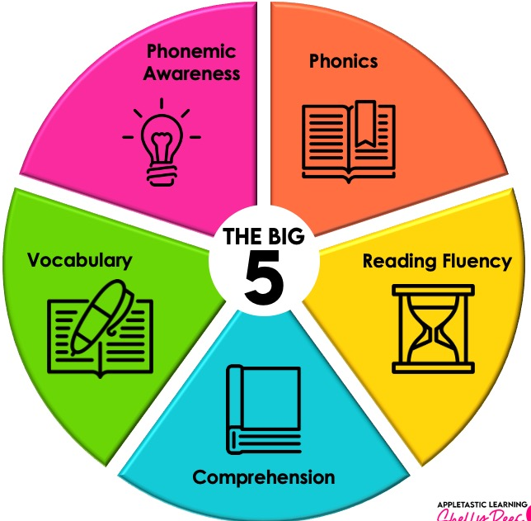
The Five Components of Literacy
Phonemic awareness is an understanding of phonemes, or the smallest units of spoken language which combine to create syllables and words. Phonemic awareness is the ability to isolate, identify, focus on, and manipulate sounds in spoken words.
Phonics is the relationship between letters and sounds in written language. A student who is strong in phonics is able to sound out and spell different words.
Fluency is the ability to read quickly and accurately, and comes about when the reader has mastered enough decoding skills to focus on the meaning of the text.
Vocabulary is the amount of words with which the reader is familiar. The larger a student’s vocabulary is, the easier it is for them to derive meaning from the text.
Comprehension is the ultimate goal of literacy. It is the reader’s ability to understand and make sense of written text.
National Reading Panel, 2000

Slide 11
The Need for
Foundational Skills
Data suggests that for students who did not master the foundational literacy skills by the end of 2nd grade, their chance to improve their reading ability or reach reading proficiency is scant.

Slide 12
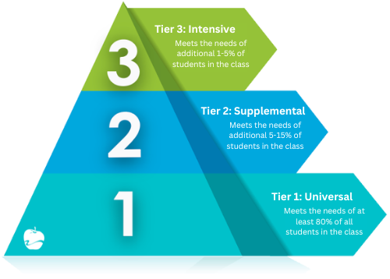
Implications for Teaching
Reading IS a Science- It’s not magic.
Education is ever evolving and we must stay on top of best practices.
Foundational Skills Matter
Without phonemic awareness and phonics, reading cannot sustain higher level texts
Tier I (ALL Students Exposed) Curriculum should be KNOWLEDGE BUILDING
“The implication for reading instruction is that expanding students’ background knowledge and enriching their reading experiences across different disciplines and genres should be an integral part of a comprehensive reading curriculum”

Slide 13
The Problem & Steps to a Solution
Based on district data, practitioner research, and recent legislation, we’ve made some shifts!
a comprehensive K-12 literacy plan
a consistent foundational literacy experience for students
Tier I or CORE ELA Curriculum

Slide 14
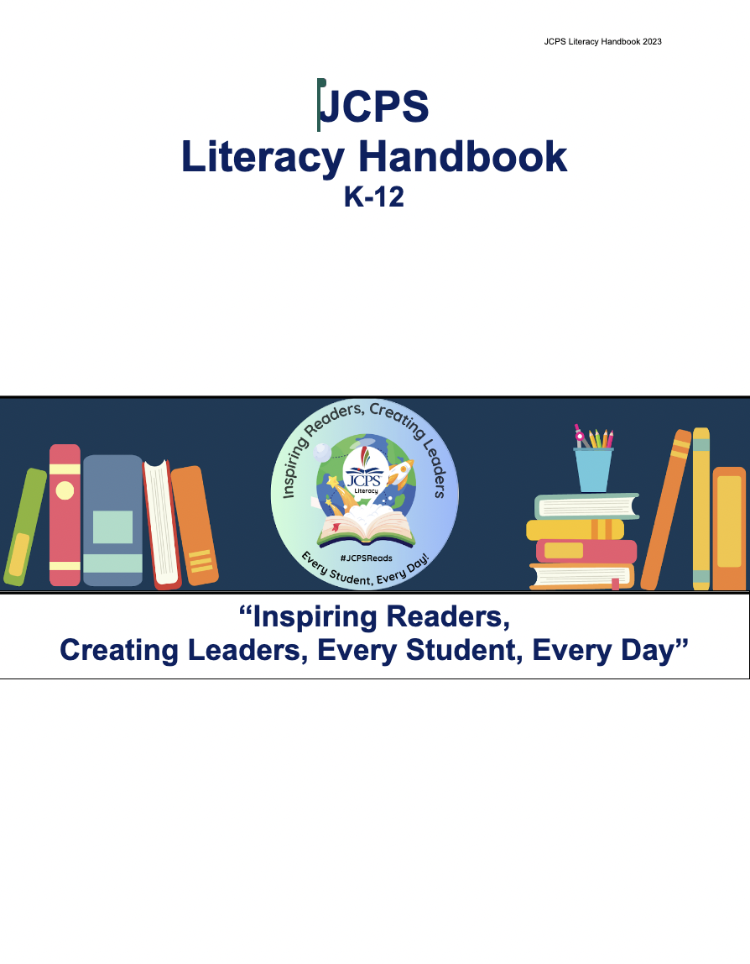
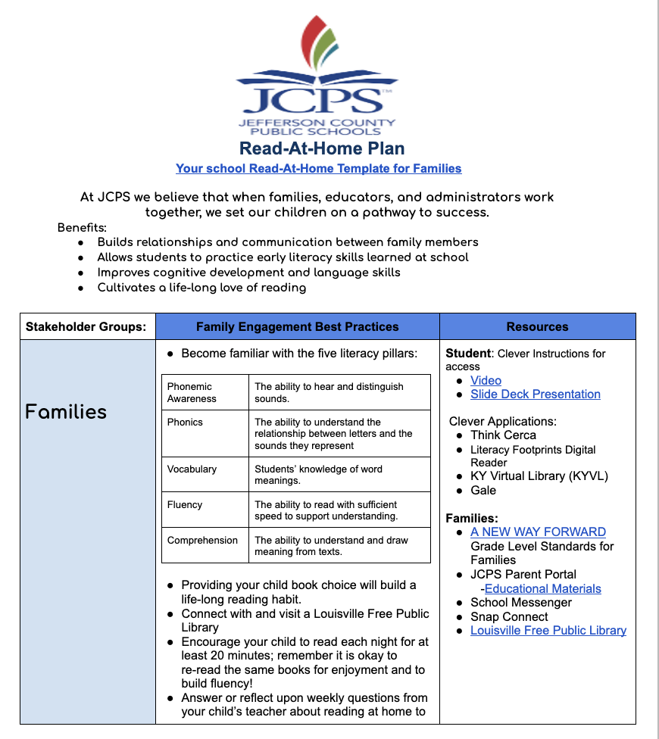
JCPS Response to Literacy Shifts
Senate Bill 1: Common Tier One (Core Instruction) Curriculum for ELA and Math
District Wide Training- 5,000+ (June-Sept)
Consistent Approach for Transient Population and District Resources/Support
EL- Expeditionary Learning & IM- Illustrative Mathematics
Senate Bill 9:
Read to Succeed Act:
K-12 Literacy Handbook
Supports for Multilingual Learners
K-12 Literacy Monitoring Tool (Every School)
K-3 Foundational Reading Skills Improvement Plan
Reading Diagnostic- MAP Reading Fluency K-3
Read at Home Plan

Slide 15
More To Come!
K-12 Comprehensive Math Plan
Full Execution of the Future State
Improved Student Outcomes

