Slide 1
The Impact of Instructional Coaching on Teacher Effectiveness, Recruitment, and Retention

Slide 2
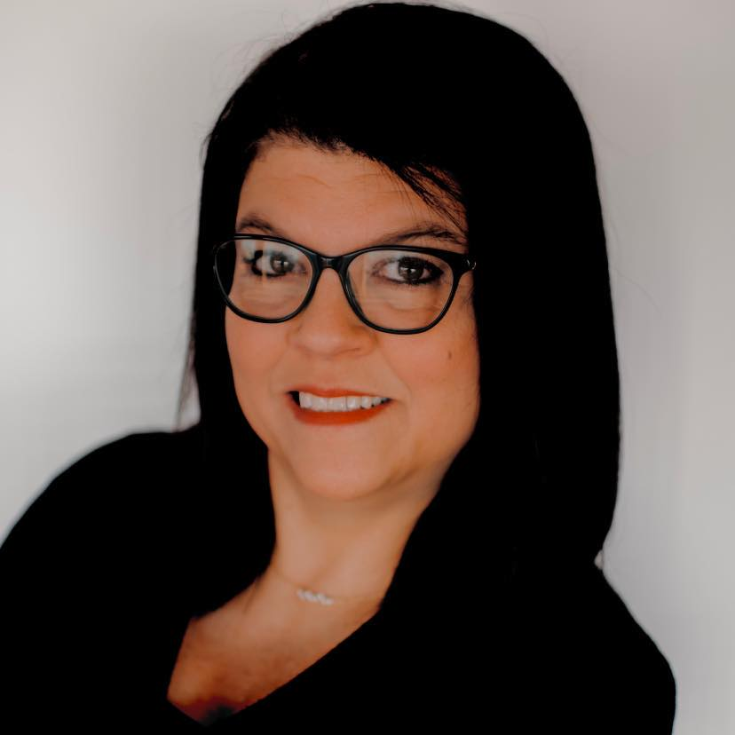
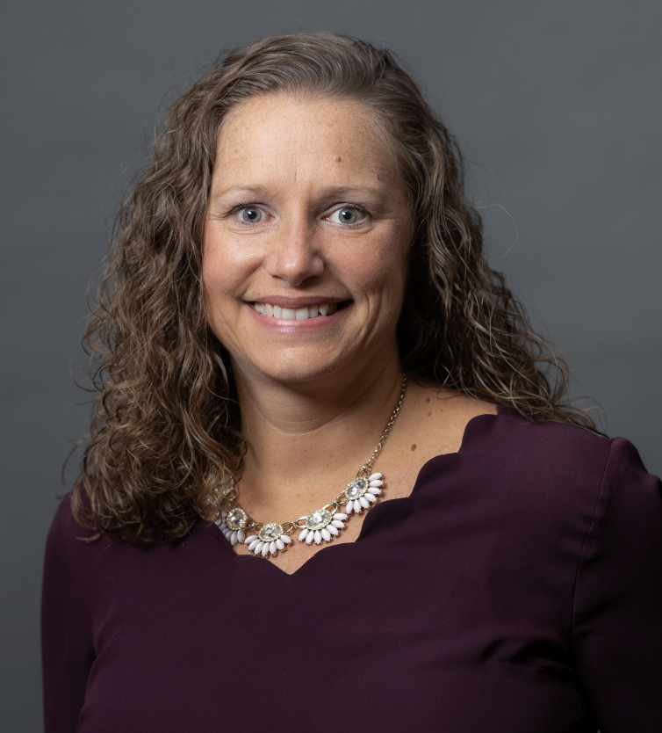
Angie Keene
Retired Educator
Former Instruction Coaching Project Lead
Shelley Winterberg
Director of Programs,
New Teacher Center
Notes:
Introductions

Slide 3
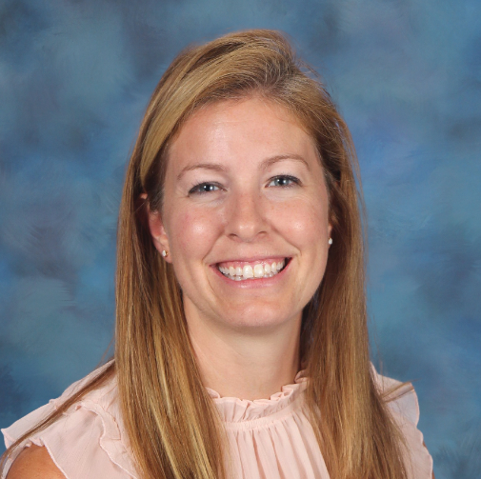
Tori Anders
NTC Lead Instructional Coach/
Literacy Consultant
Melissa Conlin
SESC/NTC FTE
Instructional Coach/
BTI Professional Growth Partner/Science Consultant
Lindsey Wilson
Elementary Teacher
Lead Teacher/Coach
Writing Teacher

Slide 4
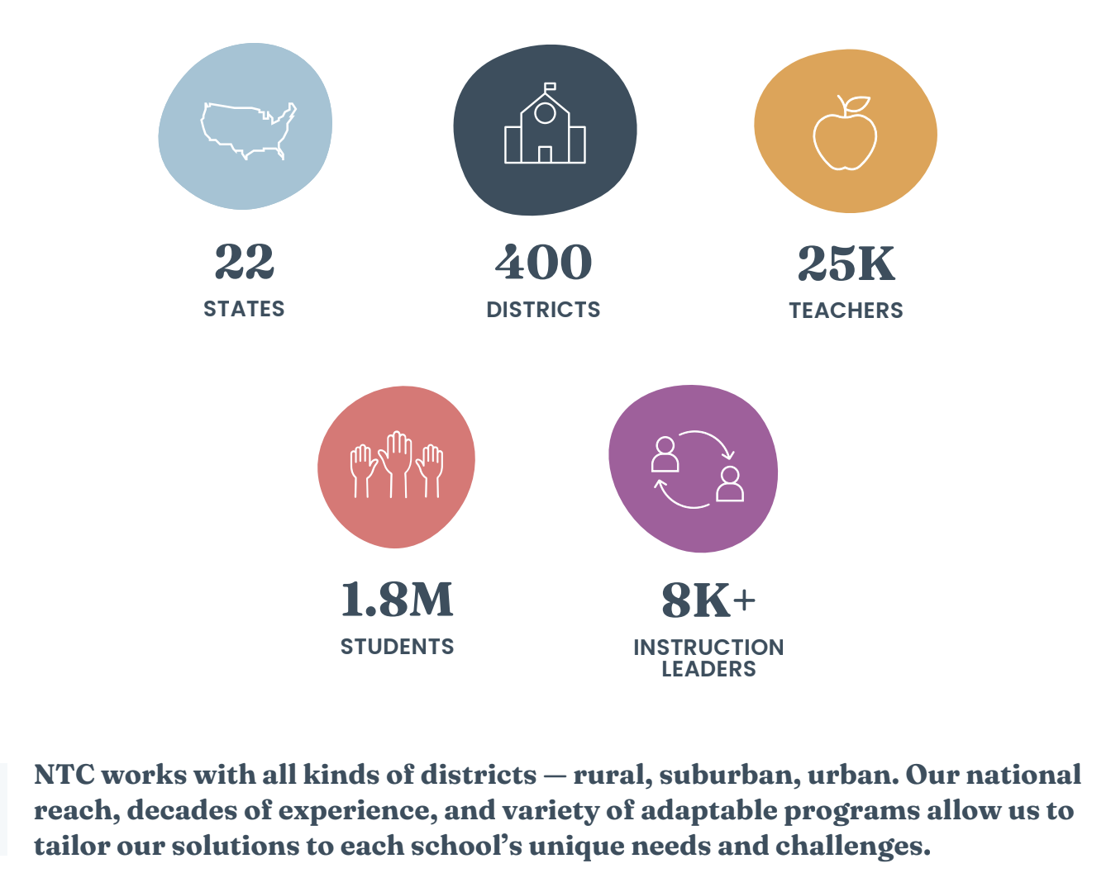
Who is New Teacher Center?

Slide 5
SESC and NTC Project Goals
NTC received an EIR Grant
Partnered with SESC
Served 10 districts
Randomized 18 schools
____ coaches
_____ teachers

Slide 6
Strategic Practices for Training and Support
NTC received an EIR Grant
Partnered with SESC
Served 10 districts
Randomized 18 schools
____ coaches
_____ teachers

Slide 7
Our Current Reality
The Elephant in the Classroom
New teachers are leaving the profession at rates between 19% and 30%.
The percentage of alternatively certified teachers is increasing each year in our districts.
Our students deserve effective teachers!
90% of open teaching positions are created by teachers leaving the profession. ⅓ of that 90% is attributed to retirement.
Teachers have the greatest impact on student achievement among all school factors.
On average, alternative certified teachers leave the profession within 3 years.
Teachers desire positive relationships and support.

Slide 8
What are the factors that motivate you to stay in a job aside from salary and benefits?
Work Relationships
Clarity of Expectations
Support
Voice in Decision Making
Positive Work Environment
Sense of Belonging
Impact Kentucky-Working Conditions Survey

Slide 9
Voices from the Field on
Work Relationships:
“Our PLCs have gone from gripe sessions to doing productive work.”
-Dayna Bingham
Dewitt Elementary
Curriculum Coach
“This is my person! She supports me and helps me to reflect and to become a better teacher everyday. Our relationship is priceless”
-Kaylee Hobbs
East Bernstadt Elementary
Teacher

Slide 10
Voices from the Field on
Support:
“This is the best week of coaching I’ve had! I’ve been able to make connections with all of the other work I’ve been doing.” “I feel like we are on the cusp of greatness”
Sarah Watkins
District Coach
Corbin Independent Schools
“The coaching is working really well. Our teachers are feeling supported.”
-Sabrina King
G.R. Hampton Elementary
Principal

Slide 11
Voices from the Field on
Voice in Decision Making:
“By looking at the data like that, it was easier for me to see what was really going on with him, so that I could make decisions that will help him to have success.”
Desiray Lakes
McKee Elementary
Teacher

Slide 12
Voices from the Field on
Sense of Belonging:
“I look forward to our coaching meeting each week. It’s so good to have someone to talk to and collaborate with.”
Mahalia Logan
Pleasant View Elementary
Teacher

Slide 13
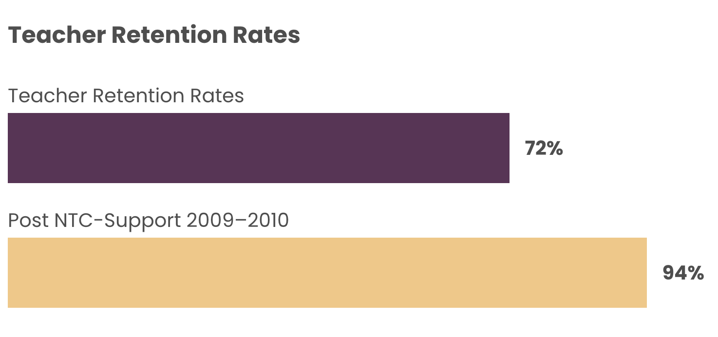
Empowering Teachers With Staying Power
An empowered teacher is the heart and soul of a thriving classroom.
Our co-creative process gives teachers an equal stake in building their school’s culture.
Notes:
Add the factors that coaching address.
Add some of our quotes from teachers and principles.
Teachers stick around because they feel supported, grow professionally, and see their students thrive
Add screenshot of 3 images…

Slide 14
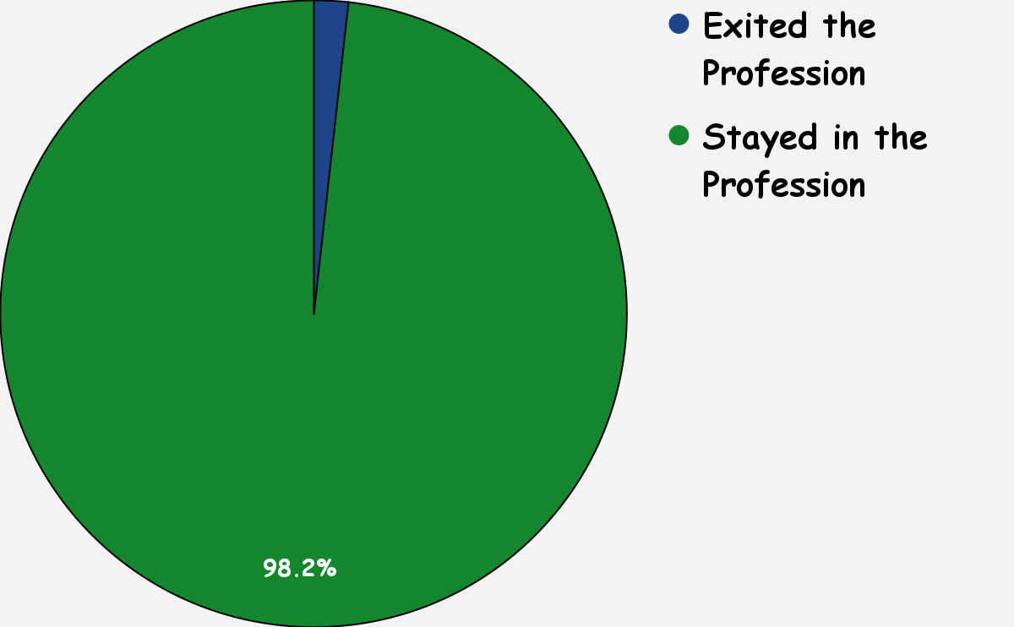
Number of teachers coached in NTC/SESC partnership in Southeast South-Central Kentucky:
168

Slide 15
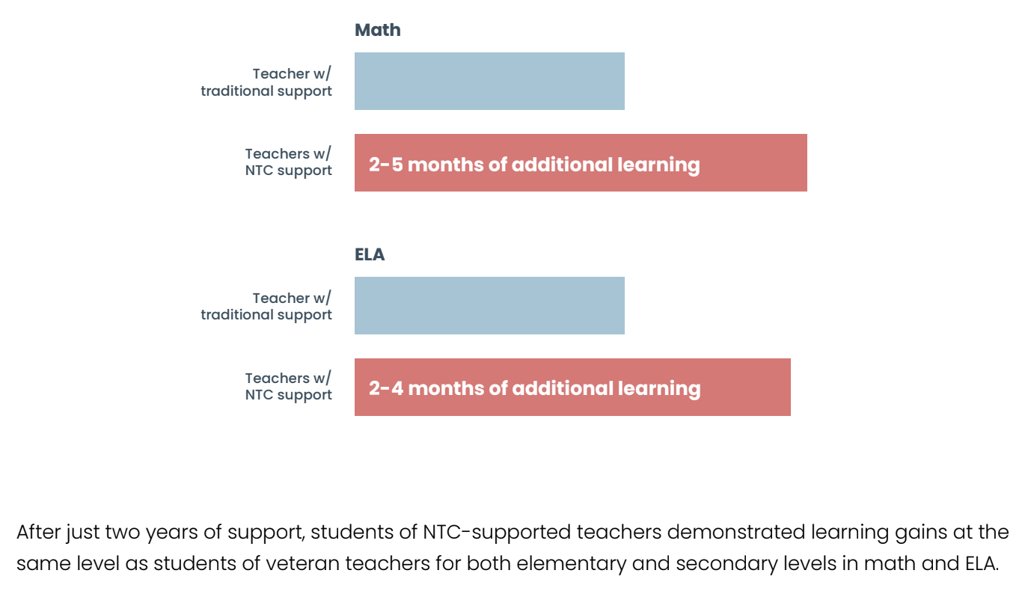
Supporting Teachers Boosts Student Achievement

Slide 16
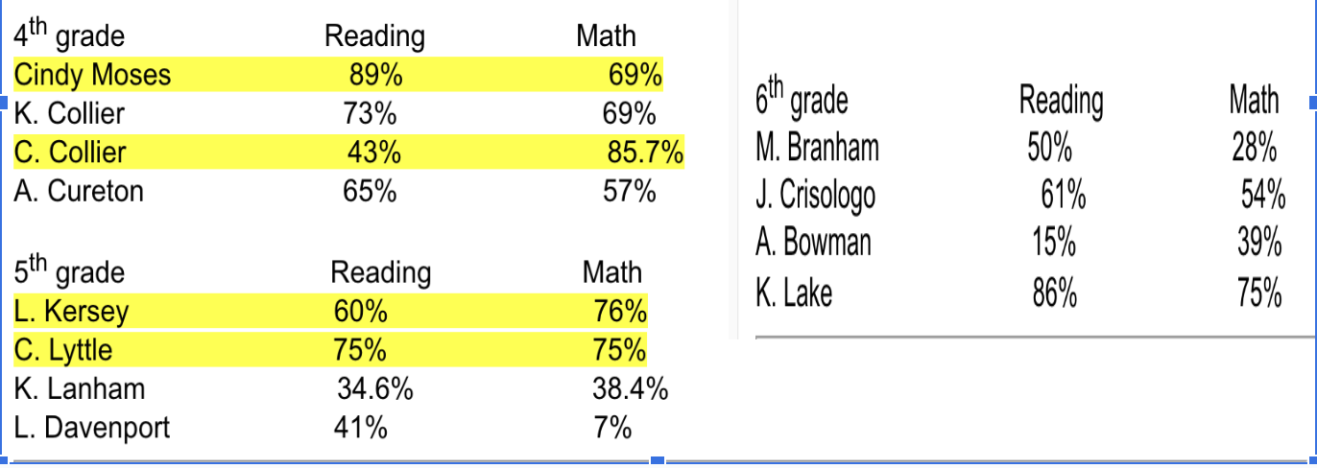
What We See: Percentages of Distinguished and Proficient Scores
Data Source: Whitley County Intermediate School 22-23

Slide 17
What We Know

Slide 18
What We Hear
“Coaching is a great asset! We have been failing by telling people to go coach without training them on coaching practice.”
Brian Fredrick
Knox County Principal Coach

Slide 19
A Teacher and Coach’s Perspective
KTIP | NTC Project
Mentors received little training Tell new teachers what to do An outsider coming in The burden of work placed on the new teacher | Coaches receive extensive training Coaches guide new teachers to realize their own strengths and abilities Coaches are teachers in the same building No burden for the new teacher, just devoting time to receive support from coach

Slide 20
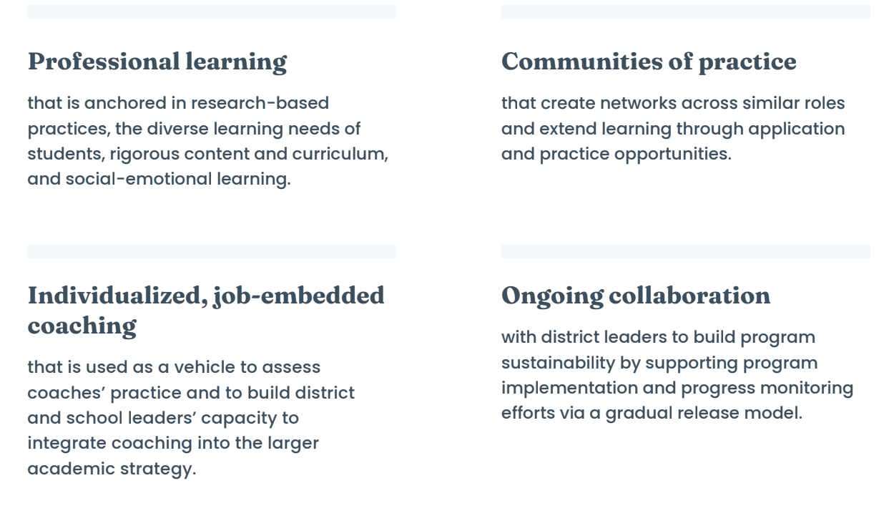
What Instructional Coaching Costs
Professional Development to train coaches and School Leaders
Time to advance practice and collaborate with peers
Stipends for coaches

Slide 21
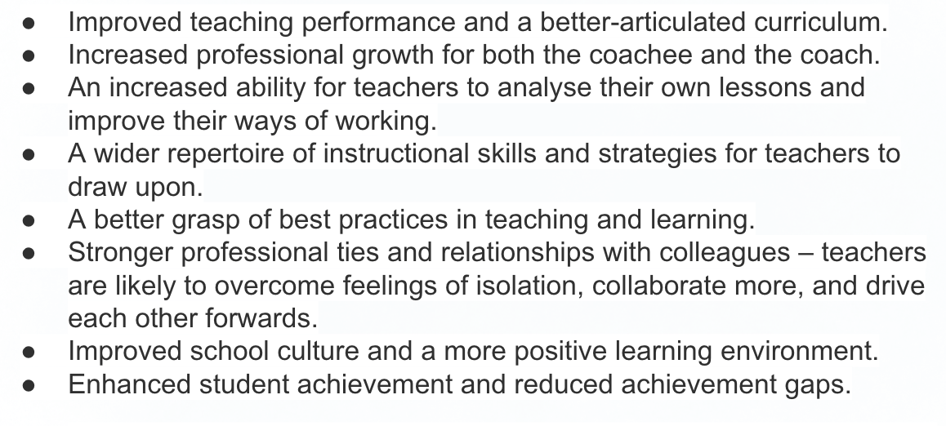
What Instructional Coaching Yields

Slide 22
Next Steps
We’re happy to follow up and provide you with any additional information that is helpful.
Our Contact Information:
Shelley Winterberg: swinterberg@newteachercenter.org
Angie Keene: angiekeene70@gmail.com
Tori Anders: tori.anders@sesccoop.org
Melissa Conlin: melissa.conlin@sesccoop.org
Lindsey Wilson: lindsey.wilson@jackson.kyschools.us

