Slide 1

Interim Joint Committee on Education
October 17, 2023
1
Cloverport Independent School District & K12: A Partnership
Keith Haynes, Superintendent
2
Kentucky Virtual Academy:
The School Experience
Dr. Tim Bobrowski, Executive Director
3
Day in the Life:
KYVA Student Experience
Sallie Johnson, Principal
4
Testimonials
Travis Johnston, Learning Coach
Colton Ellis, KYVA Student

Slide 2

CISD & K12: A Partnership
An innovative public school experience to support student learning.
Cloverport Independent School District
  Located on the Ohio River in Breckinridge County
  Founded in 1872
CISD sought a richer, more innovative virtual experience for interested students
Identified K12 as a strong option with a 20-year history of managing public school programs
Obtained unanimous local Board of Education support
Negotiated contract in close consultation with Board Attorney
Early and ongoing collaboration with the Kentucky Department of Education

Slide 3
KYVA School Experience
Providing a rigorous and innovative online public school learning experience for KY students with KY licensed educators.
KYVA student demographics are representative of state demographics as reported by KDE. Including:
68.9% White (Non-Hispanic)
10.2% African-American
9.3% Two or More Races
9.2% Hispanic
Additionally, approximately 4% of students enrolled are
McKinney Vento.
Tim Bobrowski, Ed.D - Retired Kentucky Superintendent, 11 years
Operate in compliance with KY state statutes/regulations (KRS & KAR) & KDE for virtual education
Asynchronous + Synchronous learning model – teachers teaching, not isolated computer program(s)
K-11 Curriculum & instruction aligned to KY standards and course codes
Focus on College & Career Readiness-Dual Credit courses Fall 2024
Wrap around services for enrolled students including counseling, academic support, and extra-curriculars

Slide 4
KYVA Student Experience
Full day of learning utilizing traditional experiences with online flexibility to meet the needs of students.
Synchronous Instruction
Live classes taught by KY teachers
Classes ensure guided practice
Small group instruction to meet student needs
Electives, enrichment, & remediation courses
Asynchronous Instruction
State-aligned curriculum
Students work with their Learning Coach and individually
Frequent opportunities for assessment
What makes this program different?
Proprietary learning management system utilized for teaching and learning
Involved relationship between Learning Coach and Teachers
Course materials shipped directly for each course
Student schedules maximize access to fully licensed teachers and curriculum
Technology and internet needs are met for families with access challenges

Slide 5


Slide 6
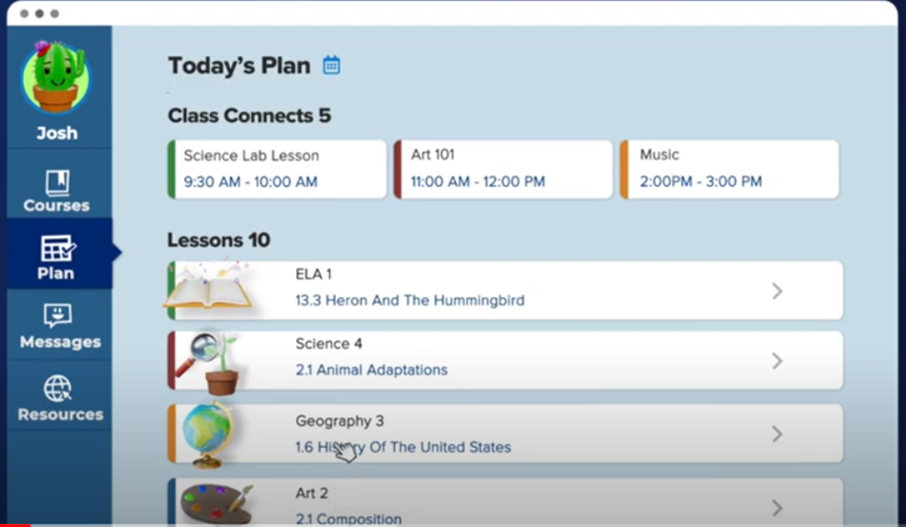

Slide 7
