Slide 1
House Bill 319 Update
Kentucky Department of Education
Office of Educator Licensure and Effectiveness

Slide 2
INTERSTATE TEACHER MOBILITY COMPACT
Todd Davis, Director of Educator Preparation and Certification

Slide 3
Overview of the Compact
The purpose of the compact is to facilitate the mobility of teachers across member states.
Allows teachers to use an eligible license from a compact member state to be granted an equivalent license in another compact member state.
To be eligible a license must require a bachelor’s degree and completion of a state-approved program for teacher licensure. The license must also be unencumbered.
Carveouts for military spouses and career and technical education

Slide 4
Overview of the Compact
Kentucky remains in control of their own teacher licensure and the compact will not close any existing pathways to teacher licensure or teacher mobility.
2023 House Bill 319 adopted the compact in Kentucky and codified it in KRS 161.135.
The compact requires that ten (10) states adopt the compact before it becomes operational.

Slide 5
Ten (10) states adopted legislation
Alabama, Colorado, Florida, Kansas, Kentucky, Nebraska, Nevada, Oklahoma, Oregon, Utah
Six (6) states proposed legislation
California, Delaware, New Jersey,
New York, Ohio, Pennsylvania
Five (5) states no legislation introduced
Georgia, Indiana, Louisiana, Mississippi, Washington
https://teachercompact.org/compact-map/

Slide 6
Next Steps
Establishment of the Compact Commission
Each member state must identify a representative
Scheduling initial commission meetings
November 2023, virtual meeting
January 2024, in-person meeting
Commission will establish rules and bylaws and implement the shared interstate licensure data system
Setup process typically takes twelve(12) to sixteen (16) months
Expect to begin issuing licenses under the compact in 2024

Slide 7
Options for Out-of-State Applicants
KRS 161.123 creates reciprocity for out-of-state teachers with National Board for Professional Teaching Standards certification.
Applicants must possess both a valid out-of-state teaching certificate and National Board for Professional Teaching Standards certificate.
16 KAR 4:030 sets standards for reviewing out-of-state prepared educators.
Completed a state-approved teacher preparation program at an accredited educator preparation institution or a state-approved alternative training program;
Meet the degree, academic preparation and grade point average requirements established for Kentucky prepared teachers; and,
Possess equivalent license from another state or territory.
KRS 160.030 exempts out-of-state teachers with two (2) or more years of experience from completing Kentucky’s certification assessments.

Slide 8
Questions
Todd Davis, Director
Office of Educator Licensure and Effectiveness
Division of Educator Preparation and Certification
300 Sower Blvd., 5th Floor
Frankfort, KY 40601
(502) 564-4606
todd.davis@education.ky.gov

Slide 9
EXIT SURVEY
Dr. Veda Stewart, Director
Elly Gilbert, Assistant Director
Justin Edwards, Program Consultant

Slide 10
KRS 160.382- Exit Surveys
Effective June 29, 2023
Requires local school districts to ensure that each employee that voluntarily leaves the district completes an exit survey.
Requires Kentucky Department of Education to develop a system to report exit survey information without providing personally identifiable information for use in evaluating factors impacting teacher retainment.
Reported information shall include the position vacated, the employee's years of service in the position and in the district, if the employee is taking a similar position in another district, and the reason or reasons provided for leaving the district.

Slide 11
Overview of the Exit Survey
The exit survey was designed to comply with KRS 160.382.​
The survey was launched to districts in July 2023. ​
The survey has six sections and takes approximately 10 minutes to complete.
The survey is available to both certified and classified staff and does not collect personally identifiable information.

Slide 12
Landing Page

Slide 13
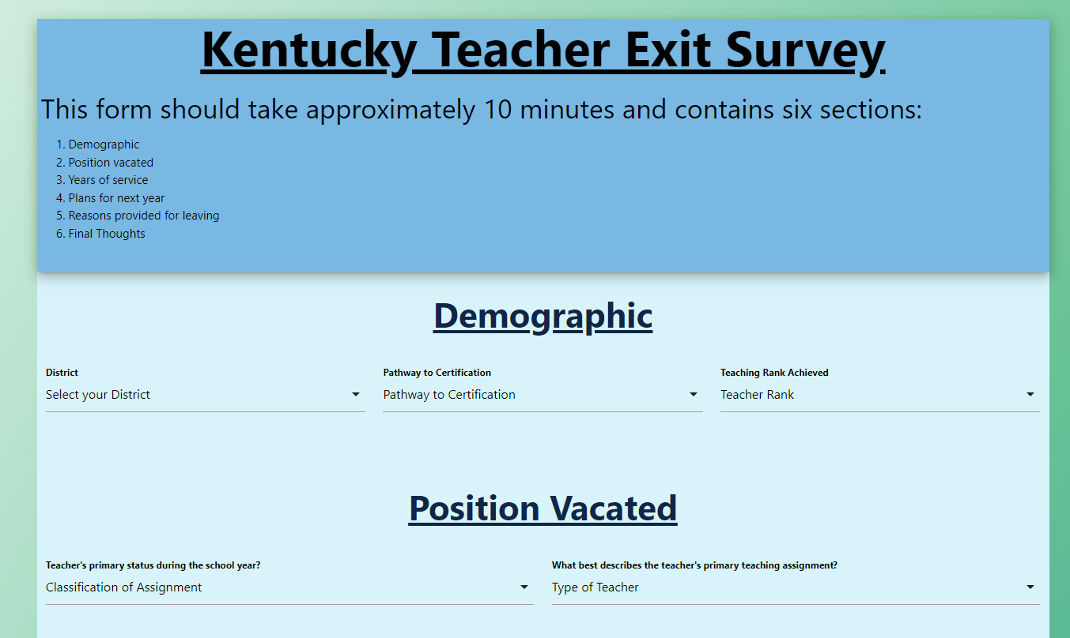

Slide 15
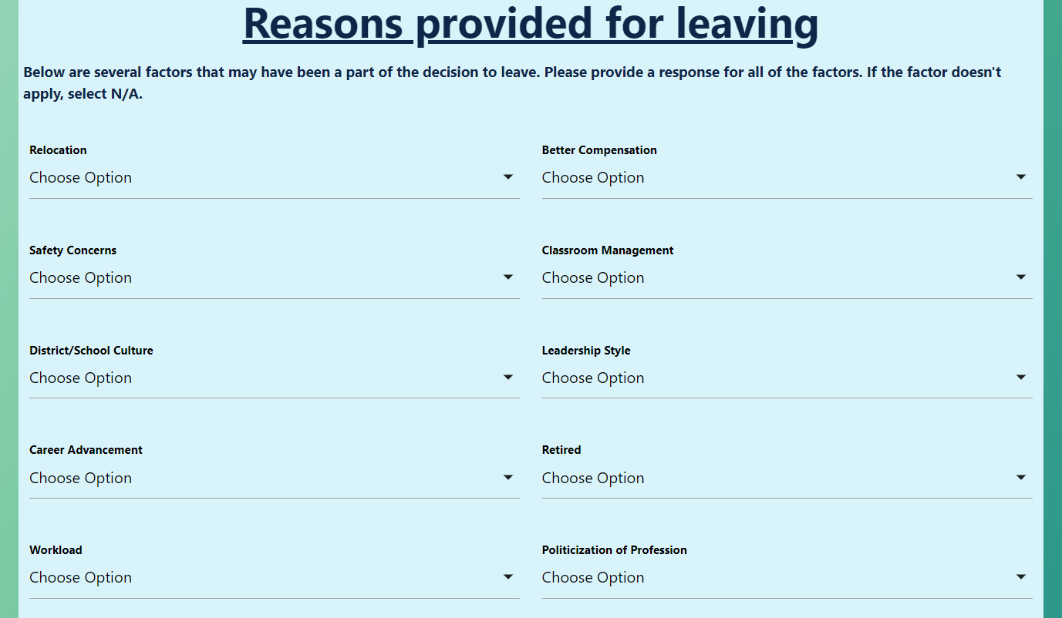

Slide 16
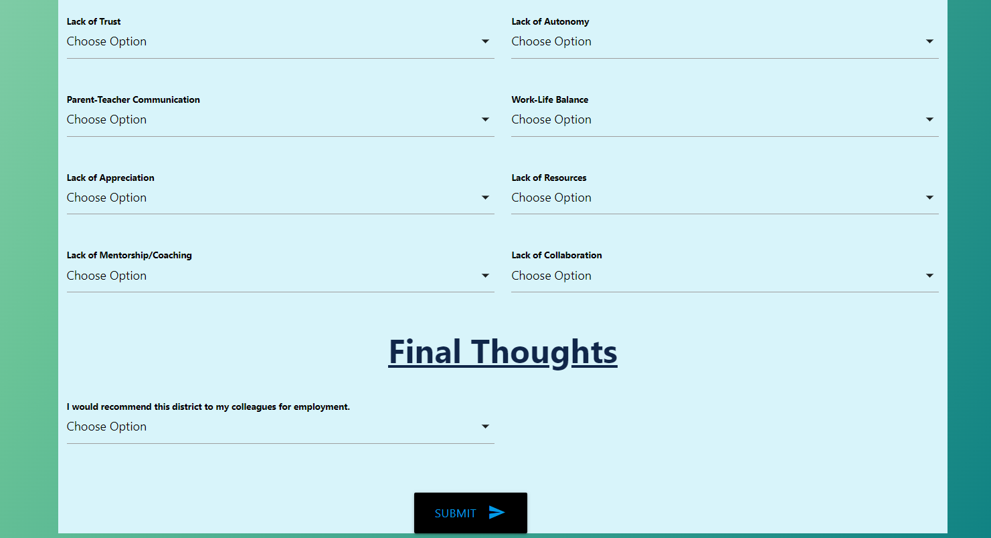

Slide 17
Reasons for Leaving
Relocation
Safety Concerns
District/School Culture
Career Advancement
Workload
Lack of Trust
Parent-Teacher Communication
Lack of Appreciation
Lack of Mentorship/Coaching
Better Compensation
Classroom Management
Leadership Style
Retirement
Politicization of Profession
Lack of Autonomy
Work-Life Balance
Lack of Resources
Lack of Collaboration

Slide 18
Options for Rating Reasons for Leaving
0 - N/A
1 - Didn’t factor in the decision
2 - Played little factor in the decision
3 - Was somewhat of a factor in the decision
4 - Was a factor in the decision
5 - Was a major factor in the decision

Slide 19
Final Question
"I would recommend this district to my colleagues for employment.“
1- Strongly Disagree
2- Disagree
3- Neutral
4- Agree
5- Strongly Agree

Slide 20
Results to Date
108 Certified Staff Responses
77 Classified Staff Responses
Results will be released to districts in December and July

Slide 21
What we’re seeing so far
More than half of the certified respondent’s agree or strongly agree that they would recommend the district to their colleagues for employment.

Slide 22
Questions
Dr. Veda Stewart (veda.stewart@education.ky.gov)
Elly Gilbert (elly.gilbert@education.ky.gov)
Justin Edwards (justin.edwards@education.ky.gov)
Office of Educator Licensure and Effectiveness
Division of Educator Recruitment and Development
300 Sower Blvd., 5th Floor
Frankfort, KY 40601
(502) 564-1479

