Slide 1
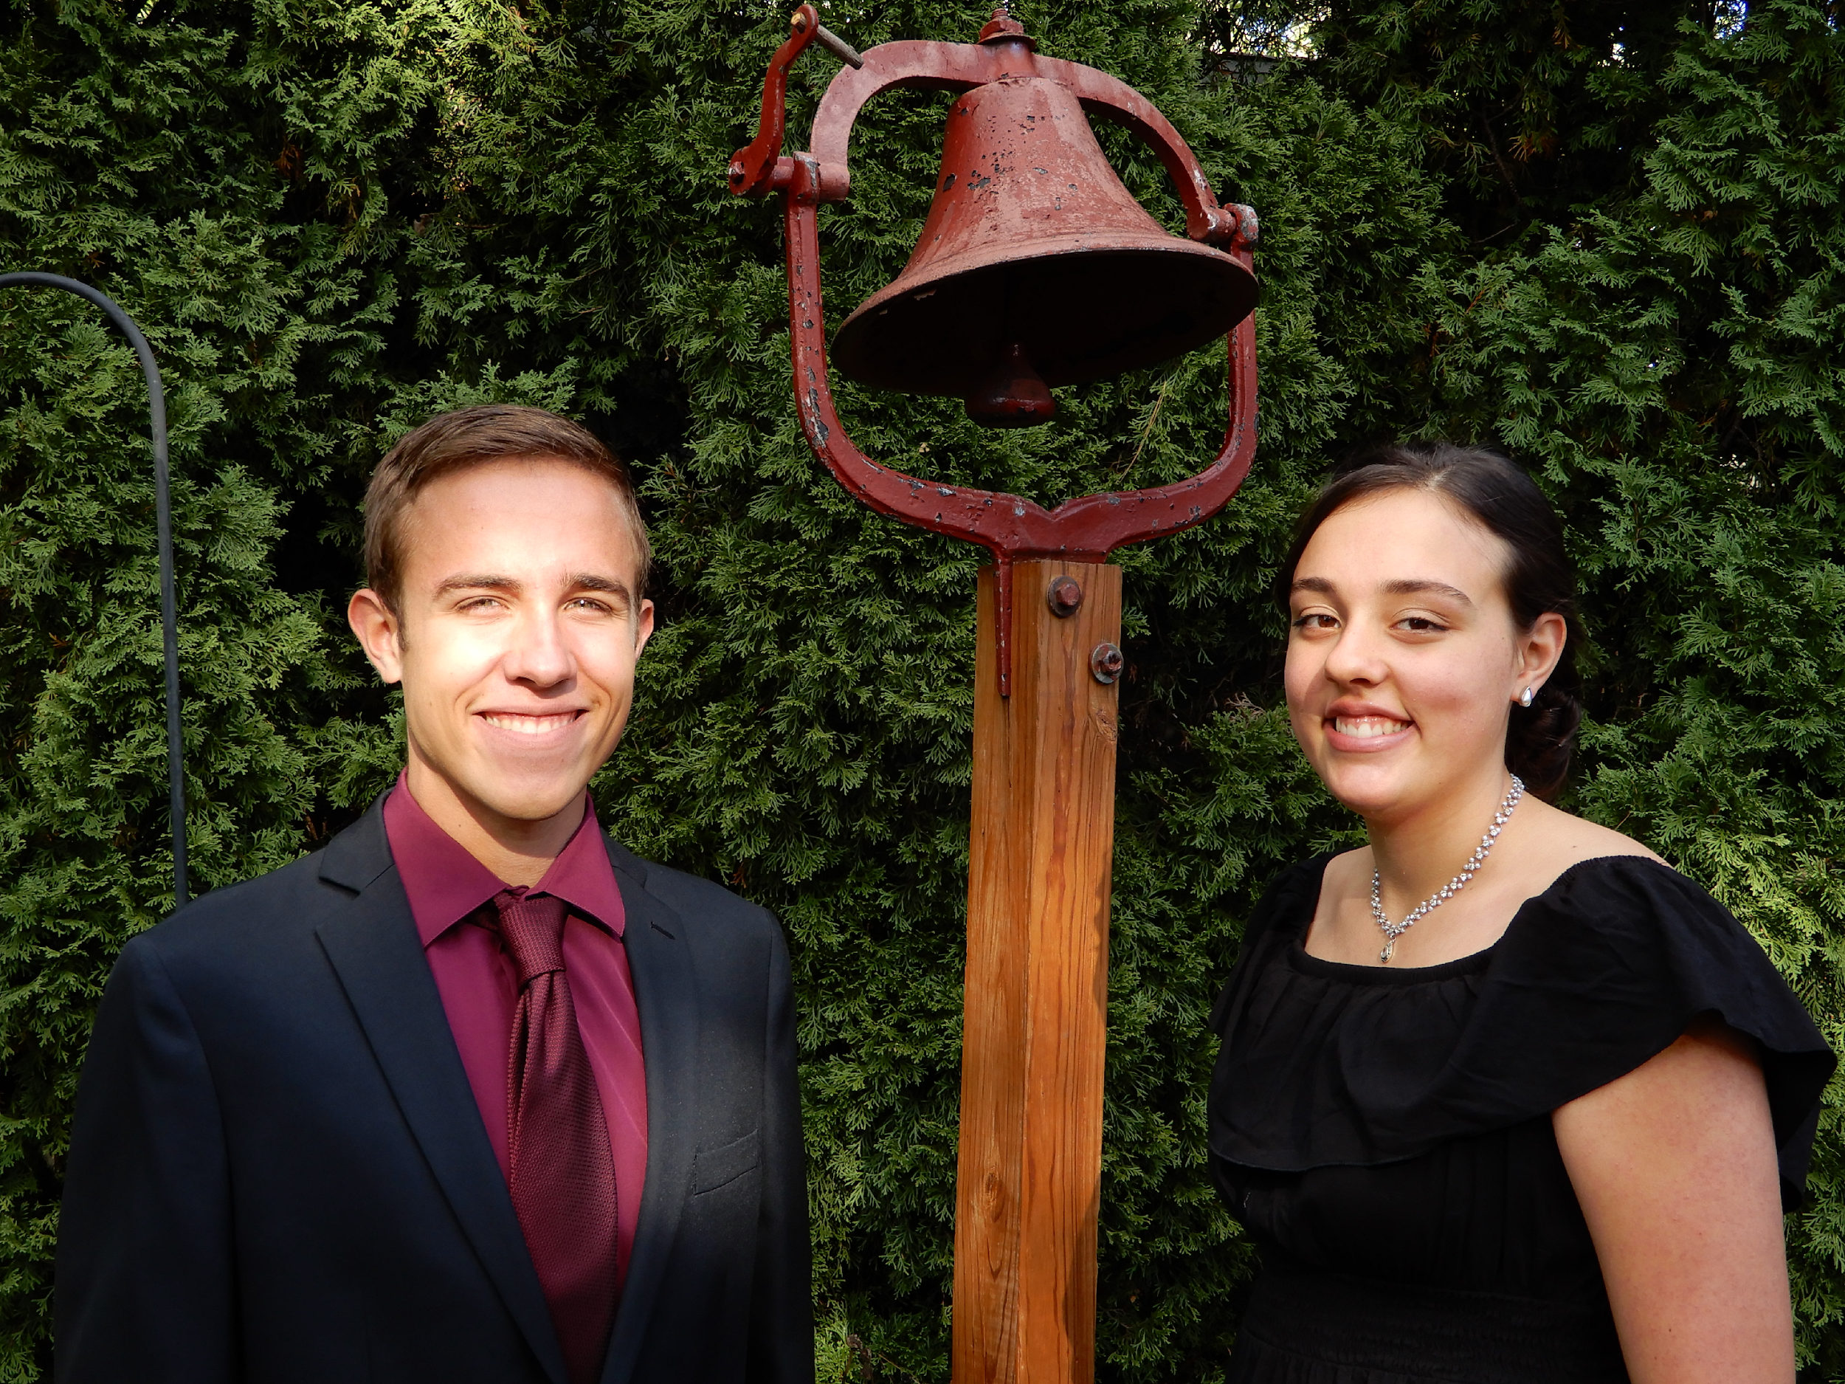
Kentucky Homeschoolers and the KEES Scholarship
1 NOVEMBER 2023
Notes:
Senate Bill 12 is the beginning of the discussion on the best way to include homeschoolers.

Slide 2
Origin of KEES Scholarship in 1999
Problem:
“Academic administrators and industry executives were concerned about losing the state’s most talented students to out-of-state colleges and careers”(25).
Solution:
“State performance-based aid programs” will “help keep future skilled and knowledgeable workers in Kentucky … for economic development and global competitiveness” (25).
“A Study of the Kentucky Educational Excellence Scholarship.” Legislative Research Commission Research Report No. 386, 2011.

Slide 3
Did you know?
Difference in Awards
Certified high school graduates are eligible for up to $10K in KEES awards
Homeschool graduates are eligible for a maximum of $2K in KEES awards

Slide 4
School Year | GPA | $ Award
9th grade | 4.00 | $500.00
10th grade | 4.00 | $500.00
11th grade | 4.00 | $500.00
12th grade | 4.00 | $500.00
ACT Score | 28+ | $500.00
 | Total Award: | $2,500.00 /year of college
Certified High Schoolers
School Year | GPA | $ Award
9th grade | 4.00 | $0.00
10th grade | 4.00 | $0.00
11th grade | 4.00 | $0.00
12th grade | 4.00 | $0.00
ACT Score | 28+ | $500.00
 | Total Award: | $500.00 /year of college
Homeschoolers

Slide 5
Alternatives for High School GPA
Dual Credit GPA x 4 (SB 12 - 2022)
ACT to GPA conversion x 4 (SB 24 - 2023)
Passed in Senate 33-2 on February 14, 2023
Similar bill passed in Senate in 2009
Dual Credit College Courses
Standardized Test Scores

Slide 6
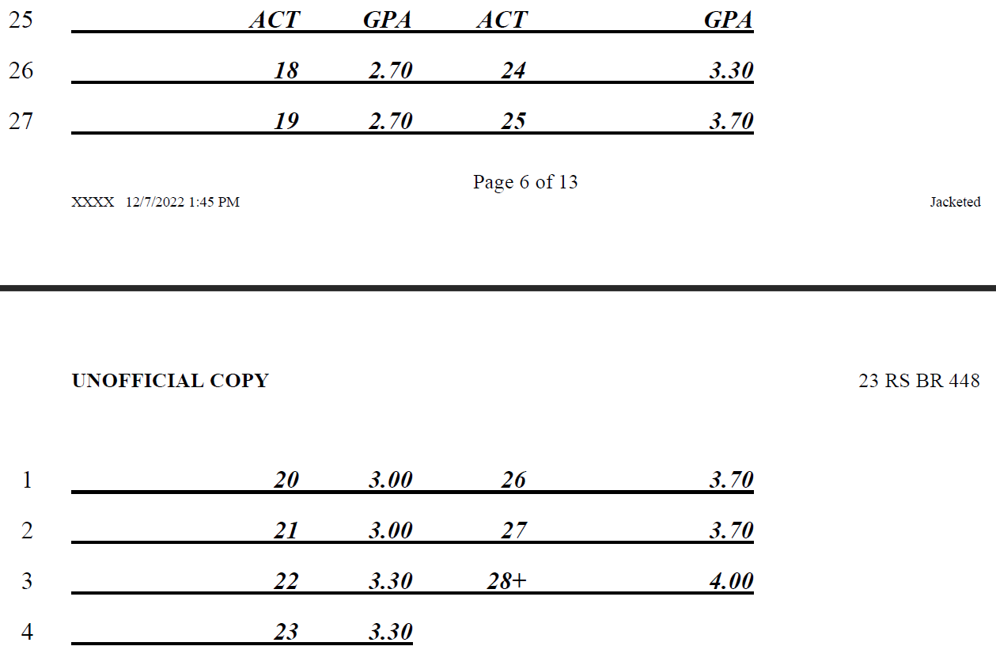
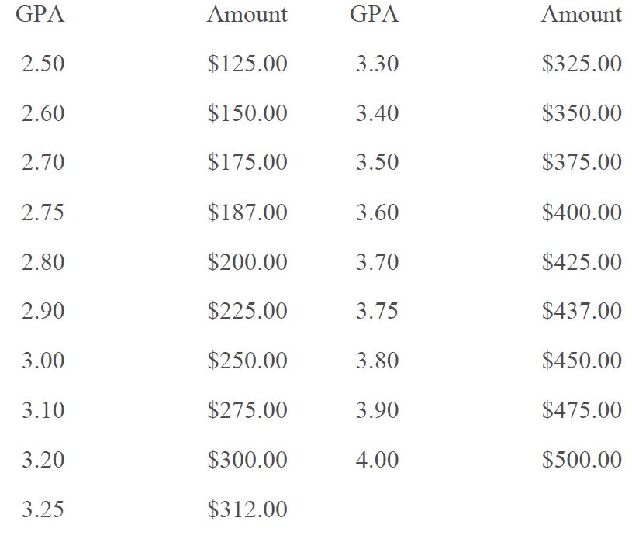
Charts in KEES
ACT to GPA
GPA to Amount

Slide 7
Homeschoolers who will earn the KEES Scholarship have
22+ grades in Kentucky’s required subject areas
been accepted by a college admissions department

Slide 8
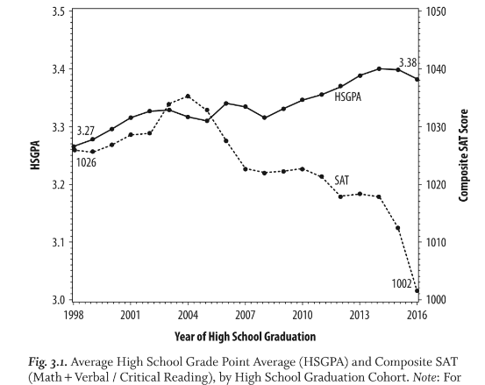
Average GPAs versus Test Scores 1998-2016
Hurwitz, Michael and Jason Lee. “Grade Inflation and the Role of Standardized Testing.” Measuring Success: Testing, Grades, and the Future of College Admissions. Johns Hopkins University Press, 2018.

Slide 9
Average GPAs versus Test Scores
Grades - Behaviors
Test Scores – Achievement
- include non-achievement factors like effort, personality traits, paying attention, participation, attendance, extra credit
-grades not uniform and inflated depending on school’s SBDM council
-higher for females
-create higher GPA by avoiding difficult courses and taking less credits
- higher for those learning English
-mastery of material
-uniform across schools
-higher for males
-may be lowered by test anxiety
-lower for those learning English

Slide 10
Percentage earning for each grade Percentage earning for each ACT score range
A to A+ 4.0 15% 12% 28+
A- 3.7-3.9 15% 13% 25-27
B+ 3.3-3.6 23% 19.5% 22-24
B 3.0-3.25 20% 17% 20-21
B- 2.7-2.9 15% 17% 18-19
C+ - B- 2.5-2.6 11% 20.5% 15-17
Total 99% 99%
Proposed ACT to GPA Conversion
ACT GPA Award
28+ 4.0 $500 x 4 = $2,000/ year
25-27 3.7 $425 x 4 = $1,700/ year
22-24 3.3 $325 x 4 = $1,300/ year
20-21 3.0 $250 x 4 = $1,000/ year
18-19 2.7 $175 x 4 = $700/ year

Slide 11
ACT, SAT, and CLT

Slide 12
CLT to ACT Conversion

Slide 13
THANK YOU Members of the Senate and House Education Committees for this interim hearing on Senate Bill 24!

