Slide 1
Truancy and the Court Designated Worker Program Department of Family and Juvenile Services Administrative Office of the Courts

Slide 2
Presented by: Ashley Clark Executive Officer Department of Family and Juvenile Services Administrative Office of the Courts

Slide 3
Court Designated Worker (CDW) Program
Per KRS 605.030, CDWs process all complaints filed on a juvenile until the age of 18.
A complaint is a “verified statement” by an officer, parent, victim or other interested party setting forth allegations regarding a youth which contains sufficient facts for the formulation of a subsequent complaint or petition.
CDWs process cases using criteria directing the formal/informal process.
A juvenile charged with a misdemeanor or status offense can be informally processed (or diverted) in the CDW office three (3) times.

Slide 4
Status Offense
Any action brought in the interest of a youth who is accused of committing acts which, if committed by an adult, would not be a crime.
Truant and Habitual Truant
A truant is defined as any youth who has been absent from school without valid excuse for three (3) or more days, or tardy without valid excuse on three (3) or more days.
A habitual truant is any youth who has been found by the court to have been reported as a truant two (2) or more times during a one (1) year period.

Slide 5
Truancy Diversion Program (TDP)
TDP is a truancy prevention program within schools where personnel from the school, CDW office, court personnel, and other community agencies meet with students that are truant to discuss resources and offer the support needed for the student to achieve success in school attendance and academic performance.

Slide 6
Processing Status Offense Truancy Cases
Upon filing of an Affidavit and Truancy Evaluation Form (JV-41), a pre-complaint conference is conducted with the affiant to ensure that all elements of the offense are met.
Only a school system’s Director of Pupil Personnel or their designee may sign a habitual truancy complaint. KRS 159.140.
The CDW office processes the affidavit with a Juvenile Complaint – Status Offense (JW-57) and schedules a preliminary intake interview with the youth.

Slide 7
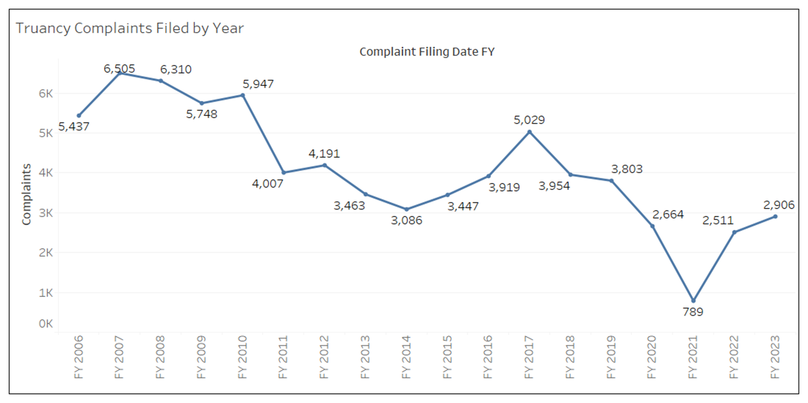

Slide 8
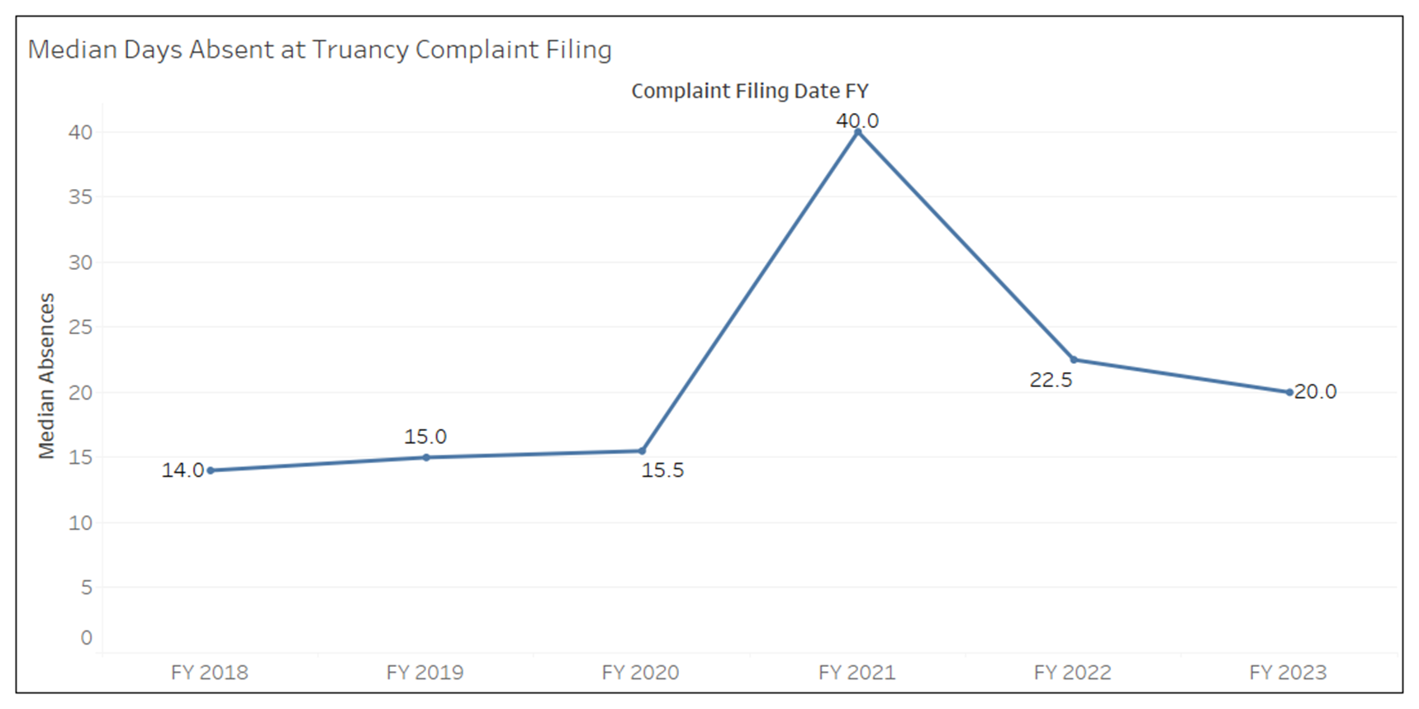

Slide 9
Preliminary Inquiry Intake Interview
CDW reads youth their rights, explains current charges and verifies demographic information.
CDW conducts the Global Appraisal of Individual Needs Short Screener (GAIN-SS) and human trafficking screener.
After completion of the Preliminary Inquiry Intake Interview, the JW-8 School Contact Information form is sent to the youth’s current school to gather relevant background information, education records, any services previously provided, and any recommend trauma informed strategies.
Schools have 5 days to complete the requested form and supply the CDW with the information.
If the youth is eligible, a Diversion Agreement Conference is scheduled while the youth is present as soon as reasonably accommodating for the family.

Slide 10
Diversion
The goal of each diversion agreement is to “prevent delinquency among Kentucky’s youth by providing education, treatment and accountability through statewide delivery of coordinated services.”
Diversion is an agreement between the CDW and the youth.
The purpose of diversion is to meet the needs of the youth and should reflect the best interest of the youth.

Slide 11
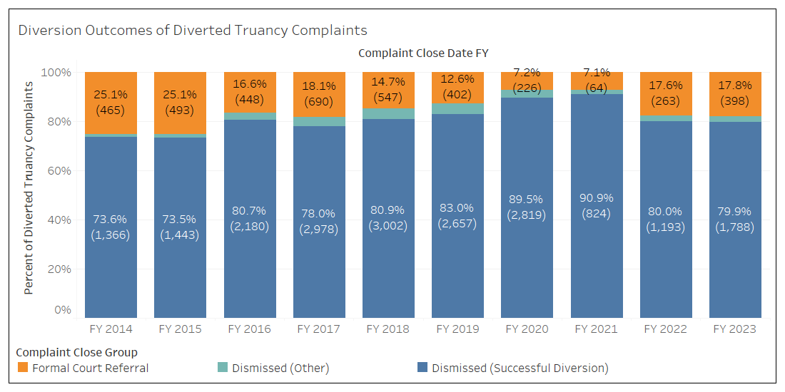

Slide 12
Family Accountability Response Teams (FAIR)
“There is hereby created in each judicial district a Family Accountability, Intervention and Response Team (FAIR) that shall develop enhanced case management plans and opportunities for services referred to the team.” KRS 605.035.

Slide 13
Family Accountability Response Teams (FAIR)
The FAIR team reviews the actions taken by the CDW, including referrals made for the child and his or her family, efforts to address barriers to successful completion, and whether other appropriate services are available to address the needs of the child and his or her family.
The FAIR team may:
Refer the case back to the CDW
Refer the case to DCBS
Advise the CDW to refer the case to the county attorney.

Slide 14
FAIR Teams and Truancy
If it is determined by the CDW, that the youth meets the criteria to be referred to a court-designated specialist (CDS), a referral will be made.
The CDS performs the Global Appraisal of Individual Needs Quick (GAIN Q3). The GAIN-Q3 is a brief screener used to identify and address a wide range of problems in clinical and general populations. It is designed for use by personnel in diverse settings (i.e., student assistance programs, health clinics, juvenile justice). The information gathered will be shared with the FAIR Team upon referral.

Slide 15
Director of Pupil Personnel (DPP) Referral
The DPP may submit the Notice of DPP Referral to FAIR Team (FAIR-4) at the time of the complaint filing. This is a request to that the case be presented to the FAIR Team regardless of CDW criteria for the youth to be referred to FAIR.

Slide 16
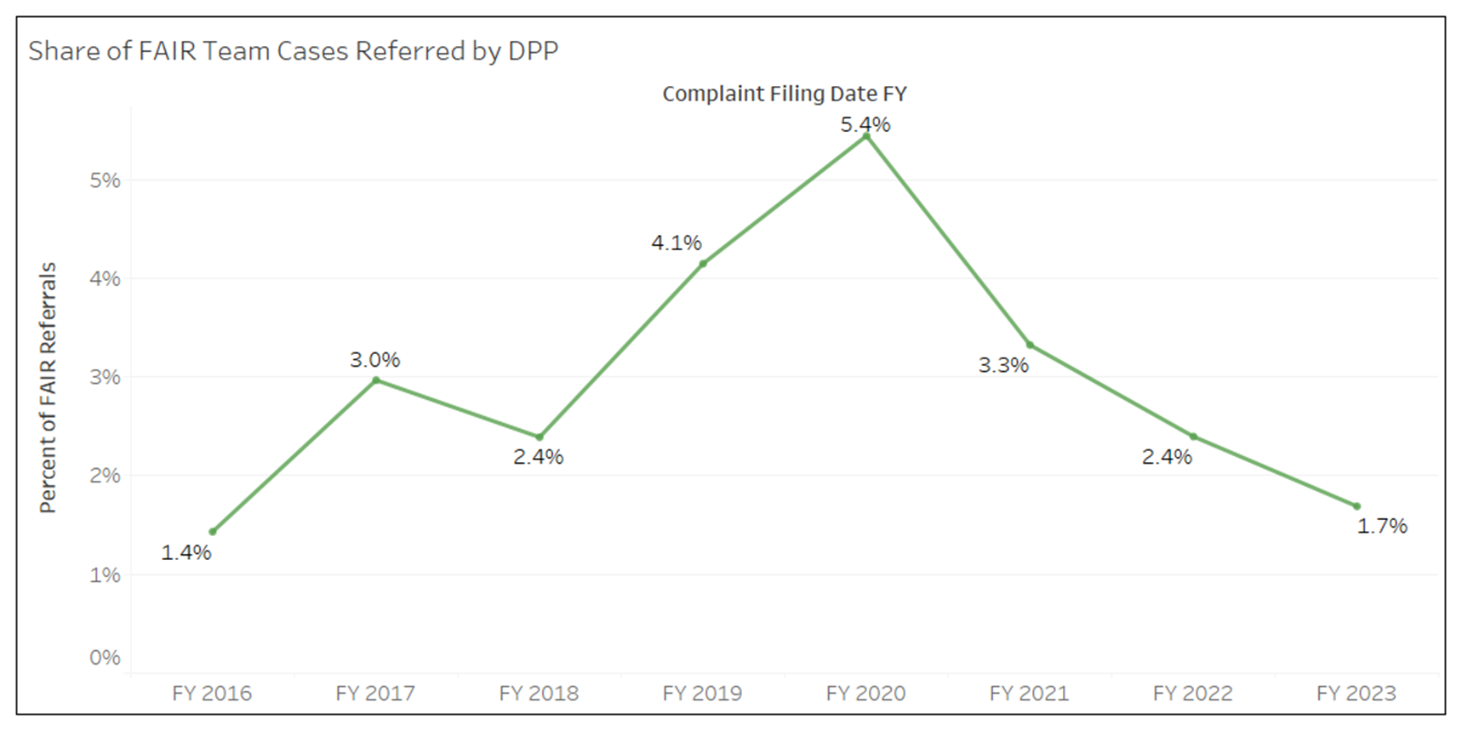

Slide 17
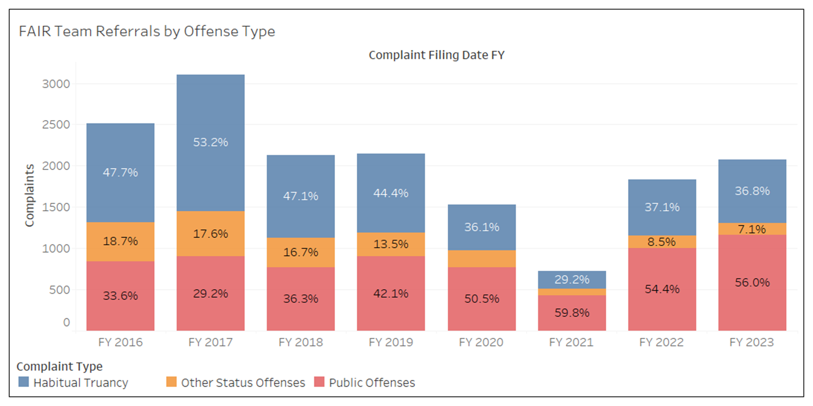

Slide 18
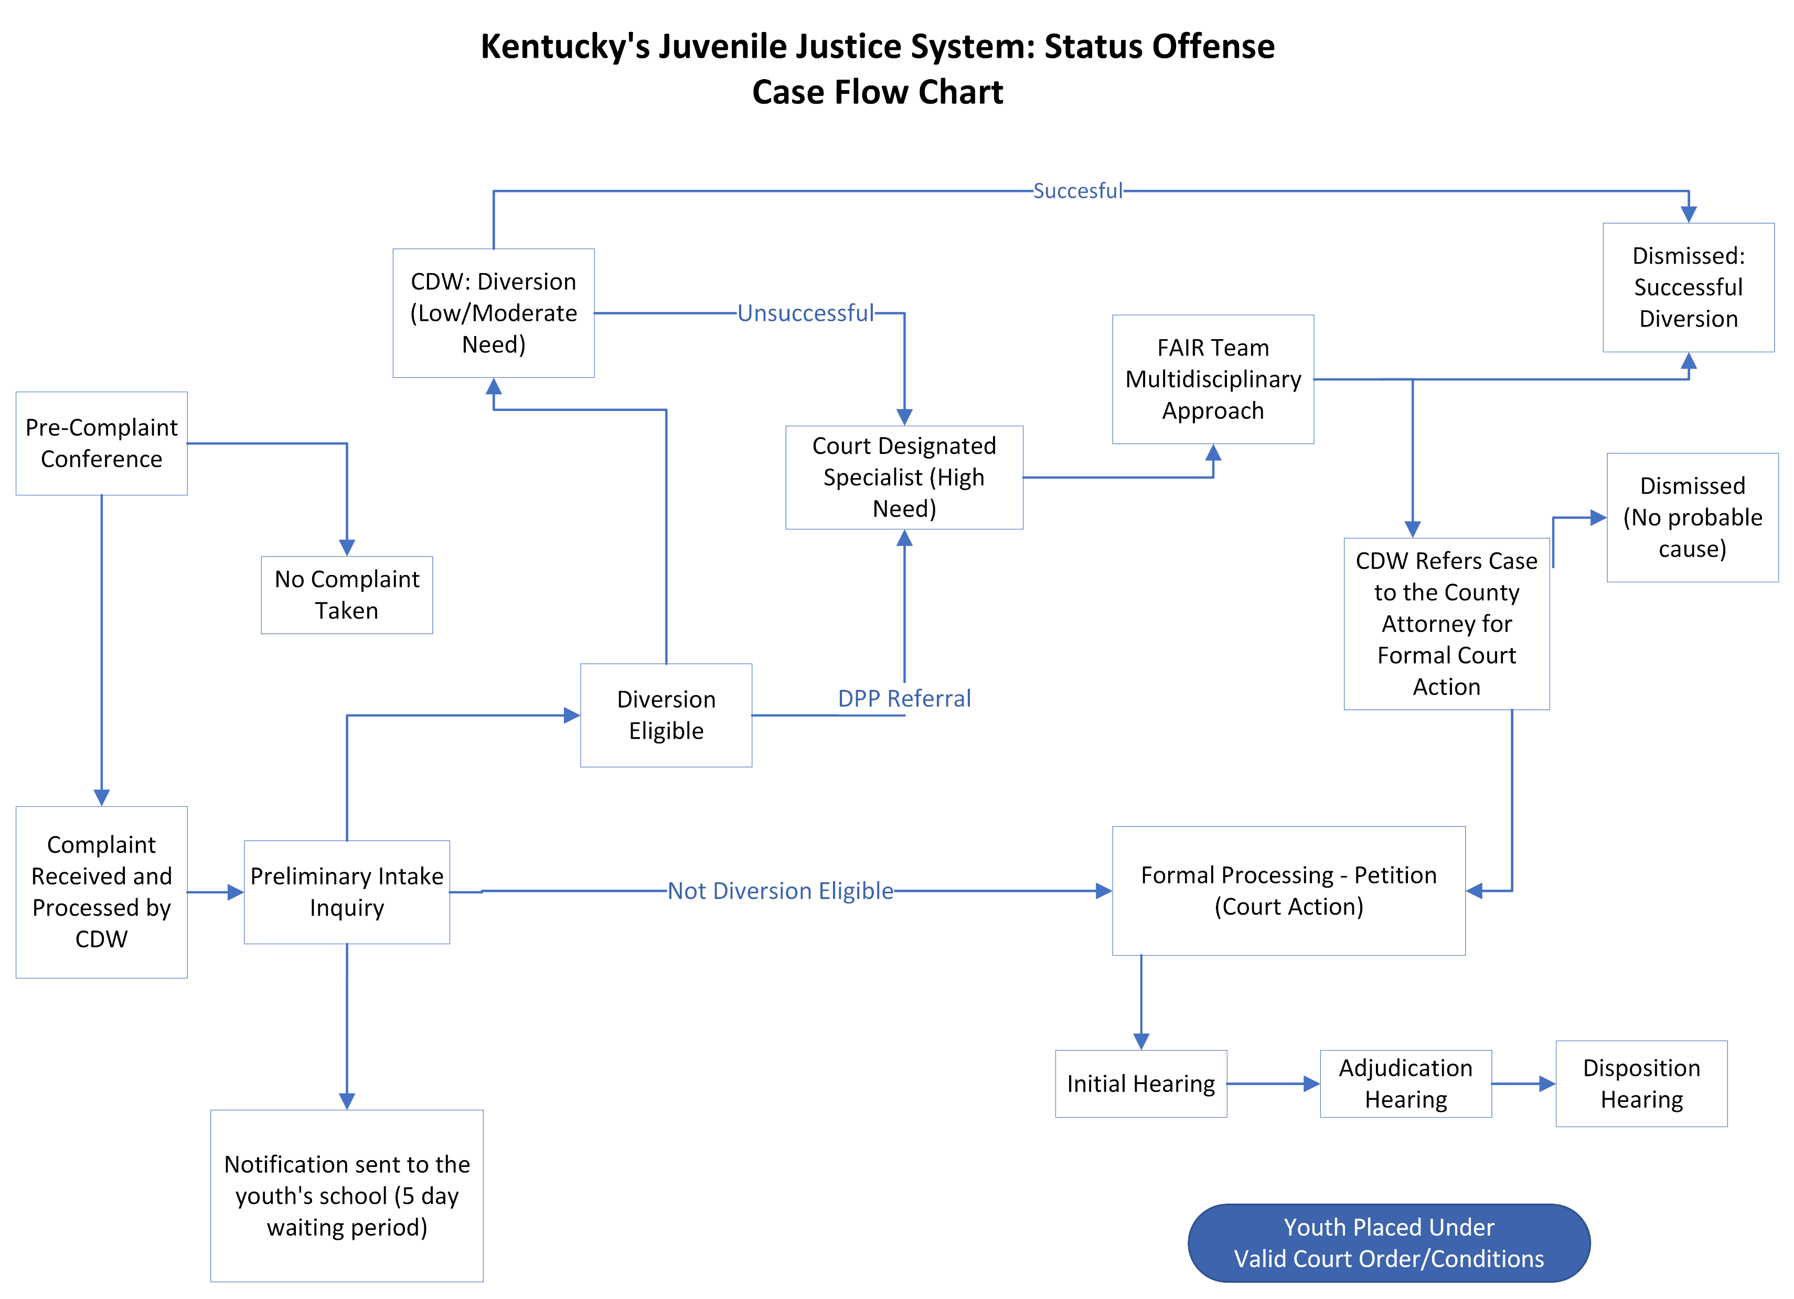

Slide 19
Thank you for your time and attention. Send future questions to: Ashley Clark Executive Officer ashleyclark@kycourts.net 270-725-7833 (Ext. 17131)

