Slide 1
Kentucky Truancy Filings

Slide 2
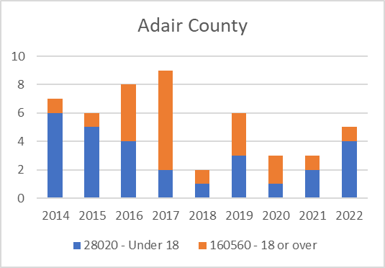
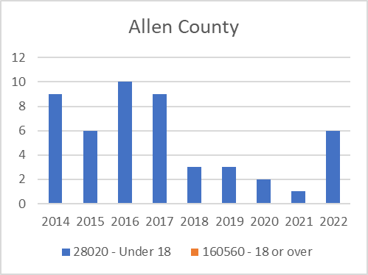
Truancy Filings
Adair | UOR | 2014 | 2015 | 2016 | 2017 | 2018 | 2019 | 2020 | 2021 | 2022 | Total
 | 28020 | 6 | 5 | 4 | 2 | 1 | 3 | 1 | 2 | 4 | 28
 | 160560 | 1 | 1 | 4 | 7 | 1 | 3 | 2 | 1 | 1 | 21
 | Total | 7 | 6 | 8 | 9 | 2 | 6 | 3 | 3 | 5 | 49
Allen | UOR | 2014 | 2015 | 2016 | 2017 | 2018 | 2019 | 2020 | 2021 | 2022 | Total
 | 28020 | 9 | 6 | 10 | 9 | 3 | 3 | 2 | 1 | 6 | 49
 | 160560 |  |  |  |  |  |  |  |  |  | 0
 | Total | 9 | 6 | 10 | 9 | 3 | 3 | 2 | 1 | 6 | 49

Slide 3
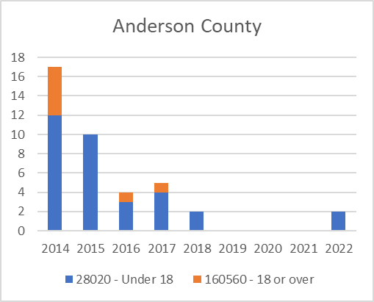
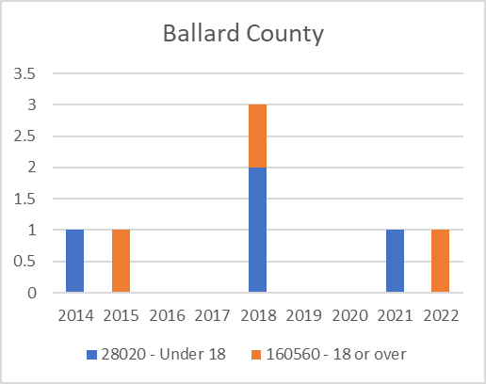
Truancy Filings
Anderson | UOR | 2014 | 2015 | 2016 | 2017 | 2018 | 2019 | 2020 | 2021 | 2022 | Total
 | 28020 | 12 | 10 | 3 | 4 | 2 |  |  |  | 2 | 33
 | 160560 | 5 |  | 1 | 1 |  |  |  |  |  | 7
 | Total | 17 | 10 | 4 | 5 | 2 | 0 | 0 | 0 | 2 | 40
Ballard | UOR | 2014 | 2015 | 2016 | 2017 | 2018 | 2019 | 2020 | 2021 | 2022 | Total
 | 28020 | 1 |  |  |  | 2 |  |  | 1 |  | 4
 | 160560 |  | 1 |  |  | 1 |  |  |  | 1 | 3
 | Total | 1 | 1 | 0 | 0 | 3 | 0 | 0 | 1 | 1 | 7

Slide 4
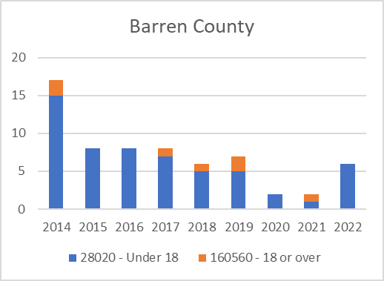
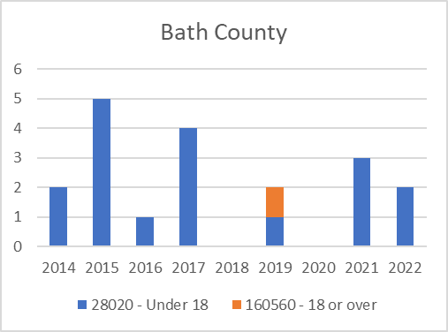
Truancy Filings
Barren | UOR | 2014 | 2015 | 2016 | 2017 | 2018 | 2019 | 2020 | 2021 | 2022 | Total
 | 28020 | 15 | 8 | 8 | 7 | 5 | 5 | 2 | 1 | 6 | 57
 | 160560 | 2 |  |  | 1 | 1 | 2 |  | 1 |  | 7
 | Total | 17 | 8 | 8 | 8 | 6 | 7 | 2 | 2 | 6 | 64
Bath | UOR | 2014 | 2015 | 2016 | 2017 | 2018 | 2019 | 2020 | 2021 | 2022 | Total
 | 28020 | 2 | 5 | 1 | 4 |  | 1 |  | 3 | 2 | 18
 | 160560 |  |  |  |  |  | 1 |  |  |  | 1
 | Total | 2 | 5 | 1 | 4 | 0 | 2 | 0 | 3 | 2 | 19

Slide 5
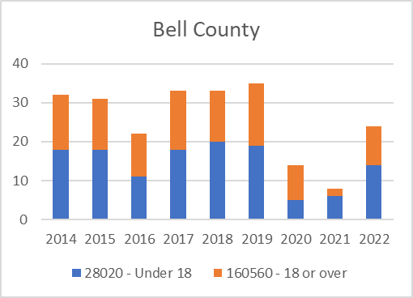
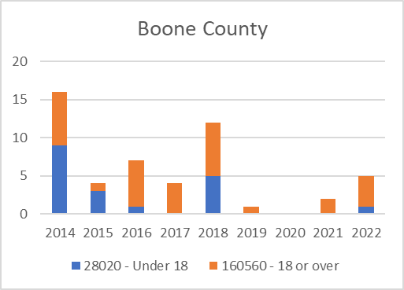
Truancy Filings
Bell | UOR | 2014 | 2015 | 2016 | 2017 | 2018 | 2019 | 2020 | 2021 | 2022 | Total
 | 28020 | 18 | 18 | 11 | 18 | 20 | 19 | 5 | 6 | 14 | 129
 | 160560 | 14 | 13 | 11 | 15 | 13 | 16 | 9 | 2 | 10 | 103
 | Total | 32 | 31 | 22 | 33 | 33 | 35 | 14 | 8 | 24 | 232
Boone | UOR | 2014 | 2015 | 2016 | 2017 | 2018 | 2019 | 2020 | 2021 | 2022 | Total
 | 28020 | 9 | 3 | 1 |  | 5 |  |  |  | 1 | 19
 | 160560 | 7 | 1 | 6 | 4 | 7 | 1 |  | 2 | 4 | 32
 | Total | 16 | 4 | 7 | 4 | 12 | 1 | 0 | 2 | 5 | 51

Slide 6
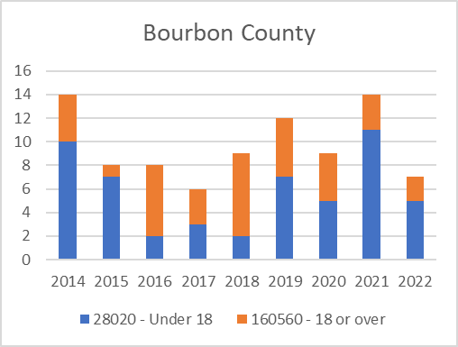
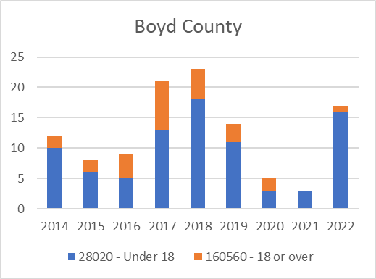
Truancy Filings
Bourbon | UOR | 2014 | 2015 | 2016 | 2017 | 2018 | 2019 | 2020 | 2021 | 2022 | Total
 | 28020 | 10 | 7 | 2 | 3 | 2 | 7 | 5 | 11 | 5 | 52
 | 160560 | 4 | 1 | 6 | 3 | 7 | 5 | 4 | 3 | 2 | 35
 | Total | 14 | 8 | 8 | 6 | 9 | 12 | 9 | 14 | 7 | 87
Boyd | UOR | 2014 | 2015 | 2016 | 2017 | 2018 | 2019 | 2020 | 2021 | 2022 | Total
 | 28020 | 10 | 6 | 5 | 13 | 18 | 11 | 3 | 3 | 16 | 85
 | 160560 | 2 | 2 | 4 | 8 | 5 | 3 | 2 |  | 1 | 27
 | Total | 12 | 8 | 9 | 21 | 23 | 14 | 5 | 3 | 17 | 112

Slide 7
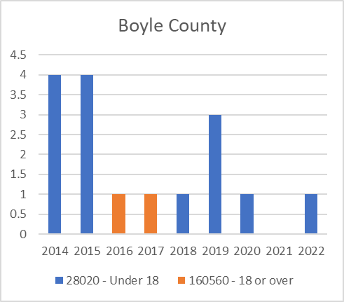
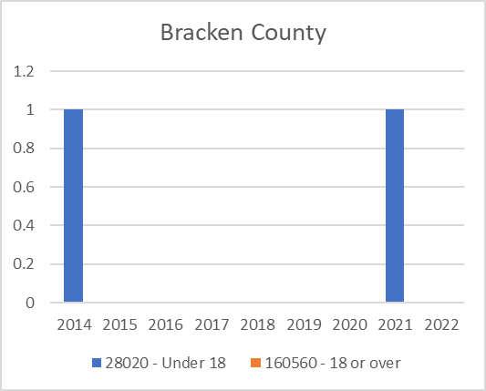
Truancy Filings
Boyle | UOR | 2014 | 2015 | 2016 | 2017 | 2018 | 2019 | 2020 | 2021 | 2022 | Total
 | 28020 | 4 | 4 |  |  | 1 | 3 | 1 |  | 1 | 14
 | 160560 |  |  | 1 | 1 |  |  |  |  |  | 2
 | Total | 4 | 4 | 1 | 1 | 1 | 3 | 1 | 0 | 1 | 16
Bracken | UOR | 2014 | 2015 | 2016 | 2017 | 2018 | 2019 | 2020 | 2021 | 2022 | Total
 | 28020 | 1 |  |  |  |  |  |  | 1 |  | 2
 | 160560 |  |  |  |  |  |  |  |  |  | 0
 | Total | 1 | 0 | 0 | 0 | 0 | 0 | 0 | 1 | 0 | 2

Slide 8
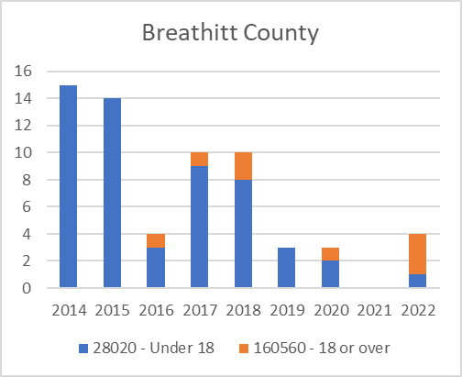
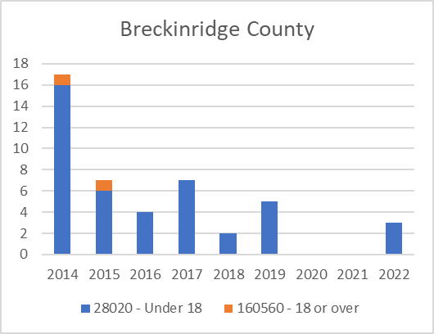
Truancy Filings
Breathitt | UOR | 2014 | 2015 | 2016 | 2017 | 2018 | 2019 | 2020 | 2021 | 2022 | Total
 | 28020 | 15 | 14 | 3 | 9 | 8 | 3 | 2 |  | 1 | 55
 | 160560 |  |  | 1 | 1 | 2 |  | 1 |  | 3 | 8
 | Total | 15 | 14 | 4 | 10 | 10 | 3 | 3 | 0 | 4 | 63
Breckinridge | UOR | 2014 | 2015 | 2016 | 2017 | 2018 | 2019 | 2020 | 2021 | 2022 | Total
 | 28020 | 16 | 6 | 4 | 7 | 2 | 5 |  |  | 3 | 43
 | 160560 | 1 | 1 |  |  |  |  |  |  |  | 2
 | Total | 17 | 7 | 4 | 7 | 2 | 5 | 0 | 0 | 3 | 45

Slide 9
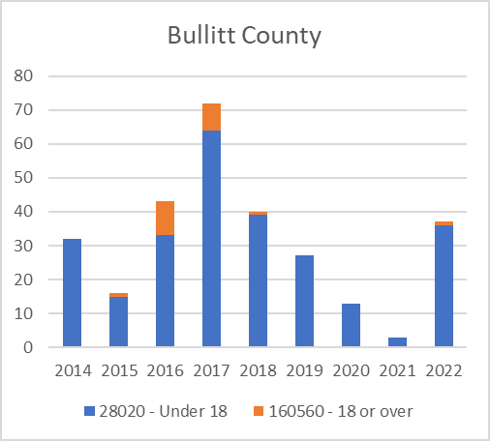
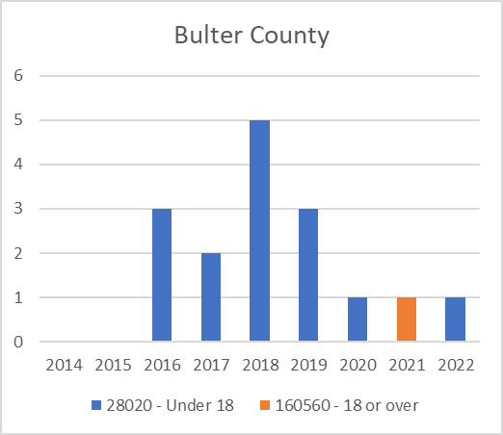
Truancy Filings
Bullitt | UOR | 2014 | 2015 | 2016 | 2017 | 2018 | 2019 | 2020 | 2021 | 2022 | Total
 | 28020 | 32 | 15 | 33 | 64 | 39 | 27 | 13 | 3 | 36 | 262
 | 160560 |  | 1 | 10 | 8 | 1 |  |  |  | 1 | 21
 | Total | 32 | 16 | 43 | 72 | 40 | 27 | 13 | 3 | 37 | 283
Butler | UOR | 2014 | 2015 | 2016 | 2017 | 2018 | 2019 | 2020 | 2021 | 2022 | Total
 | 28020 |  |  | 3 | 2 | 5 | 3 | 1 |  | 1 | 15
 | 160560 |  |  |  |  |  |  |  | 1 |  | 1
 | Total | 0 | 0 | 3 | 2 | 5 | 3 | 1 | 1 | 1 | 16

Slide 10
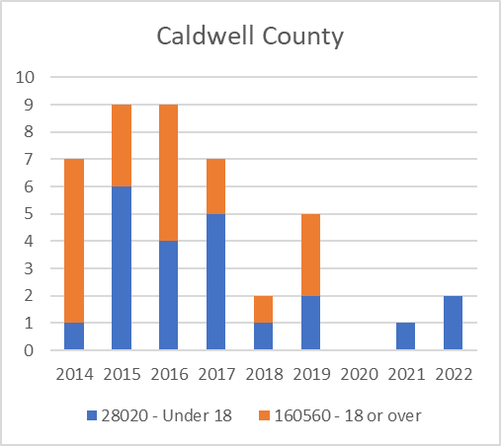
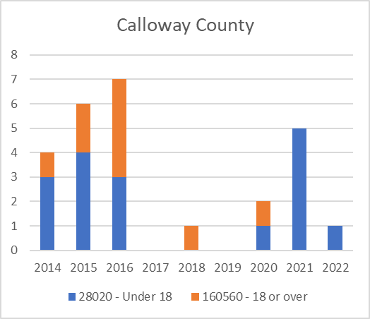
Truancy Filings
Caldwell | UOR | 2014 | 2015 | 2016 | 2017 | 2018 | 2019 | 2020 | 2021 | 2022 | Total
 | 28020 | 1 | 6 | 4 | 5 | 1 | 2 |  | 1 | 2 | 22
 | 160560 | 6 | 3 | 5 | 2 | 1 | 3 |  |  |  | 20
 | Total | 7 | 9 | 9 | 7 | 2 | 5 | 0 | 1 | 2 | 42
Calloway | UOR | 2014 | 2015 | 2016 | 2017 | 2018 | 2019 | 2020 | 2021 | 2022 | Total
 | 28020 | 3 | 4 | 3 |  |  |  | 1 | 5 | 1 | 17
 | 160560 | 1 | 2 | 4 |  | 1 |  | 1 |  |  | 9
 | Total | 4 | 6 | 7 | 0 | 1 | 0 | 2 | 5 | 1 | 26

Slide 11
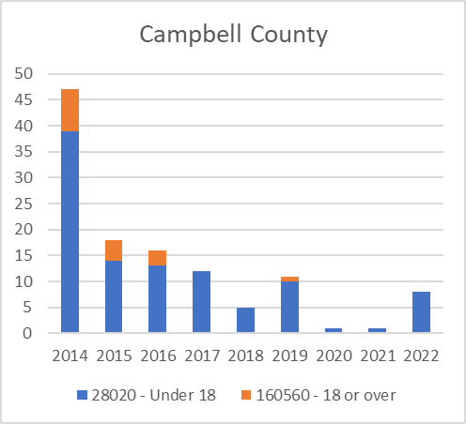
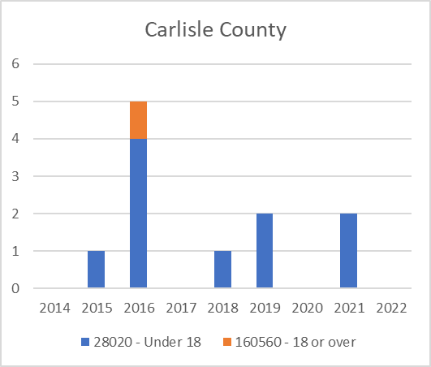
Truancy Filings
Campbell | UOR | 2014 | 2015 | 2016 | 2017 | 2018 | 2019 | 2020 | 2021 | 2022 | Total
 | 28020 | 39 | 14 | 13 | 12 | 5 | 10 | 1 | 1 | 8 | 103
 | 160560 | 8 | 4 | 3 |  |  | 1 |  |  |  | 16
 | Total | 47 | 18 | 16 | 12 | 5 | 11 | 1 | 1 | 8 | 119
Carlisle | UOR | 2014 | 2015 | 2016 | 2017 | 2018 | 2019 | 2020 | 2021 | 2022 | Total
 | 28020 |  | 1 | 4 |  | 1 | 2 |  | 2 |  | 10
 | 160560 |  |  | 1 |  |  |  |  |  |  | 1
 | Total | 0 | 1 | 5 | 0 | 1 | 2 | 0 | 2 | 0 | 11

Slide 12
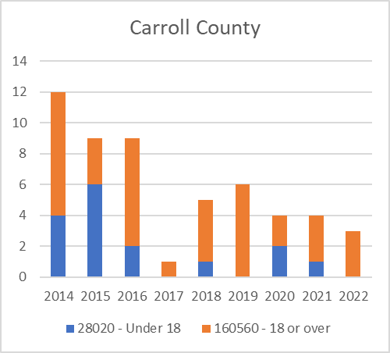
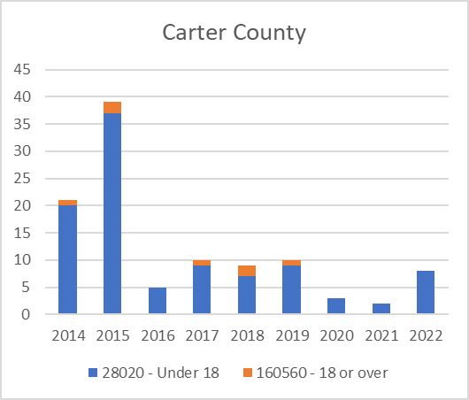
Truancy Filings
Carroll | UOR | 2014 | 2015 | 2016 | 2017 | 2018 | 2019 | 2020 | 2021 | 2022 | Total
 | 28020 | 4 | 6 | 2 |  | 1 |  | 2 | 1 |  | 16
 | 160560 | 8 | 3 | 7 | 1 | 4 | 6 | 2 | 3 | 3 | 37
 | Total | 12 | 9 | 9 | 1 | 5 | 6 | 4 | 4 | 3 | 53
Carter | UOR | 2014 | 2015 | 2016 | 2017 | 2018 | 2019 | 2020 | 2021 | 2022 | Total
 | 28020 | 20 | 37 | 5 | 9 | 7 | 9 | 3 | 2 | 8 | 100
 | 160560 | 1 | 2 |  | 1 | 2 | 1 |  |  |  | 7
 | Total | 21 | 39 | 5 | 10 | 9 | 10 | 3 | 2 | 8 | 107

Slide 13
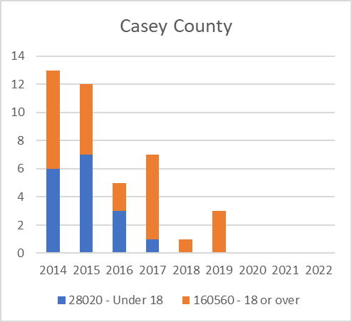
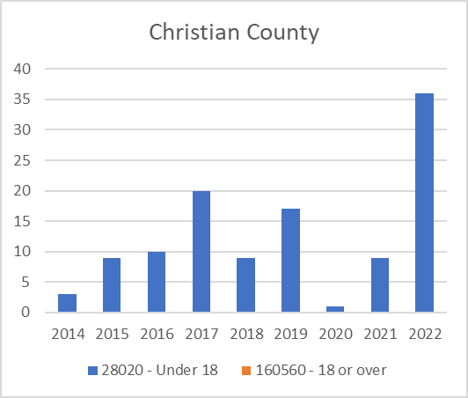
Truancy Filings
Casey | UOR | 2014 | 2015 | 2016 | 2017 | 2018 | 2019 | 2020 | 2021 | 2022 | Total
 | 28020 | 6 | 7 | 3 | 1 |  |  |  |  |  | 17
 | 160560 | 7 | 5 | 2 | 6 | 1 | 3 |  |  |  | 24
 | Total | 13 | 12 | 5 | 7 | 1 | 3 | 0 | 0 | 0 | 41
Christian | UOR | 2014 | 2015 | 2016 | 2017 | 2018 | 2019 | 2020 | 2021 | 2022 | Total
 | 28020 | 3 | 9 | 10 | 20 | 9 | 17 | 1 | 9 | 36 | 114
 | 160560 |  |  |  |  |  |  |  |  |  | 0
 | Total

Slide 14
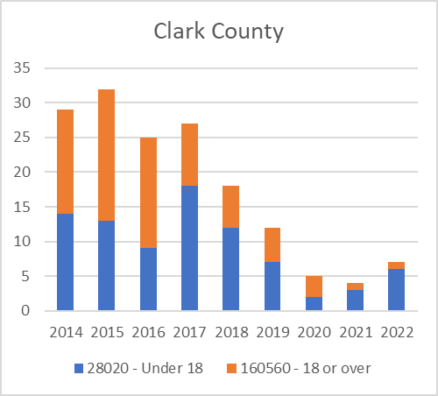
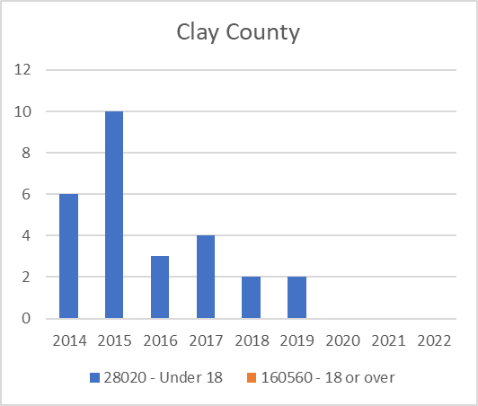
Truancy Filings
Clark | UOR | 2014 | 2015 | 2016 | 2017 | 2018 | 2019 | 2020 | 2021 | 2022 | Total
 | 28020 | 14 | 13 | 9 | 18 | 12 | 7 | 2 | 3 | 6 | 84
 | 160560 | 15 | 19 | 16 | 9 | 6 | 5 | 3 | 1 | 1 | 75
 | Total | 29 | 32 | 25 | 27 | 18 | 12 | 5 | 4 | 7 | 159
Clay | UOR | 2014 | 2015 | 2016 | 2017 | 2018 | 2019 | 2020 | 2021 | 2022 | Total
 | 28020 | 6 | 10 | 3 | 4 | 2 | 2 |  |  |  | 27
 | 160560 |  |  |  |  |  |  |  |  |  | 0
 | Total | 6 | 10 | 3 | 4 | 2 | 2 | 0 | 0 | 0 | 27

Slide 15
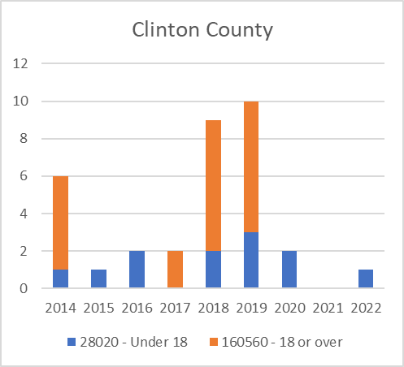
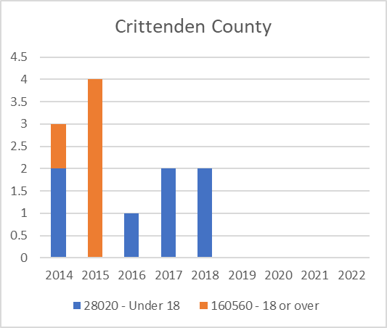
Truancy Filings
Clinton | UOR | 2014 | 2015 | 2016 | 2017 | 2018 | 2019 | 2020 | 2021 | 2022 | Total
 | 28020 | 1 | 1 | 2 |  | 2 | 3 | 2 |  | 1 | 12
 | 160560 | 5 |  |  | 2 | 7 | 7 |  |  |  | 21
 | Total | 6 | 1 | 2 | 2 | 9 | 10 | 2 | 0 | 1 | 33
Crittenden | UOR | 2014 | 2015 | 2016 | 2017 | 2018 | 2019 | 2020 | 2021 | 2022 | Total
 | 28020 | 2 |  | 1 | 2 | 2 |  |  |  |  | 7
 | 160560 | 1 | 4 |  |  |  |  |  |  |  | 5
 | Total | 3 | 4 | 1 | 2 | 2 | 0 | 0 | 0 | 0 | 12

Slide 16
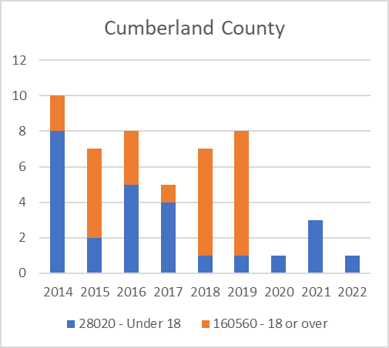
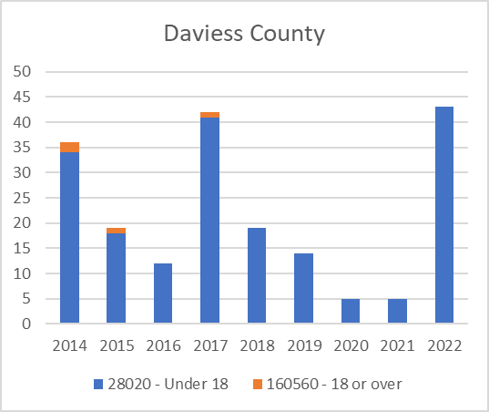
Truancy Filings
Cumberland | UOR | 2014 | 2015 | 2016 | 2017 | 2018 | 2019 | 2020 | 2021 | 2022 | Total
 | 28020 | 8 | 2 | 5 | 4 | 1 | 1 | 1 | 3 | 1 | 26
 | 160560 | 2 | 5 | 3 | 1 | 6 | 7 |  |  |  | 24
 | Total | 10 | 7 | 8 | 5 | 7 | 8 | 1 | 3 | 1 | 50
Daviess | UOR | 2014 | 2015 | 2016 | 2017 | 2018 | 2019 | 2020 | 2021 | 2022 | Total
 | 28020 | 34 | 18 | 12 | 41 | 19 | 14 | 5 | 5 | 43 | 191
 | 160560 | 2 | 1 |  | 1 |  |  |  |  |  | 4
 | Total | 36 | 19 | 12 | 42 | 19 | 14 | 5 | 5 | 43 | 195

Slide 17
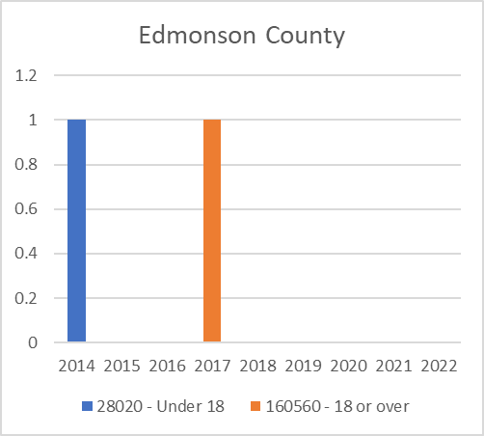
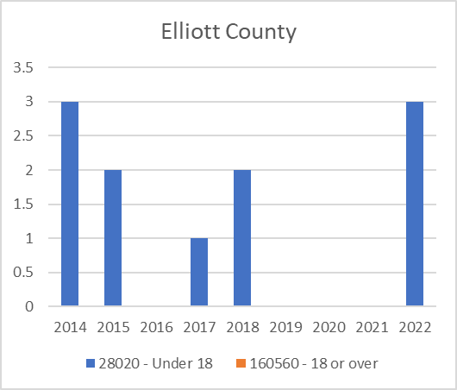
Truancy Filings
Edmonson | UOR | 2014 | 2015 | 2016 | 2017 | 2018 | 2019 | 2020 | 2021 | 2022 | Total
 | 28020 | 1 |  |  |  |  |  |  |  |  | 1
 | 160560 |  |  |  | 1 |  |  |  |  |  | 1
 | Total | 1 | 0 | 0 | 1 | 0 | 0 | 0 | 0 | 0 | 2
Elliott | UOR | 2014 | 2015 | 2016 | 2017 | 2018 | 2019 | 2020 | 2021 | 2022 | Total
 | 28020 | 3 | 2 |  | 1 | 2 |  |  |  | 3 | 11
 | 160560 |  |  |  |  |  |  |  |  |  | 0
 | Total | 3 | 2 | 0 | 1 | 2 | 0 | 0 | 0 | 3 | 11

Slide 18
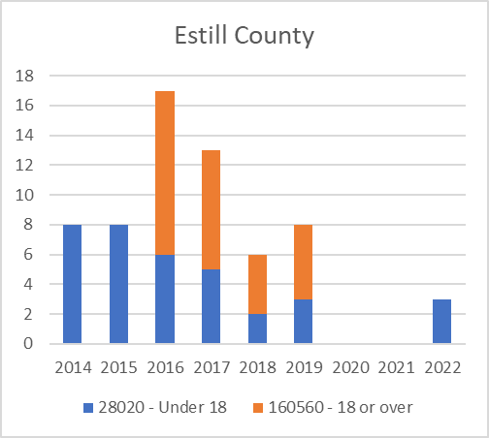
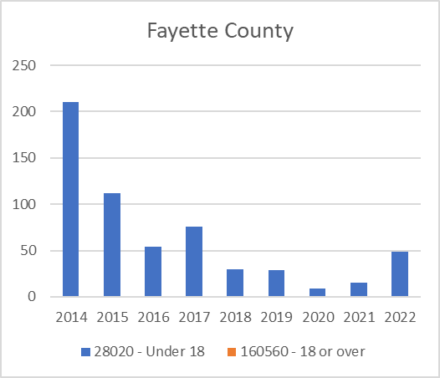
Truancy Filings
Estill | UOR | 2014 | 2015 | 2016 | 2017 | 2018 | 2019 | 2020 | 2021 | 2022 | Total
 | 28020 | 8 | 8 | 6 | 5 | 2 | 3 |  |  | 3 | 35
 | 160560 |  |  | 11 | 8 | 4 | 5 |  |  |  | 28
 | Total | 8 | 8 | 17 | 13 | 6 | 8 | 0 | 0 | 3 | 63
Fayette | UOR | 2014 | 2015 | 2016 | 2017 | 2018 | 2019 | 2020 | 2021 | 2022 | Total
 | 28020 | 210 | 112 | 54 | 76 | 30 | 29 | 9 | 15 | 49 | 584
 | 160560 |  |  |  |  |  |  |  |  |  | 0
 | Total | 210 | 112 | 54 | 76 | 30 | 29 | 9 | 15 | 49 | 584

Slide 19
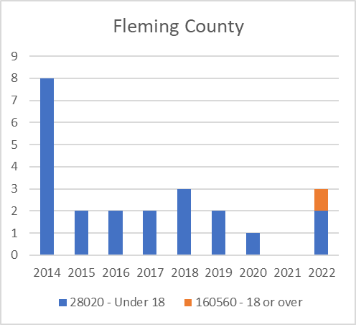
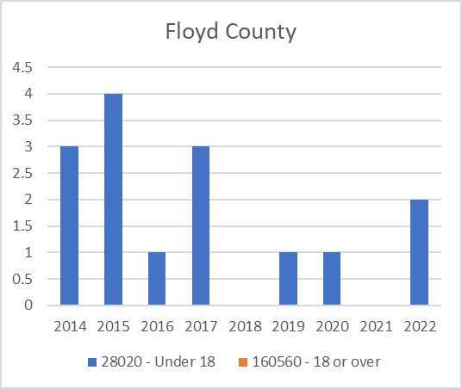
Truancy Filings
Fleming | UOR | 2014 | 2015 | 2016 | 2017 | 2018 | 2019 | 2020 | 2021 | 2022 | Total
 | 28020 | 8 | 2 | 2 | 2 | 3 | 2 | 1 |  | 2 | 22
 | 160560 |  |  |  |  |  |  |  |  | 1 | 1
 | Total | 8 | 2 | 2 | 2 | 3 | 2 | 1 | 0 | 3 | 23
Floyd | UOR | 2014 | 2015 | 2016 | 2017 | 2018 | 2019 | 2020 | 2021 | 2022 | Total
 | 28020 | 3 | 4 | 1 | 3 |  | 1 | 1 |  | 2 | 15
 | 160560 |  |  |  |  |  |  |  |  |  | 0
 | Total | 3 | 4 | 1 | 3 | 0 | 1 | 1 | 0 | 2 | 15

Slide 20
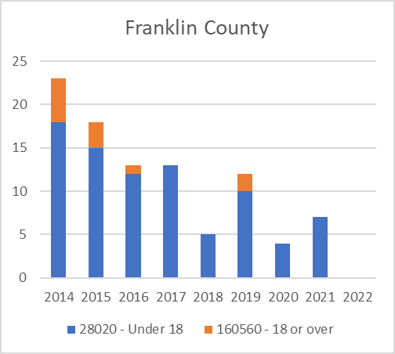
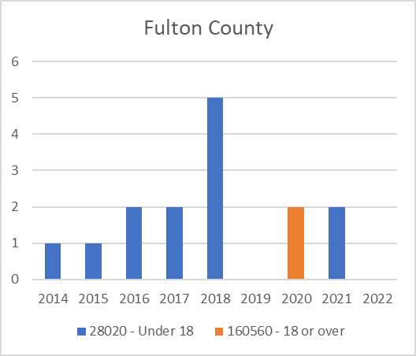
Truancy Filings
Franklin | UOR | 2014 | 2015 | 2016 | 2017 | 2018 | 2019 | 2020 | 2021 | 2022 | Total
 | 28020 | 18 | 15 | 12 | 13 | 5 | 10 | 4 | 7 |  | 84
 | 160560 | 5 | 3 | 1 |  |  | 2 |  |  |  | 11
 | Total | 23 | 18 | 13 | 13 | 5 | 12 | 4 | 7 | 0 | 95
Fulton | UOR | 2014 | 2015 | 2016 | 2017 | 2018 | 2019 | 2020 | 2021 | 2022 | Total
 | 28020 | 1 | 1 | 2 | 2 | 5 |  |  | 2 |  | 13
 | 160560 |  |  |  |  |  |  | 2 |  |  | 2
 | Total | 1 | 1 | 2 | 2 | 5 | 0 | 2 | 2 | 0 | 15

Slide 21
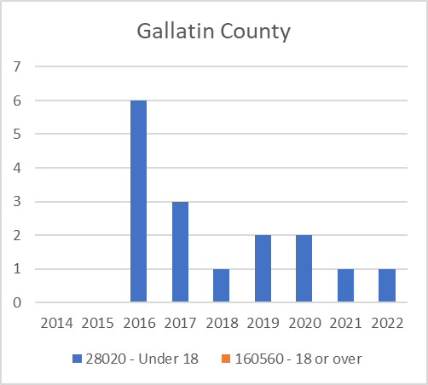
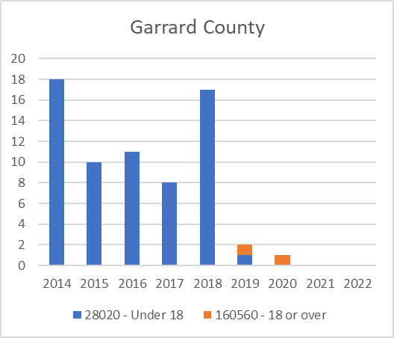
Truancy Filings
Gallatin | UOR | 2014 | 2015 | 2016 | 2017 | 2018 | 2019 | 2020 | 2021 | 2022 | Total
 | 28020 |  |  | 6 | 3 | 1 | 2 | 2 | 1 | 1 | 16
 | 160560 |  |  |  |  |  |  |  |  |  | 0
 | Total | 0 | 0 | 6 | 3 | 1 | 2 | 2 | 1 | 1 | 16
Garrard | UOR | 2014 | 2015 | 2016 | 2017 | 2018 | 2019 | 2020 | 2021 | 2022 | Total
 | 28020 | 18 | 10 | 11 | 8 | 17 | 1 |  |  |  | 65
 | 160560 |  |  |  |  |  | 1 | 1 |  |  | 2
 | Total | 18 | 10 | 11 | 8 | 17 | 2 | 1 | 0 | 0 | 67

Slide 22
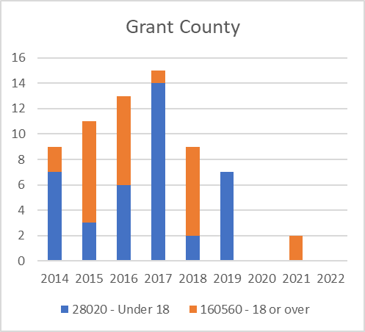
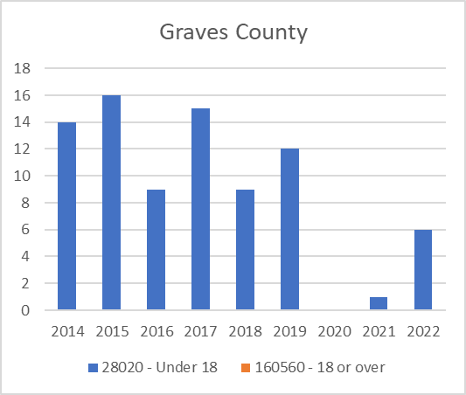
Truancy Filings
Grant | UOR | 2014 | 2015 | 2016 | 2017 | 2018 | 2019 | 2020 | 2021 | 2022 | Total
 | 28020 | 7 | 3 | 6 | 14 | 2 | 7 |  |  |  | 39
 | 160560 | 2 | 8 | 7 | 1 | 7 |  |  | 2 |  | 27
 | Total | 9 | 11 | 13 | 15 | 9 | 7 | 0 | 2 | 0 | 66
Graves | UOR | 2014 | 2015 | 2016 | 2017 | 2018 | 2019 | 2020 | 2021 | 2022 | Total
 | 28020 | 14 | 16 | 9 | 15 | 9 | 12 |  | 1 | 6 | 82
 | 160560 |  |  |  |  |  |  |  |  |  | 0
 | Total | 14 | 16 | 9 | 15 | 9 | 12 | 0 | 1 | 6 | 82

Slide 23
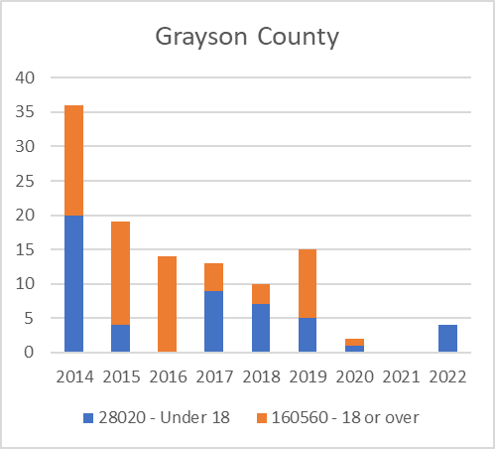
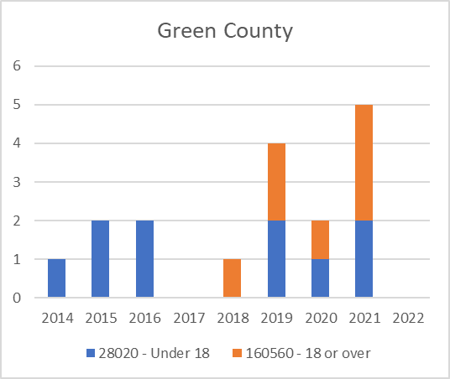
Truancy Filings
Grayson | UOR | 2014 | 2015 | 2016 | 2017 | 2018 | 2019 | 2020 | 2021 | 2022 | Total
 | 28020 | 20 | 4 |  | 9 | 7 | 5 | 1 |  | 4 | 50
 | 160560 | 16 | 15 | 14 | 4 | 3 | 10 | 1 |  |  | 63
 | Total | 36 | 19 | 14 | 13 | 10 | 15 | 2 | 0 | 4 | 113
Green | UOR | 2014 | 2015 | 2016 | 2017 | 2018 | 2019 | 2020 | 2021 | 2022 | Total
 | 28020 | 1 | 2 | 2 |  |  | 2 | 1 | 2 |  | 10
 | 160560 |  |  |  |  | 1 | 2 | 1 | 3 |  | 7
 | Total | 1 | 2 | 2 | 0 | 1 | 4 | 2 | 5 | 0 | 17

Slide 24
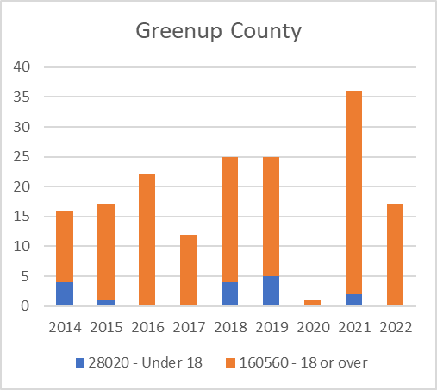
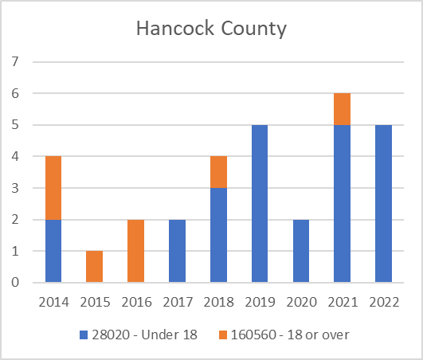
Truancy Filings
Greenup | UOR | 2014 | 2015 | 2016 | 2017 | 2018 | 2019 | 2020 | 2021 | 2022 | Total
 | 28020 | 4 | 1 |  |  | 4 | 5 |  | 2 |  | 16
 | 160560 | 12 | 16 | 22 | 12 | 21 | 20 | 1 | 34 | 17 | 155
 | Total | 16 | 17 | 22 | 12 | 25 | 25 | 1 | 36 | 17 | 171
Hancock | UOR | 2014 | 2015 | 2016 | 2017 | 2018 | 2019 | 2020 | 2021 | 2022 | Total
 | 28020 | 2 |  |  | 2 | 3 | 5 | 2 | 5 | 5 | 24
 | 160560 | 2 | 1 | 2 |  | 1 |  |  | 1 |  | 7
 | Total | 4 | 1 | 2 | 2 | 4 | 5 | 2 | 6 | 5 | 31

Slide 25
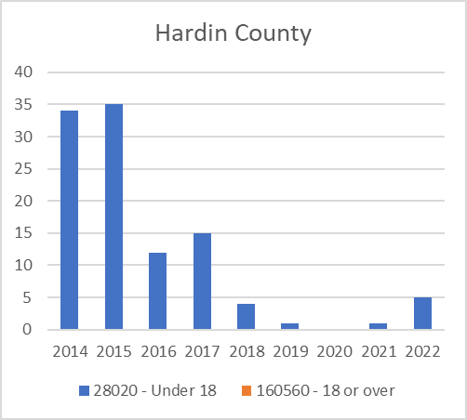
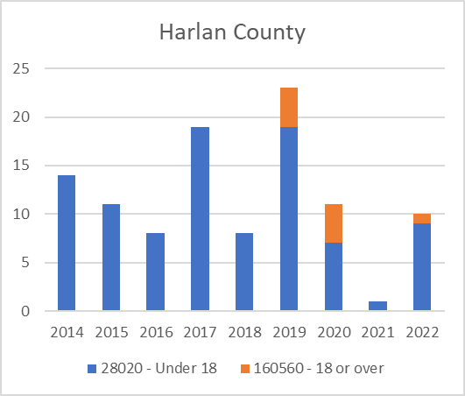
Truancy Filings
Hardin | UOR | 2014 | 2015 | 2016 | 2017 | 2018 | 2019 | 2020 | 2021 | 2022 | Total
 | 28020 | 34 | 35 | 12 | 15 | 4 | 1 |  | 1 | 5 | 107
 | 160560 |  |  |  |  |  |  |  |  |  | 0
 | Total | 34 | 35 | 12 | 15 | 4 | 1 | 0 | 1 | 5 | 107
Harlan | UOR | 2014 | 2015 | 2016 | 2017 | 2018 | 2019 | 2020 | 2021 | 2022 | Total
 | 28020 | 14 | 11 | 8 | 19 | 8 | 19 | 7 | 1 | 9 | 96
 | 160560 |  |  |  |  |  | 4 | 4 |  | 1 | 9
 | Total | 14 | 11 | 8 | 19 | 8 | 23 | 11 | 1 | 10 | 105

Slide 26
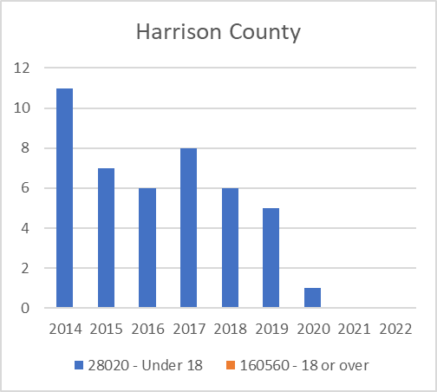
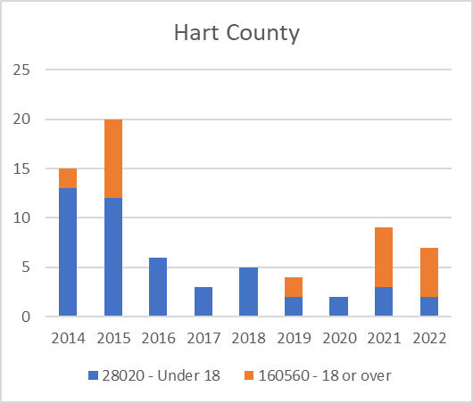
Truancy Filings
Harrison | UOR | 2014 | 2015 | 2016 | 2017 | 2018 | 2019 | 2020 | 2021 | 2022 | Total
 | 28020 | 11 | 7 | 6 | 8 | 6 | 5 | 1 |  |  | 44
 | 160560 |  |  |  |  |  |  |  |  |  | 0
 | Total | 11 | 7 | 6 | 8 | 6 | 5 | 1 | 0 | 0 | 44
Hart | UOR | 2014 | 2015 | 2016 | 2017 | 2018 | 2019 | 2020 | 2021 | 2022 | Total
 | 28020 | 13 | 12 | 6 | 3 | 5 | 2 | 2 | 3 | 2 | 48
 | 160560 | 2 | 8 |  |  |  | 2 |  | 6 | 5 | 23
 | Total | 15 | 20 | 6 | 3 | 5 | 4 | 2 | 9 | 7 | 71

Slide 27
Truancy Filings
Henderson | UOR | 2014 | 2015 | 2016 | 2017 | 2018 | 2019 | 2020 | 2021 | 2022 | Total
 | 28020 | 42 | 24 | 17 | 20 | 27 | 34 | 15 | 13 | 25 | 217
 | 160560 |  |  |  |  |  |  |  |  |  | 0
 | Total | 42 | 24 | 17 | 20 | 27 | 34 | 15 | 13 | 25 | 217
Henry | UOR | 2014 | 2015 | 2016 | 2017 | 2018 | 2019 | 2020 | 2021 | 2022 | Total
 | 28020 | 9 | 4 | 7 | 8 | 1 | 4 | 2 | 5 | 2 | 42
 | 160560 |  |  |  | 1 |  |  |  |  |  | 1
 | Total | 9 | 4 | 7 | 9 | 1 | 4 | 2 | 5 | 2 | 43

Slide 28
Truancy Filings
Hickman | UOR | 2014 | 2015 | 2016 | 2017 | 2018 | 2019 | 2020 | 2021 | 2022 | Total
 | 28020 | 2 | 1 |  |  | 1 | 1 |  |  |  | 5
 | 160560 | 1 |  |  |  |  |  |  |  |  | 1
 | Total | 3 | 1 | 0 | 0 | 1 | 1 | 0 | 0 | 0 | 6
Hopkins | UOR | 2014 | 2015 | 2016 | 2017 | 2018 | 2019 | 2020 | 2021 | 2022 | Total
 | 28020 | 45 | 9 |  | 5 | 1 | 4 |  |  |  | 64
 | 160560 | 17 | 9 | 17 | 4 | 2 | 10 | 3 | 1 | 1 | 64
 | Total | 62 | 18 | 17 | 9 | 3 | 14 | 3 | 1 | 1 | 128

Slide 29
Truancy Filings
Jackson | UOR | 2014 | 2015 | 2016 | 2017 | 2018 | 2019 | 2020 | 2021 | 2022 | Total
 | 28020 | 1 | 3 | 1 | 3 |  |  | 1 |  |  | 9
 | 160560 |  |  |  |  |  |  |  |  |  | 0
 | Total | 1 | 3 | 1 | 3 | 0 | 0 | 1 | 0 | 0 | 9
Jefferson | UOR | 2014 | 2015 | 2016 | 2017 | 2018 | 2019 | 2020 | 2021 | 2022 | Total
 | 28020 | 425 | 401 | 423 | 462 | 167 | 161 | 70 |  | 18 | 2127
 | 160560 |  |  |  |  |  |  |  |  |  | 0
 | Total | 425 | 401 | 423 | 462 | 167 | 161 | 70 | 0 | 18 | 2127

Slide 30
Truancy Filings
Jessamine | UOR | 2014 | 2015 | 2016 | 2017 | 2018 | 2019 | 2020 | 2021 | 2022 | Total
 | 28020 | 12 | 22 | 10 | 13 | 20 | 22 | 7 |  | 9 | 115
 | 160560 |  |  |  |  |  |  | 1 |  |  | 1
 | Total | 12 | 22 | 10 | 13 | 20 | 22 | 8 | 0 | 9 | 116
Johnson | UOR | 2014 | 2015 | 2016 | 2017 | 2018 | 2019 | 2020 | 2021 | 2022 | Total
 | 28020 | 6 | 3 | 2 | 3 | 2 | 4 | 3 |  | 3 | 26
 | 160560 |  |  |  |  |  |  |  |  | 1 | 1
 | Total | 6 | 3 | 2 | 3 | 2 | 4 | 3 | 0 | 4 | 27

Slide 31
Truancy Filings
Kenton | UOR | 2014 | 2015 | 2016 | 2017 | 2018 | 2019 | 2020 | 2021 | 2022 | Total
 | 28020 | 3 |  | 2 | 1 | 10 | 8 |  | 1 | 3 | 28
 | 160560 | 17 | 29 | 11 | 12 | 14 | 14 | 2 |  |  | 99
 | Total | 20 | 29 | 13 | 13 | 24 | 22 | 2 | 1 | 3 | 127
Knott | UOR | 2014 | 2015 | 2016 | 2017 | 2018 | 2019 | 2020 | 2021 | 2022 | Total
 | 28020 | 10 | 13 | 2 | 2 | 4 |  |  |  | 3 | 34
 | 160560 |  |  |  |  |  |  |  |  |  | 0
 | Total | 10 | 13 | 2 | 2 | 4 | 0 | 0 | 0 | 3 | 34

Slide 32
Truancy Filings
Knox | UOR | 2014 | 2015 | 2016 | 2017 | 2018 | 2019 | 2020 | 2021 | 2022 | Total
 | 28020 | 19 | 23 | 21 | 21 | 2 | 8 | 4 |  | 16 | 114
 | 160560 |  |  |  |  |  |  |  |  |  | 0
 | Total | 19 | 23 | 21 | 21 | 2 | 8 | 4 | 0 | 16 | 114
Larue | UOR | 2014 | 2015 | 2016 | 2017 | 2018 | 2019 | 2020 | 2021 | 2022 | Total
 | 28020 | 1 | 3 | 1 |  |  | 3 | 3 | 4 |  | 15
 | 160560 |  |  |  |  |  |  |  |  |  | 0
 | Total | 1 | 3 | 1 | 0 | 0 | 3 | 3 | 4 | 0 | 15

Slide 33
Truancy Filings
Laurel | UOR | 2014 | 2015 | 2016 | 2017 | 2018 | 2019 | 2020 | 2021 | 2022 | Total
 | 28020 | 44 | 38 | 33 | 43 | 21 | 9 | 8 | 16 | 15 | 227
 | 160560 |  |  | 1 |  |  |  |  |  |  | 1
 | Total | 44 | 38 | 34 | 43 | 21 | 9 | 8 | 16 | 15 | 228
Lawrence | UOR | 2014 | 2015 | 2016 | 2017 | 2018 | 2019 | 2020 | 2021 | 2022 | Total
 | 28020 | 3 | 2 | 3 | 5 | 2 | 3 |  | 1 | 3 | 22
 | 160560 |  |  |  |  |  |  |  |  |  | 0
 | Total | 3 | 2 | 3 | 5 | 2 | 3 | 0 | 1 | 3 | 22

Slide 34
Truancy Filings
Lee | UOR | 2014 | 2015 | 2016 | 2017 | 2018 | 2019 | 2020 | 2021 | 2022 | Total
 | 28020 | 26 | 10 | 12 | 3 | 2 |  |  |  |  | 53
 | 160560 |  |  |  |  |  |  |  |  |  | 0
 | Total | 26 | 10 | 12 | 3 | 2 | 0 | 0 | 0 | 0 | 53
Leslie | UOR | 2014 | 2015 | 2016 | 2017 | 2018 | 2019 | 2020 | 2021 | 2022 | Total
 | 28020 |  |  |  |  |  |  |  |  | 1 | 1
 | 160560 |  |  |  |  |  |  |  |  |  | 0
 | Total | 0 | 0 | 0 | 0 | 0 | 0 | 0 | 0 | 1 | 1

Slide 35
Truancy Filings
Letcher | UOR | 2014 | 2015 | 2016 | 2017 | 2018 | 2019 | 2020 | 2021 | 2022 | Total
 | 28020 | 18 | 4 | 5 | 5 |  | 1 |  |  |  | 33
 | 160560 |  | 2 |  |  |  |  |  | 1 |  | 3
 | Total | 18 | 6 | 5 | 5 | 0 | 1 | 0 | 1 | 0 | 36
Lewis | UOR | 2014 | 2015 | 2016 | 2017 | 2018 | 2019 | 2020 | 2021 | 2022 | Total
 | 28020 |  |  |  |  | 5 | 2 |  |  |  | 7
 | 160560 | 4 |  |  | 3 | 5 | 5 |  |  |  | 17
 | Total | 4 | 0 | 0 | 3 | 10 | 7 | 0 | 0 | 0 | 24

Slide 36
Truancy Filings
Lincoln | UOR | 2014 | 2015 | 2016 | 2017 | 2018 | 2019 | 2020 | 2021 | 2022 | Total
 | 28020 |  | 1 |  |  |  |  |  | 3 | 2 | 6
 | 160560 |  |  |  |  |  |  |  |  |  | 0
 | Total | 0 | 1 | 0 | 0 | 0 | 0 | 0 | 3 | 2 | 6
Livingston | UOR | 2014 | 2015 | 2016 | 2017 | 2018 | 2019 | 2020 | 2021 | 2022 | Total
 | 28020 | 1 | 1 |  |  | 2 | 5 | 3 | 1 | 5 | 18
 | 160560 |  |  |  |  |  |  |  |  |  | 0
 | Total | 1 | 1 | 0 | 0 | 2 | 5 | 3 | 1 | 5 | 18

Slide 37
Truancy Filings
Logan | UOR | 2014 | 2015 | 2016 | 2017 | 2018 | 2019 | 2020 | 2021 | 2022 | Total
 | 28020 | 7 | 2 | 4 | 1 | 1 | 2 | 2 | 1 | 3 | 23
 | 160560 |  |  |  |  | 1 |  |  | 1 |  | 2
 | Total | 7 | 2 | 4 | 1 | 2 | 2 | 2 | 2 | 3 | 25
Lyon | UOR | 2014 | 2015 | 2016 | 2017 | 2018 | 2019 | 2020 | 2021 | 2022 | Total
 | 28020 | 1 |  |  |  |  | 1 |  |  |  | 2
 | 160560 | 2 | 2 |  |  | 1 | 1 |  |  |  | 6
 | Total | 3 | 2 | 0 | 0 | 1 | 2 | 0 | 0 | 0 | 8

Slide 38
Truancy Filings
Madison | UOR | 2014 | 2015 | 2016 | 2017 | 2018 | 2019 | 2020 | 2021 | 2022 | Total
 | 28020 | 19 | 9 | 8 | 6 | 10 | 6 | 4 |  | 1 | 63
 | 160560 | 11 | 33 | 34 | 25 | 25 | 8 |  |  |  | 136
 | Total | 30 | 42 | 42 | 31 | 35 | 14 | 4 | 0 | 1 | 199
Magoffin | UOR | 2014 | 2015 | 2016 | 2017 | 2018 | 2019 | 2020 | 2021 | 2022 | Total
 | 28020 |  | 1 | 6 |  |  |  |  |  | 3 | 10
 | 160560 |  |  | 6 |  |  |  |  |  |  | 6
 | Total | 0 | 1 | 12 | 0 | 0 | 0 | 0 | 0 | 3 | 16

Slide 39
Truancy Filings
Marion | UOR | 2014 | 2015 | 2016 | 2017 | 2018 | 2019 | 2020 | 2021 | 2022 | Total
 | 28020 | 3 | 2 | 6 | 3 |  | 1 | 1 |  | 1 | 17
 | 160560 |  |  |  |  |  |  |  |  |  | 0
 | Total | 3 | 2 | 6 | 3 | 0 | 1 | 1 | 0 | 1 | 17
Marshall | UOR | 2014 | 2015 | 2016 | 2017 | 2018 | 2019 | 2020 | 2021 | 2022 | Total
 | 28020 | 2 | 1 | 2 | 2 |  |  |  | 1 | 4 | 12
 | 160560 |  |  |  |  |  |  |  |  |  | 0
 | Total | 2 | 1 | 2 | 2 | 0 | 0 | 0 | 1 | 4 | 12

Slide 40
Truancy Filings
Martin | UOR | 2014 | 2015 | 2016 | 2017 | 2018 | 2019 | 2020 | 2021 | 2022 | Total
 | 28020 | 10 | 10 | 2 | 2 | 10 | 6 |  | 1 | 7 | 48
 | 160560 |  | 5 | 2 |  | 1 |  |  |  |  | 8
 | Total | 10 | 15 | 4 | 2 | 11 | 6 | 0 | 1 | 7 | 56
Mason | UOR | 2014 | 2015 | 2016 | 2017 | 2018 | 2019 | 2020 | 2021 | 2022 | Total
 | 28020 | 5 | 1 | 3 |  | 1 | 1 | 1 | 3 | 2 | 17
 | 160560 |  |  |  |  |  |  |  |  |  | 0
 | Total | 5 | 1 | 3 | 0 | 1 | 1 | 1 | 3 | 2 | 17

Slide 41
Truancy Filings
McCracken | UOR | 2014 | 2015 | 2016 | 2017 | 2018 | 2019 | 2020 | 2021 | 2022 | Total
 | 28020 | 6 | 5 | 13 | 16 | 14 | 22 | 4 | 8 | 12 | 100
 | 160560 | 16 | 17 | 10 | 10 | 8 | 8 | 3 | 1 | 1 | 74
 | Total | 22 | 22 | 23 | 26 | 22 | 30 | 7 | 9 | 13 | 174
McCreary | UOR | 2014 | 2015 | 2016 | 2017 | 2018 | 2019 | 2020 | 2021 | 2022 | Total
 | 28020 | 11 | 2 | 5 | 8 | 6 | 2 | 1 |  | 1 | 36
 | 160560 | 15 | 2 | 26 | 39 | 18 | 6 | 9 | 2 | 5 | 122
 | Total | 26 | 4 | 31 | 47 | 24 | 8 | 10 | 2 | 6 | 158

Slide 42
Truancy Filings
McLean | UOR | 2014 | 2015 | 2016 | 2017 | 2018 | 2019 | 2020 | 2021 | 2022 | Total
 | 28020 | 2 |  |  | 2 |  | 1 |  |  |  | 5
 | 160560 |  |  |  |  |  |  |  |  |  | 0
 | Total | 2 | 0 | 0 | 2 | 0 | 1 | 0 | 0 | 0 | 5
Meade | UOR | 2014 | 2015 | 2016 | 2017 | 2018 | 2019 | 2020 | 2021 | 2022 | Total
 | 28020 | 2 |  |  | 2 |  | 1 |  |  |  | 5
 | 160560 |  |  |  |  |  |  |  |  |  | 0
 | Total | 2 | 0 | 0 | 2 | 0 | 1 | 0 | 0 | 0 | 5

Slide 43
Truancy Filings
Menifee | UOR | 2014 | 2015 | 2016 | 2017 | 2018 | 2019 | 2020 | 2021 | 2022 | Total
 | 28020 | 1 | 3 |  | 2 | 1 |  |  |  |  | 7
 | 160560 | 1 | 6 | 1 | 3 |  |  | 1 |  | 2 | 14
 | Total | 2 | 9 | 1 | 5 | 1 | 0 | 1 | 0 | 2 | 21
Mercer | UOR | 2014 | 2015 | 2016 | 2017 | 2018 | 2019 | 2020 | 2021 | 2022 | Total
 | 28020 | 1 |  |  |  |  | 1 |  |  | 1 | 3
 | 160560 | 7 | 9 | 6 | 8 | 3 | 1 |  |  |  | 34
 | Total | 8 | 9 | 6 | 8 | 3 | 2 | 0 | 0 | 1 | 37

Slide 44
Truancy Filings
Metcalfe | UOR | 2014 | 2015 | 2016 | 2017 | 2018 | 2019 | 2020 | 2021 | 2022 | Total
 | 28020 | 2 | 5 |  | 5 | 1 |  |  |  |  | 13
 | 160560 |  |  |  |  |  |  |  |  |  | 0
 | Total | 2 | 5 | 0 | 5 | 1 | 0 | 0 | 0 | 0 | 13
Monroe | UOR | 2014 | 2015 | 2016 | 2017 | 2018 | 2019 | 2020 | 2021 | 2022 | Total
 | 28020 | 4 | 1 |  | 3 |  |  |  |  | 2 | 10
 | 160560 | 8 | 7 | 14 | 11 | 6 | 3 | 3 | 2 | 1 | 55
 | Total | 12 | 8 | 14 | 14 | 6 | 3 | 3 | 2 | 3 | 65

Slide 45
Truancy Filings
Montgomery | UOR | 2014 | 2015 | 2016 | 2017 | 2018 | 2019 | 2020 | 2021 | 2022 | Total
 | 28020 | 17 | 17 | 15 | 15 | 6 | 12 | 3 | 7 | 7 | 99
 | 160560 | 4 | 1 | 2 | 7 | 2 |  |  | 3 |  | 19
 | Total | 21 | 18 | 17 | 22 | 8 | 12 | 3 | 10 | 7 | 118
Morgan | UOR | 2014 | 2015 | 2016 | 2017 | 2018 | 2019 | 2020 | 2021 | 2022 | Total
 | 28020 | 4 | 7 | 3 | 4 | 2 | 3 | 1 | 1 | 3 | 28
 | 160560 |  |  |  |  |  |  |  |  |  | 0
 | Total | 4 | 7 | 3 | 4 | 2 | 3 | 1 | 1 | 3 | 28

Slide 46
Truancy Filings
Muhlenberg | UOR | 2014 | 2015 | 2016 | 2017 | 2018 | 2019 | 2020 | 2021 | 2022 | Total
 | 28020 | 25 | 8 | 9 | 3 | 4 | 4 | 3 |  | 5 | 61
 | 160560 |  |  |  |  |  |  |  |  |  | 0
 | Total | 25 | 8 | 9 | 3 | 4 | 4 | 3 | 0 | 5 | 61
Nelson | UOR | 2014 | 2015 | 2016 | 2017 | 2018 | 2019 | 2020 | 2021 | 2022 | Total
 | 28020 | 16 | 33 | 2 | 1 | 7 | 2 |  | 1 | 2 | 64
 | 160560 | 2 | 4 | 7 | 3 | 8 | 1 |  |  |  | 25
 | Total | 18 | 37 | 9 | 4 | 15 | 3 | 0 | 1 | 2 | 89

Slide 47
Truancy Filings
Nicholas | UOR | 2014 | 2015 | 2016 | 2017 | 2018 | 2019 | 2020 | 2021 | 2022 | Total
 | 28020 |  |  |  |  |  | 1 |  |  | 1 | 2
 | 160560 |  |  |  |  |  |  |  |  |  | 0
 | Total | 0 | 0 | 0 | 0 | 0 | 1 | 0 | 0 | 1 | 2
Ohio | UOR | 2014 | 2015 | 2016 | 2017 | 2018 | 2019 | 2020 | 2021 | 2022 | Total
 | 28020 | 2 |  |  | 1 | 2 | 5 | 4 | 9 | 14 | 37
 | 160560 |  |  |  |  |  |  |  |  |  | 0
 | Total | 2 | 0 | 0 | 1 | 2 | 5 | 4 | 9 | 14 | 37

Slide 48
Truancy Filings
Oldham | UOR | 2014 | 2015 | 2016 | 2017 | 2018 | 2019 | 2020 | 2021 | 2022 | Total
 | 28020 | 15 | 10 | 10 | 3 | 3 | 11 |  | 1 |  | 53
 | 160560 | 7 | 5 | 7 | 11 | 3 | 3 |  | 1 |  | 37
 | Total | 22 | 15 | 17 | 14 | 6 | 14 | 0 | 2 | 0 | 90
Owen | UOR | 2014 | 2015 | 2016 | 2017 | 2018 | 2019 | 2020 | 2021 | 2022 | Total
 | 28020 | 2 | 1 |  |  |  | 4 |  |  |  | 7
 | 160560 |  |  |  |  |  |  |  |  |  | 0
 | Total | 2 | 1 | 0 | 0 | 0 | 4 | 0 | 0 | 0 | 7

Slide 49
Truancy Filings
Owsley | UOR | 2014 | 2015 | 2016 | 2017 | 2018 | 2019 | 2020 | 2021 | 2022 | Total
 | 28020 | 2 | 3 | 5 | 4 | 3 | 4 | 3 |  | 2 | 26
 | 160560 |  |  |  |  |  |  |  |  |  | 0
 | Total | 2 | 3 | 5 | 4 | 3 | 4 | 3 | 0 | 2 | 26
Pendleton | UOR | 2014 | 2015 | 2016 | 2017 | 2018 | 2019 | 2020 | 2021 | 2022 | Total
 | 28020 | 13 | 2 |  | 3 | 10 | 3 |  |  |  | 31
 | 160560 | 1 |  |  |  |  |  |  |  |  | 1
 | Total | 14 | 2 | 0 | 3 | 10 | 3 | 0 | 0 | 0 | 32

Slide 50
Truancy Filings
Perry | UOR | 2014 | 2015 | 2016 | 2017 | 2018 | 2019 | 2020 | 2021 | 2022 | Total
 | 28020 | 13 | 7 |  | 4 | 6 | 3 | 1 |  |  | 34
 | 160560 | 2 |  |  |  |  |  |  |  |  | 2
 | Total | 15 | 7 | 0 | 4 | 6 | 3 | 1 | 0 | 0 | 36
Pike | UOR | 2014 | 2015 | 2016 | 2017 | 2018 | 2019 | 2020 | 2021 | 2022 | Total
 | 28020 | 14 | 4 | 1 | 2 |  |  |  |  |  | 21
 | 160560 | 1 | 3 | 5 | 5 | 3 | 2 |  |  |  | 19
 | Total | 15 | 7 | 6 | 7 | 3 | 2 | 0 | 0 | 0 | 40

Slide 51
Truancy Filings
Powell | UOR | 2014 | 2015 | 2016 | 2017 | 2018 | 2019 | 2020 | 2021 | 2022 | Total
 | 28020 | 5 | 3 | 3 | 2 |  | 1 | 1 |  | 1 | 16
 | 160560 | 3 | 4 | 1 | 6 | 2 | 5 | 1 |  | 4 | 26
 | Total | 8 | 7 | 4 | 8 | 2 | 6 | 2 | 0 | 5 | 42
Pulaski | UOR | 2014 | 2015 | 2016 | 2017 | 2018 | 2019 | 2020 | 2021 | 2022 | Total
 | 28020 | 18 | 12 | 16 | 7 | 4 | 4 | 4 | 3 | 5 | 73
 | 160560 | 12 | 13 | 1 | 5 | 5 | 7 | 2 | 1 | 1 | 47
 | Total | 30 | 25 | 17 | 12 | 9 | 11 | 6 | 4 | 6 | 120

Slide 52
Truancy Filings
Robertson | UOR | 2014 | 2015 | 2016 | 2017 | 2018 | 2019 | 2020 | 2021 | 2022 | Total
 | 28020 | 1 |  | 1 |  | 2 |  |  |  |  | 4
 | 160560 |  |  |  |  |  |  |  |  |  | 0
 | Total | 1 | 0 | 1 | 0 | 2 | 0 | 0 | 0 | 0 | 4
Rockcastle | UOR | 2014 | 2015 | 2016 | 2017 | 2018 | 2019 | 2020 | 2021 | 2022 | Total
 | 28020 | 1 |  |  |  |  | 2 | 1 | 2 | 1 | 7
 | 160560 |  |  |  |  |  |  |  |  |  | 0
 | Total | 1 | 0 | 0 | 0 | 0 | 2 | 1 | 2 | 1 | 7

Slide 53
Truancy Filings
Rowan | UOR | 2014 | 2015 | 2016 | 2017 | 2018 | 2019 | 2020 | 2021 | 2022 | Total
 | 28020 | 1 | 7 | 3 | 2 | 2 | 3 |  | 3 | 2 | 23
 | 160560 | 2 |  |  | 1 |  |  |  |  |  | 3
 | Total | 3 | 7 | 3 | 3 | 2 | 3 | 0 | 3 | 2 | 26
Russell | UOR | 2014 | 2015 | 2016 | 2017 | 2018 | 2019 | 2020 | 2021 | 2022 | Total
 | 28020 | 13 | 8 | 2 | 2 | 4 |  |  |  |  | 29
 | 160560 |  |  |  |  |  |  |  |  |  | 0
 | Total | 13 | 8 | 2 | 2 | 4 | 0 | 0 | 0 | 0 | 29

Slide 54
Truancy Filings
Scott | UOR | 2014 | 2015 | 2016 | 2017 | 2018 | 2019 | 2020 | 2021 | 2022 | Total
 | 28020 | 32 | 2 | 30 | 5 | 18 | 16 | 19 | 7 | 18 | 147
 | 160560 | 14 | 9 | 6 | 5 | 12 | 4 | 6 | 3 | 1 | 60
 | Total | 46 | 11 | 36 | 10 | 30 | 20 | 25 | 10 | 19 | 207
Shelby | UOR | 2014 | 2015 | 2016 | 2017 | 2018 | 2019 | 2020 | 2021 | 2022 | Total
 | 28020 | 16 | 7 |  |  | 1 |  |  |  |  | 24
 | 160560 | 1 | 2 | 5 | 7 | 2 | 2 |  |  |  | 19
 | Total | 17 | 9 | 5 | 7 | 3 | 2 | 0 | 0 | 0 | 43

Slide 55
Truancy Filings
Simpson | UOR | 2014 | 2015 | 2016 | 2017 | 2018 | 2019 | 2020 | 2021 | 2022 | Total
 | 28020 | 9 | 9 | 1 | 6 | 1 | 1 | 1 | 1 | 4 | 33
 | 160560 |  |  |  |  |  |  |  |  |  | 0
 | Total | 9 | 9 | 1 | 6 | 1 | 1 | 1 | 1 | 4 | 33
Spencer | UOR | 2014 | 2015 | 2016 | 2017 | 2018 | 2019 | 2020 | 2021 | 2022 | Total
 | 28020 | 4 |  | 1 | 1 |  |  |  |  |  | 6
 | 160560 | 6 |  |  | 1 |  |  |  |  |  | 7
 | Total | 10 | 0 | 1 | 2 | 0 | 0 | 0 | 0 | 0 | 13

Slide 56
Truancy Filings
Taylor | UOR | 2014 | 2015 | 2016 | 2017 | 2018 | 2019 | 2020 | 2021 | 2022 | Total
 | 28020 | 8 |  |  |  | 2 | 1 |  | 2 | 2 | 15
 | 160560 |  |  |  |  |  |  |  |  |  | 0
 | Total | 8 | 0 | 0 | 0 | 2 | 1 | 0 | 2 | 2 | 15
Todd | UOR | 2014 | 2015 | 2016 | 2017 | 2018 | 2019 | 2020 | 2021 | 2022 | Total
 | 28020 |  | 2 | 1 |  | 1 |  |  |  |  | 4
 | 160560 |  |  |  |  |  |  |  |  |  | 0
 | Total | 0 | 2 | 1 | 0 | 1 | 0 | 0 | 0 | 0 | 4

Slide 57
Truancy Filings
Trigg | UOR | 2014 | 2015 | 2016 | 2017 | 2018 | 2019 | 2020 | 2021 | 2022 | Total
 | 28020 | 2 | 1 | 1 | 3 | 1 | 1 | 1 | 3 | 4 | 17
 | 160560 |  |  |  |  |  |  | 2 | 2 | 6 | 10
 | Total | 2 | 1 | 1 | 3 | 1 | 1 | 3 | 5 | 10 | 27
Trimble | UOR | 2014 | 2015 | 2016 | 2017 | 2018 | 2019 | 2020 | 2021 | 2022 | Total
 | 28020 | 2 | 1 | 1 | 3 | 1 | 2 | 2 |  | 1 | 13
 | 160560 |  |  | 1 |  |  |  |  |  |  | 1
 | Total | 2 | 1 | 2 | 3 | 1 | 2 | 2 | 0 | 1 | 14

Slide 58
Truancy Filings
Union | UOR | 2014 | 2015 | 2016 | 2017 | 2018 | 2019 | 2020 | 2021 | 2022 | Total
 | 28020 | 4 | 1 | 1 | 3 |  |  |  |  |  | 9
 | 160560 |  |  |  |  |  |  |  |  |  | 0
 | Total | 4 | 1 | 1 | 3 | 0 | 0 | 0 | 0 | 0 | 9
Warren | UOR | 2014 | 2015 | 2016 | 2017 | 2018 | 2019 | 2020 | 2021 | 2022 | Total
 | 28020 | 45 | 22 | 15 | 7 | 3 | 1 |  |  |  | 93
 | 160560 |  |  |  |  |  |  |  |  |  | 0
 | Total | 45 | 22 | 15 | 7 | 3 | 1 | 0 | 0 | 0 | 93

Slide 59
Truancy Filings
Washington | UOR | 2014 | 2015 | 2016 | 2017 | 2018 | 2019 | 2020 | 2021 | 2022 | Total
 | 28020 |  |  | 1 |  |  |  |  | 1 | 1 | 3
 | 160560 |  |  |  |  |  |  |  |  |  | 0
 | Total | 0 | 0 | 1 | 0 | 0 | 0 | 0 | 1 | 1 | 3
Wayne | UOR | 2014 | 2015 | 2016 | 2017 | 2018 | 2019 | 2020 | 2021 | 2022 | Total
 | 28020 | 6 | 5 | 4 | 2 | 4 | 1 |  | 1 | 1 | 24
 | 160560 |  | 1 |  |  |  |  |  |  |  | 1
 | Total | 6 | 6 | 4 | 2 | 4 | 1 | 0 | 1 | 1 | 25

Slide 60
Truancy Filings
Webster | UOR | 2014 | 2015 | 2016 | 2017 | 2018 | 2019 | 2020 | 2021 | 2022 | Total
 | 28020 | 1 |  |  |  |  |  | 1 |  | 2 | 4
 | 160560 |  | 4 | 6 | 1 | 1 | 1 |  | 1 |  | 14
 | Total | 1 | 4 | 6 | 1 | 1 | 1 | 1 | 1 | 2 | 18
Whitley | UOR | 2014 | 2015 | 2016 | 2017 | 2018 | 2019 | 2020 | 2021 | 2022 | Total
 | 28020 | 24 | 19 | 7 | 18 | 8 | 18 | 4 | 3 | 4 | 105
 | 160560 | 7 | 22 | 30 | 16 | 11 | 20 | 5 | 14 | 5 | 130
 | Total | 31 | 41 | 37 | 34 | 19 | 38 | 9 | 17 | 9 | 235

Slide 61
Truancy Filings
Wolfe | UOR | 2014 | 2015 | 2016 | 2017 | 2018 | 2019 | 2020 | 2021 | 2022 | Total
 | 28020 | 1 | 6 | 5 | 2 | 4 |  |  |  |  | 18
 | 160560 |  | 2 |  | 1 |  |  | 1 |  |  | 4
 | Total | 1 | 8 | 5 | 3 | 4 | 0 | 1 | 0 | 0 | 22
Woodford | UOR | 2014 | 2015 | 2016 | 2017 | 2018 | 2019 | 2020 | 2021 | 2022 | Total
 | 28020 | 17 | 7 | 7 | 2 | 7 | 6 | 3 | 3 | 5 | 57
 | 160560 |  |  |  |  |  |  |  |  |  | 0
 | Total | 17 | 7 | 7 | 2 | 7 | 6 | 3 | 3 | 5 | 57

Slide 62
Truancy Filings
Statewide | UOR | 2014 | 2015 | 2016 | 2017 | 2018 | 2019 | 2020 | 2021 | 2022 | Total
 | 28020 | 1 | 6 | 5 | 2 | 4 |  |  |  |  | 18
 | 160560 |  | 2 |  | 1 |  |  | 1 |  |  | 4
 | Total | 1 | 8 | 5 | 3 | 4 | 0 | 1 | 0 | 0 | 22

