Slide 1
Innovations in Kentucky Education
A Statewide Opportunity

Slide 2
Notes:
Meredith raised that these skills cross reference very well with the recently adopted POL

Slide 3
The System is a function of the Policy Environment within which it exists.

Slide 4
Common Policy Barriers as Identified by Kentucky Districts
State assessments don’t align with a vision for personalized learning for Kentucky’s students
Accountability requirements don’t encompass all learning that occurs and often pit schools against each other
Graduation requirements don’t allow for cross application of knowledge
Antiquated data reporting systems make it challenging to innovate
Calendar requirements don’t allow for personalization either for students or teachers
Teacher development, recruitment and certification are not aligned to the state’s vision for personalized learning
Funding is based on attendance (seat time) but not connected to mastery of content (eg. anytime, anywhere learning experiences)

Slide 5
We can make innovations in KY education the norm, not a rarity!
We need to create a policy environment that inspires innovation and unleashes schools to design and implement personalized educational programs so that students can develop their knowledge, skills and competencies for success in life as a citizen and contributor to their family, community, and the workforce.
Notes:
Unifying framework concept

Slide 6
Innovation in Accountability
A Statewide Focus

Slide 7
Accountability in Kentucky Public Education holds great significance, yet we find ourselves facing a unique opportunity for Transformation.

Slide 8
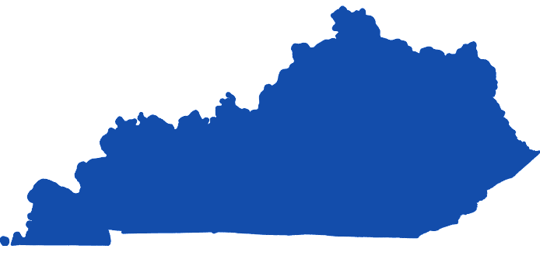
The Stars are Aligning over Kentucky

Slide 9
What Are States Trying?
Curriculum and instructionally-embedded tests
Performance tasks and assessments
Replacing traditional graduation requirements with deeper forms of assessment (e.g., capstones, portfolio/learning defenses, etc.)
Creating task and item banks for use in the classroom
Building capacity for new assessment system design

Slide 10
KnowledgeWorks.org

Slide 11
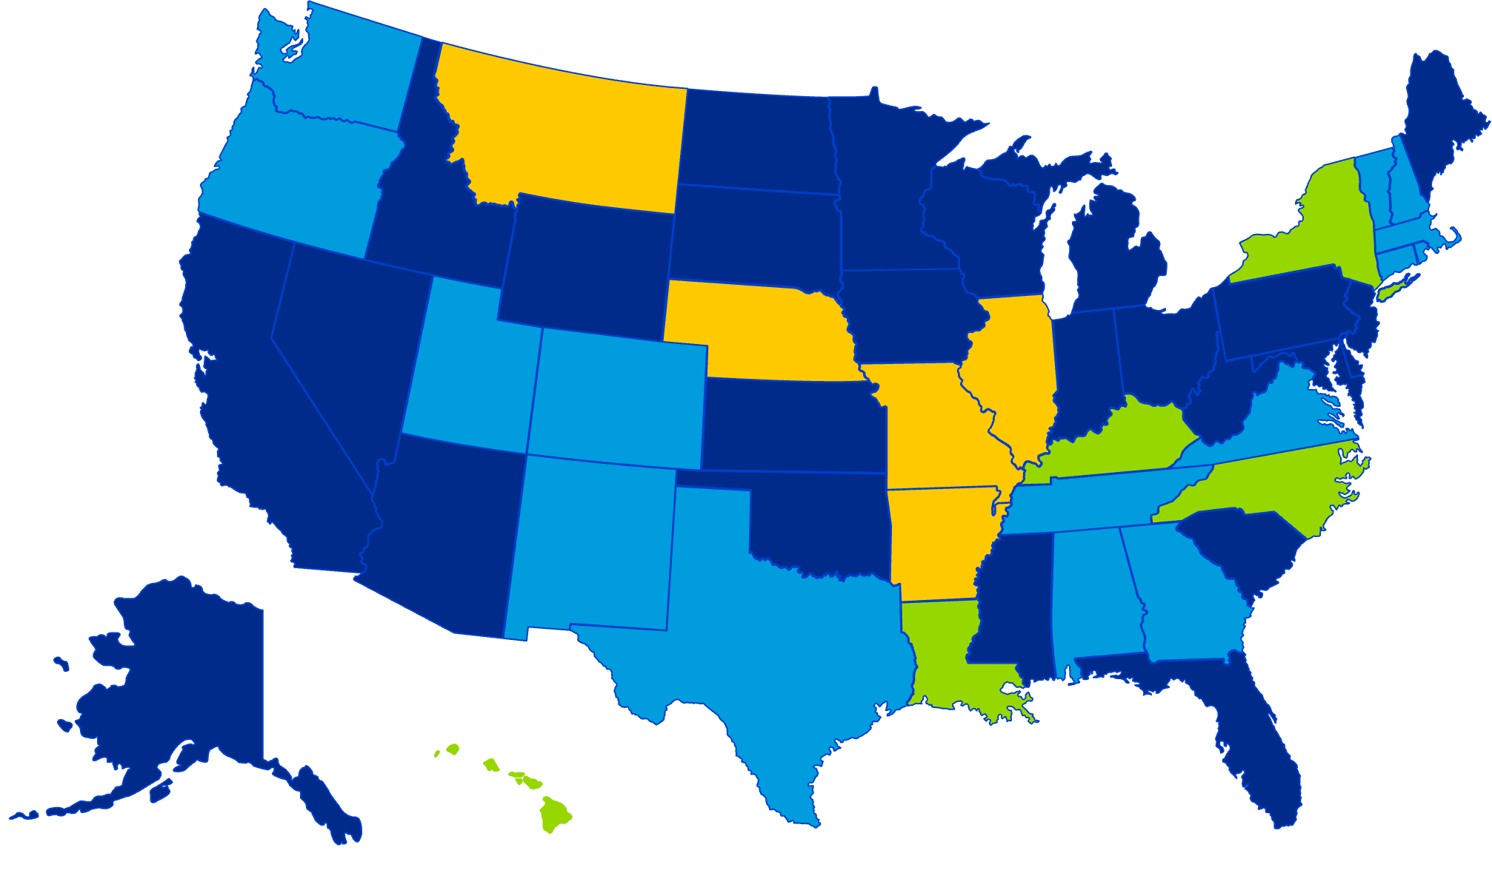
States Working on Next Generation Assessments
States Employing Innovative Strategies
2022 CGSA Recipients
CGSA Recipients/Innovative Assessment States
KnowledgeWorks.org
Notes:
Map of the states in the Measuring Forward paper plus the 10 states that just received a CGSA award from USED in September.

Slide 12
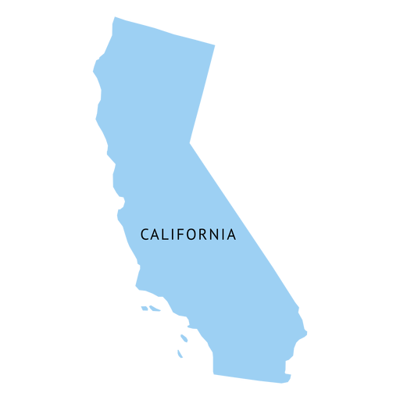
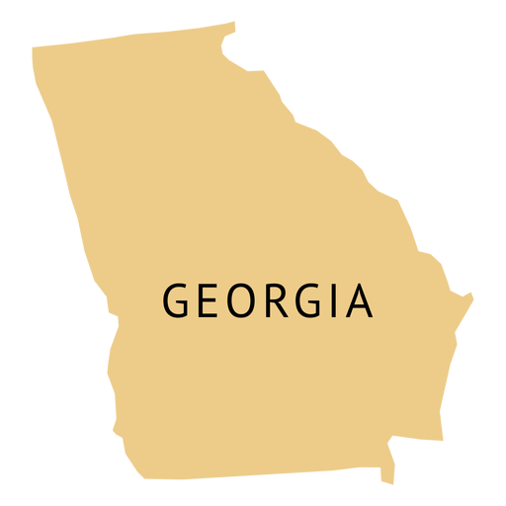
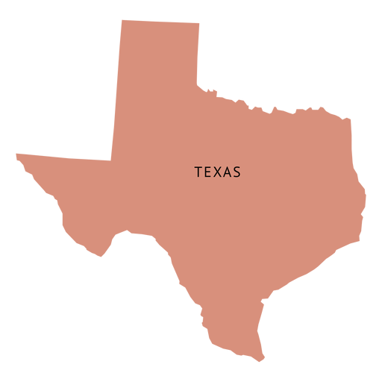
A Bipartisan National Focus - Rethinking School Accountability

Slide 13
Local Laboratories of Learning (L3 Coalition)
L3s will be involved in the design of a new assessment and accountability system and pilot any newly created systems.
Each L3 district shares a history and culture of transformative change that is understood and accepted in the district and community.

Slide 14
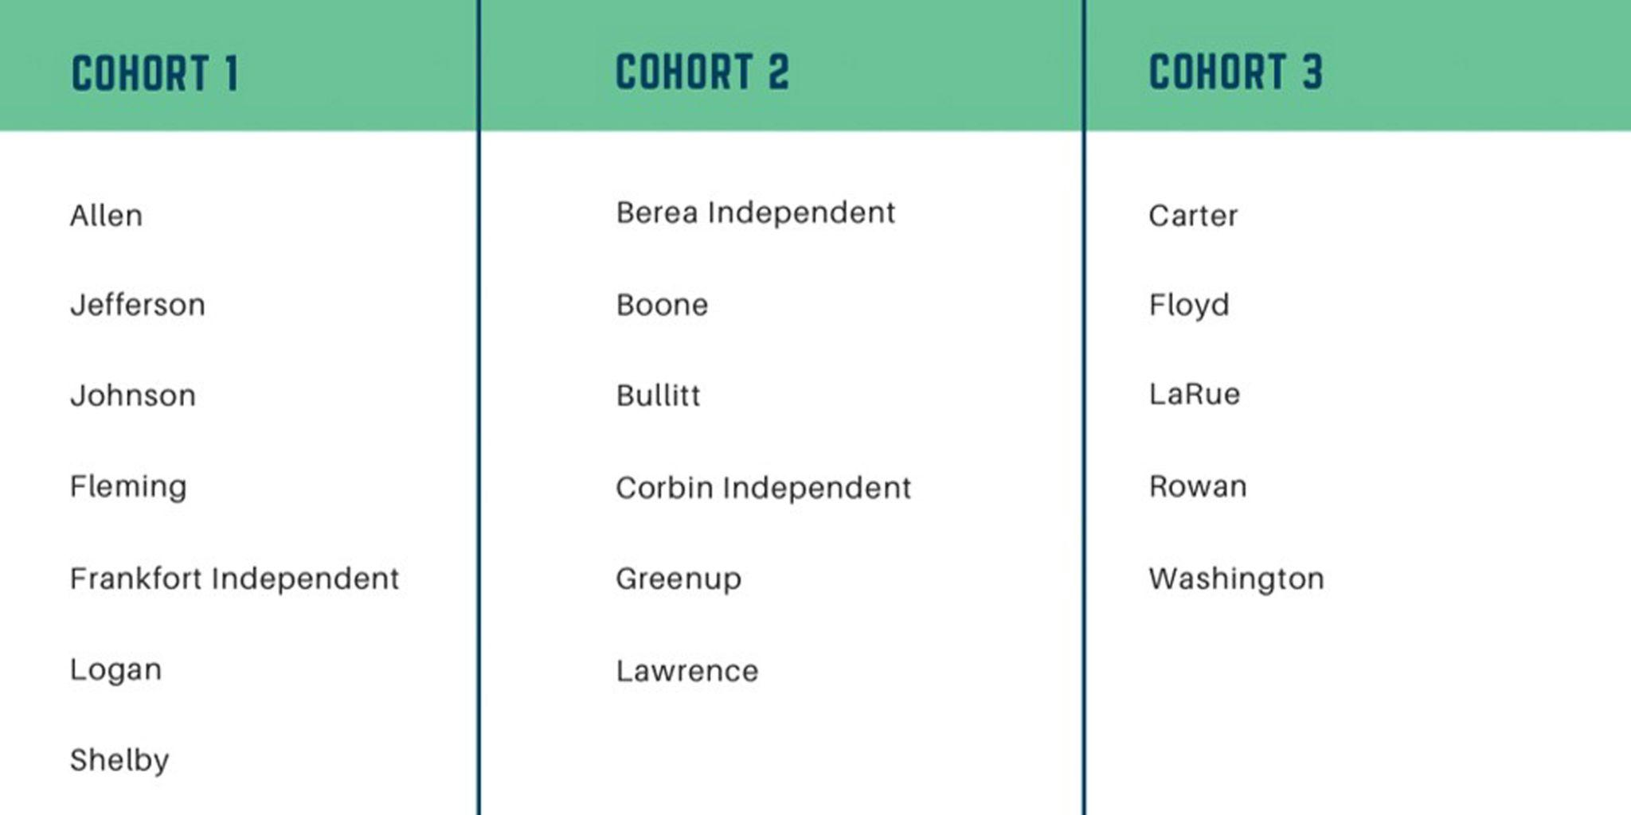

Slide 15
Next-Generation Accountability Models are:
Ultra-Simplistic,
Inherently Local,
Driven by Students,
Aligned to Community Expectations; and
Meets Workforce Needs and Trends

Slide 16
With an Overarching Demand for Real-time Transparency!

Slide 17
Areas of Focus in our Communities and by the Workforce
Traditional Accountability Focus
Next-Generation Accountability Model - Responsive
Workforce Readiness (Real-world Skills)
Reading
Critical Thinking and Creativity
Math
Work Ethic (including attendance)
Writing
Communication
Science
Responsibility
Social Studies
Problem-Solving
Teamwork

Slide 18
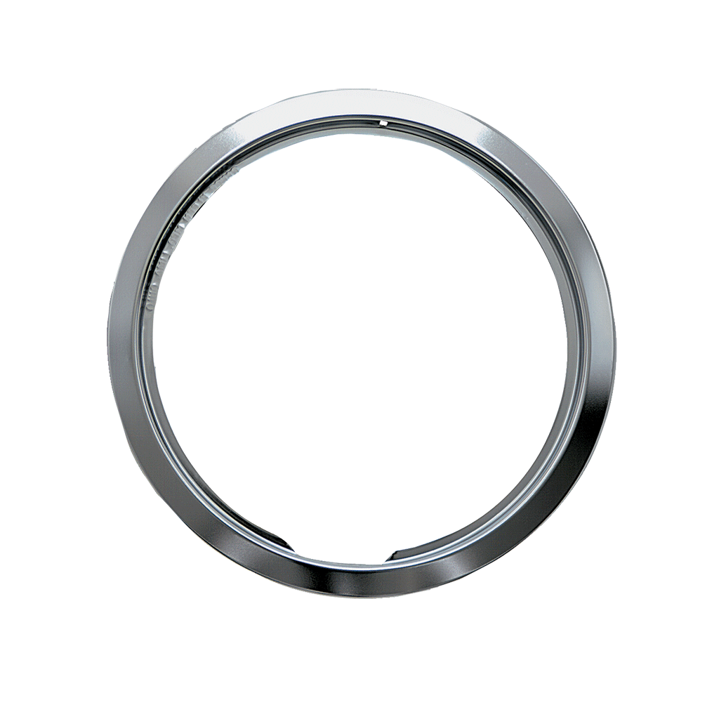
Kentucky currently has two districts with fully operational Community-based Accountability Systems.

Slide 19
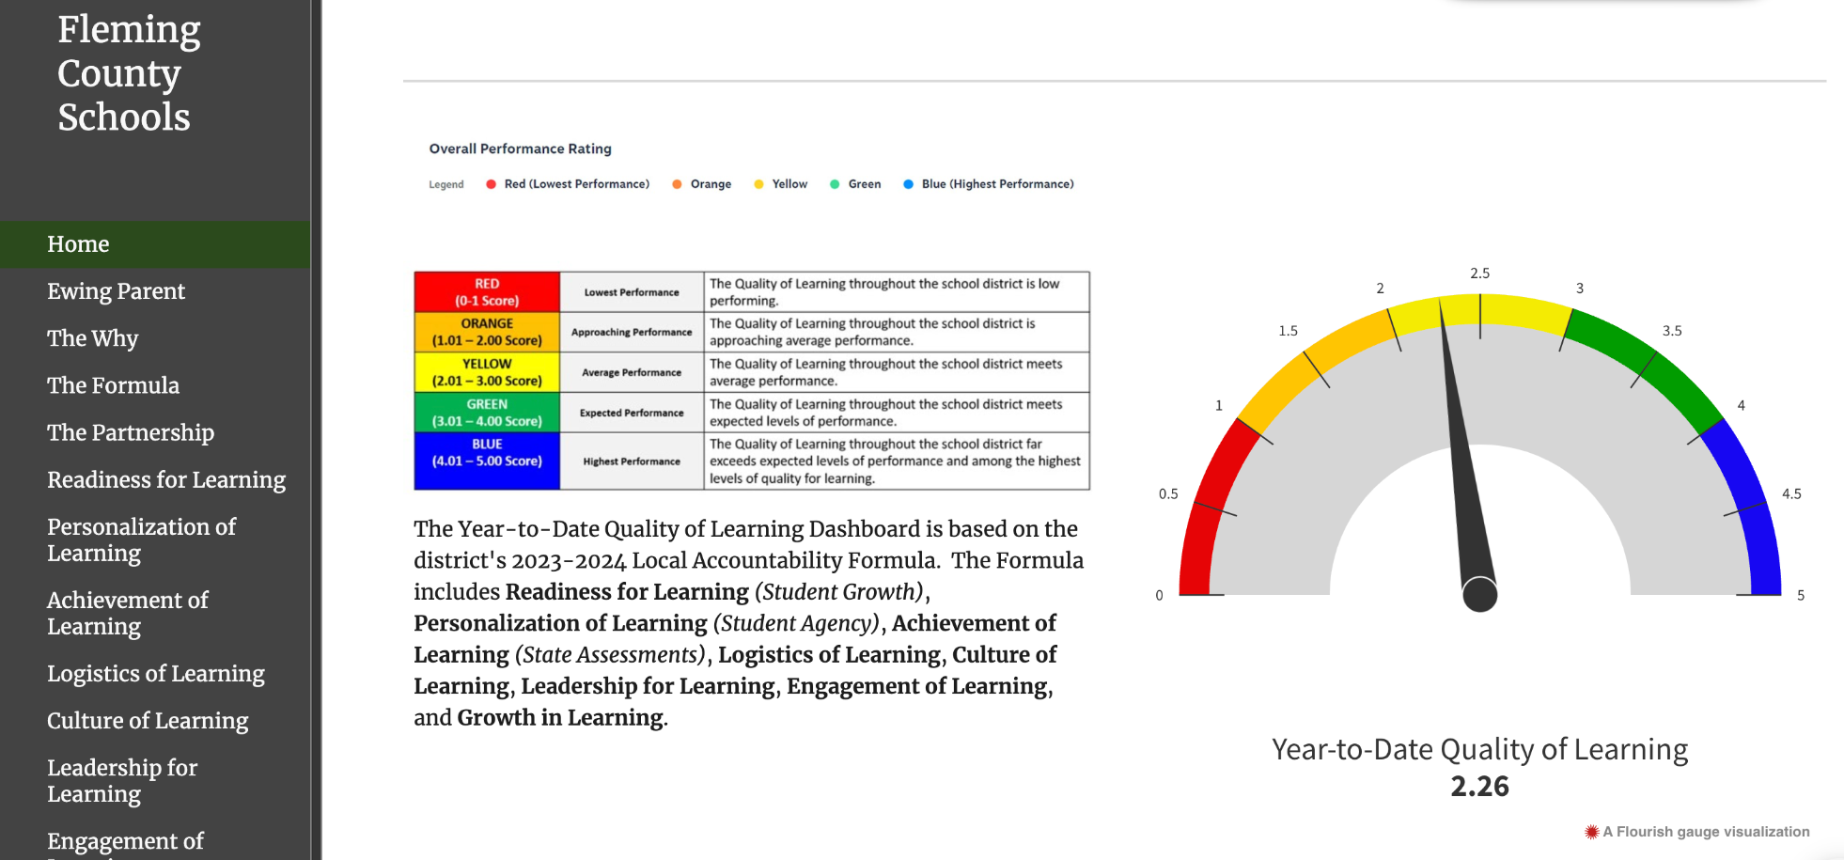
Fleming County Schools - Measures of Quality
Launched in January 2022
All versions and data are shared publicly from the district’s homepage
Data is updated monthly
Based on feedback from Students, teachers, families,
The community, and
Businesses (L3 requirement)

Slide 20
Fleming County Schools - Measures of Quality 3.0
Formative Data
State Achievement Data
Student
Growth Data
Research-based Rubrics
Observation Data
Stakeholder Surveys

Slide 21
Barriers to Innovation in School Accountability
Lack of or limited models or paths to follow
A Strong dependency on the traditional
Hesitancy due to misalignment or misunderstanding of purpose
Local Accountability is not:
Anti-testing, or
A driver for lower expectations
Lack the opportunities to innovate
Laws and Space - Limited, however:
ESSA allows for state waivers
KY Districts of Innovation: KRS 156.108 and KRS 160.107

Slide 22
Great Moments, Lead to Great Opportunities!
Kentucky needs an accountability model or assessments that accurately and realistically measure or report the readiness of every high school Kentucky graduate in terms of college, workforce, or life readiness.
We have an impressive responsibility to establish an accountability system that authentically gauges each student's readiness for life, taking into account their individual skills, talents, and needs and the workforce requirements.
This is an opportunity for Kentucky to do something meaningful and change the trajectory for students, public education, and the state for the next generation. While Federal and State accountability provide stable components to the system, we need local accountability to provide the agility and nimbleness to respond to the contextual needs of local communities.

Slide 23
Johnson County Schools
Local Accountability System
A more individualized and wholistic approach to showcase each student and their learning.
places an emphasis on our local assessments and diagnostics
embeds portrait of a learner
a collaborative effort between community, the school, & students

Slide 24
What our Local Community wants:
Career & Technical Options
Dual Credit Options
Personal Leadership Development

Slide 25
L3 Project SOAR
Personalized Pathway Selection
Exit Presentations
Leadership & Career Exploration
Leadership Events
Transition Meetings
Opportunity Fairs
Exit Interviews
Career Fairs
Project Presentations
Certification/Graduation

Slide 26
Success-Opportunity-Accomplishment-Relationships
SOAR
THE WHO & WHAT:
A Digital Portfolio (leadership notebook) that showcases an individual student’s growth, as well as career exploration, pathway completions, and/or certification attainment.
Rollout Year 1: 12th Grade Students
Rollout Year 2: All 8th-12th grade students
Portfolio Defense Interview
Students will present their Digital Portfolios as part of an exit interview at transition grades.
THE WHY:
To better capture the full spectrum of success for our students.
To give students the opportunity to showcase their accomplishments, skills, goals, and postsecondary plans.
To give students a pathway to take charge of their learning.
To provide a more individualized way to assess student growth and achievement.

Slide 27
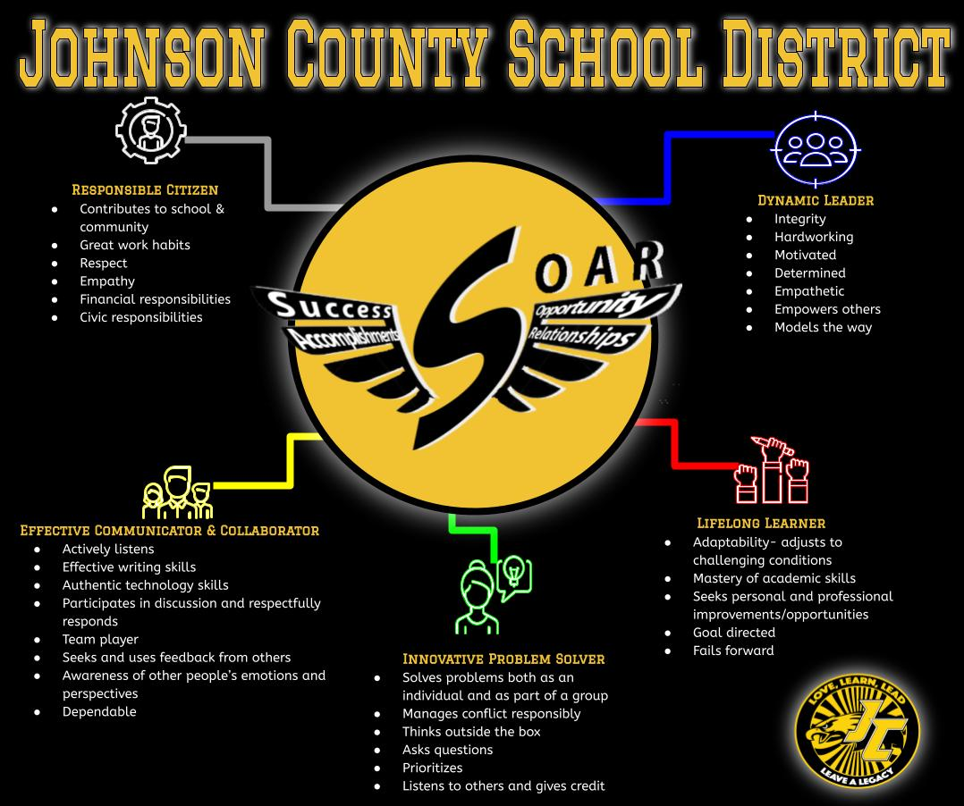
Portrait
of a
Learner

Slide 28
SOAR 12th Grade Expectations of Mastery
Responsible Citizen
Contributes to school and community Great work habits Respect Empathy Financial Responsibilities Civic Responsibilities
Expectations of Mastery
The student has personal examples in the Community Contributions section pertaining to involvement in their school and community, including, but not limited to, academic, athletic, leadership organizations, student organizations, and/or community service. The student exemplifies behaviors of positive civic responsibility by explaining their roles and responsibilities within their Community Contributions. The student explains that they are able to exemplify respect and empathy amongst peers and community members during collaborative efforts documented in the Community Contributions section of their portfolio. The student completes the graduation requirement of passing the state-mandated civics test that demonstrates their knowledge of civic responsibilities.
KY Technology Standards: DC1. Recognize the rights, responsibilities, and opportunities of living, learning, and working in an interconnected and digital world; act and model in ways that are safe, legal, and ethical. DC2. Demonstrate an understanding of and respect for the rights and obligations of using and sharing intellectual property.

Slide 29
Success-Opportunity-Accomplishment-Relationships
SOAR
JCHS Google Site
JCHS Student’s SOAR

Slide 30
Local
Current Assessment & Accountability
State
SUMMATIVE
K Screen Brigance
SOAR
Screeners
Data
Driven Instruction
A-KSA
Diagnostics
Portrait of a Learner
ACT
Formative Assessments
KSA
Benchmarks
KSA AP
ACT SAT
EOC KYOTE
CERT L3
Unit Tests
ACCESS
Summative
Notes:
Study how to incorporate local indicators, like those generated through L3 districts and others implementing community-based accountability, into the state’s accountability dashboard
Consider how Kentucky might reduce the state’s summative assessment footprint within federal requirements, while providing more flexibility to expand high quality performance assessments in non-federally tested subjects that reflect what student know and can do
Examine the state’s postsecondary readiness indicator to determine how it might incorporate competency-based pathways or additional measures, such as a capstone or a statewide or local competency framework
Examine the state’s accountability requirements to determine how the system could be made more reciprocal between the state and local communities and less competitive or punitive

Slide 31
Dual Credit Academy
IN HOUSE dual credit academy allowing our students to get 1 year of college absolutely FREE
Students can leave JCHS with 29 hours-
Savings of $20,000-$30,000 depending on which college they choose.
Last year’s graduating class graduated with 946 COLLEGE CREDITS
We currently service:
101 juniors ( 44% of the entire junior class)
106 seniors (47% of the senior class)
English 100/200, MTH 105, MTH 113, MTH 114, HIS 225/226, Coms 225, FMA 135, CHEM 100/101, EDU 101/203
FIve (5) in Career Pathways with in-house dual credit
Currently service 93 CTE dual credit students who will receive college credit and/or certification in-house for subjects like Certified Nurse’s Aid, Industrial Safety, Coding, Graphic Design, etc.

Slide 32
Dual Credit Academy
Hurdles:
Required Master’s in that core subject area (which is much more intensive and difficult) or a Master's in education with 18 additional hours above a Master’s
The paper load for grading is more than double because you have to follow the college guidelines, not high school ones;
DC Teachers have to attend additional trainings/meetings within the college bc they are now considered staff;
Teacher willingness to take over upon current teachers retiring

Slide 33
Launching Rocket Learners to Rocket Leaders: Community Based Accountability
Rock Accountable

Slide 34
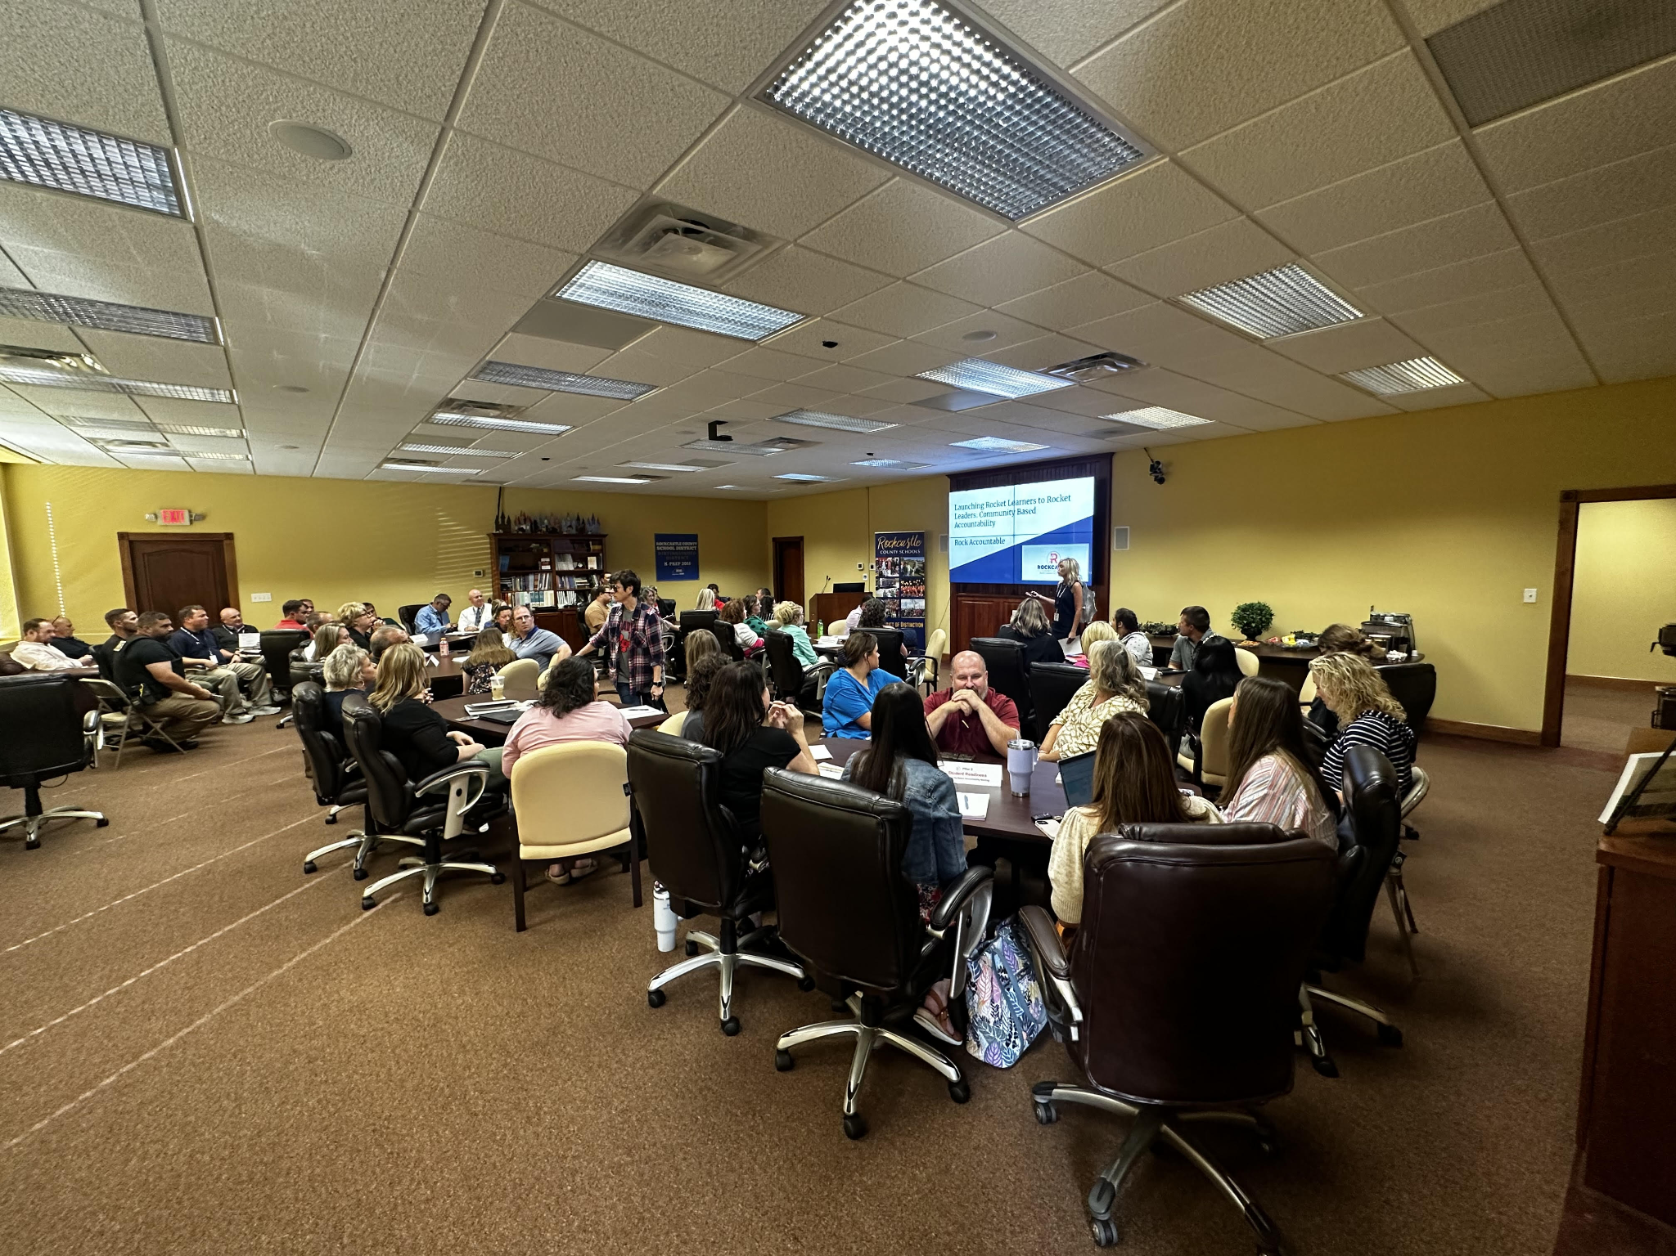
What does Community Based Accountability Mean for Rockcastle County Schools?
The Components of a Community Based Accountability Model Include:
Pillars and Key Questions
Signaling
An Annual Summary
More than Reading and Math….

Slide 35
7 Pillars of Rockcastle County Schools as Developed in Partnership With Local Community Stakeholders
Student Achievement
Student Readiness
Fiscal Systems
Operation Systems
Community Engagement and Family Partnerships
Student Support, Safety, and Well Being
Professional Learning and Staff Support

Slide 36
Using the Community Based Accountability Model to Create Innovation and Opportunity Within KY Public Schools
Questions Posed By Rockcastle Stakeholders:
How does Rockcastle County Schools innovate to better meet the needs of habitually truant students?
How does Rockcastle County Schools innovate to better meet the needs of chronically disruptive students?
How does Rockcastle County Schools innovate to better meet the needs of students experiencing mental health needs?
How does Rockcastle County Schools innovate to ensure that our students are truly ready to enter the workforce and/or post secondary education?
How does Rockcastle County Schools innovate to promote academic acceleration of students on the College Track?

Slide 38
We Must Make Schools More Responsive to Student Needs
A Story of a Student….
Depression, stress, and anxiety is the most prevalent obstacle to learning for secondary students at every grade level, six through twelve.
Overall 13 percent of middle school students and 14 percent of high school students report that they have considered suicide in the last year
How do we make our Kentucky public schools more individually responsive to the needs of our students?
Let’s end the “one size fits all” factory model of education.
FROM YOUTH AT RISK TO KIDS AT HOPE

Slide 39
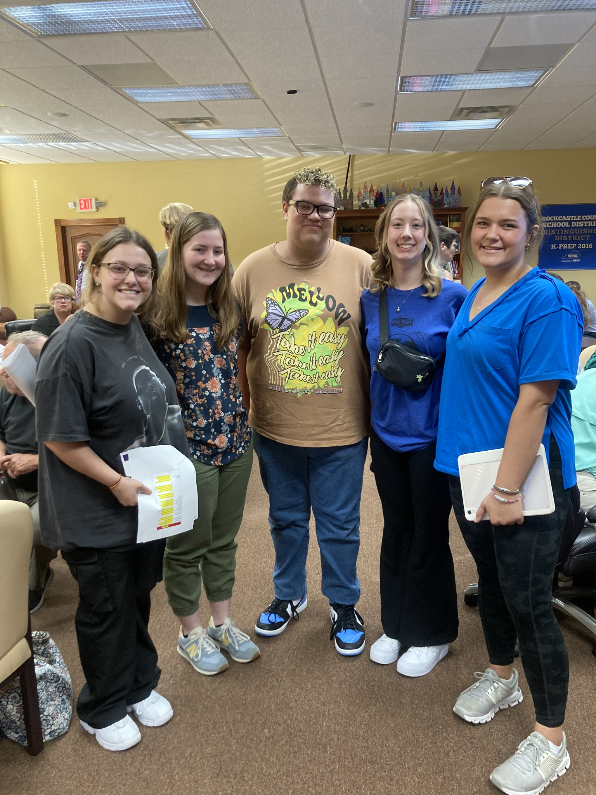
Leading with High Expectations: Visions of Innovations for Kentucky Public Schools
Expansion of the Alternative Education Model to create personalized learning opportunities for habitually truant students, students struggling with emotional regulation, and students who are chronically disruptive.
Provide personalized learning opportunities with a focus on career pathways for students in an alternative setting allowing student learning in the traditional high school classroom to continue without interruption.

Slide 40
A Picture of Innovation and Choice in the KY Public School Setting
Therapeutic setting where students can receive intensive day treatment in partnership with counselors and clinicians
Wrap around services for both students and families
Setting based on individualized relationships and personalized educational plan
Creative programing structure allowing focus on counseling, mental health supports, emotional regulation, skill development, and preparing students to be successful in the workforce
Ingrained clinical and academic partnerships

Slide 41
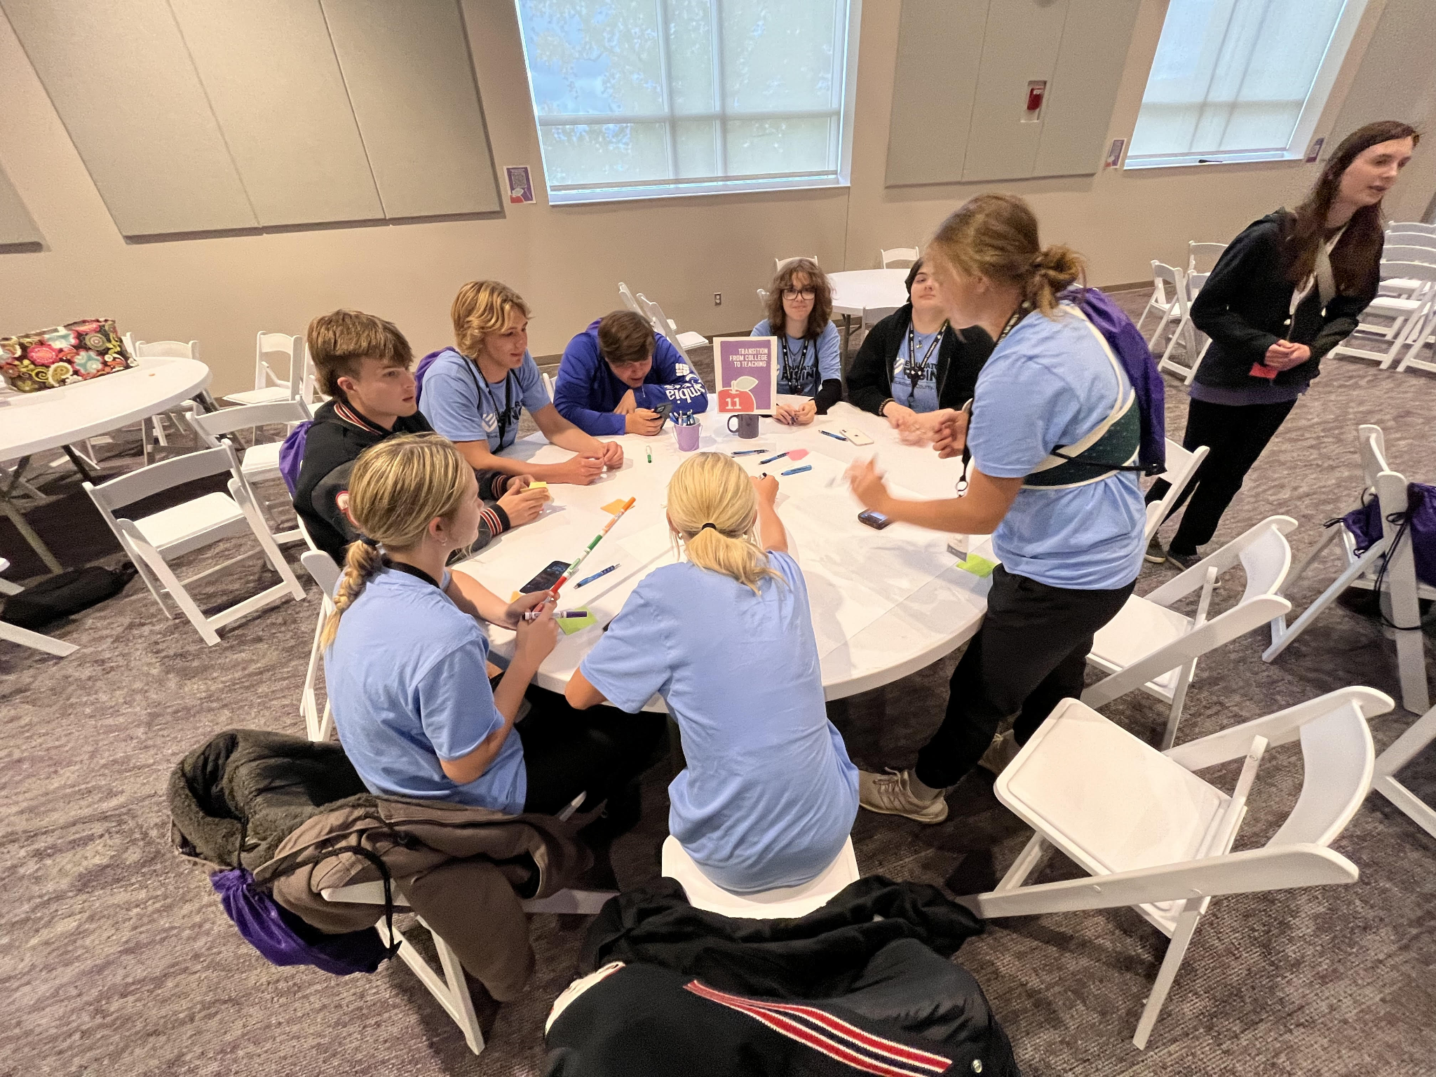
Next Steps
Task Forces to Study Innovation Opportunities in the Kentucky Public Education Model:
Community Based Accountability Models
Competency Based/Performance Based Models
Alternative Education Models
“The only limits are, as always, those of vision.”
James Broughton

