Slide 1


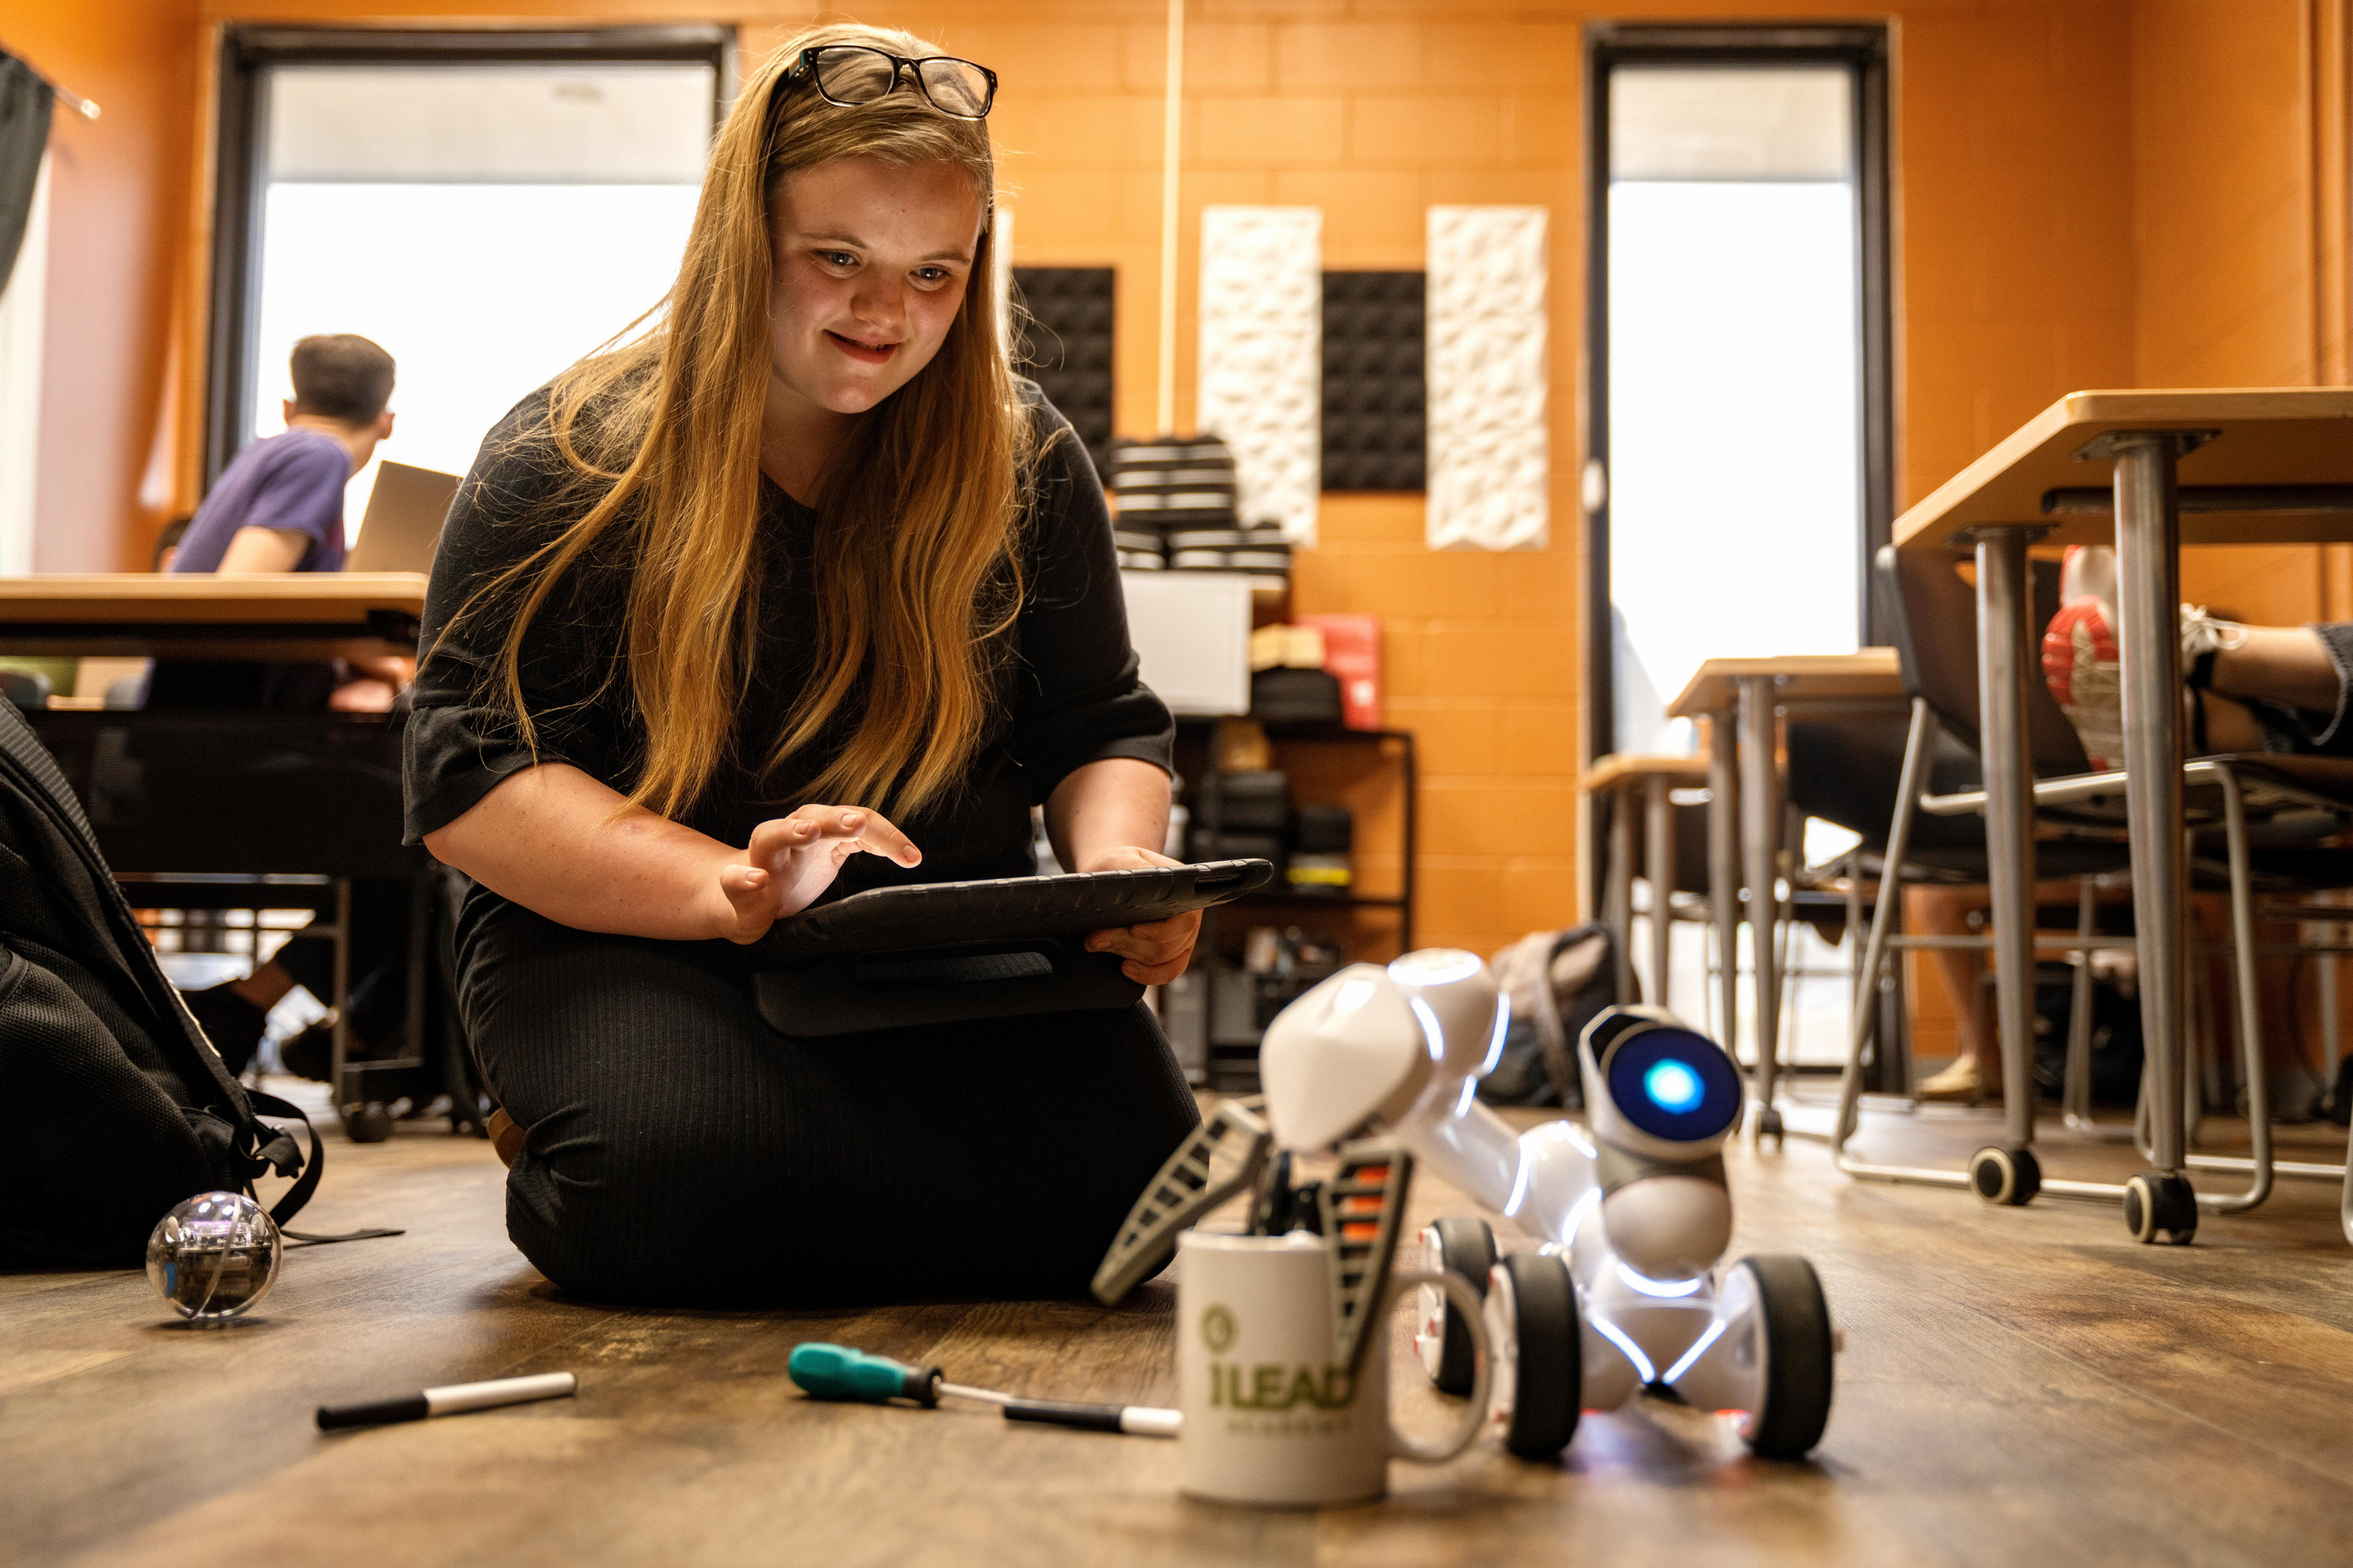

IJC on Education 2023
HIGH SCHOOL WORKFORCE DEVELOPMENT
www.ileadacademy.org

Slide 2
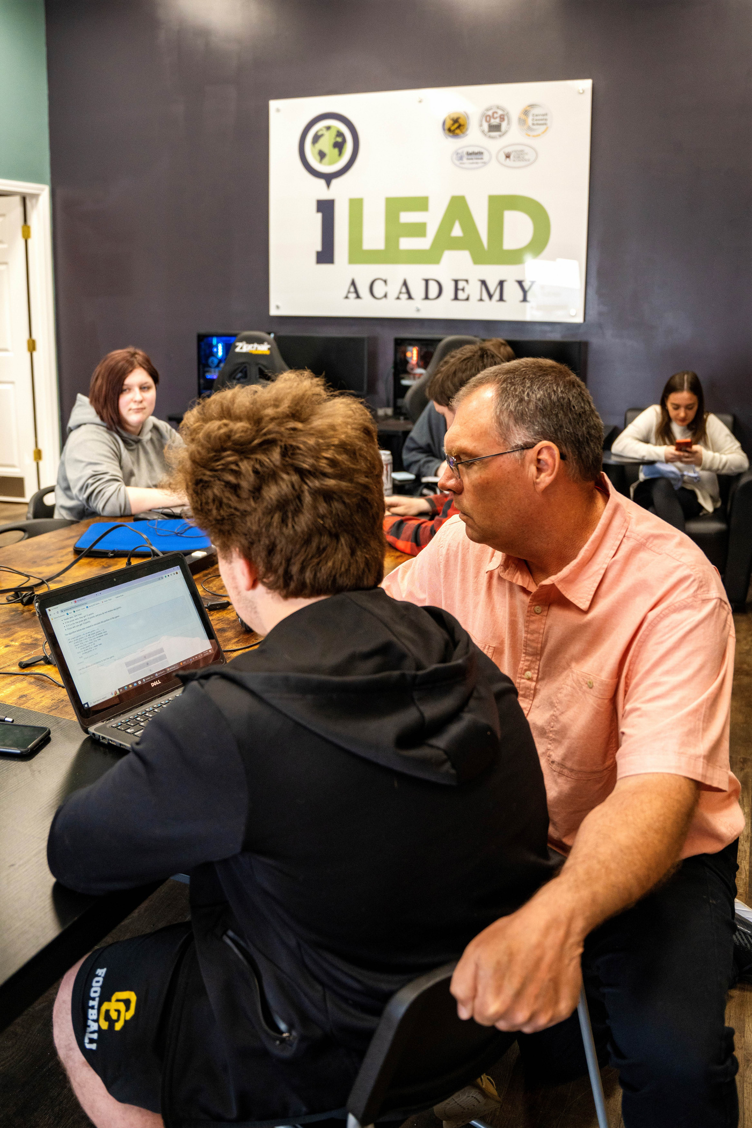

Overview
01
4-Year High School
02
Regional - serves Carroll, Gallatin, Henry, Owen, Trimble
03
Interlocal Agreement
04
District appropriation funding - $95K each
05
Superintendent board
06
KBE graduation requirement waiver
07
$250K state start-up funding in 2014

Slide 3






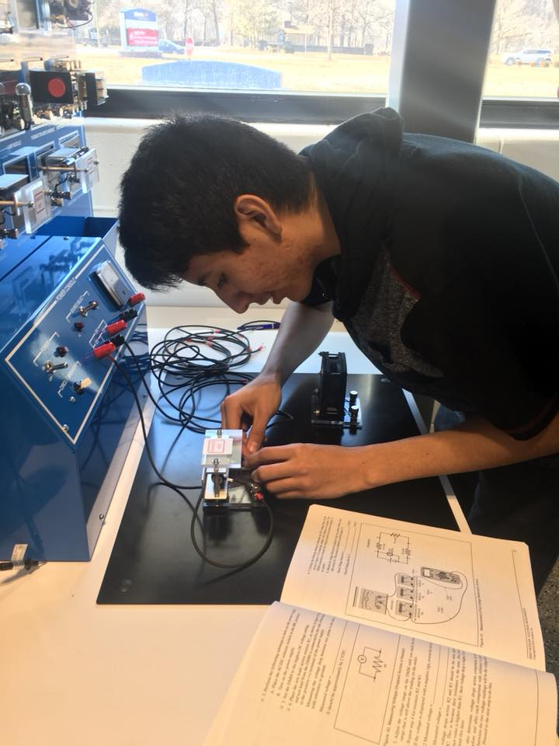
Career Pathways
01
Computer Science
02
Engineering
03
Healthcare -
pre-med, nursing
04
Technical Skills -
welding, electrical, additive manufacturing
05
STEM Teaching

Slide 4
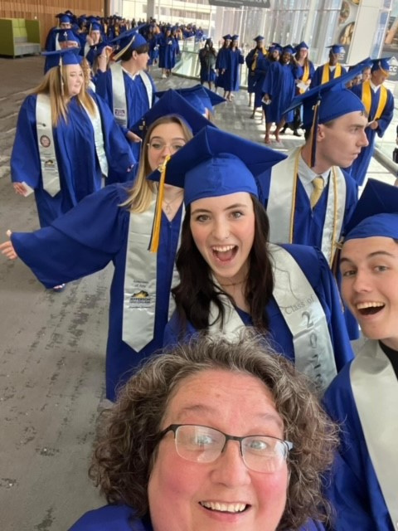





  Ready for workforce or college
  Accelerate degree completion
1st College Degree in High School
  92 Associate Degrees 75%of graduates
123 Graduates
100% academic & career ready

Slide 5
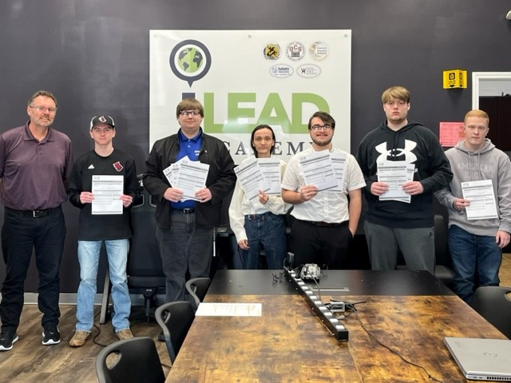


Certiport Digital Literacy IC3, Certiport IT Specialist in JAVA, Python, HTML & CSS, Tableau Desktop Specialist
Autodesk Fusion
Certified Nursing Assistant (CNA)
  Aligned to industry demand
Industry Certifications
  84.55% of graduates
123 graduates/104 industry certifications

Slide 6














Employers Lead the Way

Slide 7




Employers Need a Larger
Tech Talent Pipeline
Big Demand
Big Skills Gap
Big Opportunities
On 10/1/23:
3,300 active, online postings for computing jobs in Kentucky
(1.9x state average
demand rate)
with an average salary of $63,700
Skills development, industry certs not aligned
Degree attainment not adequate to meet demand
No focus on data literacy
35,318 jobs in KY’s computer science sector
Earning a median wage of $70,261
$30K more than $39,183 median wage for all Kentucky jobs.

Slide 8





iLEAD Has a Solution
2020 Rural Tech Project
2022 HB 680
2023 Career Z Challenge
1 of 5 most innovative ideas in the nation
Scale innovation statewide
Build innovative, virtual work based learning network

Slide 9



Lack of CS teachers, cost of providing pathways
  Rural students have less access to CS & work based learning
Problems to Solve
  Number of CS degrees earned in KY can’t meet workforce demand
Pathways/industry certs not aligned to employer demand

Slide 10






Solutions
Lower cost of providing CS pathways
Create Virtual Work Based Learning Program
Accelerate CS degree completion - 18/21 hours transferrable credit
Expand access to dual credit CS pathways - Data Science, Cybersecurity, Programming

Slide 11
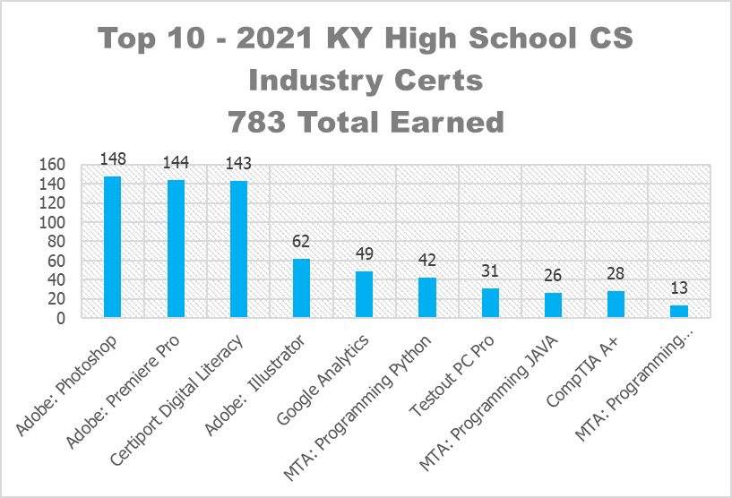
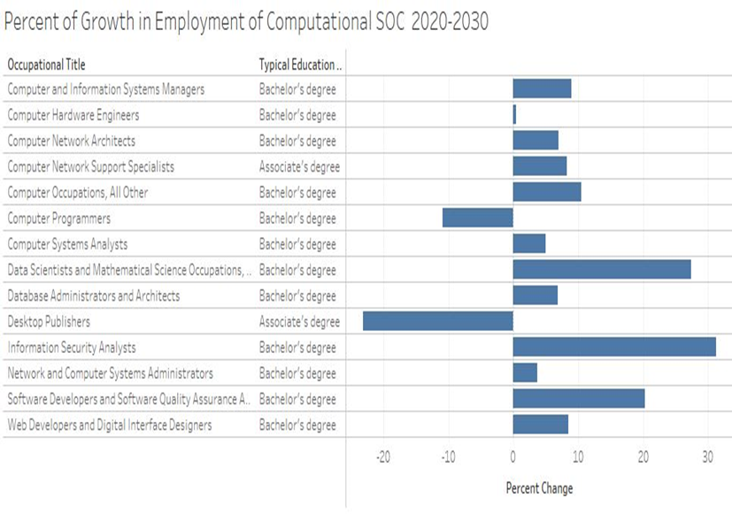
High school industry certs not aligned to employer demand

Slide 12
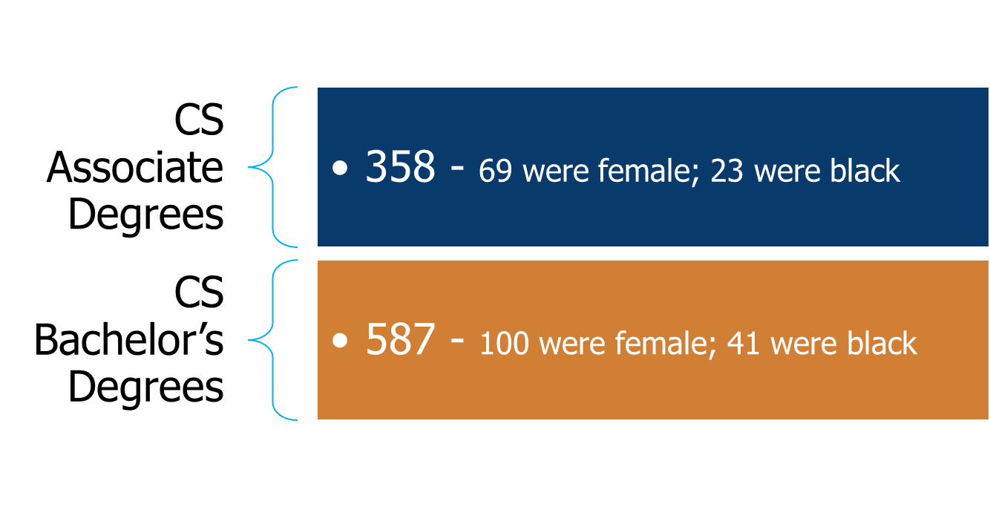
CS degrees won’t keep pace
with demand

Slide 13

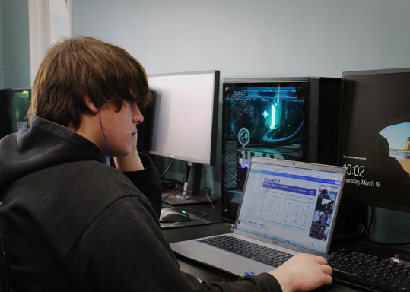
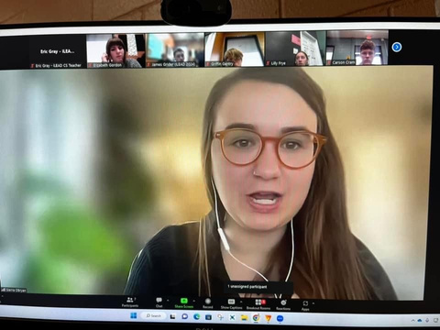





Virtual CS Academy
2-Year Pilot Results
26
Students
Completed
2 Years
63 hours college credit
7 IC3
Industry Certifications
100%
Resume
Mock Job Interview
Mentor

Slide 14





$4M Request
Biennial request for We Lead CS teaching, advising, work based learning
ROI
2024-2025 - 100 student pilot
Add 250 students per year
Graduate 200+ students a year
with 18-21 hours CS college credit
Larger, More Highly Qualified Tech Talent Pipeline
All graduate workforce ready
(resume, social media presence, network, multiple work based learning, experiences)

Slide 15
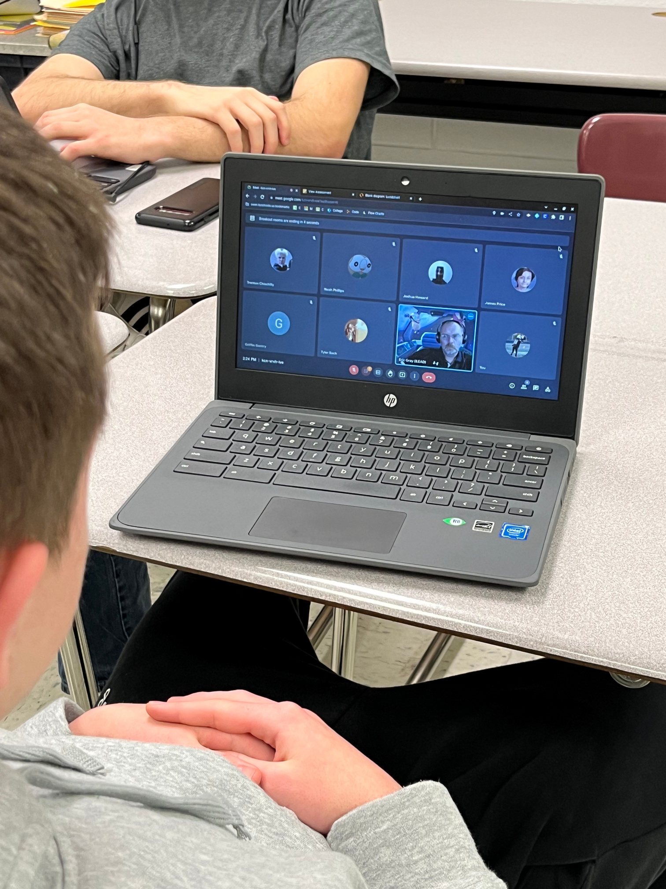

You’re Invited
Cracking the Code
How Kentucky will build its tech talent pipeline
November 15 1:00 -5:00 pm EST
Northern Kentucky University
REGISTER

Slide 16
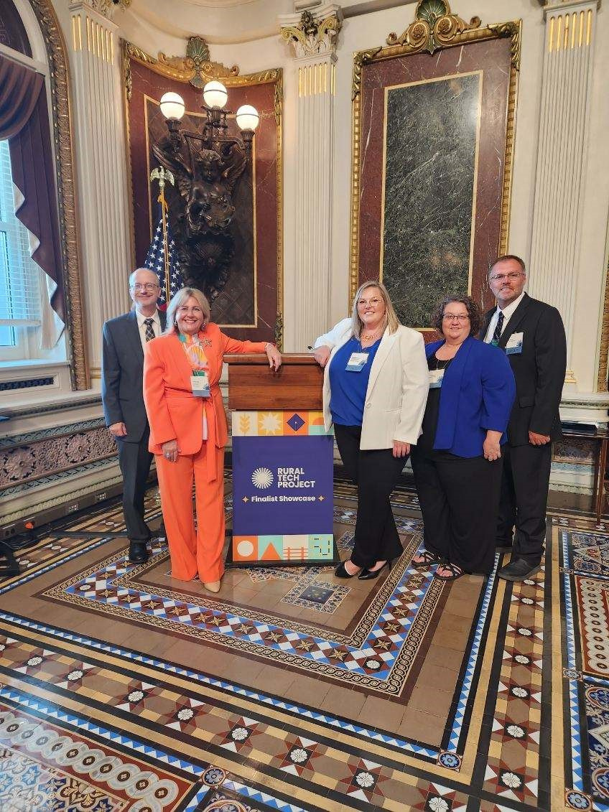




THANK YOU
Alicia J. Sells
502-475-1245
asells@ovec.org
www.ileadacademy.org
2257 US HWY 227
Carrollton, KY 41008

