Slide 1
Interim Joint Committee on Education | June 4, 2024

Slide 2
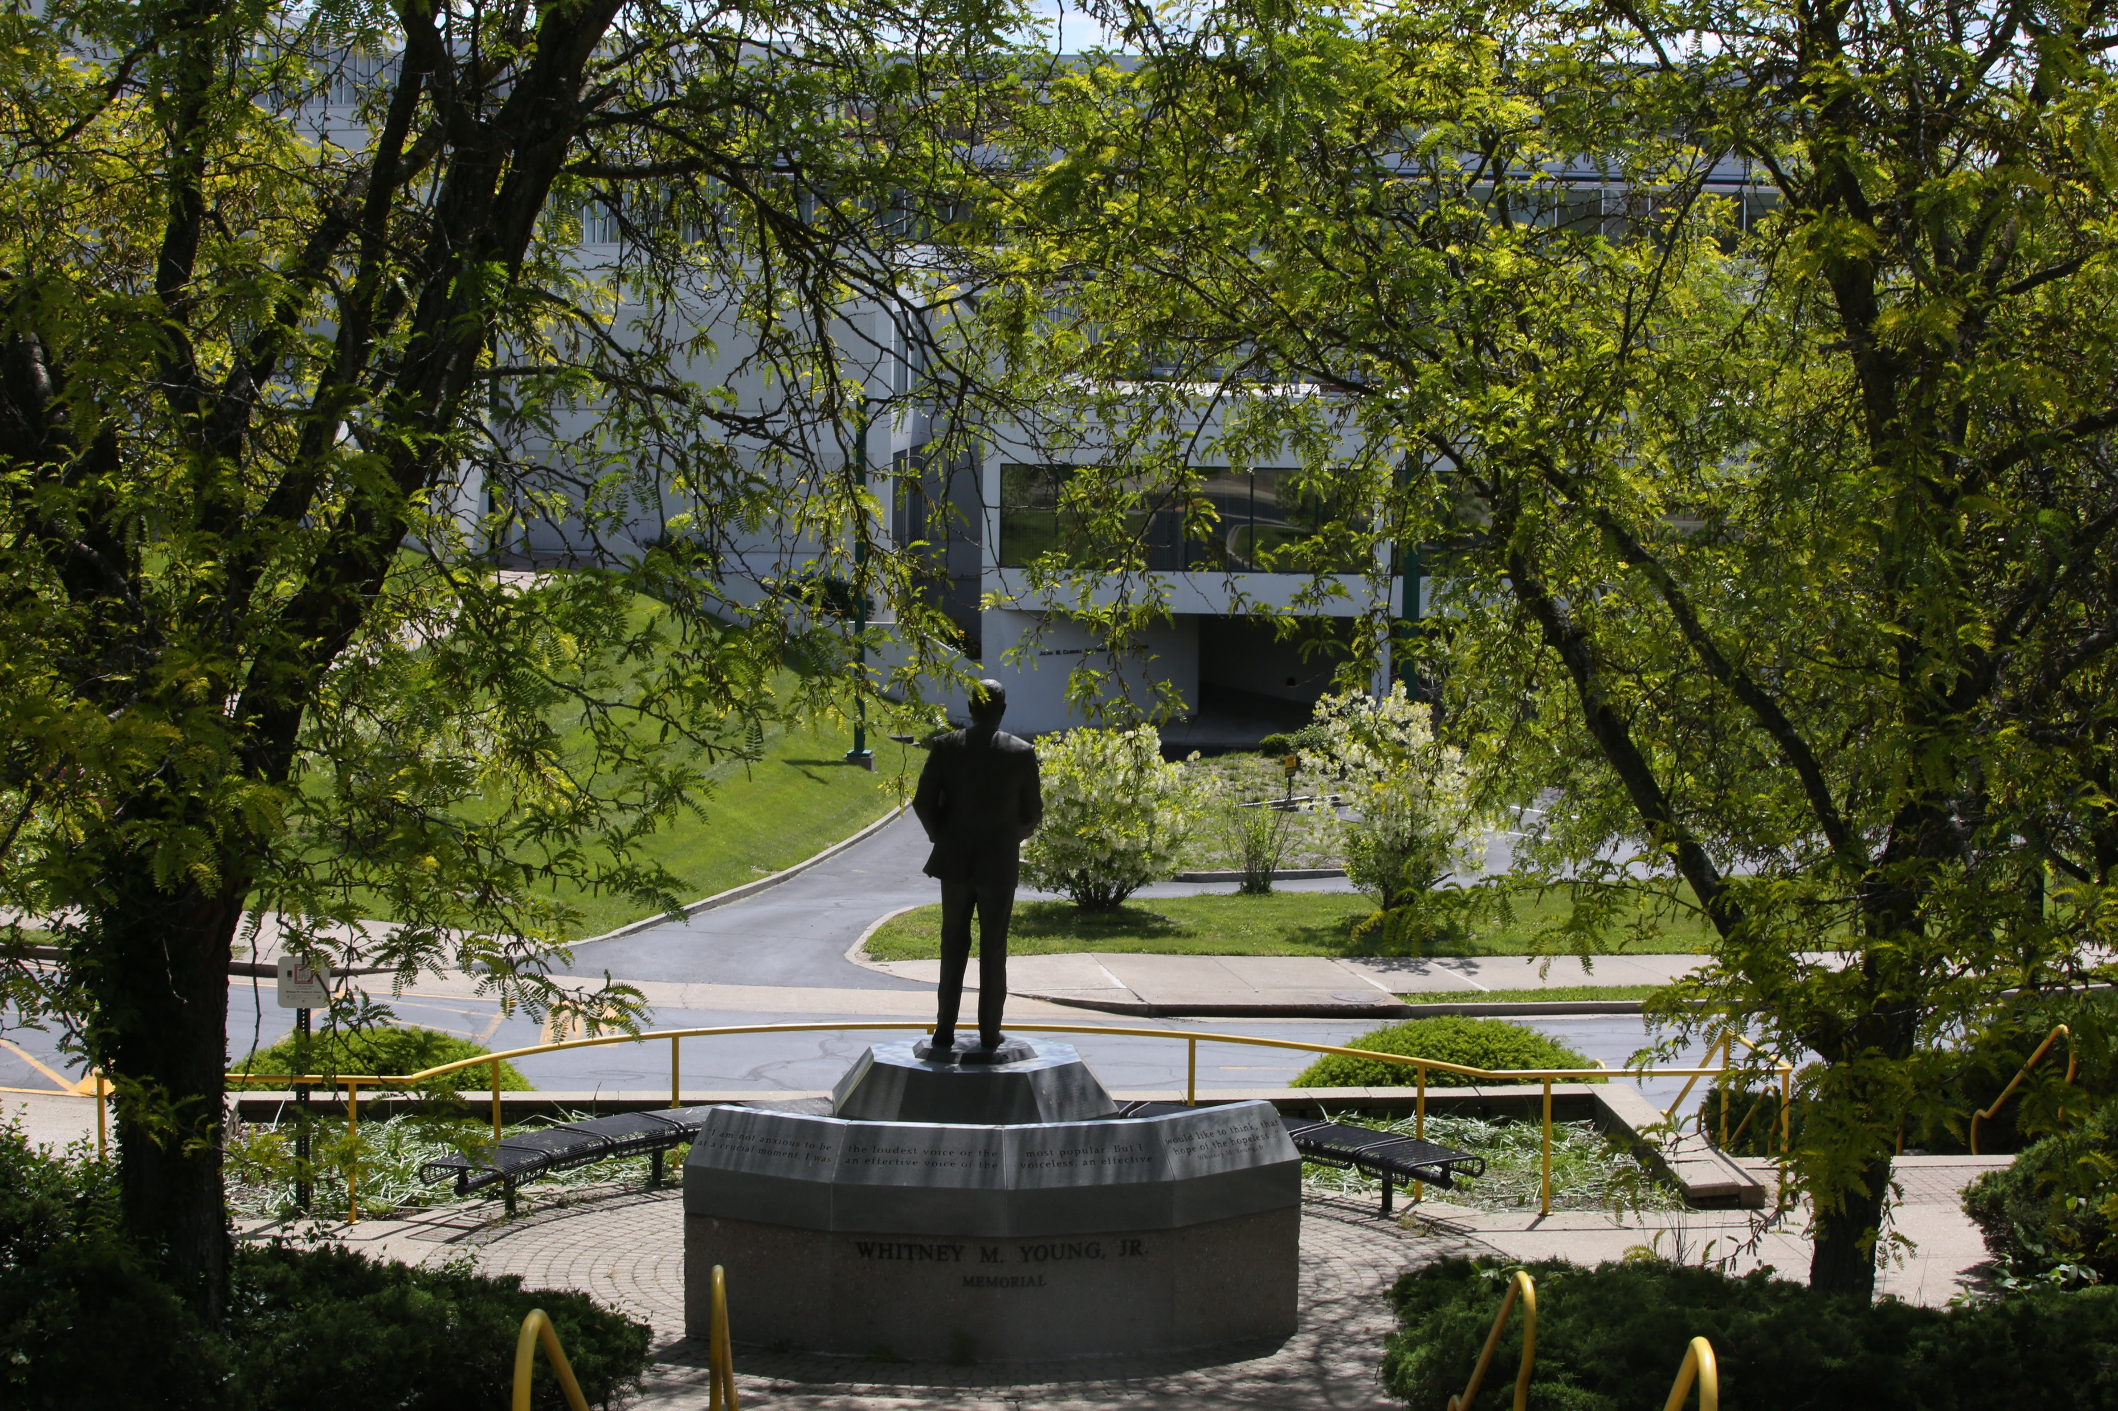

Slide 3
Agenda
Management Improvement Plan
Enrollment
Retention Rates
Financial Aid
Capital Improvement
Academic Update
1
2
3
4
5
6

Slide 4
HB 250 – Management Improvement Plan
# Objective
% Objective
Completed
53
41%
In Progress
72
55%
Pending Approval
3
2%
Removed
2
2%
Total
130

Slide 5
Enrollment
Academic Year (AY) 2024-2025
First-Time, Full-Time Freshmen
Total Applications
Applied
Scheduled Orientation
2522
1296
Completed Applications
1206
206
Admitted
In State – 41% Out of State – 59%

Slide 6
Enrollment
Academic Year 2024-2025
Transfer
Dual Credit
Graduate
Continuing
90
1000*
(Projected)
42
638

Slide 7
Outreach and Yield Efforts
Admitted Student Receptions
Assigned Advisor Outreach
Weekly Email Reminders
Campaigns:
Postcard
Stop-Out
Readmit

Slide 8
Financial Aid
Awarded approximately to KSU students in AY 23-24
For 2024-2025 FAFSA, students included KSU in their school choice
FAFSA numbers are lower than previous year due to the new FAFSA rollout
$16M
3,276

Slide 9
Financial Aid
FA staff are currently uploading the 24-25 ISIRs for fall/spring packaging (including scholarships)
Outreach via email, call campaigns, etc. are ongoing to ensure all registered students have completed the 24-25 FAFSA

Slide 10
Retention Rates
AY 22-23
AY 23-24
(Current/Projected)
61%
66.54%
75 %

Slide 11
Graduation Rates – (6 year)
AY 22-23
AY 23-24
28%
34%
7 %

Slide 12
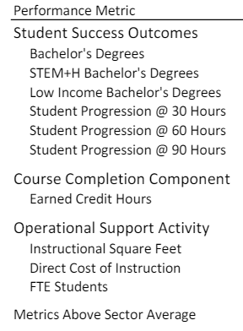
Performance Funding Model
75 %

Slide 13
Financial Overview
Permanent CFO hired March 18, 2024
Management Improvement Plan Milestones
Forecasting a surplus fund balance as of June 30, 2024

Slide 14
Health Sciences Center - Design
Appropriation
Process
RFP process begins spring of 2025 for award in July 2025
Design process = an accurate programming process of the facility and resulting budget
2024 Regular Session
HB6: $5M for design
Authorized for fiscal year 2026

Slide 15
Asset Preservation Pool - $60M
Projects Planned for 2024-2026 Biennium
Residence Hall Renovations
Miscellaneous
Chandler Hall
Kentucky Hall
Door Access Control Project
Continue MEP repairs and upgrades to the campus infrastructure
HVAC upgrades and repairs
Classroom Renovations
Carver Hall (to support the Engineering Program)

Slide 16
Academic Affairs
Academic and Student Affairs Restructuring: Established three Colleges – aligned with program offerings
New Programs:
Board approved new programs, February 16th
Program Inventory: Streamlined course offerings for General Education
Redesign First Year Experience (FYE):
RFP is posted with the intent to identify a vendor.
5 %

Slide 17
Academic Affairs
Credit for Life and Work Experience Handbook
Create a Center for Global Learning and International Student Services
5 %

Slide 18
KYSU Online
Completed and implemented the RFP Process
New policies and governance structure
Redesigned curriculum maps
Faculty professional development
Marketing campaign underway
KYSU Online “Thorobreds Going Global” - June 1st public launch
7 %

Slide 19
KYSU Online
Programs Scheduled for Fall 2024 Bachelor of Criminal Justice
Bachelor of Social Work (Proposed)
Bachelor Cybersecurity (Pending CPE Approval)
Bachelor Business Administration
Bachelor of Liberal Studies (Interdisciplinary Studies)
Doctor of Nursing Practice
RN to BS Nursing
5 %

Slide 20
KYSU Online
Programs Scheduled for Spring 2025
Master’s in Business Administration
Master of Arts in Interdisciplinary Behavior Science
Masters in Social Work (Proposed)
Masters in Criminal Justice (Proposed)

