Slide 1
Instructional Resource Adoption and Implementation
Interim Joint Committee on Education
June 4, 2024
Micki Ray
Chief Academic Officer

Slide 2
Statutory Basis KRS 156.405
“(1) The purpose of the State Textbook Commission is to provide a recommended list of current and high quality textbooks and instructional materials to local school districts that complement the educational program in Kentucky schools; to provide a consumer guide to schools to aid with the selection of materials; and to provide for public participation in the evaluation process.”
“(2) The Department of Education and the State Textbook Commission shall receive assistance in the textbook evaluation process from professionals and lay citizens who will be referred to in this chapter as the ‘textbook reviewers.’”

Slide 3
Overview of Statutory Responsibilities Per KRS 156.405
State Textbook Commission (STC)
Textbook Reviewers
Direct the activities of the textbook reviewers
Develop and approve selection and evaluation criteria
Recommend a list of high-quality materials
Provide for public comment
Publish and distribute consumer guides
Develop subject-specific evaluative criteria to be used in reviewing textbooks and programs
Review textbooks and programs to determine those of high quality for approval by the commission
Ensure that textbooks are free from factual error

Slide 4
Changing Landscape of Instructional Resources

Slide 5
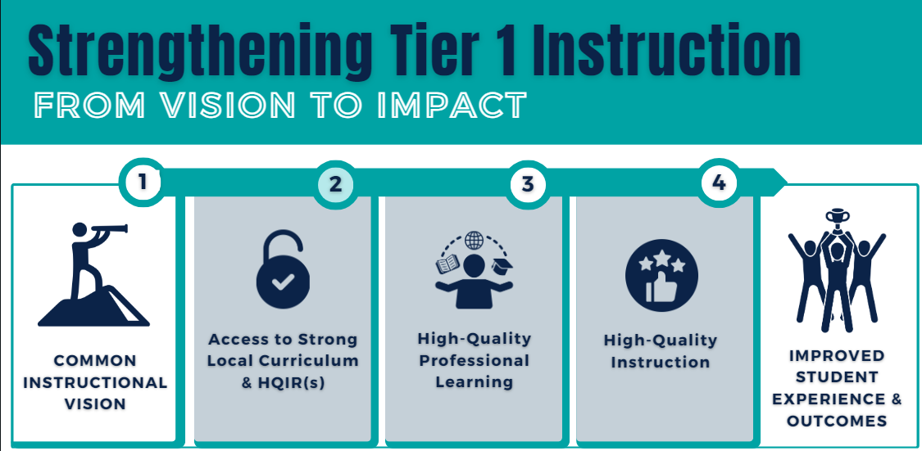

Slide 6
High-Quality Instructional Resources (HQIRs)
The KDE defines HQIRs as materials that are:
Aligned with the Kentucky Academic Standards;
Research-based and/or externally validated;
Comprehensive to include engaging texts (books, multimedia, etc.), tasks, and assessments;
Based on fostering vibrant student learning experiences;
Culturally relevant, free from bias; and
Accessible for all students.

Slide 7
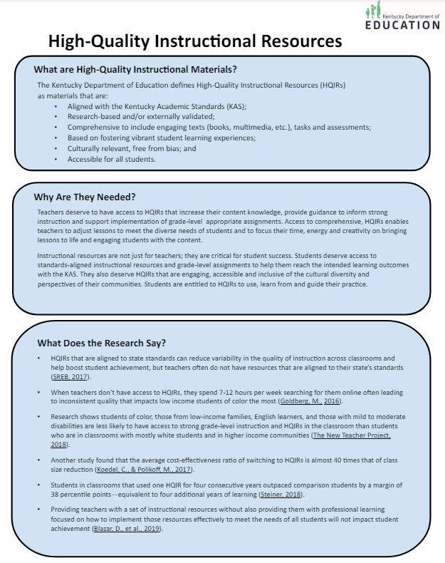
Positive Impacts of HQIRs
HQIRs that are aligned to state standards can reduce variability in the quality of instruction across classrooms and help boost student achievement (SREB, 2017).
Students in classrooms that used one HQIR for four consecutive years outpaced comparison students by a margin of 38 percentile points — equivalent to four additional years of learning (Steiner, et. al. 2018).
Teachers reported spending 7 hours per week or 250 hours per year developing or selecting instructional materials (Goldberg, M., 2016).
The effect on learning when using a HQIR is the same as moving an average performing teacher to one at the 80th percentile (Jackson et. al., 2017).
Teachers using HQIRs engaged students in mathematical practices at a significantly higher rate than teachers who did not have access to aligned curriculum, (Opfer et. al., 2018).
Goldberg, M. (2016). Classroom Trends: Teachers as Buyers of Instructional Materials and Users of Technology. K-12 Market Advisors. Retrieved from: https://mdreducation.com/reports/classroom-trends-teachersbuyers-instructional-materials-users-technology/
Jackson, K., Makarin, A. (2016-2017). Can Online On-the-Shelf Lessons Improve Student Outcomes? Evidence from a Field Experiment. American Economic Journal: Economic Policy, Vol 10 (3), pages 226-254. Retrieved from: https://www.nber.org/papers/w22398
Southern Regional Education Board (SREB). (2017). Alignment of Instructional Materials Trends in State Efforts. Retrieved from: https://insights.sreb.org/reports/instructionalmaterials.pdf
Steiner, D., Magee, J., and Jensen, B. What we teach matters how quality curriculum improves student outcomes. Johns Hopkins Institute for Education Policy. Retrieved from: https://jscholarship.library.jhu.edu/server/api/core/bitstreams/050bc165-4c10-4808-8959-e4e29f6c8880/content

Slide 8
KDE Actions and Recommendations to Support HQIR Selection and Implementation

Slide 9
Review and Selection
Guidance and Resources
Quality Curriculum Taskforce (QCT):
21 members composed of district leaders, teachers, library specialists, educational cooperative representatives, and university faculty
Review guidance and provide feedback on the tools and resources needed for local HQIR evaluation and selection
Kentucky Academic Standards (KAS) Advisory Panels and Review Committee:
Members serve as instructional resource reviewers
Advise on the markers of HQIRs by content area
Provide feedback on the alignment of the KAS to instructional resources
Local HQIR Coordinators
Model Curriculum Framework
Establishes a curriculum development process, including the selection of HQIRs
Consumer Guides
Reading and Writing
Mathematics
Science
Instructional Resource Alignment Rubrics
Reading and Writing
Mathematics
Science
Social Studies

Slide 10
Overview of KDE Recommendations
Rename commission to denote shifts in instructional resource adoption vs. textbooks only
Repurpose commission to focus on supporting local districts in the evaluation, selection, and use of HQIRs
Modify responsibilities to maximize efforts:
Develop and approve selection criteria and evaluation forms for the review of instructional resources at the local level per KRS 160.345
Publish consumer guides to support schools and districts in implementation
Rather than reviewing all materials, provide feedback on gateways, selection criteria, and evaluation tools to ensure alignment to the KAS for local resource review
Engage more stakeholders as active participants in the process:
Quality Curriculum Task Force – 21 members
Advisory Panels and Review Committee members per KRS 158.6453
Tools for public/community involvement and feedback
Repurpose funding and direct it toward local district use and purchase of HQIRs
Require reporting of resource adoption to the KDE

Slide 11
Questions?
Micki Ray
Chief Academic Officer
micki.ray@education.ky.gov

