Slide 1
Kentucky Office of Adult Education
Interim Joint Committee on Education
June 4th, 2024

Slide 2
Presenter
Dr. John Gregory, Executive Director, Office of Adult Education

Slide 3
Topics to Discuss
Purpose of Adult Education
Mission Statement & Goals
Data & Statistics
Testimonials & Success Stories
Budget
Looking Ahead

Slide 4
Adult Education per the Workforce Innovation & Opportunity Act (WIOA), 2014
“Adult education” is academic instruction and education services below the postsecondary level
Assist adults in obtaining knowledge and skills for employment and economic self-sufficiency
Full partners in educational process of their children
Improve economic opportunities for their family
Assist adults in attaining a secondary school diploma/HSE (GED) and in transition to postsecondary education/training including career pathways
Assist individuals who are English language learners

Slide 5
Mission Statement
Our Mission is to work with Kentuckians to improve their quality of life through education, training, and employment so they can take care of themselves and their families and help their communities and the state’s economies expand and thrive.

Slide 6
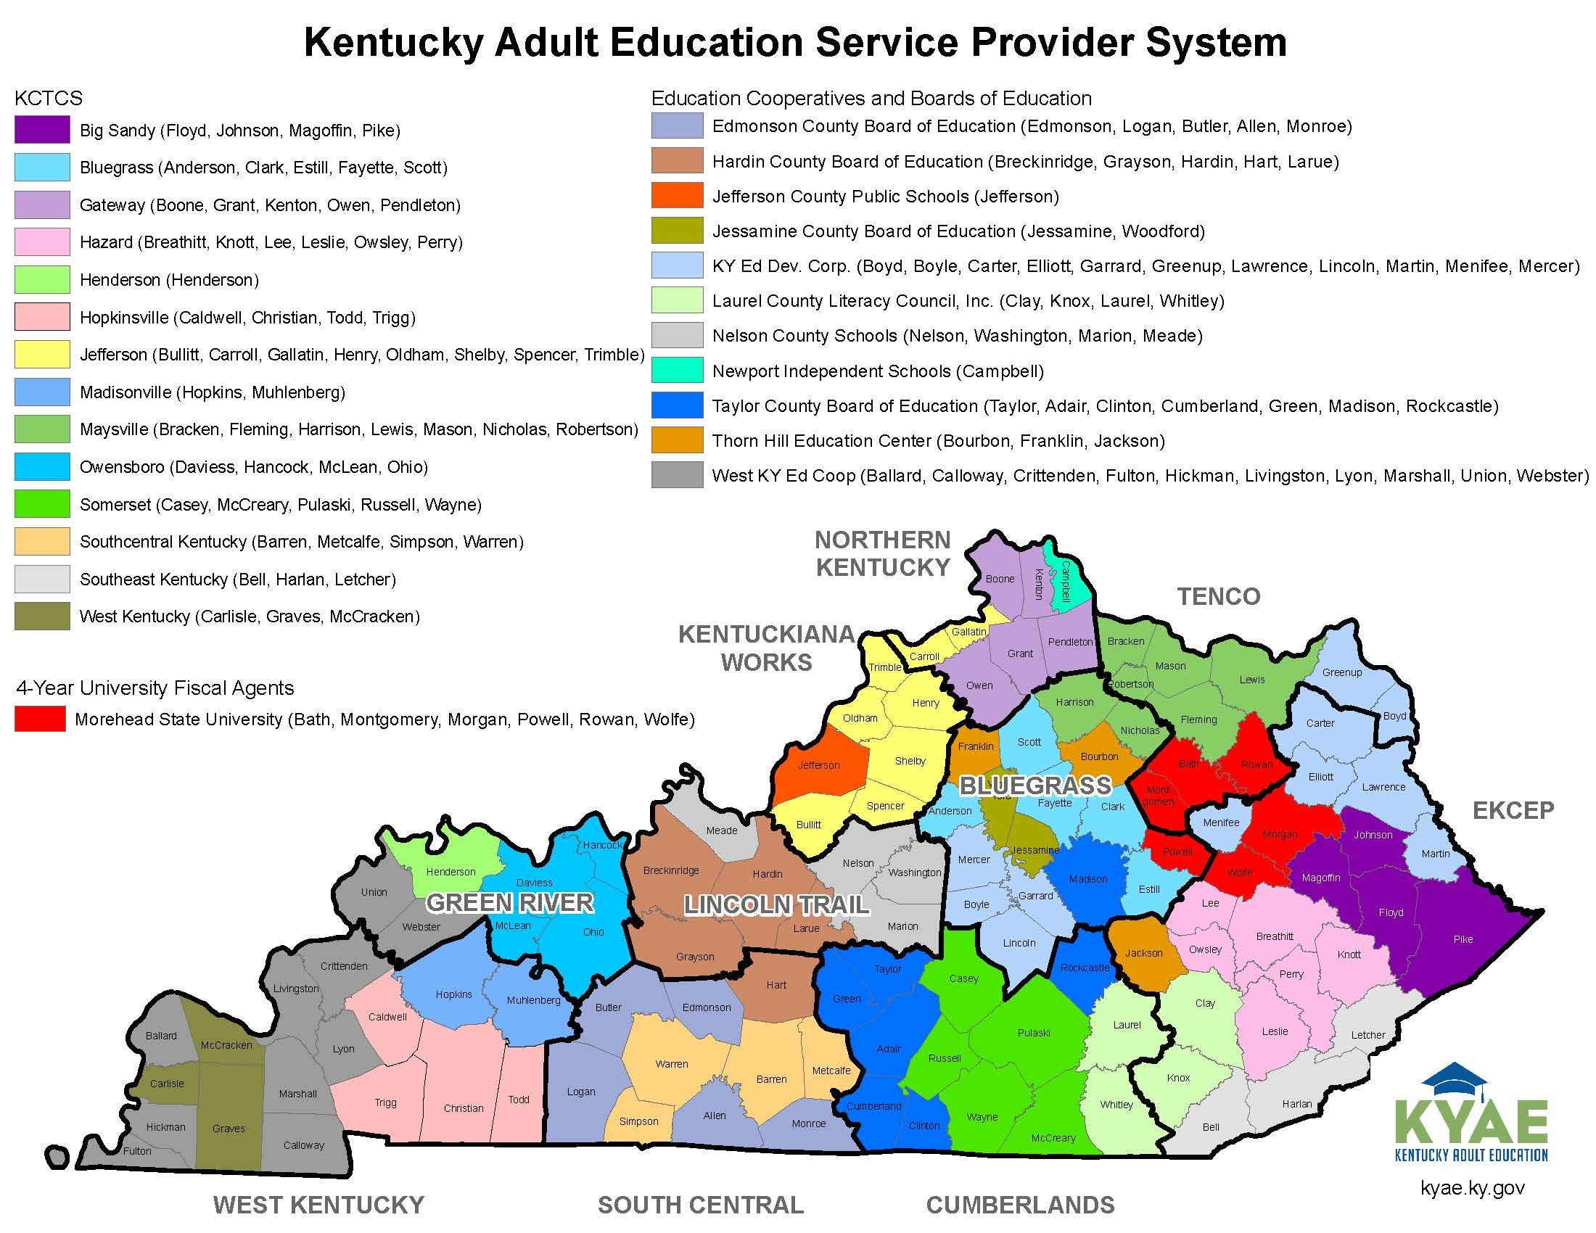
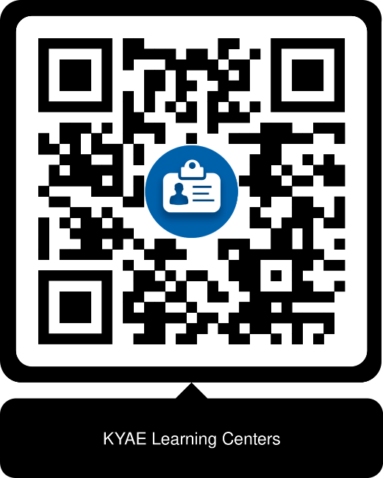
ADULT EDUCATION SERVICE PROVIDER SYSTEM
Notes:
KCTCS
Non-profit – 1
Board of Education
Consortiums
University

Slide 7
Goals (Federal - US Department of Education)
Employment Rate (2nd/4th Quarter After Exit): The % of participants who are in unsubsidized employment after exit from the program
Median Earnings (2nd Quarter After Exit): The median earnings of participants who are in unsubsidized employment during the 2nd Quarter after exit from the program
Credential Attainment Rate: The % of participants who attain a recognized postsecondary credential or a secondary school diploma (only if participant is employed or enrolled in education/training program leading to a recognized postsecondary credential)
Measurable Skill Gains (MSG): The % of participants who are in an education/training program that leads to a postsecondary credential or employment who achieve an MSG, defined by documented academic, technical, occupational , or other forms of progress, towards such a credential or employment

Slide 8
Measurable Skill gains
Measurable Skill Gains
Secondary Diploma/ Equivalent
Progress Toward Milestones
Secondary or Postsecondary Transcript
Program Exit + Entry Into Postsecondary Education
Educational Functioning Level Gain
Pre-Post Test
Completion of Carnegie Units
Passing Technical/ Occupational Knowledge-Based Exam

Slide 9
Data (Federal Requirements)
Program Years (PY) 2023-2026
Surpassed all Goals in PY 22 (FY 23)
KY ranks 15 out of 56 (states/territories) for MSG Rate
PERFORMANCE INDICATORS | PY 2023 (FY 2024) Negotiated Level | PY 2024 (FY 2025) Negotiated Level | PY 2025 (FY 2026) Negotiated Level
Employment (2nd QTR After Exit) | 40.20% | 42.50% | 43.00%
Employment (4th QTR After Exit) | 42.20% | 46.00% | 46.50%
Median Earnings (2nd QTR After Exit) | $4,125.00 | $4,550.00 | $4,600.00
Credential Attainment Rate | 39.60% | 39.60% | 40.60%
Measurable Skill Gains (MSG) | 46.20% | 51.50% | 52.00%

Slide 10
Data (State & Federal Goals)
As of May 20th, 2024:
GOAL | FY 24 | FY 23 | % Change | FY 24 GOAL | % of GOAL
Enrollment | 12,656 | 11,284 | 12% | 16,000 | 79.1%
MSG | 47% | 46% | 1% | 46.20% | 101.7%
GED | 2,602 | 2,553 | 2% | 3,600 | 72.3%

Slide 11
Data (GED-Related)
FY 24 (As of 20 May)
FY 21 (Pandemic)
141 Test Centers
Natl Pass Rate: 75%
KENTUCKY | FY 19 | FY 20 | FY 21 | FY 22 | FY 23 | FY 24
Pass Rate | 84% | 80% | 78% | 80% | 79%
Passers (GED Attainment) | 3,332 | 2,843 | 2,081 | 2,679 | 2,961 | 2,602
Completers (All 4 Tests) | 3,949 | 3,564 | 2,659 | 3,362 | 3,729 | 3,178
Test Takers | 5,990 | 6,165 | 4,494 | 5,852 | 6,539 | 5,862

Slide 12
KENTUCKY | FY 21 | FY 22 | FY 23 | FY 24
Education Functional Level (ED Level +) | 1,494 | 2,433 | 3,951
GED | 1,128 | 1.767 | 2,256
IET/WPL | 0 | 291 | 519
Data (MSG-Related)
Historic high for IET and WPL MSGs
FY 21 = 0 compared to FY 23 = 519)
Integrated Education & Training (IET): Literacy activities/instruction concurrently and contextually with workforce preparation activities/training for a specific occupation for Education/Career Advancement
Workplace Literacy (WPL): Adult Education activities in collaboration with an employer at a workplace/off-site that is designed to improve the productivity in the workplace

Slide 13
Testimonials & Success Stories
Education and training that have led to employment and conditions for economic self-sufficiency
Putting Kentuckians First (PKF) success stories
Emerging trends in Putting Kentuckians First
Partnerships

Slide 14
Notes:
Maria Hill
Bullying kept Maria from finishing high school and getting her diploma. But thanks to Kentucky Adult Education, she was able to get her G.E.D. in just three months. “After I got my GED, I cried,“ says Maria. “I was just ecstatic. I have officially conquered something that I thought that I was a failure at.” Maria is currently working on her Master’s degree and looking forward to reaching her life and career goals.
Danielo Pickett
Danielo Pickett came to Bowling Green from his native Haiti, where he was just one month away from graduating high school when a devastating earthquake struck. After relocating to Kentucky, Danielo earned his G.E.D. through Kentucky Adult Education. “If you have the GED, it opens many doors to help you get further where you want to go,” says Danielo. Today he is a welder, and is on track to become a process engineer.
Sheng Xia Ding
When Sheng Xia Ding came to Kentucky from China, she couldn’t speak English. Now she can, after completing an English as a Second Language program and getting her G.E.D. through Kentucky Adult Education. “The GED can give me a better future and a better life, and I can be a role model for my kids.”

Slide 15
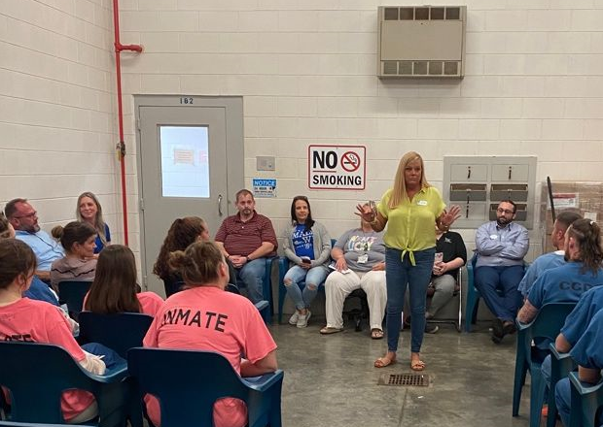
Putting Kentuckians First (PKF)
A juvenile was referred to the Reentry and Employment Services Branch upon his release, under house arrest.
The county attorney requested a career plan, employment, and GED attainment as terms for release. The reentry services coordinator immediately contacted the local adult education center, who promptly assisted the school system with documentation needed to get the juvenile started with the process of obtaining his GED.
This juvenile is currently working toward earning his GED and obtaining employment while having the support of the local adult education center, and and the Reentry and Employment Services Branch.
Notes:
The RES Branch was referred a Juvenile young man by the Russell County Attorney in District court. This individual was just released from 6 months in the Regional Juvenile Detention Center and is continuing to serve a sentence under house arrest. The County Attorney requested a career plan, employment, and the completion of his HSE. This young man comes from a generational cycle of poverty, substance abuse, and incarceration. The County Attorney has enough trust in the Reentry and Employment Service Branch to allow us to help in changing the mindset and life of this juvenile, and we were asked to assist in a job and education. RES immediately contacted our local Adult Education office, and they promptly assisted the school system with all the paperwork they needed for the juvenile to start the process of obtaining his GED. The District Judge and County Attorney are both agreeable to allow this individual release from his home incarceration to go in person to work on his GED. Upon speaking with our local Adult Education office, we agreed that we should make his schedule as structured as possible. It is very important to note that this juvenile will turn 18 in October, so there is little time to make a huge impact and difference in the changing the trajectory of his life. This young man is currently working towards his HSE, is completing the proper steps to obtain employment while having the support of the Local Adult Education Office and the Reentry and Employment Services Branch. This is also a prime example of the level of trust that has been established with the Judicial System.

Slide 16
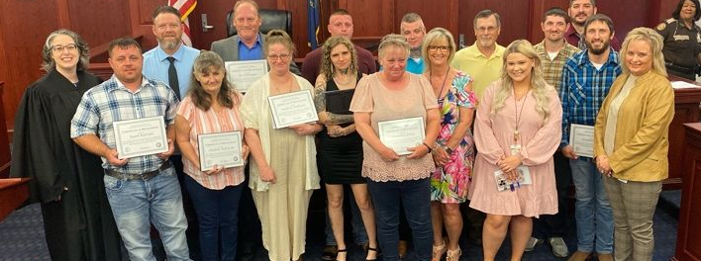
Putting Kentuckians First (PKF)
Notes:
The RES Branch was referred a Juvenile young man by the Russell County Attorney in District court. This individual was just released from 6 months in the Regional Juvenile Detention Center and is continuing to serve a sentence under house arrest. The County Attorney requested a career plan, employment, and the completion of his HSE. This young man comes from a generational cycle of poverty, substance abuse, and incarceration. The County Attorney has enough trust in the Reentry and Employment Service Branch to allow us to help in changing the mindset and life of this juvenile, and we were asked to assist in a job and education. RES immediately contacted our local Adult Education office, and they promptly assisted the school system with all the paperwork they needed for the juvenile to start the process of obtaining his GED. The District Judge and County Attorney are both agreeable to allow this individual release from his home incarceration to go in person to work on his GED. Upon speaking with our local Adult Education office, we agreed that we should make his schedule as structured as possible. It is very important to note that this juvenile will turn 18 in October, so there is little time to make a huge impact and difference in the changing the trajectory of his life. This young man is currently working towards his HSE, is completing the proper steps to obtain employment while having the support of the Local Adult Education Office and the Reentry and Employment Services Branch. This is also a prime example of the level of trust that has been established with the Judicial System.

Slide 17
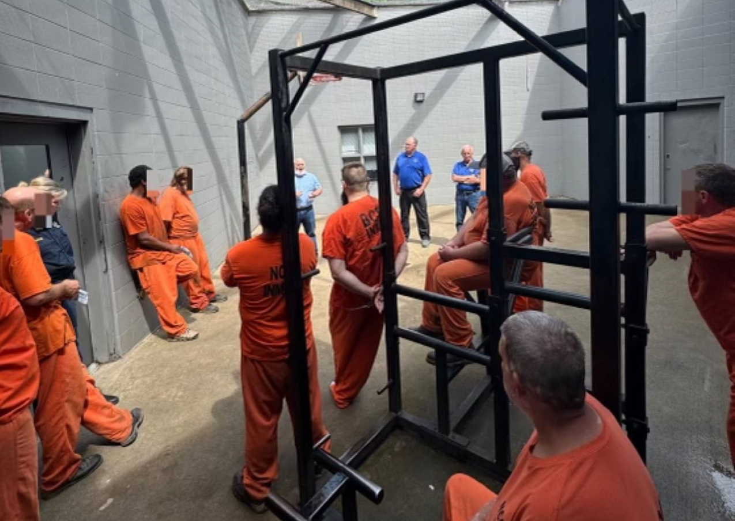
Putting Kentuckians First (PKF)
Nelson County Detention Center has initiated several programs to help inmates secure jobs to stop the revolving door of incarceration.
Nelson County Adult Education in partnership with the Welding Institute of Bardstown affords inmates the opportunity to be certified welders with guaranteed employment upon their release.
This is a significant milestone in providing employment opportunities and helping inmates break the cycle of incarceration.
Notes:
The RES Branch was referred a Juvenile young man by the Russell County Attorney in District court. This individual was just released from 6 months in the Regional Juvenile Detention Center and is continuing to serve a sentence under house arrest. The County Attorney requested a career plan, employment, and the completion of his HSE. This young man comes from a generational cycle of poverty, substance abuse, and incarceration. The County Attorney has enough trust in the Reentry and Employment Service Branch to allow us to help in changing the mindset and life of this juvenile, and we were asked to assist in a job and education. RES immediately contacted our local Adult Education office, and they promptly assisted the school system with all the paperwork they needed for the juvenile to start the process of obtaining his GED. The District Judge and County Attorney are both agreeable to allow this individual release from his home incarceration to go in person to work on his GED. Upon speaking with our local Adult Education office, we agreed that we should make his schedule as structured as possible. It is very important to note that this juvenile will turn 18 in October, so there is little time to make a huge impact and difference in the changing the trajectory of his life. This young man is currently working towards his HSE, is completing the proper steps to obtain employment while having the support of the Local Adult Education Office and the Reentry and Employment Services Branch. This is also a prime example of the level of trust that has been established with the Judicial System.

Slide 18
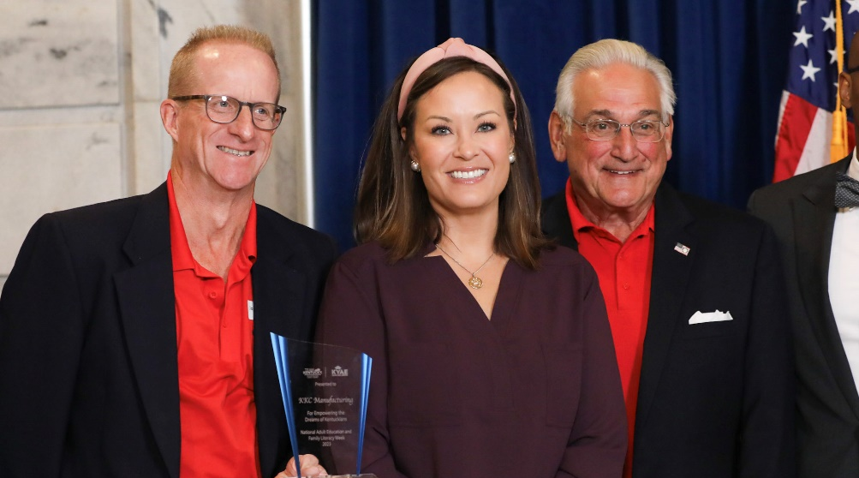
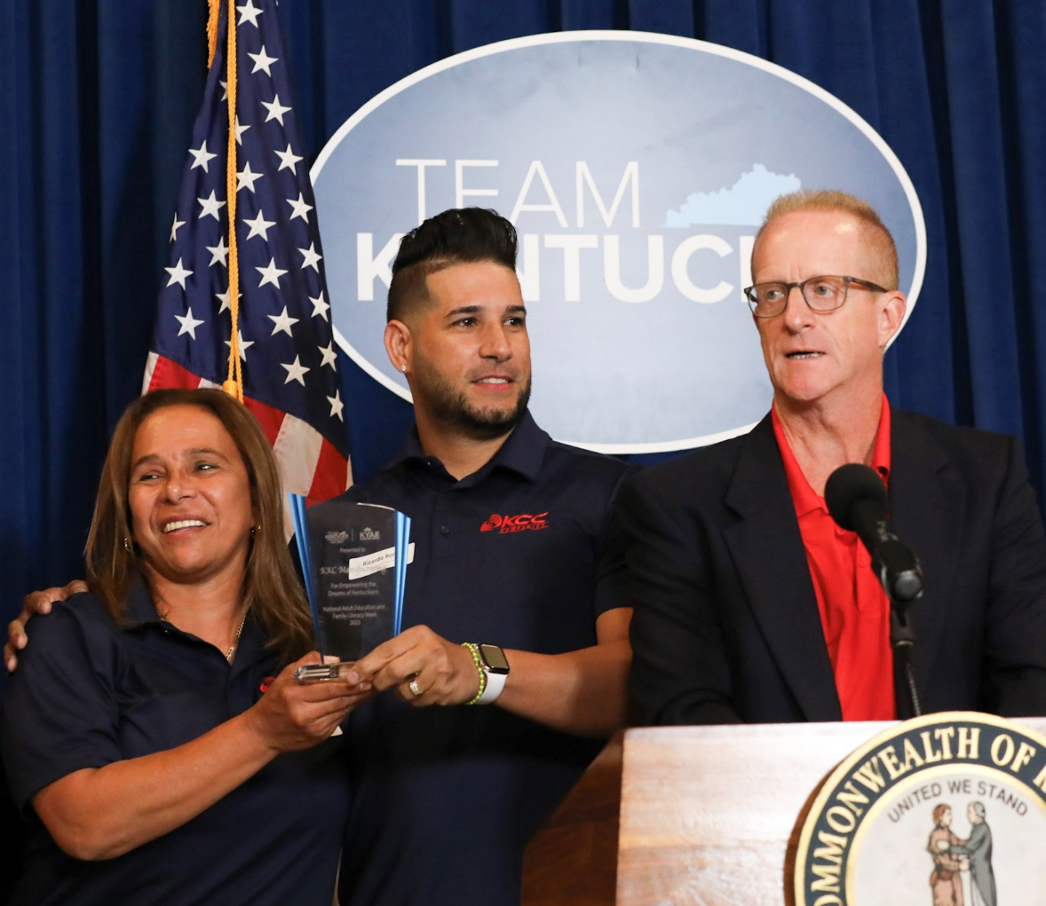
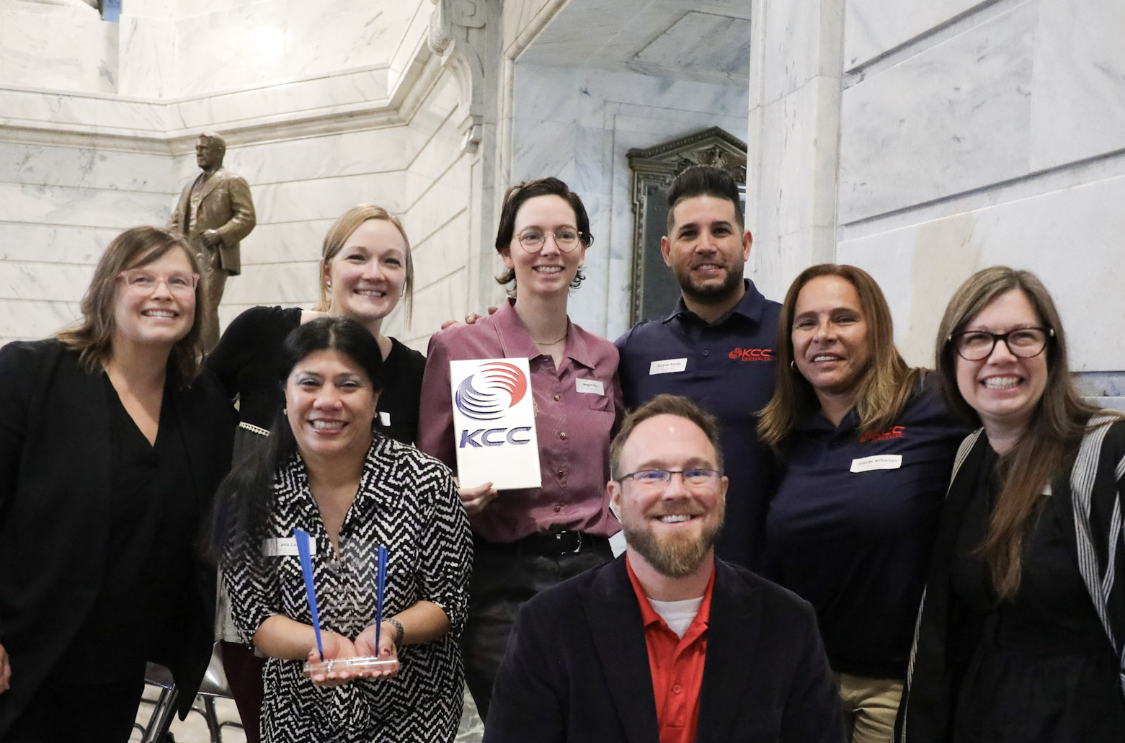
Partnership Spotlight

Slide 19
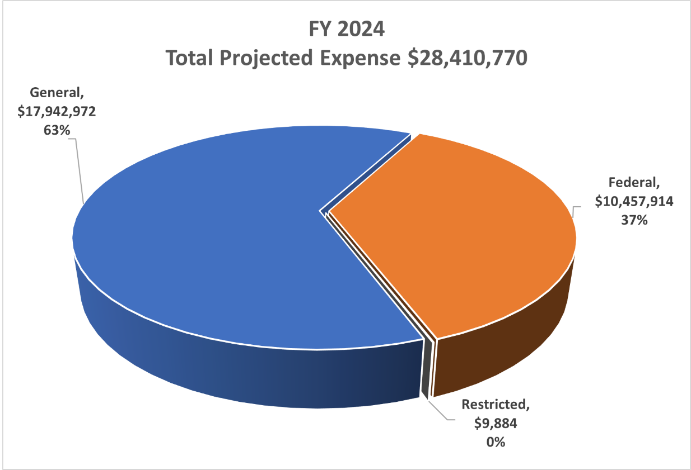
FY 2024 Budget
63% (General Fund –State)
37% (WIOA: AEFLA – Federal)
Planning, programming, budgeting, and executing for WIOA co-enrollment services and activities in support the Kentucky Career Center system

Slide 20
Looking Forward
Maximize MSG growth & expand partnerships to improve workforce participation & career advancement
Expand family literacy activities in support of lifelong learning and economic self-sufficiency
Improve HSE/GED pass rate to a minimum of 85%
Expand scope and efforts for the Jobs on Day 1 Initiative
New request for proposal (RFP) cycle

Slide 21
Thank You!

