Slide 2
Growing Access to Advanced Coursework for Kentucky Students
Promoting Rigorous Learning and Preparing for Postsecondary Opportunities
Notes:
The Community School Strategy is a local engagement strategy that creates and coordinates opportunities with public school(s) to accelerate student success. It serves as a vehicle for hyper-local decision-making that responds to the unique needs of each community.
Through this framework, academic growth and stronger connections are made between schools, parents, families and surrounding communities, leading to improved educational outcomes.

Slide 3
Today's Agenda
The Current Landscape
Proposed Solution
Why it Matters

Slide 4
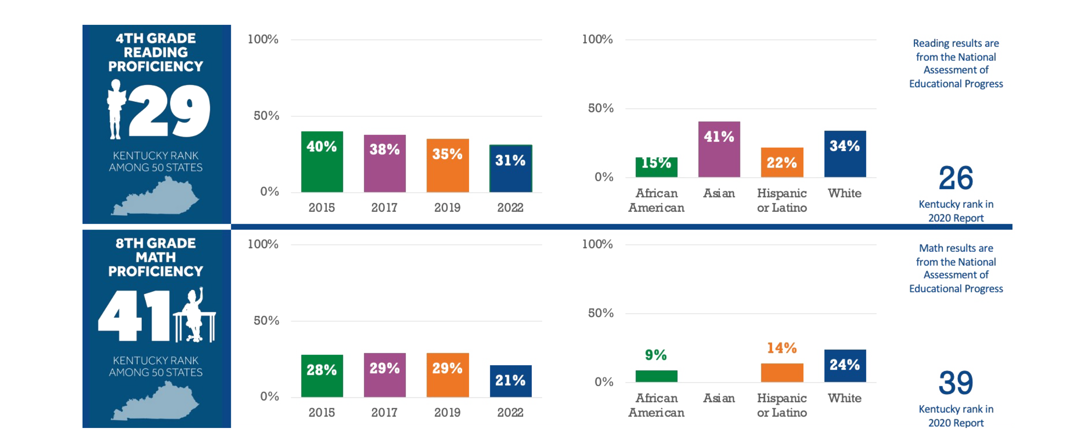

Slide 5
Identifying the Problem: The Current Landscape of Advanced Coursework Access in Kentucky
Overview of existing barriers to advanced course access in public schools
Data highlighting disparities and potential growth
Consequences of limited access on student achievement and future opportunities

Slide 9
Proposed Solutions: Legislative Proposals to Grow Advanced Course Access
Automatic enrollment and opt-out option; parental notification
Expanding access through online courses and reciprocal district agreements
Incentives for teachers and students
Implementing accelerated learning policies
Providing annual reporting and accountability to the LRC

Slide 10
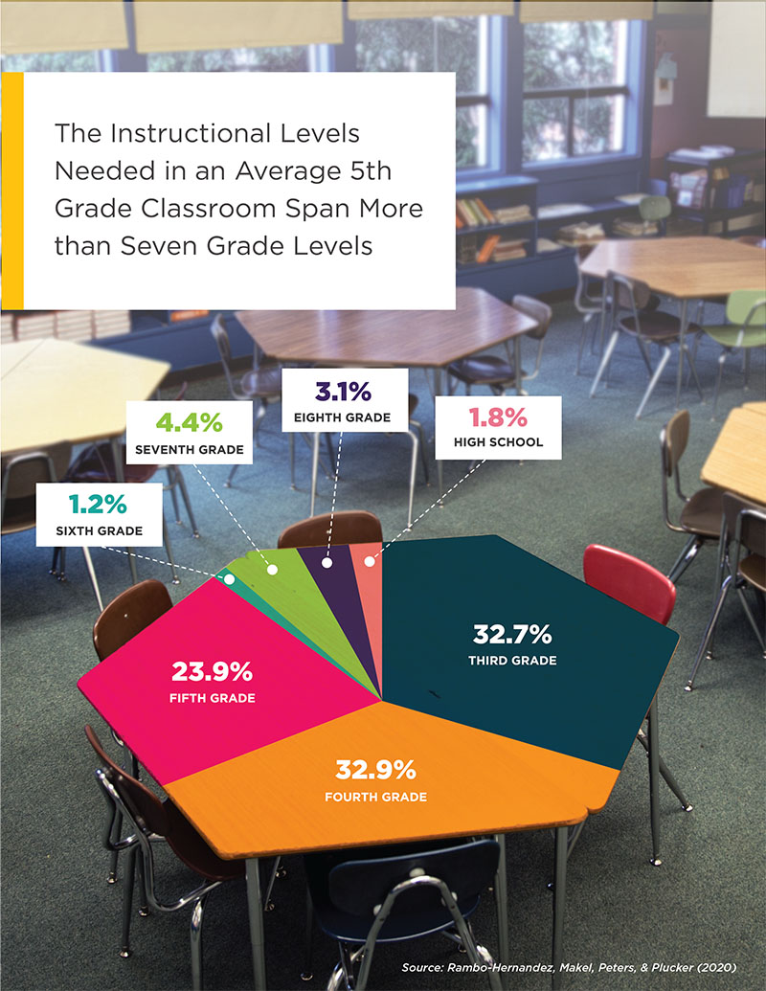

Slide 11
The Impact of Expanding Advanced Coursework Access: Benefits of Advanced Coursework
Increases high school graduation rates, postsecondary enrollment, and college persistence.
Encourages college credit accumulation, persistence, hard work, and deeper engagement.
Students are less absent, face fewer discipline issues, and are more likely to graduate.

Slide 12
Thank you!
Anthony Mires
Executive Director of AdvanceKentucky
Kentucky Science and Technology Corporation
Email: amires@kstc.com
Brigitte Blom
President and CEO
The Prichard Committee
Email:
Dr. Julia Link Roberts
Executive Director
The Center for Gifted Studies
The Carol Martin Gatton Academy of Mathematics & Science
Email: julia.roberts@wku.edu

