Slide 1
DEI at NKU:
Presentation to the Interim Joint Council on Education
CADY SHORT-THOMPSON, PH.D.
PRESIDENT, NORTHERN KENTUCKY UNIVERSITY
July 16, 2024

Slide 2
Mission of NKU
NKU delivers innovative, student-centered education and engages in impactful scholarly and creative endeavors, all of which empower our graduates to have fulfilling careers and meaningful lives, while contributing to the economic, civic, and social vitality of the region.

Slide 3
Vision of NKU
NKU will be nationally recognized for being a student-ready, regionally-engaged university that empowers diverse learners for economic and social mobility.

Slide 4
DEI Defined @ NKU
Diversity: variety or differences
Equity: process of ensuring freedom from bias or favoritism such that all individuals can achieve full potential; a measure of achievement, fairness, and opportunity for all in education
Inclusion: process of improving success for all

Slide 5
Inclusive Excellence
Goal: Create a culture of belonging & success
NKU offers an ever-evolving set of programs, projects, and activities that bring students from every race, culture, religion, and identity together for academic, social, and professional development.

Slide 6
Diverse Learners NKU serves
NKU embraces a broad definition of diversity. We recognize that our learners represent the world around us, including differences in age, class, race, family status, gender, sexual orientation, socioeconomic status, physical or cognitive abilities, first generation college status, military/veteran status, and cultural, political, and religious affiliation.

Slide 7
Teachable Moments
Cross Cultural Interaction
NKU believes that a college campus at its best meets each student where they are and brings them forward to learn, flourish, and reach their goals.
Ideally, students share and learn from one another’s lived experiences and perspectives along with our formal education.

Slide 8
“Birds of a feather flock together”
223 Affinity groups & student clubs enhance belonging and support
Students pay fees that go toward student activities.
Students create clubs and groups that interest them.
There is a place for every student here.

Slide 9
223 STUDENT GROUPS AT NORTHERN KENTUCKY UNIVERSITY
Inter-Faith Council
Baptist Campus Ministry
Campus Outreach
Cru at NKU
Delight Ministries
Every Nation Campus
NKU Catholic Newman Center
Northstar Ministry
Vine and Branches
Young Life College
Ignite the Norse
Alpha Kappa Alpha Sorority
Alpha Omicron Pi
Alpha Phi Alpha Fraternity, Inc.
Alpha Sigma Phi
Alpha Tau Omega
Delta Gamma
Delta Sigma Theta Sorority
Delta Zeta
Interfraternity Council
Kappa Alpha Psi Fraternity, Inc.
Kappa Delta
National Pan-Hellenic Council
Omega Psi Phi Fraternity
Order of Omega
Panhellenic Council
Phi Beta Sigma Fraternity, Inc.
Phi Mu
Phi Sigma Sigma
Pi Kappa Alpha
Sigma Gamma Rho Sorority, Inc.
Sigma Phi Epsilon
Tau Kappa Epsilon
Theta Chi Fraternity
Theta Phi Alpha Sorority
Zeta Phi Beta Sorority
Alpha Psi Lambda
University Housing
Residence Hall Association
Black Women's Organization
Phi Delta Theta KY
Sunrise Movement
Herps and Ichs Club
Music Student Advisory Council
Business Intelligence Group
Black Law Student Association
Energy & Environmental Law Society
Equilibrium
Federal Bar Association
Legal Association of Women
Norse Intellectual Property Law
OutLaw
Kinesiology Club
Black Business Association
NKU Women In Business Club
Supply Chain Management Student Forum
Beta Gamma Sigma
Collegiate Entrepreneurs
Finance and Accounting
International Business Student Association
Women in Entrepreneurship
Haile Ambassador Organization
Haile College of Business Emerging Leaders
Mechanical Contractor Association of America
National Society of the Collegiate Scholars
Golden Key International Honour Society
ACM at NKU
Alpha Lambda Delta
American String Teachers Association
Aspiring Educators
Athletic Training Club
Beta Beta Beta
Black and Brown Educators of Excellence
Center Stage Players
College of Health and Human Services Ambassadors
College of Informatics Ambassadors
Data Science Club
Delta Alpha Pi International Honor Society
Design Guild
Diversity Scholars In Informatics
Environmentally Concerned Organization of Students
Fine Arts Movement
Geology Club
Health Professions Club
Honors Student Association
Japanese Culture Club
Lambda Alpha Epsilon
NKU Dance Honors Society
Norse Offstage - USITT Student Chapter
Nu Rho Psi delta-Kentucky Chapter
Public Administration Student Society
Public Relations Student Society of America
Respiratory Care Club
Spanish Club
National Association of Teachers of Singing
Student Nurses Association
Student Occupational Therapy Association
The Henry Konstantinow Studio Theatre
Women in Cybersecurity
Women in Informatics
Women in Physics and Engineering
Society of Manufacturing Engineers
Physics and Astronomy Club
National Society of Leadership and Success (NSLS)
Ceramic Sculpture Society
National Society of Black Engineers
NKCyber
Norse Baja
Norse of Nepal
NKU Social Media Ambassadors
Association for Mental Health Law
Chase College of Law Student Bar Association
Disabled Law Students Association
Phi Alpha Delta Law Fraternity
Public Advocacy Coalition
The Federalist Society
The Latinx Law Student Association
Anointed Voices Gospel Choir
Catholic Knights
Fellowship of Christian Athletes
God Is For Today's Students
Muslim Student Association
NKU Bhakti Yoga Club
The Navigators
Student Government
Society for Human Resource Management
The Underground Agency Club
Leadership Mentors
Norse Leadership Society
Norse Violence Prevention Peer Ambassadors
Northern Kentucky Leadership Institute
Phi Sigma Pi Epsilon Rho National Honor Fraternity
Presidential Ambassadors
Student Alumni Council
Freshmen Service Leadership Committee
NKU Black Graduate & Professional Student Association
Norse Code Radio
Alpha Phi Omega
College Democrats
NKU Equestrian Club
NKU Hiking Club
NKU Men's Soccer Club
NKU Taekwondo
NKU Ultimate
Norse Bowling Club
Norse Men's Volleyball
Norse Ski Club
Northern Kentucky Waves Wrestling
Vertical Frontiers Climbing Club
Women's Club Lacrosse
Women's Club Soccer
Women's Club Volleyball
Vikings Men's Club Lacrosse
Norse Students of Rivalry
American Sign Language Club
Disney Fan Club
Fit Girl's Club
Fireside Chats
NKU Boxing Club
Turning Point USA at NKU
NKU Cornhole Club
The Zoomies
Northern Kentucky Risograph Guild
Katie's Office
NKU Esports Club
Latinos Avanzando Mentorship Program
Norse V.E.T.S.
Activities Programming Board
African Student Union
Best Buddies International - NKU Chapter
Birding Club
Black Men's Organization
Black Student Union
Common Ground
Drag Club
E.N.V.I.
French Club
Friends of Dorothy
Grandpa Club
Indian Students Association
International Movement for Resilience, Authenticity, and Activism at NKU
International Student Union
Korean Language and Culture Club
Lavender Society
Leadership, Education, Advocacy and [Dis]ability
League of United Latin American Citizens
Model United Nations
Monsters and Mythology
NKU R.O.C.K.S.
Norse Film Society
Norse IoT
Norsin' Time's Band & Music Club
Northern Car Culture
Northern Kentucky City/County Management Association
Northern Kentucky Young Democratic Socialists of America
Norse for Life
Nu Upsilon Black Women's Honorary
NUKE Robotics
Odyssey of the Mind
Organization for Women's Rights
Science Fiction Fantasy Club
SCUBA Club
Student Support Services Ambassadors
Students for Equity, Diversity, and Inclusiveness
Tabletop Gaming Club
The Black Lotus Club
The Gender Initiative
The Investment Club
The Northerner
The Pokemon Fan Club
The Queer Writers' Collective
The Quill & The Scroll
True Crime Club
Video Game Development Club
Voices Of Women
Welcoming International Students Home (WISH)
Young Americans for Freedom
Miss Northern Kentucky University Scholarship Pageant
NKU Dodgeball Club
NKU Color Guard
Norse Run Club

Slide 10
Diversity of Thought—an education exposes students to many ideas along with the critical thinking tools to question them.
Freedom of Speech and Expression—
“Northern Kentucky University recognizes the essential place of free expression in a democratic society, as well as an educational community’s need to cultivate responsible avenues and means for free expression. As an educational community, NKU adheres to the belief that the freedoms of speech, thought, conscience, inquiry, and assembly hold central positions among the principles defended by an institution of higher learning. The University therefore supports the right of peaceful expression by members of the campus community.” (NKU Free Expression Policy)

Slide 11
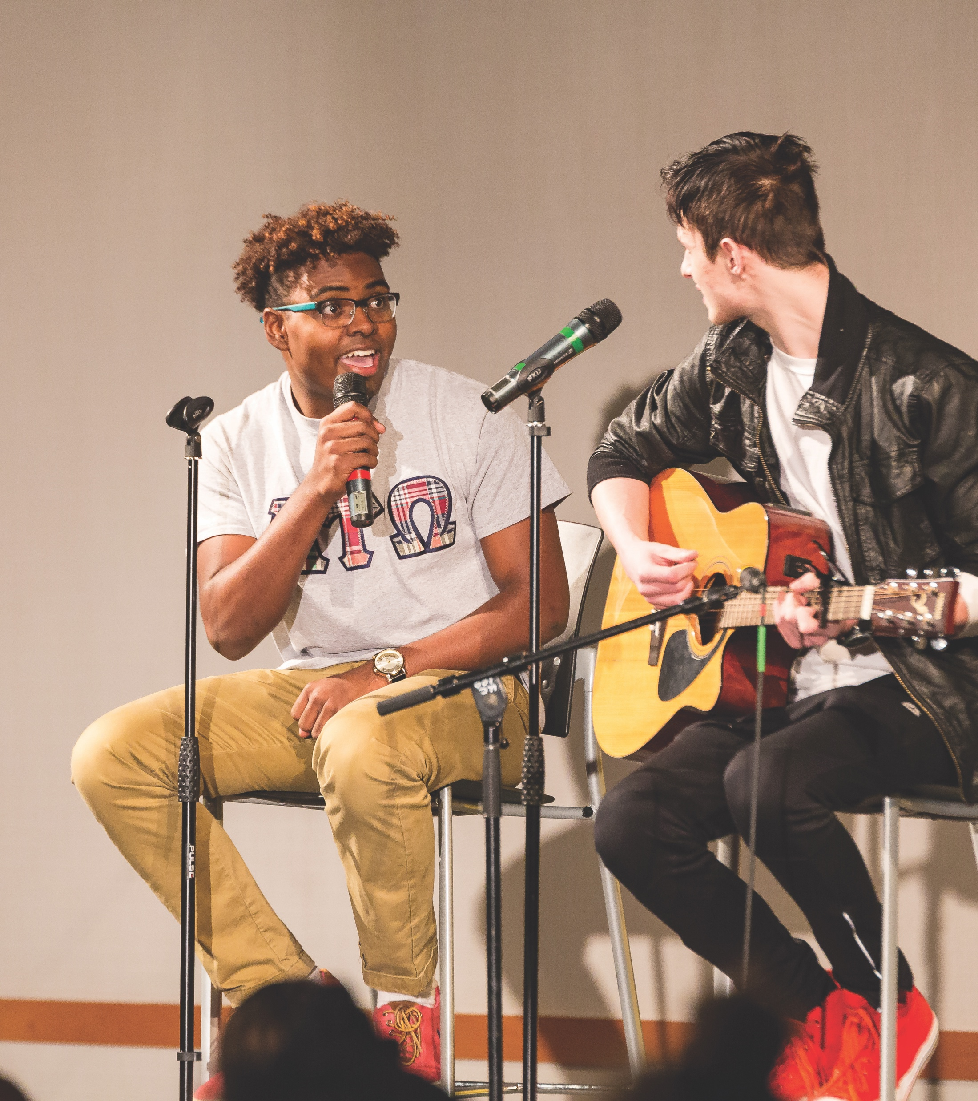
Academic Freedom
“Northern Kentucky University strongly adheres to the long-standing tradition and practice of academic freedom. In order for the University to fulfill its mission and be of service to society, the recognition of the free search for truth and its free expression is paramount. The University has an obligation to recognize and protect freedom of inquiry, teaching, and research in all facets of the academic community. The right of academic freedom will be the right of every faculty member.” (NKU Faculty Handbook, Section16.3)

Slide 12
SACSCOC Accreditation
“Promoting diversity, equity, and inclusion is an opportunity for institutions to recruit students of all backgrounds, identities and abilities; to support them, adapt teaching methods, and use technology to meet their needs and break down barriers to learning; and to successfully guide, mentor, retain, and graduate them.”

Slide 13
NKU has 45 Different External Academic Program Accreditations to Manage--
They have DEI curricular requirements to maintain accreditation, such as the following:
Engineering Technology, ABET (to create and engage diverse workforce)
Education, CAEP (to teach diverse students)
Nursing, CCNE (to care for diverse patients)
Public Administration, NASPAA (to serve a diverse populace)
Social Work, CSWE (to counsel and serve diverse populations)

Slide 14
DEI Aspects NOT at NKU
We do not have institutionally funded scholarships based on DEI attributes.
We do not have a Bias Incident Report Team.
We do not have DEI criteria in admissions.
Diversity statements are not a condition of employment, promotion, or other benefit.

Slide 15
2nd Fall Retention (First-Time, Full-Time)

Slide 16
Graduation Rates – Six-Year Rate

Slide 17
Our full cadre of programs help all to succeed by:
Meeting common learning objectives and professional standards
Learning about themselves and others
Building relationships with people who are similar and different from them
Exploring NKU’s campus and programs
Developing campus communities for support and growth
Learning to communicate across difference
Growing in high-impact practices together
Building professional skill sets and knowledge
Connecting to regional workforce assets

Slide 18
Return on Investment
In FY24, NKU spent 0.34% of its budget on programs and activities with DEI elements.
NKU’s retention and graduate rates have recently reached historic highs, closing the achievement gaps across different student populations.
Students report higher levels of engagement & satisfaction with their NKU education & experience, becoming loyal alumni with 82% of 84,000 remaining in the region to work & live.

Slide 19
Workforce Demands
NKU graduates need to be prepared to work in a global economy.
NKU is positioned to grow enrollments to meet the specific talent demands of our region—given population declines, this will require additional population via broader access to NKU education and migration to NKY.
NKU effectively meets the needs of our region.

