Slide 1
2025 BR 23
relating to public school facilities

Slide 2
Henry Clay and dunbar high schools

Slide 3
Parent Survey

Slide 4
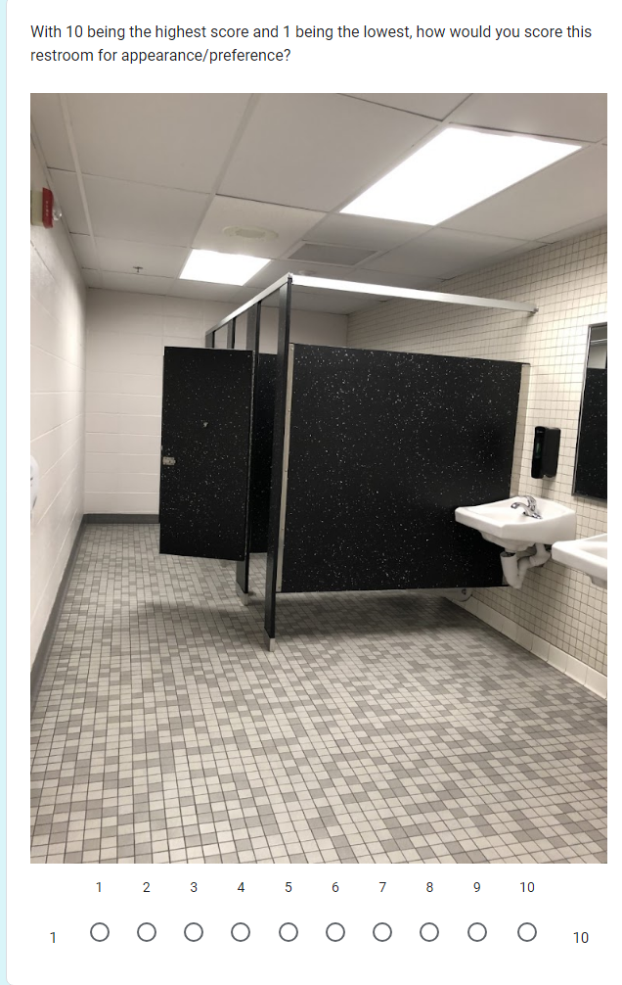
Parent Survey

Slide 5
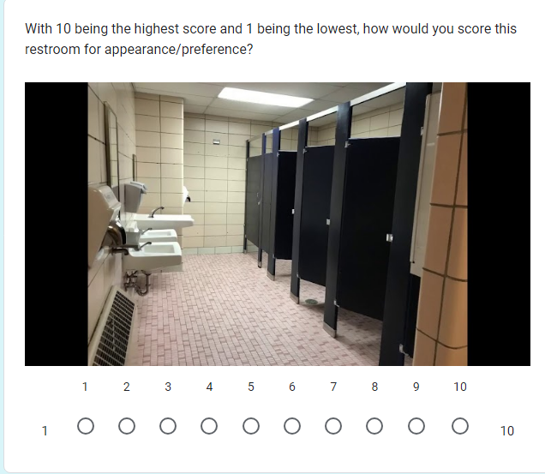
Parent Survey

Slide 6
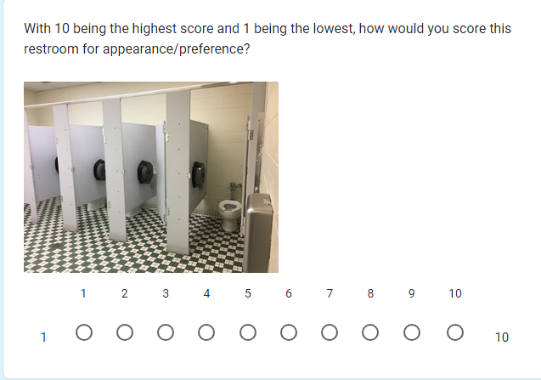
Parent Survey

Slide 7
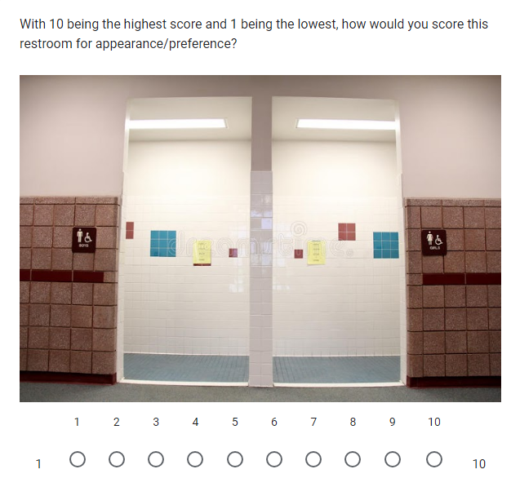
Parent Survey

Slide 8
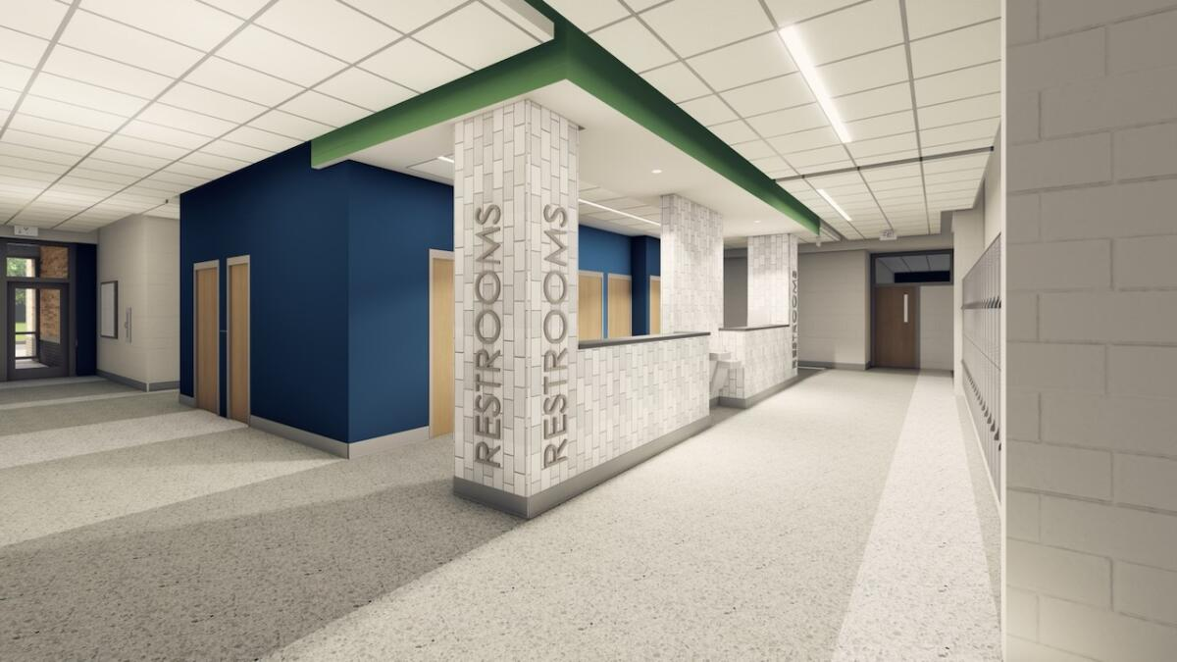
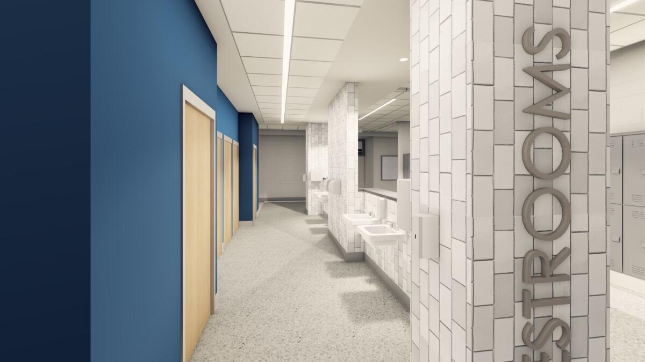
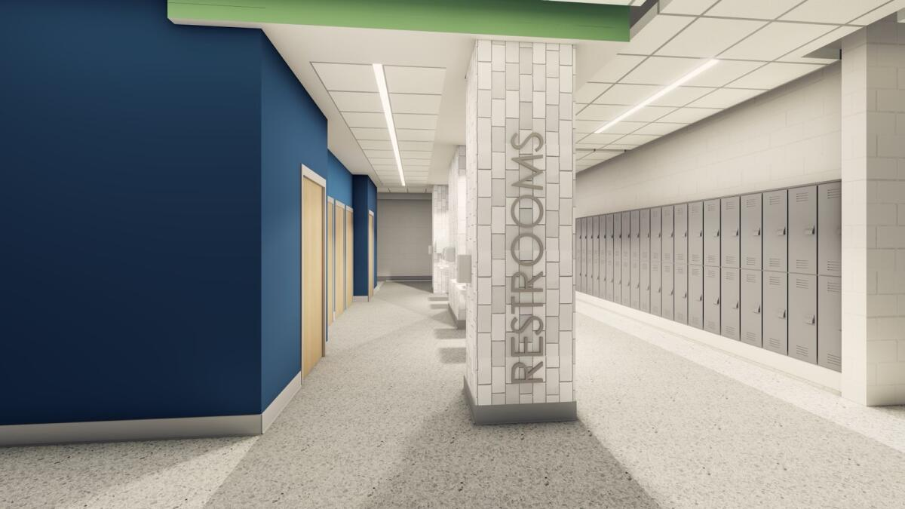

Slide 10
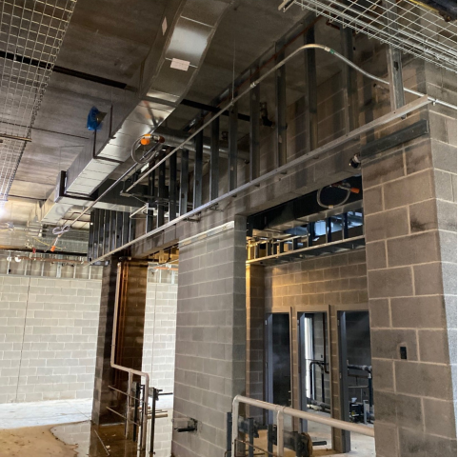
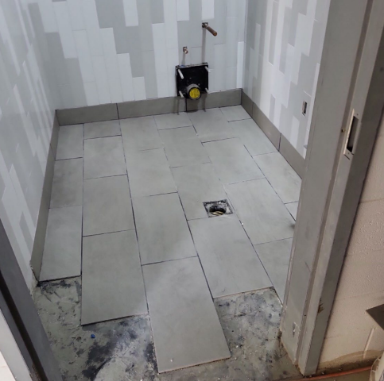

Slide 11
Be it enacted by the General Assembly of the Commonwealth of Kentucky:
:
(1) For the purposes of this section:
(a) "Biological sex" and "school" have the same meaning as in KRS 158.189; and
(b) "Restroom facilities" means a restroom containing at least one functioning toilet or urinal and shall include nearby sinks and mirrors that are designed to be used by people using the restroom
(2) At least ninety percent (90%) of restroom facilities in each school building that is designed to serve more than one hundred (100) students shall be designated by the school administration to be for a specific biological sex pursuant to KRS 158.189.

Slide 12
Thank you for your time! Any Questions?

