Slide 1
Vacancy Data
Interim Joint Committee on Education
Dr. Robbie Fletcher, Commissioner
Dr. Brian Perry, Director of Government Relations
Todd Davis, Division Director, Office of Educator Licensure and Effectiveness
October 2024

Slide 2
Kentucky Educator Placement Service (KEPS) Data
October 1, 2024, Written Report to IJCE
Notes:
Per KRS 160.152, a written report on KEPS data was provided to the IJCE on October 1, 2024. This is the second annual report required by the statute, and though it can provide information regarding district postings, it does not always provide a clear and accurate picture of the vacancy data across the state.

Slide 3
Kentucky Educator Placement Service (KEPS)
KRS 160.380(2)(b)- Superintendents are required to post district vacancies to the statewide job posting system 15 days before the position shall be filed.
KRS 160.152(2) requires KDE to ensure that KEPS:
Is accessible through KDE’s website;
Includes a mechanism to electronically submit job openings for posting;
Allows the public to review job postings;
Allows applicants to electronically submit applications and materials; and
Permits districts and public charter schools to access, review, and download applications and application materials.
Notes:
Two statutes that specifically reference KEPS.

Slide 4
Limitations of the Current System
Created in 1997.
Districts aren’t required to update postings when filled.
Creates discrepancies between postings and actual vacancies.
In order to address these limitations, KDE has worked with districts to collect survey data regarding vacancies as of Sept 1.
Notes:
The technology is outdated and difficult to update. While KEPS can give information regarding postings, that does not always translate to accurate vacancy data.
Districts may choose to fill positions and not update that information in KEPS.
Different districts may choose to handle vacancies that are filed with emergency or temporary provisional certificates different. Some leave the position posted as a vacancy, since a permanent solution is not in place. Others
Some positions posted may be anticipated vacancy, that due to enrollment numbers are not true vacancies and are withdrawn.
Statute provides flexibilities to districts and specifically states that KDE does not have authority in the hiring process or hiring decisions of any school district or public charter school.

Slide 5
Kentucky Educator Shortage Survey Results
Fall 2024
Note: 717 elementary, 319 middle, and 228 high schools
Notes:
This survey aimed to collect information from superintendents regarding the current vacancies in their districts. It sought to gather data on the percentage of both instructional and non-instructional positions that were unfilled at the start of the 2024-2025 school year, as well as to assess how the overall vacancy situation in 2023-2024 contributed to educator shortages in Kentucky schools. While the survey did not explore the reasons for these vacancies, it did ask for details on how districts planned to address the shortages.

Slide 6
Last year, how many vacancies remained unfilled by the end of the year?
For the 2023-2024 school year, 13% of all vacancies statewide persisted until the end of the school year.
Notes:
Note: Data on this slide does include Jefferson County Public Schools.

Slide 7
The majority of districts started the school year with less than 10 total vacancies.
Notes:
Data reflects all Kentucky school districts and State Run schools. (Includes Jefferson County)

Slide 8
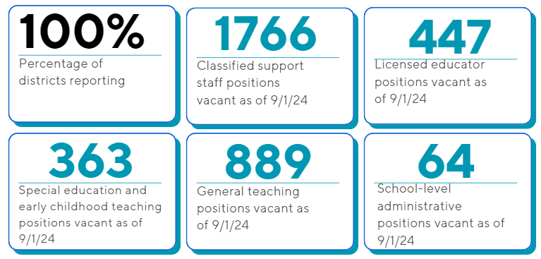
As of September 1st, only one district was fully staffed.
Source: Educator Shortage Survey – October 2024
Notes:
Update 10/14/24: Updated to report counts (inclusive of Jefferson Co) instead of percentages.

Slide 9
Certification areas where Kentucky teacher shortage is hitting hardest
Source: Educator Shortage Survey – October 2024
Notes:
* Please note, Jefferson County is included in overall counts, but is not included in calculation of percentage of vacancies unfilled (17%)

Slide 10
How are districts dealing with general teaching vacancies?
Districts are addressing vacancies by…
Top 3 mitigation reported strategies used by districts in addressing vacancies:
offering virtual options
increasing class sizes
eliminating courses
utilizing substitute teachers
utilizing a retired teachers
increasing the workload of other teachers or administrators
combining classes
administrators teaching classes
reducing or eliminating teacher planning
outsourcing the position
no Issues operating with unfilled positions
anticipate filling this position in the future
Source: Educator Shortage Survey – October 2024
Notes:
Note vacancy list is not presented in any particular order

Slide 11
Special education and early childhood educator shortages remain a significant issue for many districts
Source: Educator Shortage Survey – October 2024
Notes:
* Please note, Jefferson County is included in overall counts, but is not included in calculation of percentage of vacancies unfilled (21%)

Slide 12
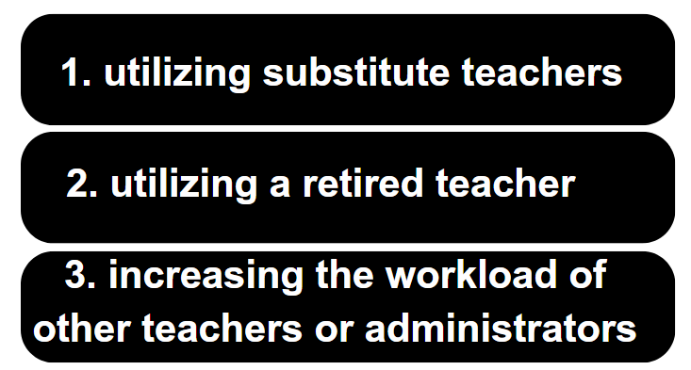
How are districts dealing with special education and early childhood teaching shortages?
Districts indicated addressing vacancies by…
Top 3 mitigation strategies used by districts in addressing vacancies
offering virtual options
utilizing substitute teachers
utilizing a retired teachers
increasing the workload of other teachers or administrators
combining classes
administrators teaching classes
reducing or eliminating teacher planning
outsourcing the position
no Issues operating with unfilled positions
anticipate filling this position in the future
eliminating courses
increasing class sizes
Source: Educator Shortage Survey – October 2024
Notes:
Note vacancy list is not presented in any particular order

Slide 13
Vacant school-level, administrative positions were largely filled as of the beginning of the school year
Source: Educator Shortage Survey – October 2024
Notes:
* Please note, Jefferson County is included in overall counts, but is not included in calculation of percentage of vacancies unfilled (11%)
The highest needs were in the central, west and southern parts of the state

Slide 14
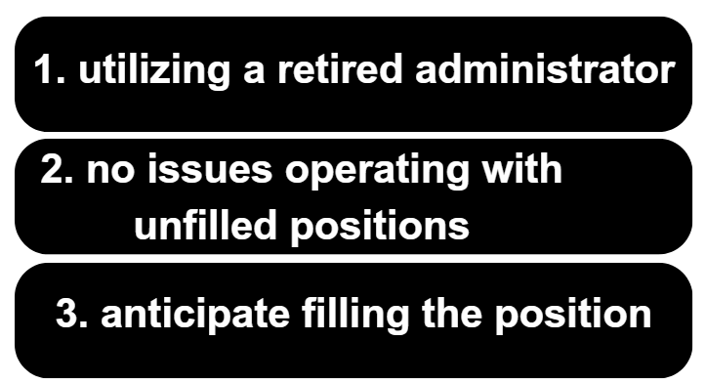
How are districts dealing with school-level administration shortages?
Districts indicated addressing vacancies by…
Top 3 mitigation strategies used by districts in addressing vacancies
utilizing a retired administrator
increasing the workload of another faculty member
Share the position with another school
no Issues operating with unfilled positions
anticipate filling this position in the future
virtual options
Notes:
Note vacancy list is not presented in any particular order

Slide 15
School psychologists have the highest shortage rates among licensed educators
Source: Educator Shortage Survey – October 2024
Notes:
* Please note, Jefferson County is included in overall counts, but is not included in calculation of percentage of vacancies unfilled (24%)

Slide 16
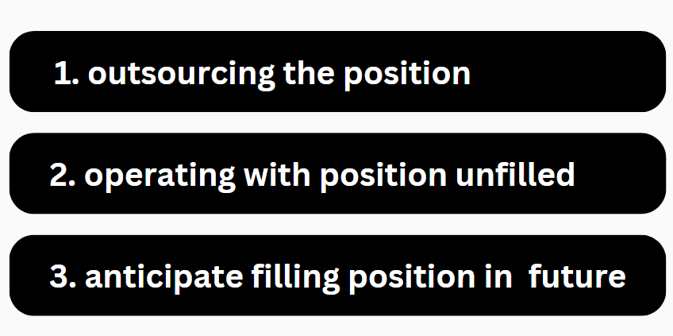
How are districts dealing with shortages of licensed professionals?
(Including Jefferson County Public Schools)
Districts indicated addressing vacancies by…
Top 3 mitigation strategies used by districts in addressing vacancies
Outsourcing the position
No issues operating with position unfilled
Anticipate filling position in the future
Increasing class sizes
Eliminating services offered
Combining classes
Offering virtual options
Source: Educator Shortage Survey – October 2024
Notes:
Note: Data on this slide does include Jefferson County Public Schools.
Note vacancy list is not presented in any particular order

Slide 17
Schools struggle to find bus drivers and teaching aides to support their students
Source: Educator Shortage Survey – October 2024
Notes:
* Please note, Jefferson County is included in overall counts, but is not included in calculation of percentage of vacancies unfilled (29%)

Slide 18
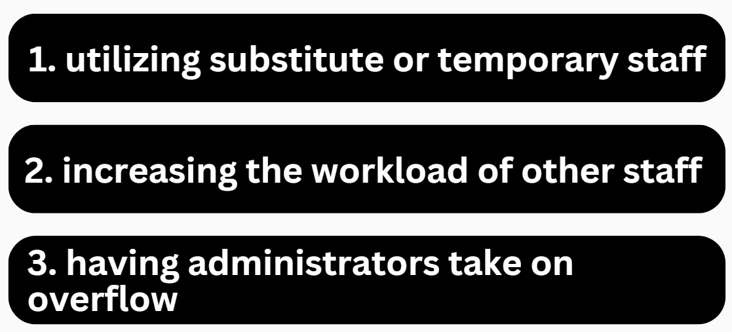
How are districts dealing with shortages of support staff?
Districts indicated addressing vacancies by…
Top 3 mitigation strategies used by districts in addressing vacancies
Utilizing substitute staff
Increasing the workload of other staff members
Having administrators take on overflow
Anticipate filling position in the future
Outsourcing the position
Operating with position unfilled
Eliminating courses or programs
Increasing class sizes
Sharing staff across schools
Combining classes
Notes:
Note: Data on this slide does include Jefferson County Public Schools.
Note vacancy list is not presented in any particular order

Slide 19
Among certified staff, special education teachers and elementary school teachers had the highest number of unfilled vacancies for the 2023-2024 school year.
Notes:
Note: Data on this slide does include Jefferson County Public Schools.
Notes: Special Ed teachers includes: General Special Ed, Behavior Specialist, Multiple Disabilities and Other special ed. All other teachers includes K-12 special area and EL/Bilingual teachers.

Slide 20
In 2023-2024, positions for speech pathologists and school psychologists had the highest number of unfilled vacancies at the end of the school year.
Notes:
Note: Data on this slide does include Jefferson County Public Schools.

Slide 21
Teaching aides/paraprofessionals had the highest number of unfilled vacancies among all types of staff for the 2023-2024 school year.
Source: Educator Shortage Survey – October 2024
Notes:
Note: Data on this slide does include Jefferson County Public Schools.

Slide 22
District leaders feel the quality of applicants for the 2024-2025 are of similar or lower quality than those in previous years.

Slide 23
Tools Utilized by Other States
Colorado – “Connecting Colorado”
State-wide application and tracking system
Integrated in the state government personnel system for all government positions
Florida - Integrates Multiple Application Tracking Platforms
Utilizes vendors familiar to Kentucky school districts
Connects to local district for completing the application process
Vendor provided analytics platform for HR data through
Notes:
Can begin this by sharing discussion from the NASDTEC Southern Region meeting where other states expressed similar issues for reporting accurate, real-time vacancy data.
Definition of “vacancy” differed and was not always clear statewide
Some require job posting on a state centralized website though not always mandated
Postings are often controlled by local districts and are self reported

Slide 24
Tools Utilized by Other States
West Virginia – Single Vendor System
Centralized posting and application tracking system
Controlled by districts – state does not approve postings
Discounted add-on resources for evaluation, professional development, etc.
Georgia and South Carolina - Surveys
Require posting to a centralized website
Data collection thru surveys
Georgia – Annual Survey
South Carolina – Biannual Survey in September and Updated January/February

Slide 25
Recommended Actions
Fund a statewide job posting system and require districts to update postings when positions are filled.
Annual survey to districts regarding vacancy data.

