Slide 1
Overview of SREB’s Commission on Artificial Intelligence in Education
October 15, 2024
-Stephen Pruitt, President
-Ivy Coburn, Division Director, Education and Workforce

Slide 2
AI: Biggest Work Disruption…
49%
56%
60%
Skills irrelevant by 2025
Entry-level jobs eliminated
Jobs impacted
12M
41%
25%
Fewer jobs by 2030
Executives expect to employ fewer workers
Work tasks replaced
Notes:
Source: “AI is The Disruption of Our Lifetime.” “The AI Breakdown” podcast
https://open.spotify.com/episode/2Kze93p7iYDVyeVRn0YAK5
Listening time: 13 minutes, 4 seconds

Slide 3
Our Charge
The SREB Commission on Artificial Intelligence in Education will evaluate research, industry data and advice from experts to determine how education can successfully adopt and integrate AI across the region and lead the nation. Based on this critical evaluation, the Commission will then develop recommendations for
policies regarding the use of AI in K-12 and postsecondary education,
use of AI in instruction to promote AI literacy among students, educators, and the workforce and
the development of skills and seamless pathways in the education-to-workforce system to meet industry and state needs.

Slide 4
AI Commission Subcommittees
K-12 AI Policies
PSE AI Policies
K-12 AI Instruction
PSE AI Instruction
AI Skill Development

Slide 5
AI Policy Committee Initial Recommendations
Consideration by full commission in October
Adoption at November meeting

Slide 7
AI Education Guidance in SREB States
Does not currently have guidance
DE
Guidance taskforce established
MD
Has law in place that requires guidance
Has guidance
Notes:
Link to SREB’s State Guidance on AI Resource Page: https://www.sreb.org/ai-policy-guidance

Slide 8
AI-Policy Draft Considerations
2-Integrate AI Knowledge & Skills
3-Provide Professional Development for Educators
4-Establish State-Wide AI Networks
5-Develop and Administer AI Needs Assessments
1-Develop Targeted AI Guidance for All Groups
6-Develop Costs Models for AI Implementation

Slide 9
K-12 Instruction Update

Slide 10
Process and Accomplishments
Review, discuss and draft a document outlining the skills needed for students and educators to be AI-literate.
Review current state and other entities’ guidelines for the use of AI in K -12 Instruction.
Interview current educators and state education leaders to understand how AI is currently used in schools and what barriers exist.
Draft a guidance document for starting points for using AI in instruction.
Potential Uses – Opportunities and Cautions
Resources
Stories of current use in classrooms and schools

Slide 11
Postsecondary Instruction Update

Slide 12
Postsecondary Education Instruction
Subcommittee is:
Researching and developing landscape analysis for postsecondary instruction.
Discussing accreditation implications with accrediting bodies to develop an alignment document institutions, states, and accreditors.
Comparing shared resources and viewpoints presented in the 2020 Global AI Strategy Landscape to identify alignment and opportunities to strengthen instructional practices needed to support workforce developent.
Notes:
2020 Global AI Strategy Landscape: https://www.holoniq.com/notes/50-national-ai-strategies-the-2020-ai-strategy-landscape

Slide 13
AI Skill Development

Slide 14
AI Examples Across Industries
Agriculture, Food & Natural Resources
AI-powered drones and sensors monitor crop health, soil conditions, and weather patterns to optimize farming practices.
Finance
AI algorithms analyze transaction data to identify and prevent fraudulent activities.
Transportation, Distribution and Logistics
AI analyzes traffic patterns to optimize delivery routes and reduce fuel consumption.
STEM
AI tools assist researchers in data analysis, literature review, and experiment design.
14
Notes:
Use cases
Explore other use cases across career cluster areas using the handout linked below.
Handout: https://docs.google.com/document/d/1m8QsnIB_7I4gl-lpoBUB2ie_3QfE8FJBxUVrR4J8hVo/edit?usp=sharing

Slide 15
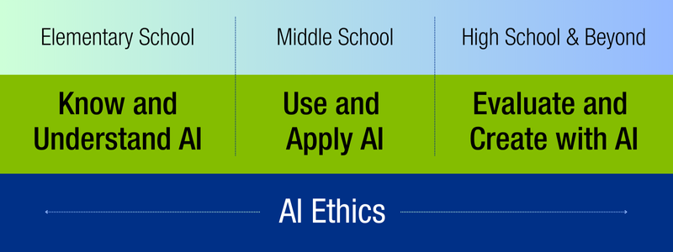
AI Learning Progressions

Slide 16
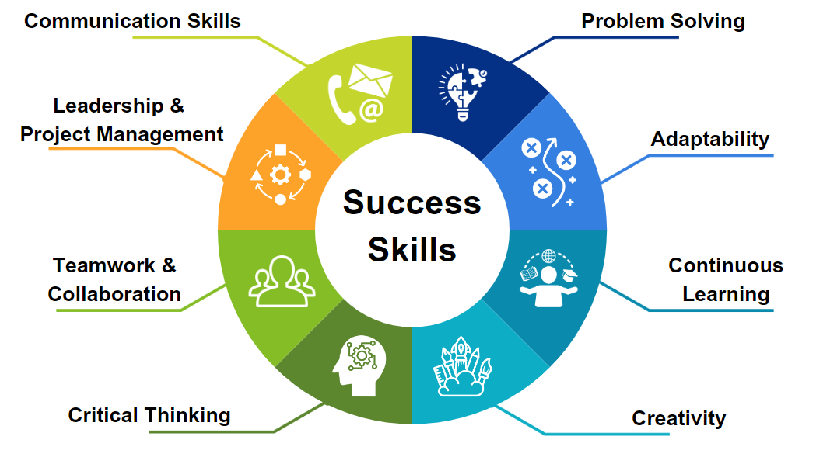

Slide 17
Industry Baseline Skills
AI
Ethics
Responsible
AI
Domain
Knowledge
Cybersecurity
& Data Privacy
Core Academic Skills

Slide 18
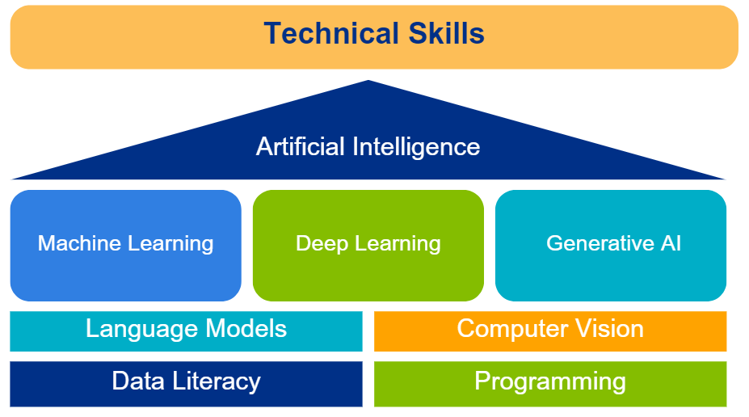

Slide 19
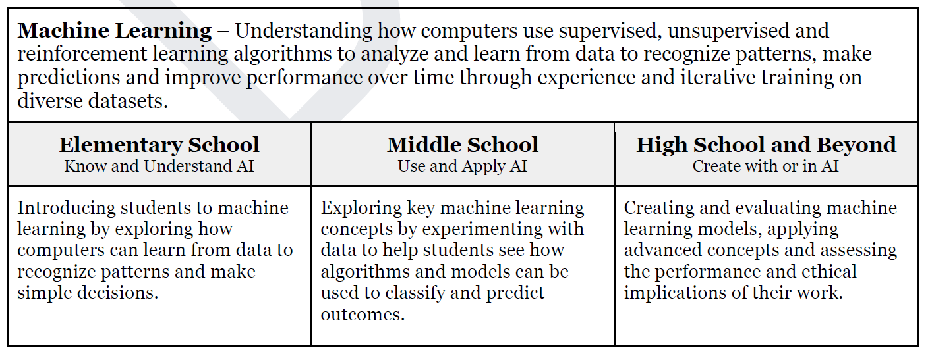

Slide 20
For more information:
Stephen Pruitt
President
Stephen.Pruitt@sreb.org
Ivy Coburn
Division Director – Education and Workforce
Ivy.Coburn@sreb.org

