Slide 1
Harnessing AI and Gamification in the Classroom
Supercharge
Your
PEDAGOGY
Fall 2024 Faculty and Staff Institute
Lana Browning –School of Psychology

Slide 2
Workshop Outcomes:
Review basic information about AI platforms and tools relevant to higher education.
Discuss and develop strategies to enhance the academic learning experience
Discuss and identify gamification strategies in the classroom

Slide 3
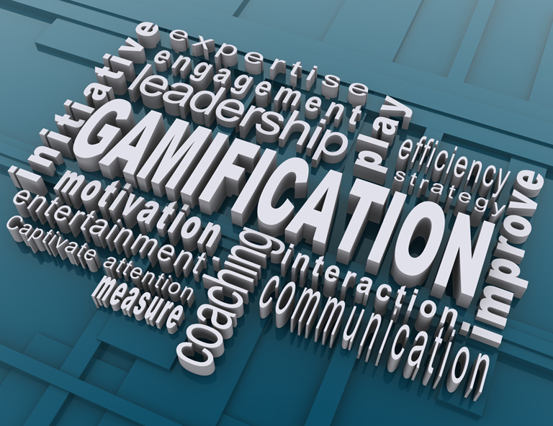
What are your thoughts on the use of GAITs (Generative Artificial Intelligence Tools) in higher education?

Slide 4
The AI universe is changing:
CoPilot (Microsoft-formerly Bing Chat)
Gemini (Google) formerly Bard)
ChatGPT 4o (newest version and free)
Think about it:
Because Gemini is a Google tool, it can be used to summarize YouTube (owned by Google) videos.
LLMs (Large Language Models) can help educators design more interactive and varied learning activities that don’t actually use AI, create contextually relevant examples, and generate thought-provoking questions. The key is to use these tools to support and enhance engaging pedagogical practices, not to replace them (Furze. 2024).

Slide 5
Watch Me!
Microsoft Game Day Commercial | Copilot: Your everyday AI companion

Slide 6
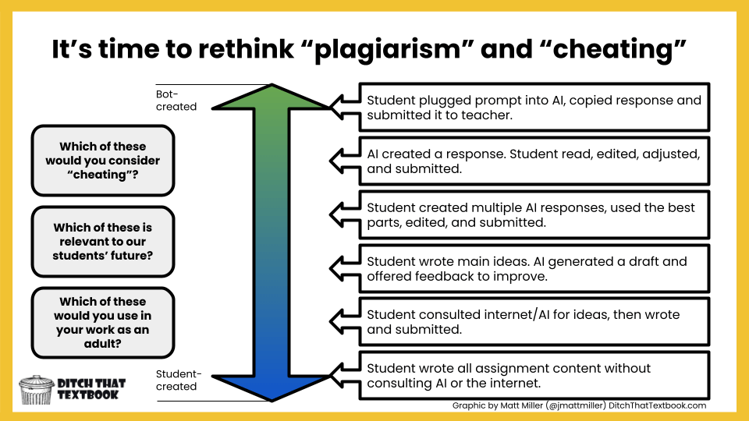

Slide 7
Prompt: Discuss the how psychology can be useful to a university student.
Which response is human or AI?
Response 1: Psychology is immensely useful to university students as it fosters self-awareness and enhances academic performance. By understanding psychological principles, students can improve their study habits, manage stress effectively, and develop strong communication and problem-solving abilities. Furthermore, psychology promotes empathy and cultural competence, aiding students in navigating diverse environments and fostering better relationships. Ultimately, psychology offers invaluable insights and tools that contribute to personal growth, academic success, and career readiness.
Response 2: I think psychology can help you understand yourself and others. Learn to study, chill out, and talk.
Response 3: Psychology will help me understand why I feel certain ways, deal with stress during tests, and learn better, so I can get good grades in school.
Response 4: Psychology helps college students understand themselves and others. It teaches us to study better, handle stress, and communicate effectively. It also enables us to connect with diverse individuals, which is beneficial for academic pursuits and employment opportunities.
Response 5: It teaches me ways to handle stress and stay calm during school. Plus, it helps me think better and figure things out, which is good for school and future jobs.

Slide 8
Prompt Question: Discuss the how psychology can be useful to a university student
Psychology is immensely useful to university students as it fosters self-awareness and enhances academic performance. By understanding psychological principles, students can improve their study habits, manage stress effectively, and develop strong communication and problem-solving abilities. Furthermore, psychology promotes empathy and cultural competence, aiding students in navigating diverse environments and fostering better relationships. Ultimately, psychology offers invaluable insights and tools that contribute to personal growth, academic success, and career readiness. ChatGPT4o
I think psychology can help you understand yourself and others. Learn to study, chill out, and talk. Google Gemini – humanized with human alterations
Psychology will help me understand why I feel certain ways, deal with stress during tests, and learn better, so I can get good grades in school. ChatGPT4o humanized
Psychology helps college students understand themselves and others. It teaches us to study better, handle stress, and communicate effectively. It also enables us to connect with diverse individuals, which is beneficial for academic pursuits and employment opportunities. Grammarly suggested improvements.
It teaches me ways to handle stress. Plus, it helps me think better and figure things out, which is good for school and future jobs. Microsoft CoPilot - humanized with additional parameters

Slide 9
Pedagogy Supercharge:
Suggestions for reducing the use of AI in assignments:
Make it personal
Scaffold Assignments
Group activities
Specific Reflection (connect to class discussion)
Multimedia- (ex. Make a Podcast, create a Meme, Interviews, YouTube, Blog, scripts)
Make it fun-Scavenger Hunt, Escape Rooms, Gallery walk-Themed Stations in class
Creative Activities- Draw, design, Scenario based creations, posters
Integrate class discussions into submission
Run your assignments through AI to generate a response.
Let them use AI ethically- assess AI output, design statements, screenshot their prompt and rewrite
Gamification
The long-term solution is not to catch and punish as many offenders as possible. We need to change the way we approach instruction.

Slide 10
Outsource your doing, not your thinking.

Slide 11
Breakout Session 1:
Divide into groups
Choose an AI platform
Choose content that applies to your program and create an online discussion, written assignment, or activity. P.R.E.P
Example Prompt: Create an online discussion for a General Psychology course at a university for students to discuss the learning and behavior chapter……………
Discuss with your group. Review the prompt and refine.
Example: I like the observational learning section. Just use this section. How can I AI proof this assignment?
Continue to review the prompt and refine.
Example: Create 2 prompts for the response post that help the student connect to the information in their peer’s initial post.
Example: Make this a fun discussion for the students where they should apply it to a lived experience.
After, developing your assignment, create a rubric or learning outcomes for your activity.
Example:
Create a rubric for this assignment.
Create three learning outcomes for this assignment.
Discuss with your group if this rubric is appropriately assessing the assignment. Review and make a few refinements.
Examples:
Create a tabled rubric for this assignment
Make rubric worth 30 points
Collapse into 3 criteria
Add APA citation and reference expectation

Slide 12
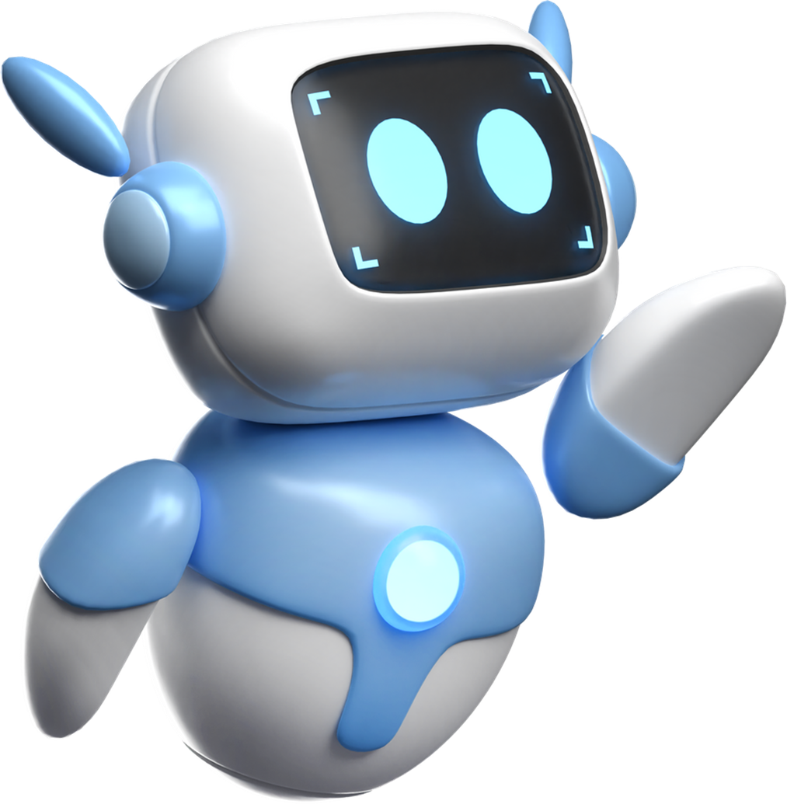
Breakout Session 1 Discussion:
Present your groups AI generated assignment.
Briefly discuss your prompt and how you refined your assignment?
What challenges did you encounter during the process?
How effective do you think the AI tool was in creating educational materials?
What potential benefits and drawbacks did you identify for using AI in this way?

Slide 13
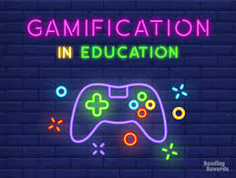
JOIN THE ADVENTURE: GAME ON!

Slide 14
What are your thoughts on the use of gamification in the classroom? Do you already incorporate a gamified approach?

Slide 15
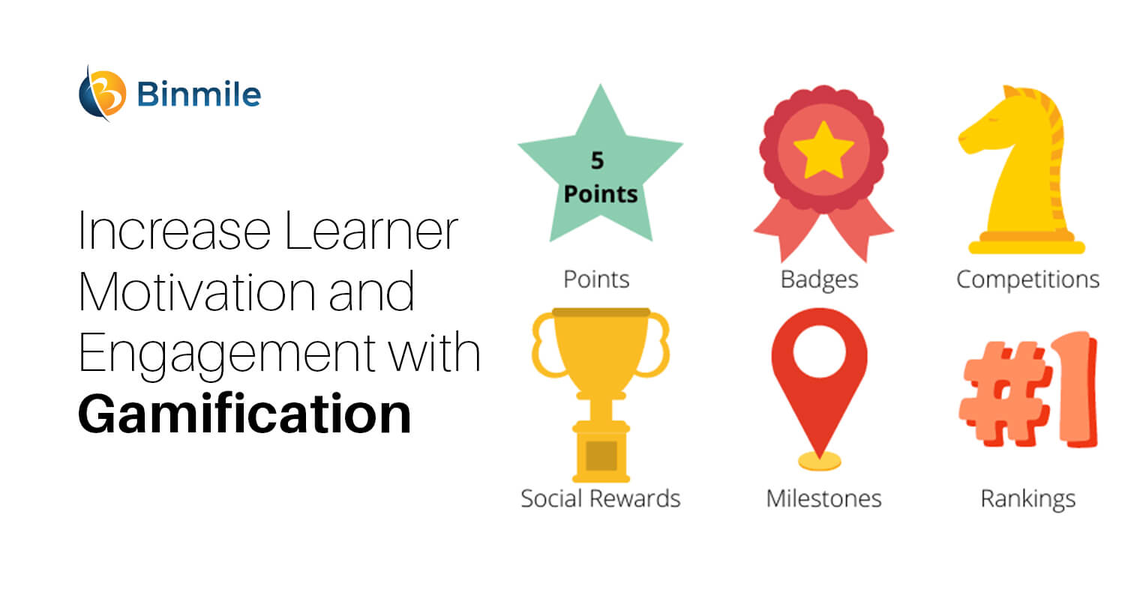
What is Gamification?
The whole purpose of AI in education is to improve learning practices and make them more engaging. Gamification could be one powerful tool to achieve that. It transforms traditional learning into interactive games and activities. Imagine students solving math problems through a point-based competition or exploring historical events through a simulated role-playing game. Gamification keeps students motivated and actively involved in their learning journey.

Slide 16
Gamification efforts have shown positive effects on student engagement, affect, and
learning outcomes.
Benefits of gamifying the classroom: increased motivation, engagement, and retention

Slide 17
Resources:
Adare-Tasiwoopaapi, S., & Silva, D. (2024). Gamification in higher education: A how-to instructional guide. Routledge. https://www.routledge.com/Gamification-in-Higher-Education-A-How-To-Instructional-Guide/Adare-Tasiwoopaapi-Silva/p/book/9781642673937
Bowen, J. A., & Watson, C. E. (2024). Teaching with AI: A practical guide to a new era of human learning. Johns Hopkins University Press. https://www.aacu.org/publication/teaching-with-ai
Cornell University Center for Teaching Innovation. (n.d.). Generative artificial intelligence. https://teaching.cornell.edu/generative-artificial-intelligence
Furze, L. (2024, July 22). More practical strategies for GenAI in education: Part 1. Leon Furze. https://leonfurze.com/2024/07/22/more-practical-strategies-for-genai-in-education-part-1/
Shell, D. F., & Damour, L. (2023). The AI classroom: The ultimate guide to artificial intelligence in education. EduPress. https://www.amazon.com/Classroom-Artificial-Intelligence-Education-Hitchhikers/dp/1959419110
TeachThought. (n.d.). 20 examples of gamification in the classroom. TeachThought. https://www.teachthought.com/the-future-of-learning/examples-gamification/
l University Center for Teaching Innovation. (n.d.). Generative artificial intelligence. Cornell University Center for Teaching Innovation. (n.d.). Generative artificial intelligence.
HigherEd GenAI resources

Slide 18
Questions?
Workshop 1-
Thank you for your valuable feedback!
https://www.surveymonkey.com/r/K6JKVPN

Slide 19
S
Contact Information:
Lana Browning
Kentucky State University
lana.browning@kysu.edu

