Slide 1
Reimagining Assessment and Accountability Framework 4.0
Dr. Robbie Fletcher, Commissioner of Education

Slide 2
Three Priorities
Vibrant Learning Experiences for every student.
Encouraging Innovation, especially around assessment.
Creating a Bold New Future for Kentucky’s schools through collaboration with our communities.

Slide 3
Kentucky United We Learn Council
Formed to engage a community of interested stakeholders in the design, development and coordination of activities to bring the United We Learn vision to life.
Led by the Kentucky Department of Education (KDE)
Funded by a federal grant from the U.S. Department of Education
Diverse representation of approximately 50 educators, students, families and community members from across Kentucky
Local Laboratories of Learning (L3) Collaboration

Slide 4
Kentucky United We Learn Council’s Journey to the Moon

Slide 5
Iterative Development Process
Continuous Stakeholder Feedback
Surveys, Focus Groups, Reports and Memos
Four Prototypes
1.0 (May 2024) - 4.0 (Fall 2024)
Four Frameworks
1.0 (November 2024) - 4.0 (April 2025)

Slide 6
Regional Town Hall Information January and February 2025
Attendance
Over 600 Participants
Frequency
9 Town Halls; hosted with the Regional Educational Co-ops
Structure
Welcome – Commissioner of Education Robbie Fletcher
What is Vibrant Learning – KDE Staff
Local Accountability in Action – Various District Staff
Framework 2.0 - Jennifer Stafford, KDE Division Director, OAA
Wows! And Wonders?
Common Themes
Assessments
Local Accountability
Vibrant Learning Experiences (VLE)
Social Studies and Science
Student Growth
Equity Concerns
Inclusion of Special Education
Federal Requirements and Implementation Timeline

Slide 7
Reimagining Assessment
and Accountability
Framework 4.0

Slide 8
The System

Slide 9
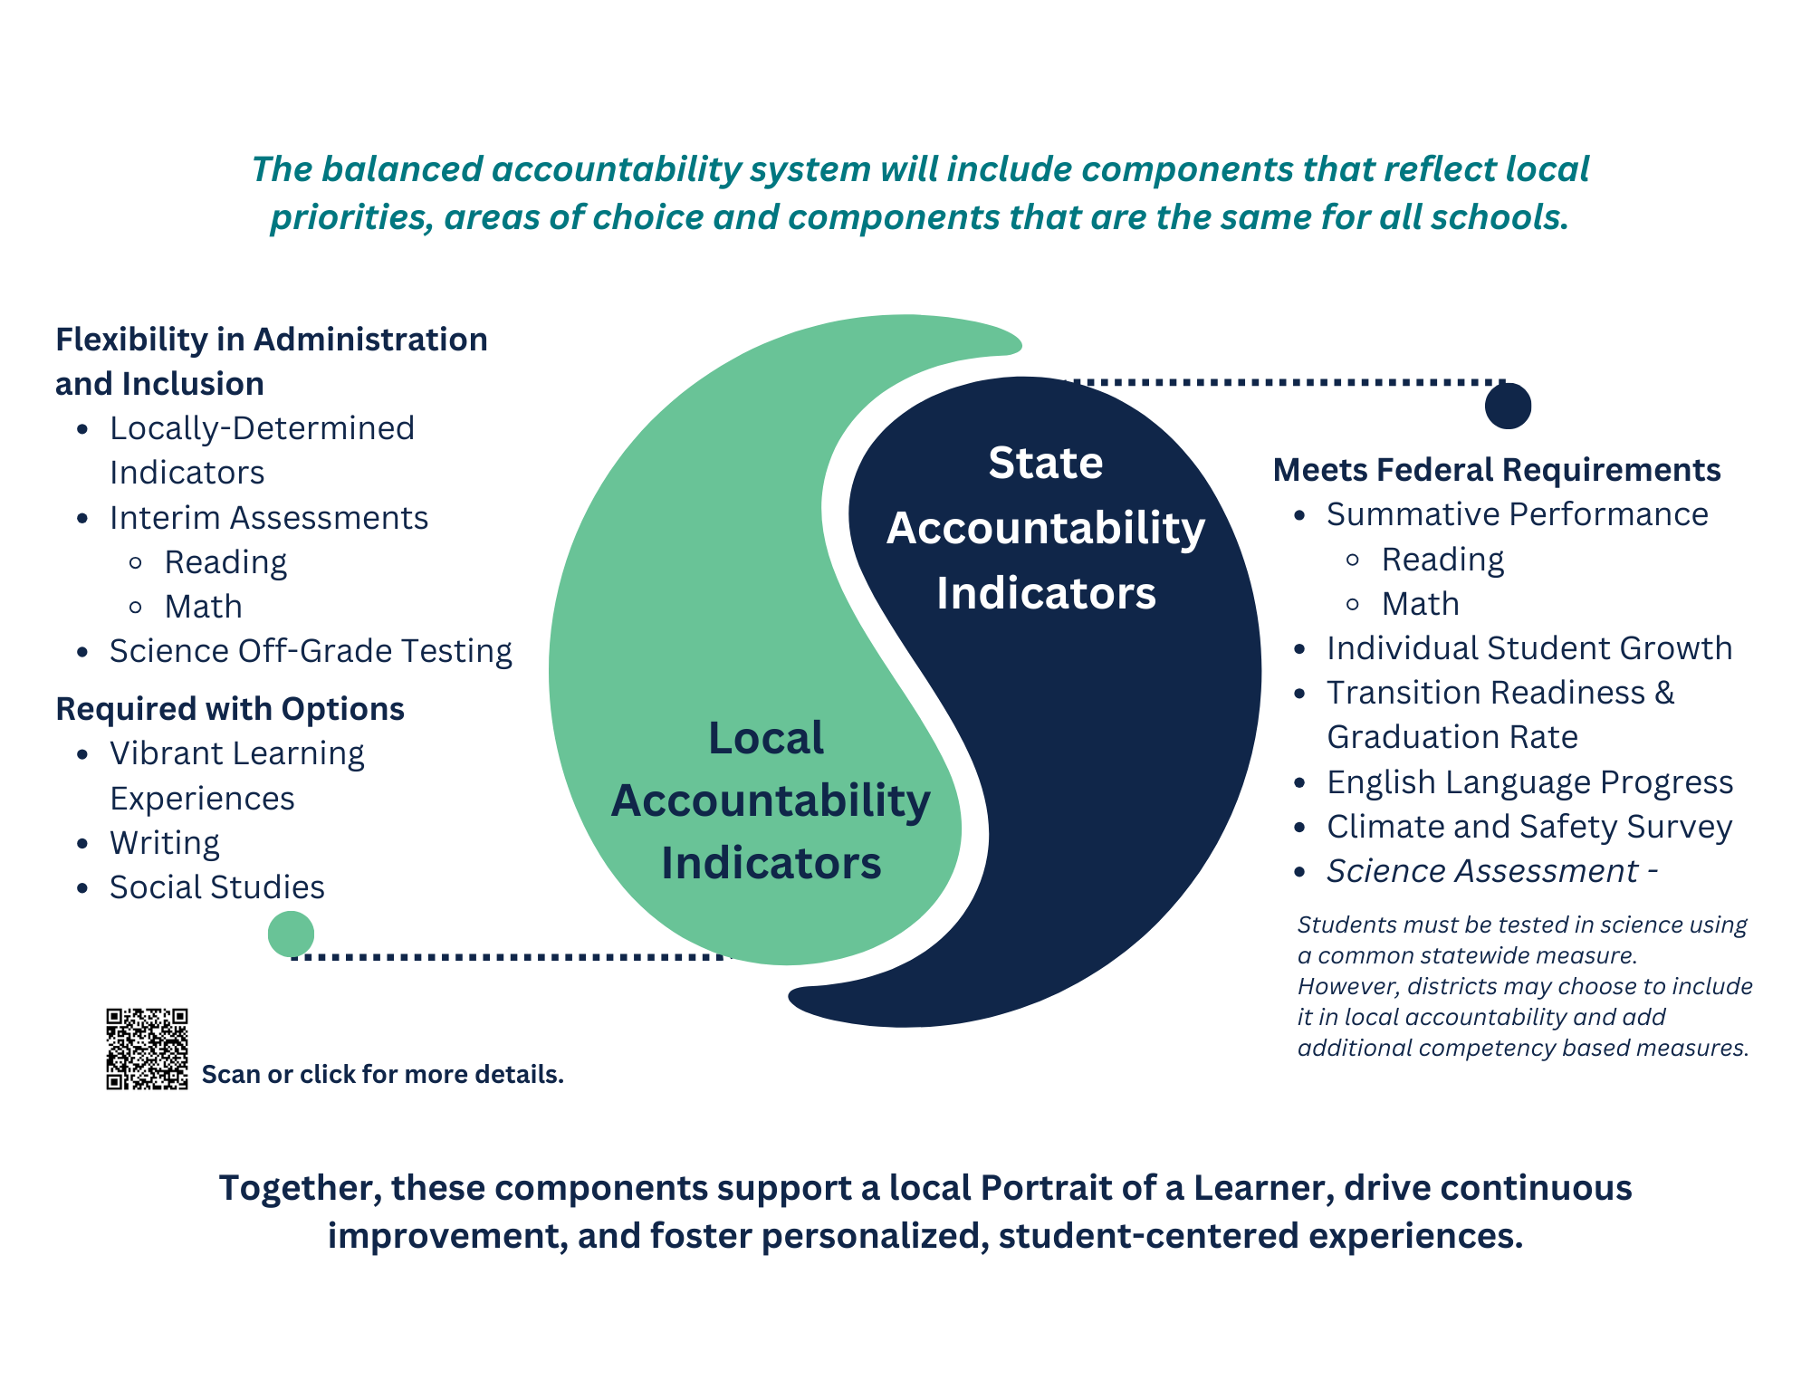
Indicators

Slide 10
Phased in Approach

