Slide 1



Where Kentuckians Find Their Futures
Amanda Ellis, Ed.D., Senior Vice President, Student Access and Success, CPE
Jessica Fletcher, MPA, Program Director, Partnerships and Outreach, CPE

Slide 2
Choose Your Career Path Career exploration for
K-12 students, adult learners & military veterans.
Continue Your Education
Find your major and choose a school, find financial aid options.
Start Your Career
Create your resume, land the interview and the job you’ve been working toward.
Objective
To create a platform that Kentuckians can use to visualize their paths from classroom to career.
Goal
To increase Kentucky’s educational attainment and labor force participation rates so they meet or exceed the national average.

Slide 3
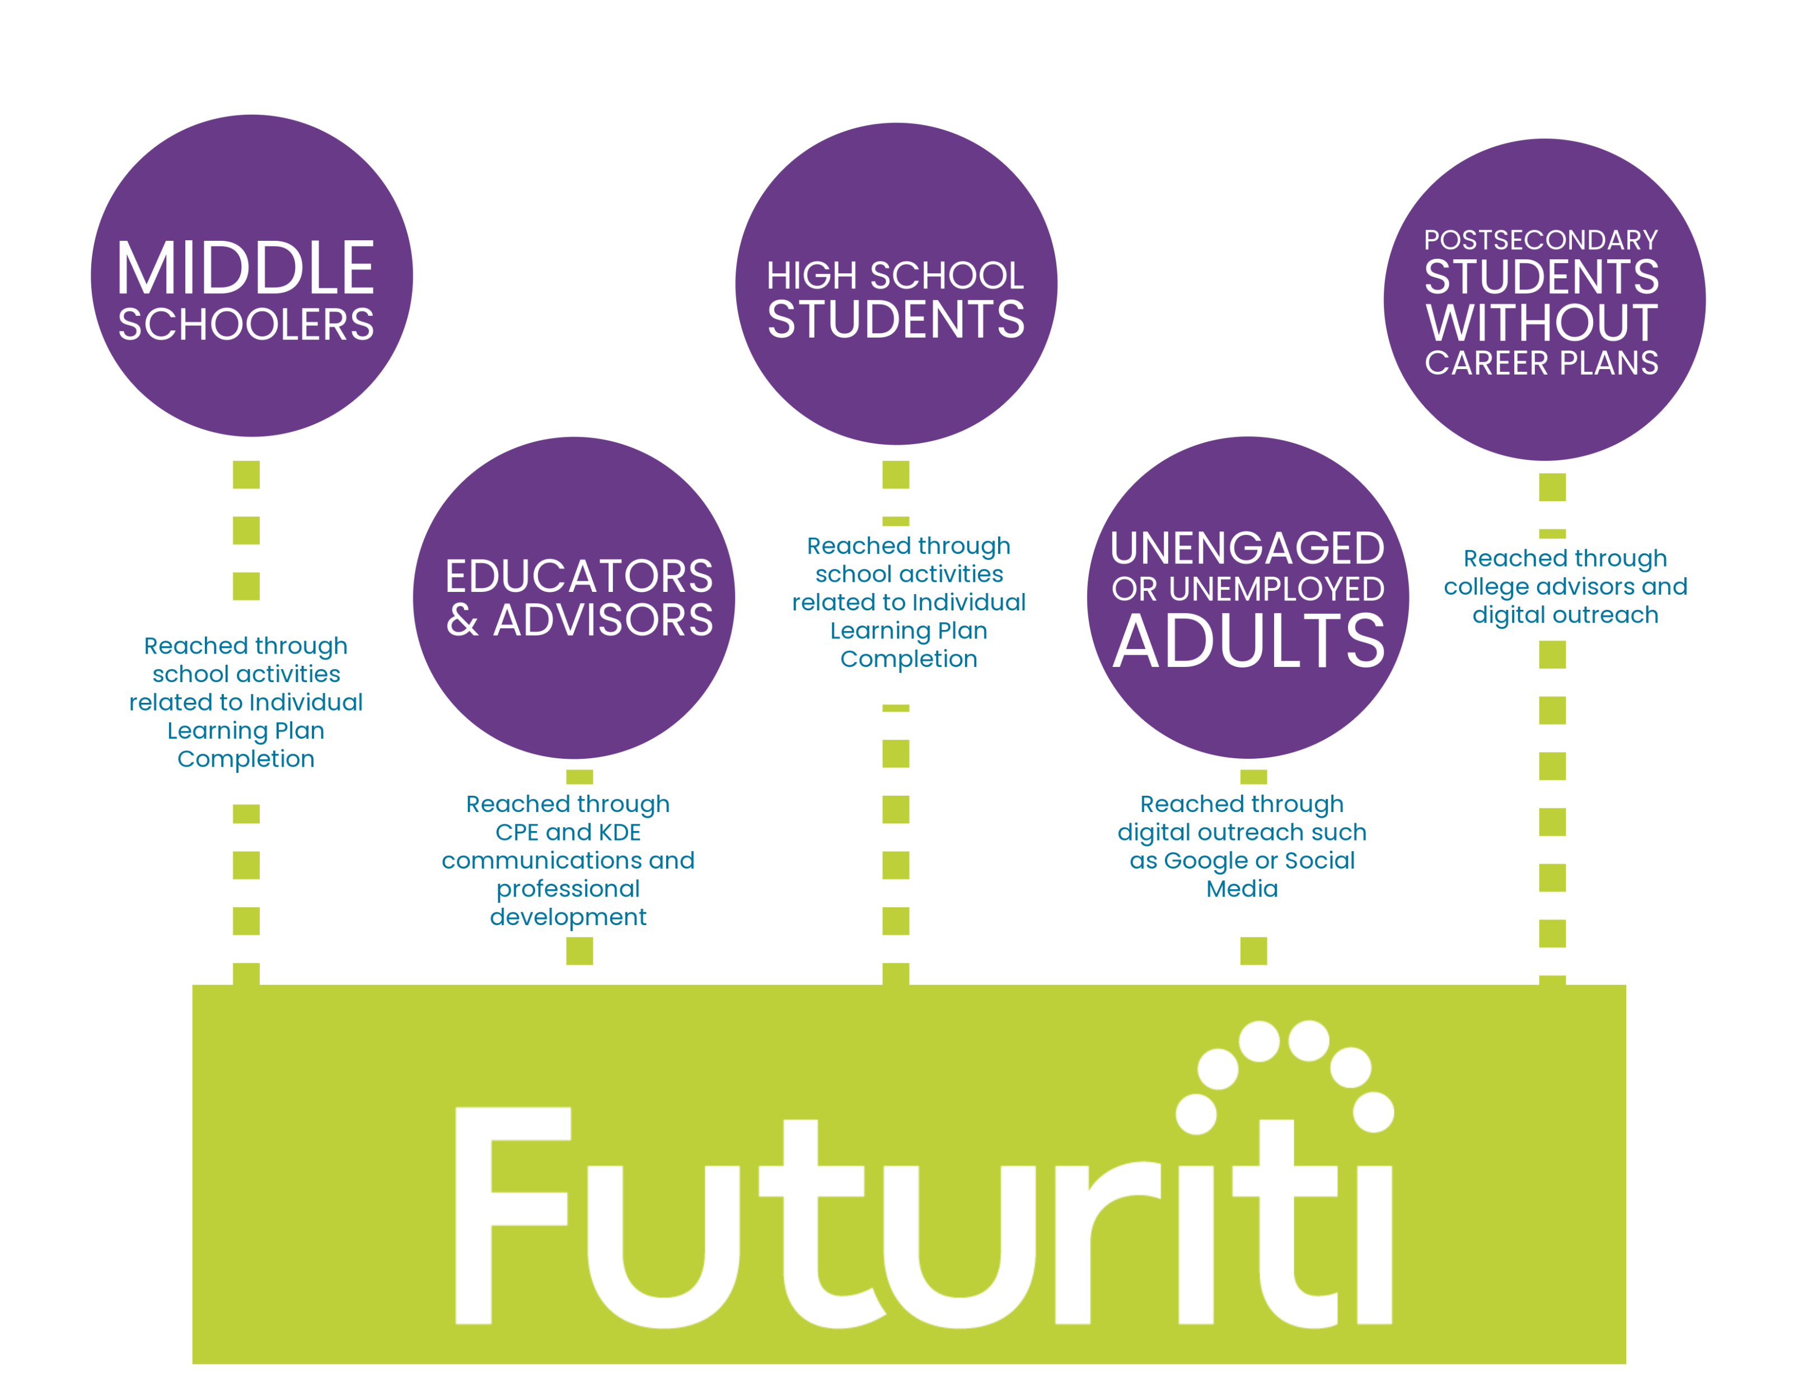
Audiences
& Outreach

Slide 4







There are many unconnected online resources, but there has never been a mechanism to connect the dots for our citizens to help them on their paths to sustainable careers.

Slide 5
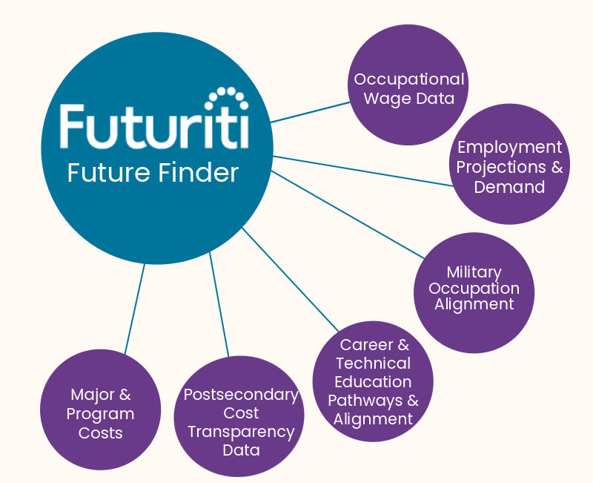
Future Finder
Data from
KYSTATS

Slide 6
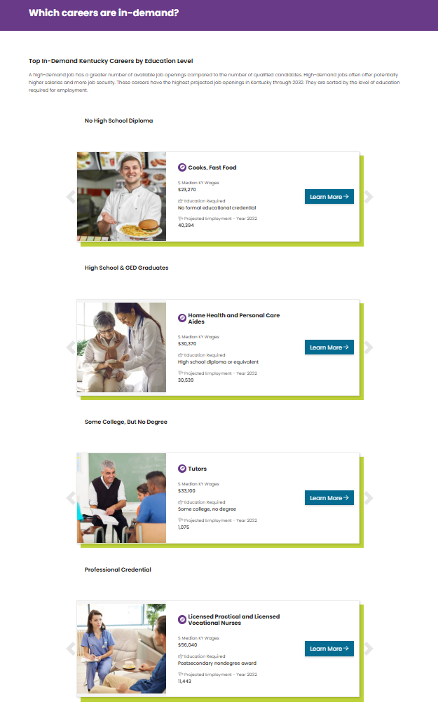
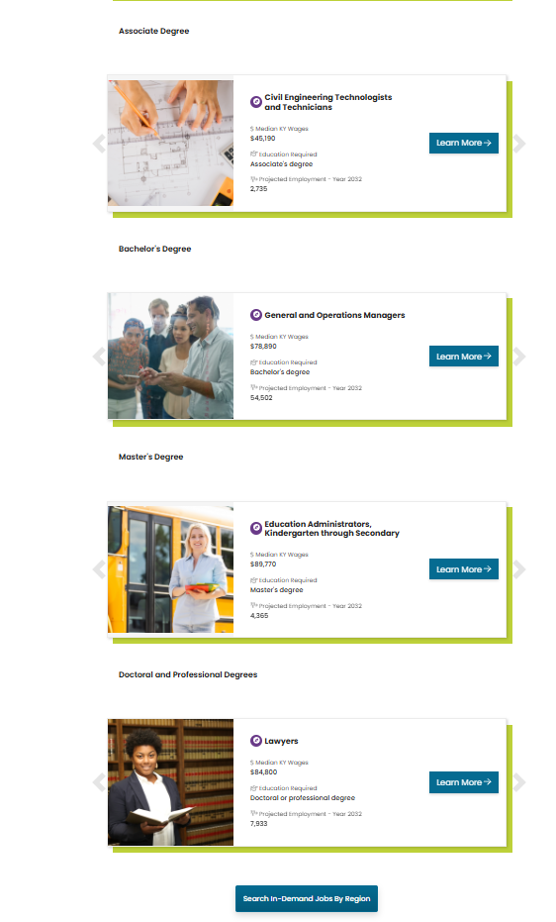

Slide 7
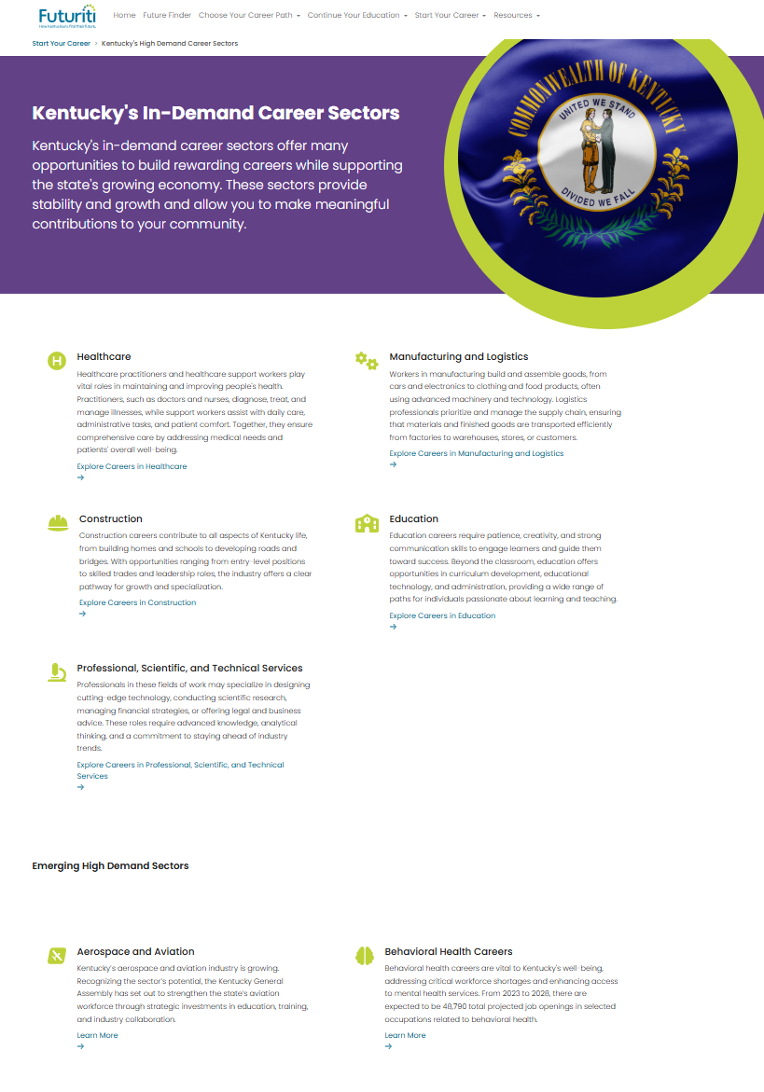

Slide 8

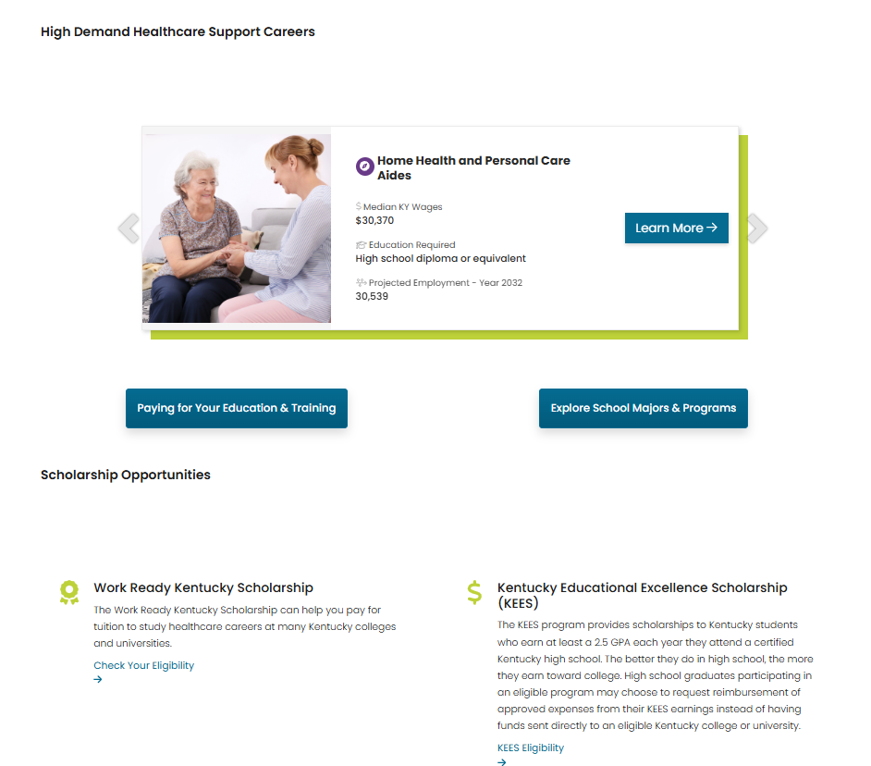

Slide 9
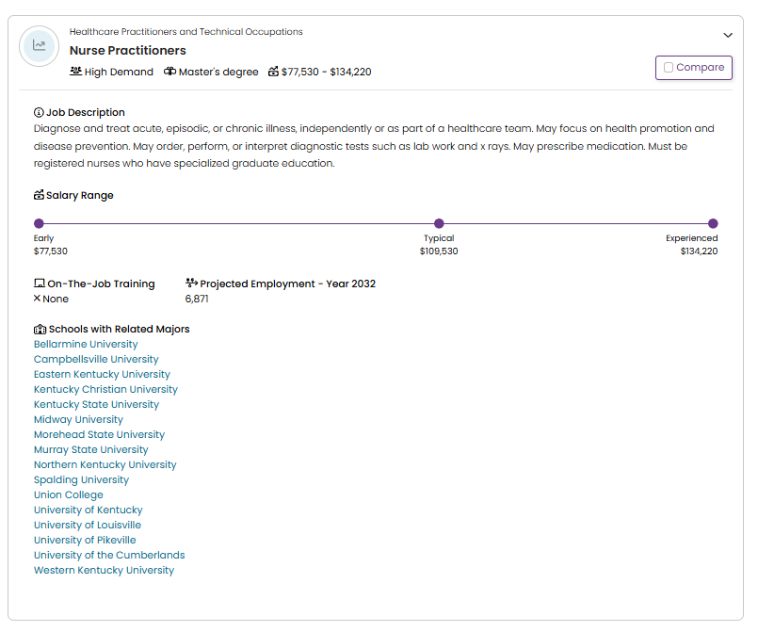

Slide 10
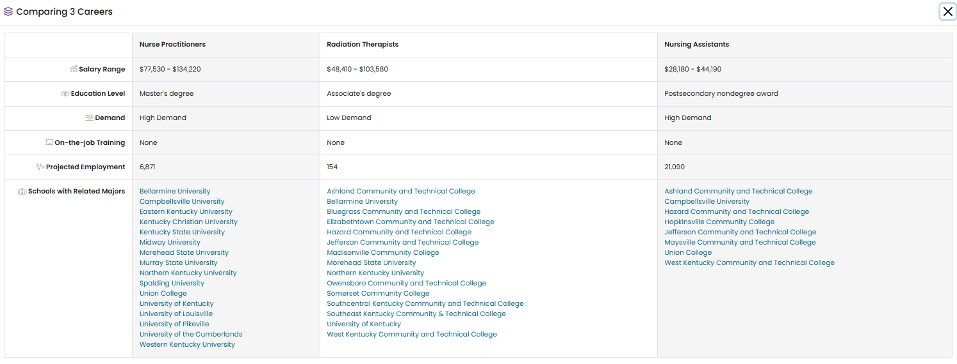

Slide 11
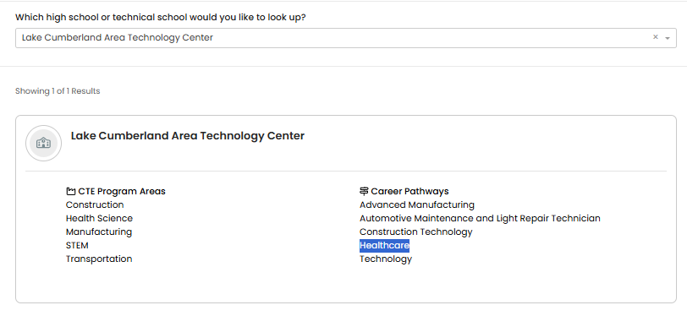
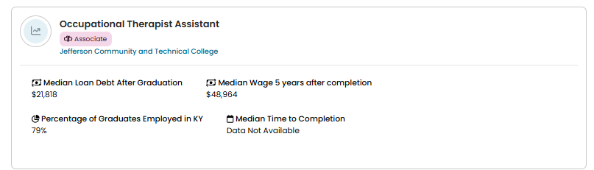

Slide 12
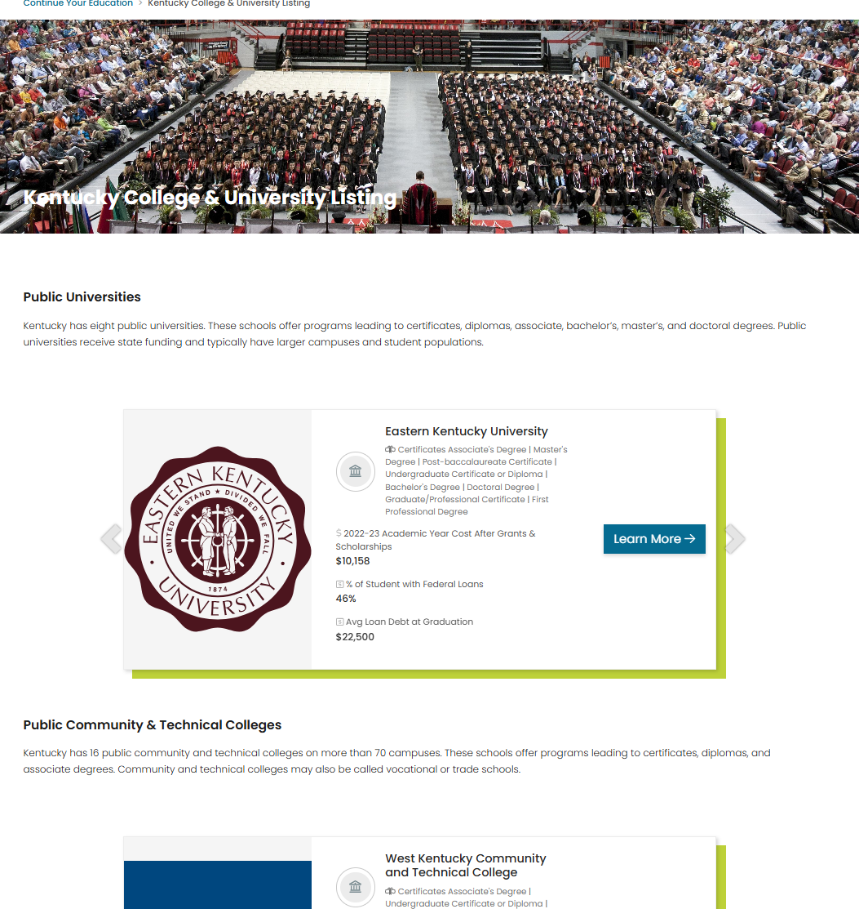
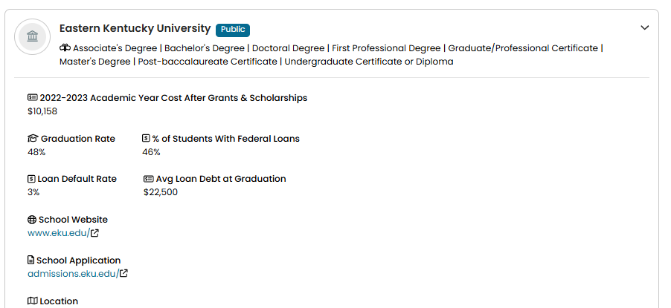

Slide 13
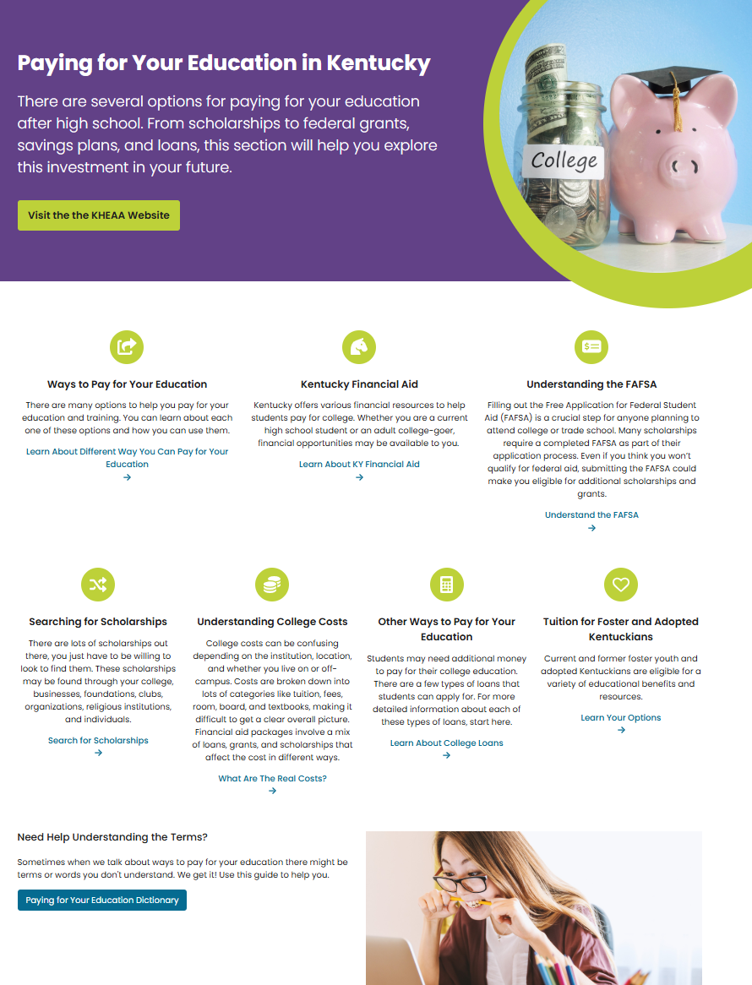

Slide 14
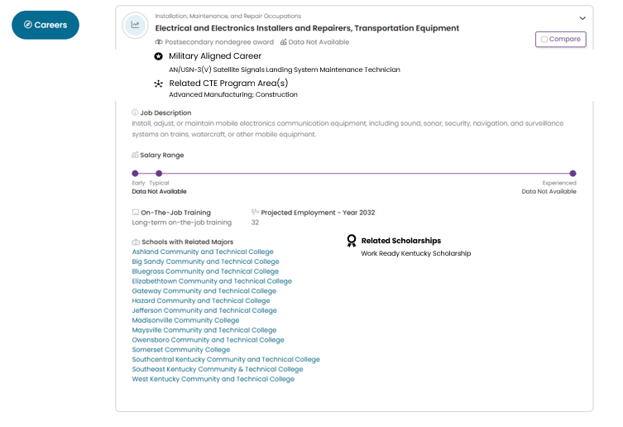
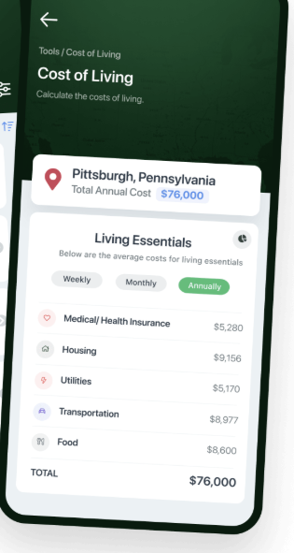


Expansion Projects
Lexington, KY
Related Apprenticeships
Independent Electrical Contractors Association
Louisville Electric
Related Kentucky Businesses
Mr. Electric of Central Kentucky
Dixon Electric Inc
Elliot Services
Fayette Heating and Air

Slide 15
KENTUCKY’S SOLUTION
FOR FINDING YOUR FUTURE

