Slide 1
Interim Joint Committee on Education
July 14, 2025

Slide 2

Welcome, and thank you for continued support of higher education and UofL.
Notes:
Personal background

Slide 3
Great Place to Learn Student Success

Slide 4
Student Body Snapshot
Total Enrollment (Fall 2024): 24,123 – historic record
  Undergraduates: 17,248
  Graduate & Other: 5,204
  Professional: 1,671
 | Fall 2020 | Fall 2021 | Fall 2022 | Fall 2023 | Fall 2024 | 4-Year % Change
Undergraduate Students (total) | 16,118 | 15,830 | 16,121 | 16,397 | 17,248 | 7.0%
First Generation ¹ | 4,437 | 4,830 | 5,308 | 5,777 | 6,125 | 38.0%
Pell Eligible* | 7,069 | 7,047 | 7,158 | 7,281 | 7,177 | 1.5%
Transfer | 1,613 | 1,511 | 1,633 | 964 | 1,241 | -23.1%
*Undergraduate only

Slide 5
Student Body Snapshot
Demographics:
  119 of 120 Kentucky counties represented
  54 U.S. states & territories, 91 countries
  43.6% Pell-eligible students
  34.3% First-generation students
  2,590 military-connected students
  (10% increase over 3 years)

Slide 6
Student Body Snapshot
Access & Affordability Initiatives:
  Expanded Cardinal Commitment Grant for low-income Kentucky students
  Programs such as 15 to Finish, Comeback Cards, and border-state tuition initiatives
  Strong partnerships with KCTCS; UofL is a top transfer destination
  39.1% increase in transfer students in 2 years (868 to 1,207)
  3 UofL admissions counselors are embedded on KCTCS campuses

Slide 7
Student Body Snapshot
Student Success Outcomes:
  Fall-to-Fall Retention:
  81.5% (record high)
  Fall-to-Spring 2025 Persistence: 94.2%
 | 2023 | 2024 | 2025**
Overall Fall Enrollment | 23,225 | 24,123 | 25,204
FTIC* | 3,117 | 3,125 | 3,425
Y1 Fall to Y2 Fall | 80.5% | 81.5% | 83.6%**
Y1 Fall to Y1 Spring | 92.3% | 92.7% | 94.2%
Y1 Fall to Y2 Spring | 71.3% | 73.9% | 76.1%
Y1 Fall to Y3 Spring | 63.0% | 64.8% | 66.3%
Graduation Rate | 60.6% | 61.1% | Available Fall 2025
*First time in college. **Preliminary

Slide 8
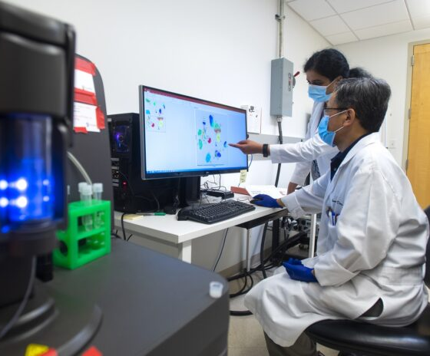
Student Body Snapshot
Recognition & Designation:
  UofL is one of only 19 public universities nationwide with both:
    Research 1 (R1) classification
    Opportunity College & University (OCU) designation – high access, high earnings
  Only ACC institution and one of two public institutions in Kentucky with OCU
UofL researchers use a mass cytometer to help improve the effectiveness of cancer immunotherapies.

Slide 9
Great Place to WORK Employee Excellence

Slide 10
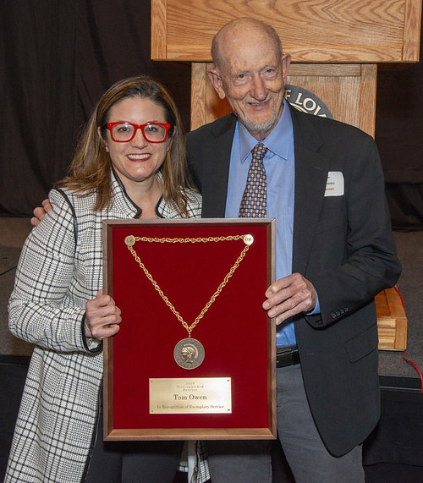
Employee Excellence
  UofL and UofL Health employ more than 18,000 people – 2nd largest employer in the Louisville Metro area
  Commitment to:
    Staff and faculty engagement on campus and in the community
    Professional development and career growth opportunities
  Competitive benefits and strong work-life balance

Slide 11
Great Place to CONNECT Outreach & Community Engagement

Slide 12
OUTREACH & COMMUNITY ENGAGEMENT
Workforce & Health Impact:
  Largest producer of bachelor’s-prepared nurses in Kentucky.
  Statewide health outreach through:
    Redbird Clinic, Owensboro, Paducah, Madisonville, Shelbyville, West Louisville, plus partnership with UofL Health.
  $25M Center for Rural Cancer Education and Research under construction at UofL Health South Hospital in Bullitt County, improving access to cancer care for rural Kentuckians.

Slide 13
OUTREACH & COMMUNITY ENGAGEMENT
Manufacturing & Economic Development:
  KY Manufacturing Extension Partnership (MEP) supports modernization of small and mid-sized manufacturers statewide.
National Recognition:
  Carnegie-designated “Community Engaged University”.

Slide 14
Great Place to DISCOVER Research & Innovation

Slide 15
RESEARCH & INNOVATION
Record Research Expenditures (2025): $204 million
  Includes $67M from NIH and $6.75M from Humana Foundation
Signature Research Projects:
  Green Heart Louisville –
  internationally recognized urban health initiative
  Louisville Clinical & Translational Research Center –
  $24M investment to train clinical researchers

Slide 16
RESEARCH & INNOVATION
Strategic Designations:
  Reaffirmed R1 status by Carnegie – highest research activity.
  One of only 10 public universities nationwide with all three designations:
    Research 1 (R1)
    Opportunity College & University (OCU)
    Carnegie “Community Engaged”
    (Peers include Arizona State University Campus Immersion, San Diego State University, University of Central Florida, Florida Atlantic University, Florida International University, Southern Illinois University-Carbondale, University of Texas at El Paso, University of Texas at San Antonio, University of California-Merced)

Slide 17
Unprecedented Legislative Partnership
Over $500 million in legislative support received in 2024
  $260M for Simulation Center and Collaboration Hub
  $90M+ for Asset Preservation and renovations
  Continued support for new Engineering Building
  Investment in the UofL Health Center for Rural Cancer Education and Research
  Funding for MEP initiative, modernizing the state’s manufacturing infrastructure via grants distributed to small and medium sized manufacturers

Slide 18
Strategic Focus:
President Bradley’s First 100 Days

Slide 19
Strategic Focus:
A. FY26 Annual Budget
B. Implementation of KRS 164.2895
C. Changes in federal funding that may impact research
D. Strategic Plan 2030
E. UofL Health & University Affiliation Agreement
Notes:
A. FY26 Annual Budget
Budget alignment with UofL’s four strategic pillars:
Learn, Work, Discover, Connect
Challenges of the rising costs to educate students, especially as demand is growing in more high-cost fields of study.
B. Implementation of KRS 164.2895
Compliance with the law as passed by the 2025 General Assembly.
Opportunity and access to all students. Emphasis on student success to provide all students with the tools they need to be successful, earn a degree, and enter the workforce.
C. Strategic Plan 2030
Refreshing and updating the 2023 strategic plan
Maintaining four-pillar structure while adding new action steps
Broad shared governance and community input
Target: draft ready for Board review and public engagement
D. UofL Health & University Affiliation Agreement
First update since UofL Health was created in 2019
Goal: deeper clinical-academic integration
Enhanced statewide health service delivery

Slide 20
Closing
  UofL is fulfilling its mission as Kentucky’s premier urban research university
  Historic success in enrollment, student outcomes, research, and outreach
  Serve as a major economic, health care, research and educational resource for the Commonwealth of Kentucky.
  Deep gratitude to the Kentucky General Assembly – your partnership is shaping the future of Kentucky through education, innovation, and service

