Slide 1

Presentation to KY Joint Interim Committee on Education
Dr. Monica A. Beane, NBCT, Head of Educational Partnerships
Lisa Hedrick, Director Educational Partnerships
August 2025

Slide 2

Topics
ETS Overview
The Praxis Program
Resources and Support
Kentucky Context

Slide 3
ETS Overview

Slide 4



ETS
Talent & Workforce
A global education and talent solutions non-profit organization enabling lifelong learners to be future ready
Science of Measurement
Driving innovations in measurement science to power human progress
ETS Research Institute
Conducting and disseminating ground-breaking research to explore new, more inclusive approaches to learning, measurement and instruction
Notes:
ETS is a global education and talent solutions organization, enabling lifelong learners to be future ready.
We advance the science of measurement to build the benchmarks for fair and valid skill assessment.
We are committed to powering human progress by promoting skill proficiency, upward mobility, and unlocking more opportunities for everyone, everywhere.
Our assessment products help people to clarify their strengths and find opportunities for growth.

Slide 5
The Praxis Program

Slide 6
Purpose of Licensure Assessments
Licensure tests provide a consistent measure of teacher candidate abilities regardless of the route by which a teacher receives preparation and training.
Licensure tests assure parents, policymakers, and communities that teachers have the knowledge needed to enter the classroom based upon widespread agreement by practitioners in the profession.
Licensure is a form of public protection assuring that aspiring teachers have the requisite knowledge and skills necessary for safe and effective beginning level practice.

Slide 7
Test Development
Determine Content Domain
Development Advisory Committee
Job Analysis Survey
Design Structure of Test
National Advisory Committee
Confirmatory Survey
Develop and Administer Test
Educator Consultants
Multistate Standard-Setting Study (MSSS) Panel
DEVELOPMENT PROCESS
Practicing educators involved throughout the process
Notes:
Assessments are developed through a process that prioritizes quality, fairness, and relevance to real-world teaching.
We follow guidelines detailed in the Standards for Educational and Psychological Testing which involve diverse committees of practicing educators and university faculty that ensure the tests align with national and state standards.
Large scale surveys of practicing educators confirm these statements so that tests reflect necessary knowledge and skills.
Key components of developing licensure assessments
Collaboration with educators – both practicing teachers and educator preparation program faculty
KY educators have served on advisory committees
Building Validity Evidence throughout the process
Annual review for currency by standing committees
Revisions when directed by the field

Slide 8
Praxis Series
Praxis Basic Skills
Praxis Content Assessments
Praxis Pedagogical Assessments
Purpose: To measure skills that are critical to learning and achievement in a preparation program
Reading measures the ability to understand, analyze & evaluate texts.
Writing measures the ability to use use standard written English correctly and effectively.
Mathematics measures the ability to solve problems and to reason in a quantitative context
Purpose: To measure content knowledge proficiency in a particular subject area
Subject area tests provide evidence that candidates have acquired the knowledge and skills for beginning practice.
Examples: Elementary Education, Teaching Reading, Mathematics, Social Studies, etc.
Purpose: To measure knowledge and understanding of foundational educational practices
Pedagogical practices such as Student Development & Learning Process, Instructional Process, Assessment, Professional Development, Etc.
Examples: K-6, 5-9, or 7-12 Principles of Teaching and Learning,

Slide 9
Resources and Support

Slide 10
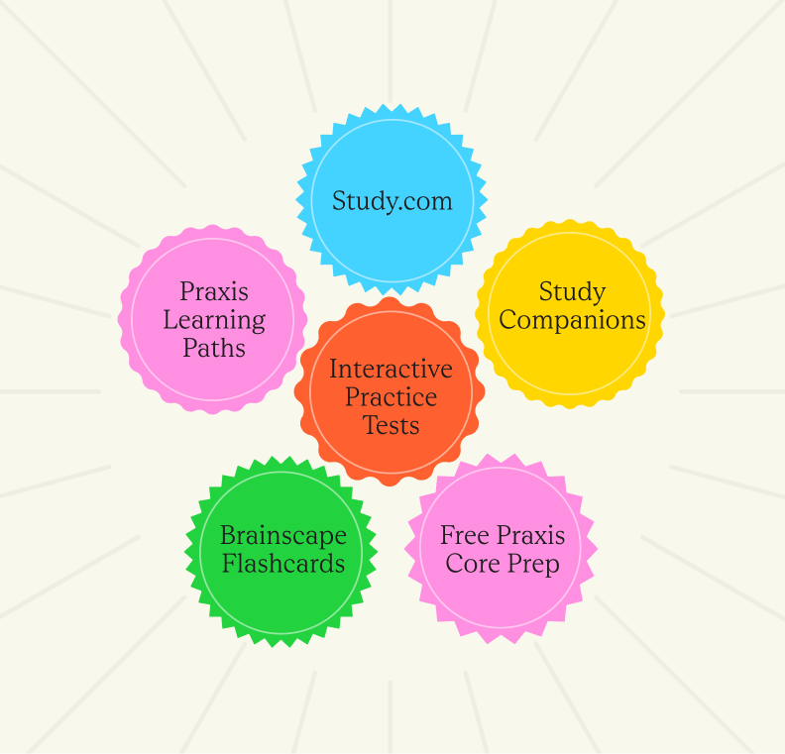
Test preparation that makes a difference
Free Study Companions
Free Study Plans
Free Interactive Practice Test (IPT)
Free Study.com Praxis Core Prep
Study.com courses for Praxis Subject Matter Assessments
Brainscape Mobile Flash Cards
Praxis Learning Paths
eBooks

Slide 11

EPP Resources
Curriculum Crosswalks
Title II Reporting Services
ETS Data Manager Access
Test Content Review
Deep-dive Data Sessions
In-person Campus Representation
Bulk Pricing for EPP Purchases
Flexible Voucher Program
Monthly Newsletter, The Praxis Beacon
Tomorrow's Teacher Blog

Slide 12
Kentucky Context

Slide 13
Kentucky Support
Praxis Director of Educational Partnerships
  Kentucky Educator Preparation Programs
  Kentucky Department of Education
  Kentucky Association of Colleges for Teacher Education (KACTE)
  Kentucky District Human Resources
Engagement in Kentucky
  KY EPSB Presentations – December 2024 and February 2025
  JCPS HR Meeting – February 2025
  KiTEP - Review of ETS Data Manager & use for preparation program improvement
  KACTE- Summer 2025 – ETS Data Manager Overview and Workshop Offerings

Slide 14
Q & A

Slide 15

Thank you!
Lisa Hedrick
Director, Educational Partnerships
lhedrick@ets.org
praxis.ets.org

