Slide 1
Kentucky Academic Standards for
Reading and Writing
Interim Joint Committee for Education
August 18, 2025

Slide 2
Statute and Regulation
KRS 158.6453(2)
Requires the Kentucky Department of Education to implement a process for reviewing Kentucky’s academic standards every six years.
704 KAR 8:020, Required academic standards for reading and writing
This amended administrative regulation will adopt into law the revised “Kentucky Academic Standards for Reading and Writing.”

Slide 3
KRS 158.6453(2)(b)
Review of Academic Standards
“The revision to the content standards shall:
Focus on critical knowledge, skills and capacities needed for success in the global economy;
Result in fewer but more in-depth standards to facilitate mastery learning;
Communicate expectations more clearly and concisely to teachers, parents, students and citizens;
Be based on evidence-based research;
Consider international benchmarks; and
Ensure that the standards are aligned from elementary to high school to postsecondary education so that students can be successful at each education level.”

Slide 4
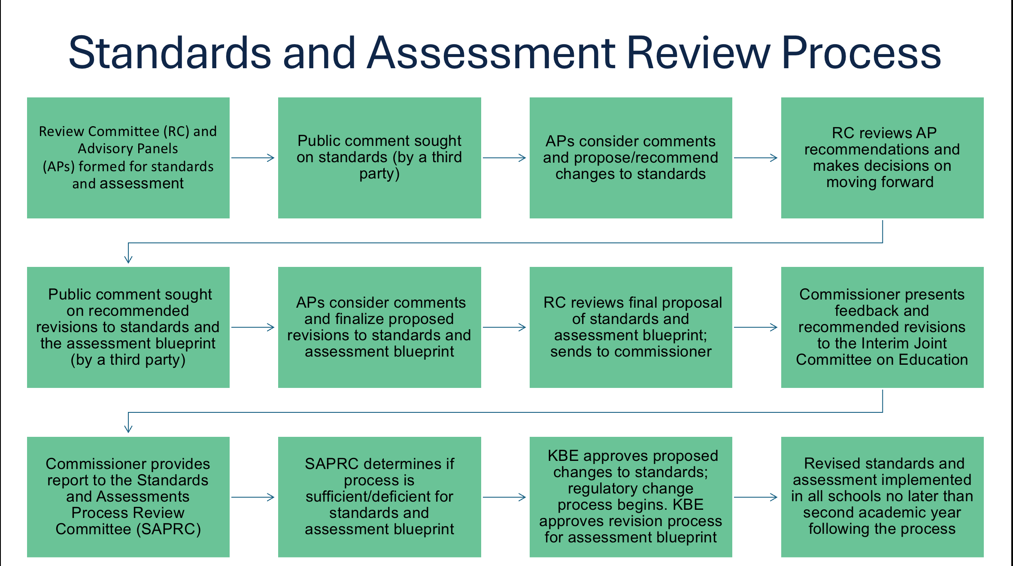
Process

Slide 5
Standards Process Review Timeline
October 2024: Call for participation on standards committee opened
November 1 – 30, 2024: Current reading and writing standards open for initial public comment/feedback
January 14 - 16, 2025: Advisory Panels (APs) and Review Committee (RC) meetings
January 27, 2025: APs and RC identify recommended changes to be released for public comment
February 3 - March 5, 2025: Recommended changes to reading and writing standards released for second public comment/feedback
February 10 - March 12, 2025: Reading and Writing Assessment Blueprint released for public comment/feedback
March 2025: APs and RC review public feedback and finalize recommendations
August 2025: Recommendations and public feedback presented to the Interim Joint Committee on Education

Slide 6
Writers’ Vision
The writing team strives to provide vertically aligned standards that lend themselves to evidence-based practices and access to grade-level learning opportunities for each student
Reading and responding to complex texts are integral components of every K-12 classroom and provide access to rigorous grade-level content
Reading comprehension is both a process and a product for developing both oral language and reading abilities
Vertical alignment of standards reflect cohesive evidence-based practices that emphasize reflective and expressive language
Standards engage students in reading and writing daily as reciprocal skills and processes

Slide 7
Initial Public Comment Period
Initial public comment period allowed respondents to provide feedback on the current Kentucky Academic Standards (KAS) for Reading and Writing
Over 300 responses received during the initial public comment period from a variety of stakeholder groups, including:
  Teachers and administrates
  Parents and guardians
  Business and community partners
  Postsecondary education representatives
For each standard, respondents were asked to select “keep as-is” or “revise”
  95% of K-5 standards approved “as-is”
  97% of grades 6-8 standards approved “as-is”
  95% of grades 9-12 standards approved “as-is”
For each standard respondents selected to “Revise,” they were prompted to give their reasoning, suggestions and/or comments
Based on public feedback, a total of 12% of standards were revised

Slide 8
Draft “KAS for Reading and Writing”
Revision Highlights
Revised foundational skills to reflect current research and evidence-based practices for teaching early literacy:
  K-2 standards related to reading decodable texts for the purpose of fluency
  K-5 standards related to encoding and decoding words
Revised Reading Standard 10 for K-12 Reading Literature and Informational Text emphasizes the importance of knowledge and strategies for reading comprehension
Updated standards writers’ vision statement
Improved document design colors, logos and fonts for consistency with other disciplines and improved usability
Updated Interdisciplinary Literacy Practices visual and content and included before each grade-level overview for ease of document navigation
Emphasized experiences grounded in complex texts and evidence while composing for a wide range of purposes and audiences

Slide 9
Second Public Comment Period
The second public comment period allowed respondents to provide feedback on the revised Kentucky Academic Standards (KAS) for Reading and Writing
Over 400 responses received during the second public comment period from a variety of stakeholder groups, including
  Teachers and administrates
  Students
  Parents and guardians
  Business and community partners
  Postsecondary education representatives
Respondents flagged no additional standards for review; the APs and RC reconvened to consider this round of feedback and revised, as needed, to complete the current draft KAS

Slide 10
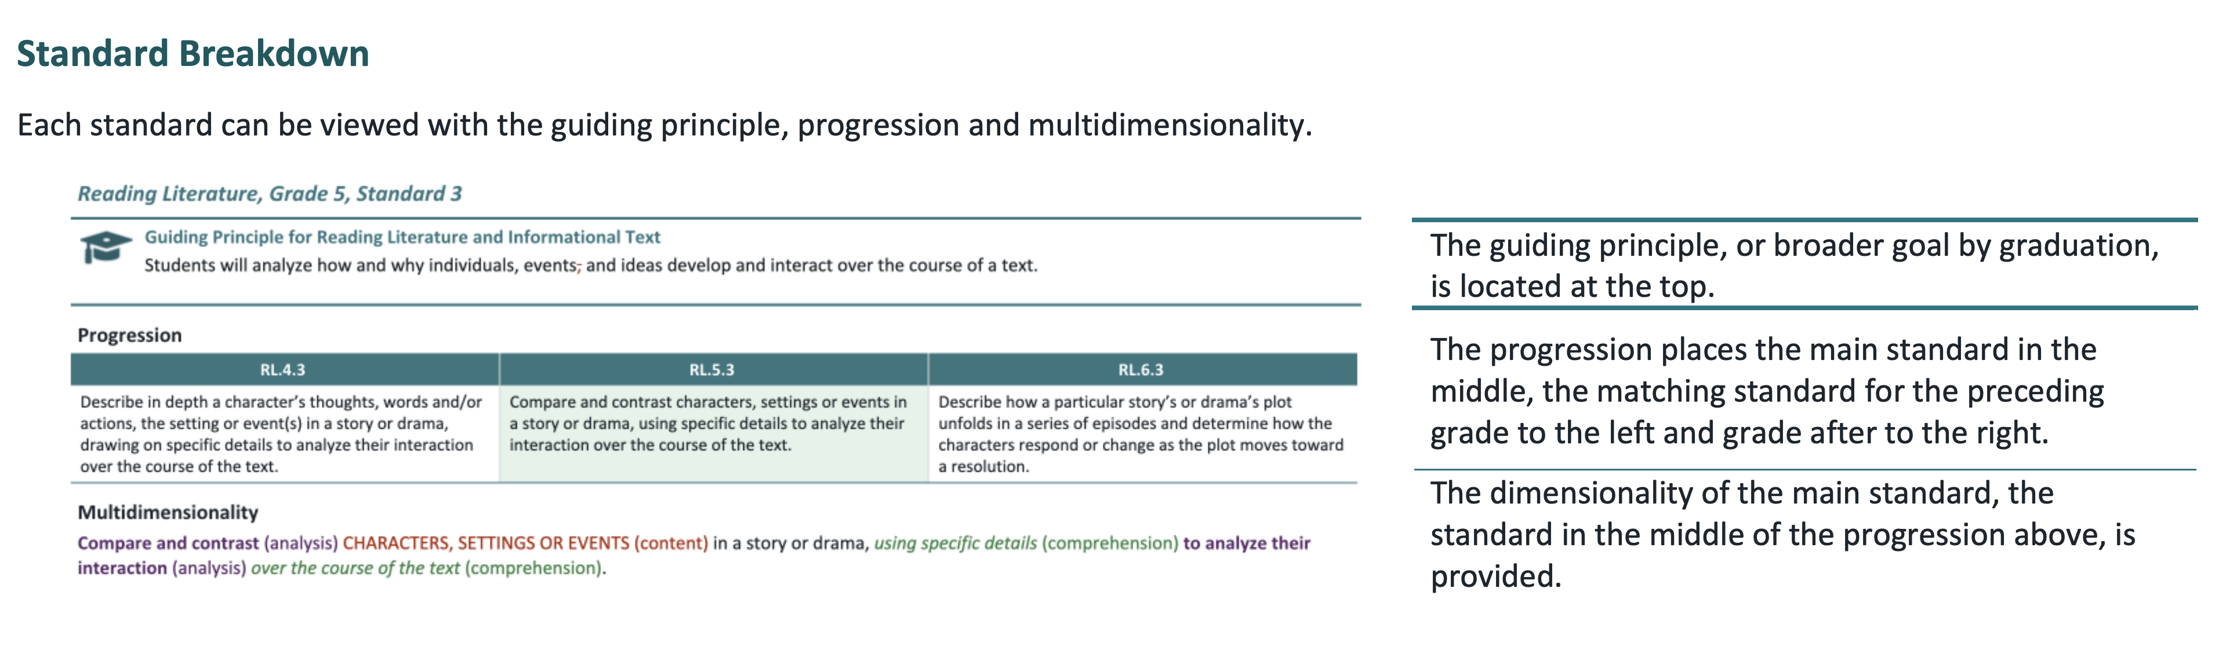
Draft “KAS for Reading and Writing”

Slide 11
Questions?
Kentucky Academic Standards
for Reading and Writing

Slide 12
Committee for Mathematics Achievement
Strategic Plan for Improving Mathematics Achievement in Kentucky
Interim Joint Committee for Education
August 18, 2025

Slide 13
KRS 158.842
Committee for Mathematics Achievement
KRS 158.842(1) establishes the Committee for Mathematics Achievement (CMA) “for the purposes of developing a multifaceted strategic plan to improve student achievement in mathematics at all levels of schooling, prekindergarten through postsecondary and adult.”

Slide 14
Committee For Mathematics Achievement (CMA)
Strategic Plan Development Timeline
Fall 2023 – Spring 2024:
Reviewed statutory purpose and responsibilities of the committee.
Discussed findings of the 2006 strategic plan and reviewed the current landscape of mathematics instruction in Kentucky.
Considered priority areas to be addressed in the 2025 strategic plan.
Re-established priorities and committee composition to align to HB 162 (2024), Kentucky Numeracy Counts Act, and established subcommittees to address plan revisions.
Fall 2024 – Spring 2025:
Subcommittees reviewed feedback and other state comprehensive mathematics initiatives to identify key priority areas for the 2025 strategic plan.
Identified six priority areas for inclusion in the strategic plan to include specific goals and recommended actions for each.
Developed a mission statement and drafted goals to reflect measurable outcomes for P-20 supported by evidence-based research.
Provided a draft plan for review and feedback by committee members prior to its unanimous approval in January 2025.

Slide 15

Mathematics Vision for Kentucky
The Committee for Mathematics Achievement (CMA) envisions a Kentucky where all students can competently and flexibly use mathematical ideas to see the mathematics around them and to think critically and solve problems throughout their lives.

Slide 16


Strategic Plan for Improving Mathematics Achievement in Kentucky
Key Priority Areas

Slide 17
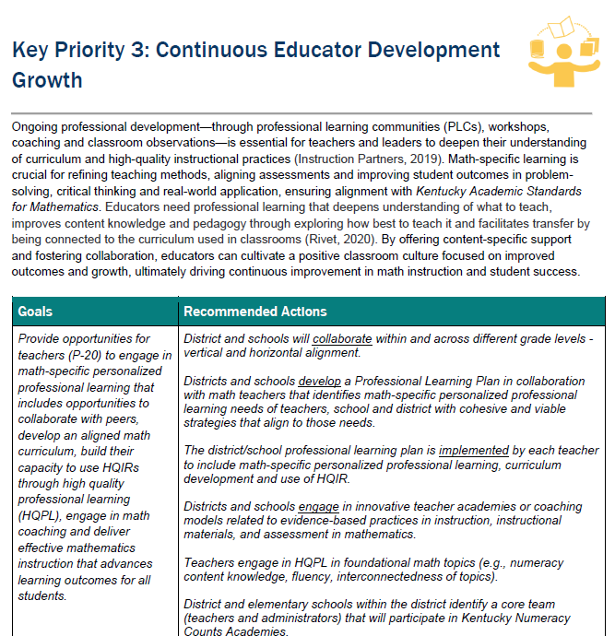
Goals
Key Priority
Clarification
and research basis
Recommended Actions

Slide 18
Alignment to Kentucky Numeracy Counts
Effective Mathematics Teaching and Learning (Priority 2)
Guidance for evidence-based mathematics instruction, intervention, and instructional strategies aligned to the Kentucky Academic Standards (KAS) for Mathematics.
Approved list and support for effective implementation of valid and reliable high-quality instructional resources (HQIRs) for mathematics.
Continuous Educator Growth and Development (Priority 3)
Curriculum-based high-quality professional learning (HQPL) through teacher academies for students in K-8 focused on evidence-based practices in instruction, HQIR implementation and assessment in mathematics.
Leadership academy focused on effective implementation of systems and structures to recognize and support high-quality mathematics instruction.
Network for grant awardees in selecting HQIRs for K-3 and providing curriculum-based professional learning.
Community and Family Partnerships (Priority 5)
Resources to empower families with strategies to support mathematics success at home.
Resources for local community partners to provide additional support to further student proficiency.

Slide 19
Committee for
Mathematics Achievement
Questions?
Micki Ray-Marinelli
Chief Academic Officer
Office of Teaching and Learning
Micki.Ray@education.ky.gov
Chrystal Rowland
Director of the Division of Academic Program Standards Office of Teaching and Learning
Chrystal.Rowland@education.ky.gov

