Slide 1
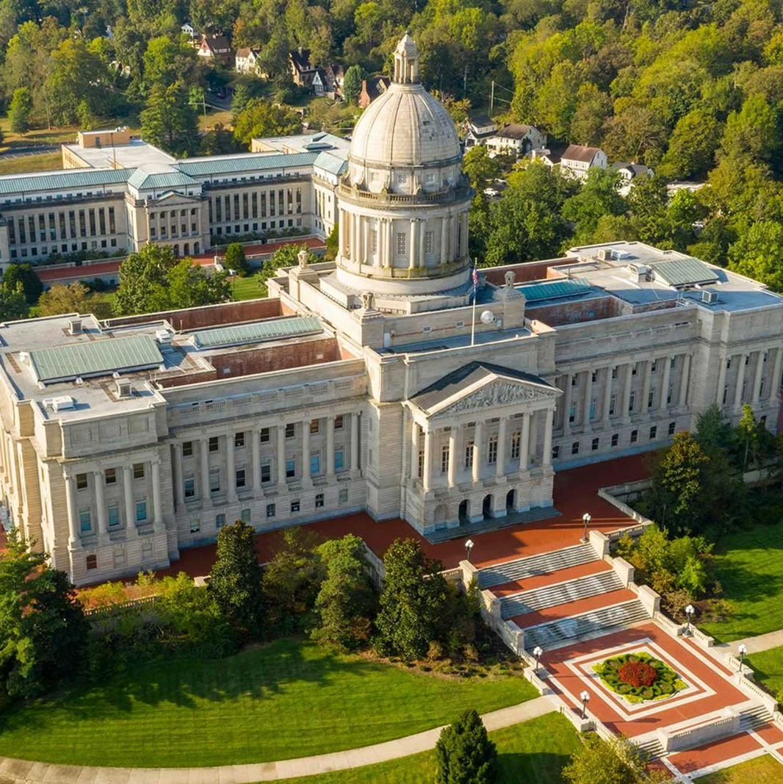
Workforce Pell Overview
Autumn Rivera, Senior Policy Specialist, NCSL
June 2, 2026

Slide 2
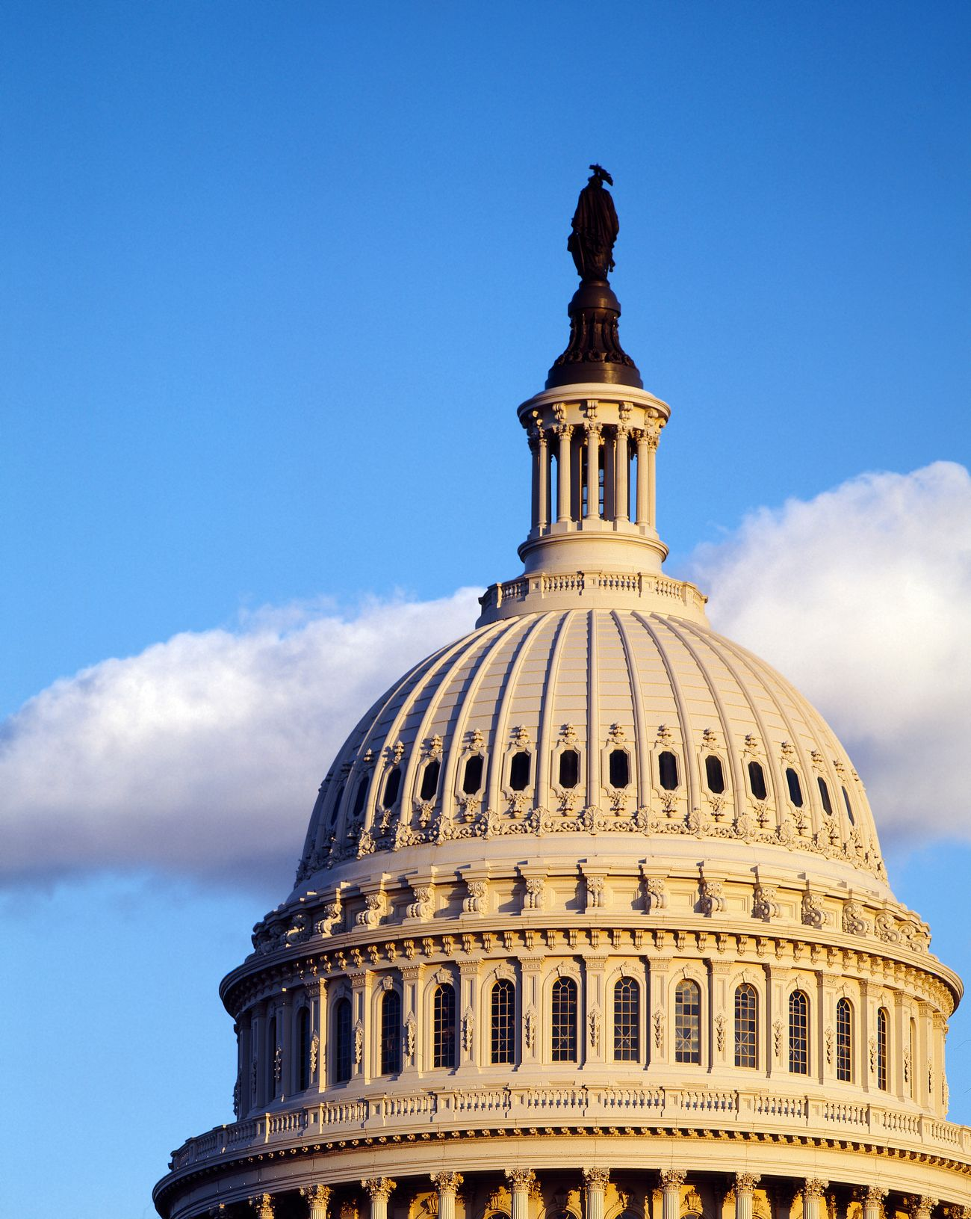
Workforce Pell Implementation
For the first time, states have a formal role in Pell administration
Program Basics: what programs may qualify
Governance: who decides and how states coordinate
Accountability and Data: federal standards and the state data they require
Funding and Student Supports: how awards work and how state aid fits

Slide 3

Workforce Pell Timeline
July 1, 2026
Workforce Pell becomes available for eligible programs
2026-27 through 2028-29
Transition period for completion and placement calculations
Beginning 2029-30
Stricter standardized accountability calculations begin
Beginning 2030-31
Value-added earnings test begins to bind
Notes:
*The program launches in 2026, but the accountability framework becomes more data-intensive over time*

Slide 4

Workforce Pell Program Basics
Workforce Pell extends Pell to short-term workforce programs
Run 8-14 weeks and 150-599 clock hours
Offered by a Title IV-eligible institution
Prepare students for high-skill, high-wage or in-demand occupations
Lead to a recognized, stackable postsecondary credential
Have operated for at least one year
Distinct from other approvals
WIOA ETPL approval does not automatically confer Workforce Pell eligibility
Institutions cannot outsource more than 25% of a program to third-party providers; RA related instruction may exceed 25% but must remain under 50%
Open to credit-bearing & noncredit programs

Slide 5

Workforce Pell Governance
Federal law creates a two-step process
Governors, in consultation with state workforce boards, designate eligible programs
ED verifies Pell eligibility through the Title IV process
Implementation may involve broader state coordination
State higher education agencies may play a major role in practice
States may need to coordinate approval, definitions, data and oversight
Governors can also enter bilateral agreements with other states for distance education programs

Slide 6

Workforce Pell Accountability & Data
Programs must meet three standards
70% completion
70% job placement
Value-added earnings test
State data capacity will shape implementation
Placement depends heavily on state wage records
Noncredit data may sit outside postsecondary systems
Occupation-aligned placement may require enhanced wage records

Slide 7

Workforce Pell Funding and Student Supports
Awards are expected to range from approximately $125 to $4,310
Awards may reduce, but not eliminate, cost barriers
Students may still need transportation, child care, advising and career coaching
States already invest more than $8.1 billion in short-term credential programs (HCM Strategists)
Workforce Pell will need to coordinate with state aid, WIOA, Perkins V and apprenticeship funding

Slide 8

State Considerations and Potential Legislative Roles
State Considerations
Which programs qualify, need redesign or remain outside Workforce Pell
Who leads designation and how agencies coordinate
Whether data systems can support reporting and accountability
How Workforce Pell fits with existing state strategies
Potential Legislative Roles
Governance and oversight
Eligibility and program design
Data infrastructure
Funding and student supports
Coordination across systems

Slide 9
Early State Legislative Trends
26 Bills | 16 States
Codifying state implementation
State approval process; federal criteria incorporated
Directing governance
Governor, workforce board, higher ed or agency roles
Adding state-level oversight
Reporting, monitoring data, cost or review provisions
Connecting to broader workforce & postsec strategies
Credential quality, workforce data, stackability, transfer or funding alignment
AK
WA
ID
MT
ME
OR
ND
MN
MI
WI
NY
RI
CA
WY
SD
NV
PA
CT
UT
NE
IA
IL
OH
VT
NH
CO
IN
WV
NJ
KS
MO
VA
MA
KY
DE
MD
AZ
NM
TN
NC
DC
OK
TX
AR
SC
MS
AL
GA
HI
LA
FL
AS
GU
MP
PR
VI
Source: NCSL Tracking

Slide 10

Thank you for joining today!
Stay Connected
www.ncsl.org/
@NCSLorg
Denver
7700 East First Place,
Denver CO 80230
Washington, D.C.
444 North Capitol Street, N.W.
Suite 515,
Washington, D.C. 20001
Autumn.Rivera@ncsl.org

