Slide 1

Leveraging workforce pell to serve students and meet Kentucky economic demand
Dr. Ryan F. Quarles, President
Interim Joint Committee on Education
June 2026

Slide 2
MEETING KENTUCKY WORKFORCE NEEDS
Workforce Pell was a top priority for the nation’s community colleges, but it is only one tool in the toolbox for meeting workforce training needs.
Title IV Funding
KHEAA Funding
State Funding
Workforce Pell
Tuition and Fees
Endowment Earnings
Other Federal Funding
Private Philanthropy
Non-Federal Grant Funds
KCTCS TRAINS
Corporate Funding
External Contracts

Slide 3
Preparing for success
Analyze federal regulations through the negotiated rulemaking process
Identify and recommend changes to KCTCS processes/programs to benefit students
Engage with all stakeholders to understand and elevate Workforce Pell
Recommend steps to comply with reporting, accountability and compliance rules
Determine preliminary programs based on Workforce Pell requirements

Slide 4
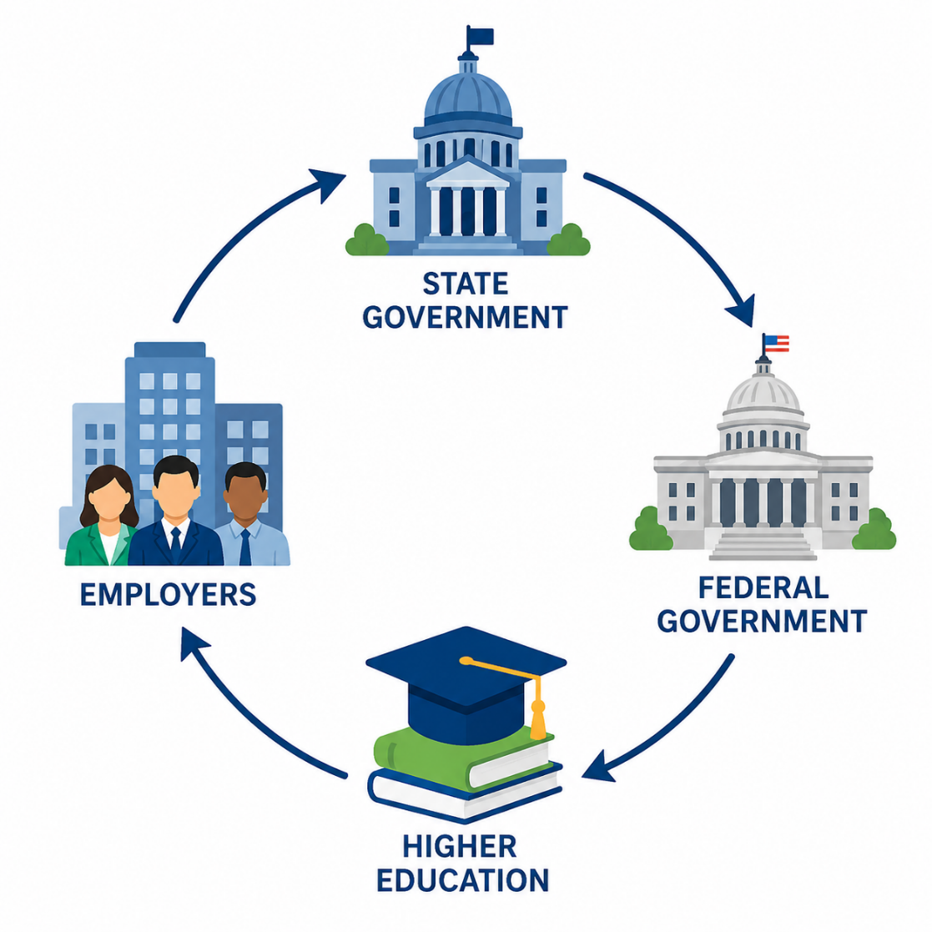
State and national engagement
Public and Private Sector State Partners
  Kentucky General Assembly (SB249)
  Governor’s Task Force
  Kentucky Workforce Innovation Board
  Council on Postsecondary Education
National Partners and Federal Engagement
  National Governors Association
  American Association of Community Colleges
  Association of Community College Trustees
  Kentucky Congressional delegation
  Public comment period for Notice of Proposed Rulemaking

Slide 5
Kctcs process for identifying eligible programs
Internal Resources
Workforce Pell Playbook with regulatory framework
Program approval process maps
Admissions and enrollment guidelines
Accountability reporting guidelines
Employer FAQ
Eligibility Template
KCTCS developed a Workforce Pell eligibility template to assist colleges
Includes information about federal guidelines
Will be updated based on state definitions and policy framework
State Submission
Using the eligibility template, KCTCS can refine a list of potentially eligible programs for state submission
KCTCS will assist colleges in reporting and managing accountability guidelines used by the Dept. of Education for annual program assessment

Slide 6
Projected Eligible Programs
Guiding Principles for Determining Program Eligibility:
  What is in the best interest of students?
  What meets the needs of employers?
  What complies with the state and federal framework?
Preliminary Programs Based on Federal Framework
  Credit and contact hour threshold
  Placement rates and Value-added Earnings benchmarks (based on preliminary data)
Preliminary Programs May Change Based on State Eligibility Framework
KCTCS Eligible Programs Based on
Preliminary Framework
41

Slide 7
SAMPLE PROGRAMS BASED ON PRELIMINARY ELIGIBILITY
Productivity Software Specialist
Informatics Programming
Industrial Mechanic
Skilled Operator
Utility Technician
Industrial Electrician Level I & II
Auto and Robotics Technician
Env. Systems Repair
Industrial Maint. Tech.
Automotive Electrician
Heavy Duty Brake Mechanic
Heavy Duty Drive Train Mechanic
Fluid Power Mechanic
Certified Medical Technician
Physicians Office Laboratory
Logistics Technology
Supply Chain Specialist
Electronic Systems Mechanic

Slide 8
Questions?

