Slide 1
Kentucky Academic Standards for Social Studies
Interim Joint Committee on Education
June 2, 2026

Slide 2
Statute and Regulation
KRS 158.6453(2)
Requires the Kentucky Department of Education to implement a process for reviewing Kentucky’s academic standards every six years and subsequently present recommendations and public feedback to the Interim Joint Committee on Education.
704 KAR 8:060, Required academic standards for social studies
This amended administrative regulation will adopt into law the revised “Kentucky Academic Standards for Social Studies.”

Slide 3
KRS 158.6453(2)(b)
Review of Academic Standards
“The revision to the content standards shall:
Focus on critical knowledge, skills and capacities needed for success in the global economy;
Result in fewer but more in-depth standards to facilitate mastery learning;
Communicate expectations more clearly and concisely to teachers, parents, students and citizens;
Be based on evidence-based research;
Consider international benchmarks; and
Ensure that the standards are aligned from elementary to high school to postsecondary education so that students can be successful at each education level.”

Slide 4
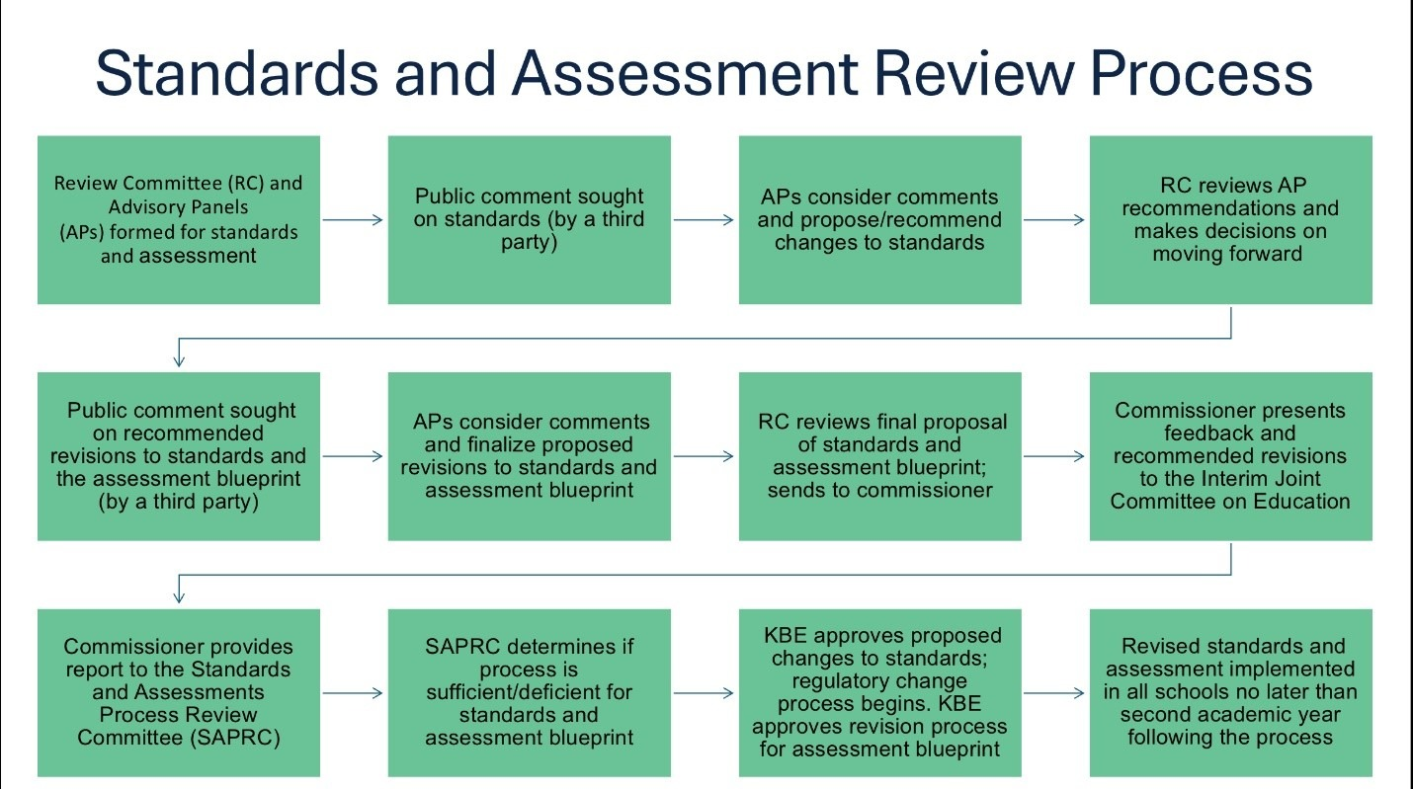
Process

Slide 5
Standards Process Review Timeline
February 2025: Call for participation on standards committee opened
March 2025 - April 2025: Current social studies standards opened for initial public comment/feedback
April 2025: Advisory Panels (APs) and Review Committee (RC) met to review public feedback and recommend potential changes to be released for public comment
June 2025 - July 2025: Recommended changes to social studies standards and Social Studies Assessment Blueprint released for second round of public comment/feedback
September 2025: APs and RC review public feedback and finalize recommendations to draft standards
February 2026: APs and RC reconvene to review public feedback and finalize recommendations
June 2026: Recommendations and public feedback presented to the Interim Joint Committee on Education

Slide 6
Writers’ Vision
The writing team strives to develop vertically aligned standards that provide students with the opportunity to question, create and collaborate for a better future.
Students engage with the social studies disciplinary concepts and practices of civics, economics, geography and history.
In kindergarten through high school, students interact with multiple perspectives and ask thoughtful questions that promote critical thinking and informed decision making.
The standards emphasize evaluation of sources, respectful civil discourse and logical, effective communication as essential civic skills that support informed civic engagement.

Slide 7
Initial Public Comment Period
Initial public comment period allowed respondents to provide feedback on the current Kentucky Academic Standards (KAS) for Social Studies.
Nearly 400 total responses received during the initial public comment period from a variety of stakeholder groups, including:
  Teachers and administrators;
  Parents and guardians;
  Business and community partners;
  Postsecondary education representatives.
For each standard, respondents were asked to select “keep as-is” or “revise”:
  86% of K-5 standards approved “as-is”;
  97% of grades 6-8 standards approved “as-is”;
  93% of high school standards approved “as-is”.
For each standard respondents selected to “revise,” they were prompted to give their reasoning, suggestions and/or comments.
After receiving initial public feedback, standards flagged for review were considered for revision by the APs and RC.

Slide 8
Draft “KAS for Social Studies”
Revision Highlights
Updated standards writers’ vision statement.
Improved document design colors, logos and fonts for consistency with other disciplines and improved usability.
Links to the Table of Contents were added above the Specific Overview sections for each grade level for ease of document navigation.
The Inquiry Practice Definition for Questioning (Q) was updated to clarify the meaning, intent and purpose of questioning referenced in the standards when engaging with each of the social studies disciplines.
Grade Band Overview for high school was updated to highlight the organization of the standards around the disciplines of civics, economics, geography and history.
Emphasis placed on the importance of teaching the social studies disciplinary strands in unison rather than in isolation.

Slide 9
Second Public Comment Period
The second public comment period allowed respondents to provide feedback on the revised Kentucky Academic Standards (KAS) for Social Studies.
Over 175 respondents commented during the second public comment period from a variety of stakeholder groups, including:
  Teachers and administrators;
  Parents and guardians;
  Business and community partners; and
  Postsecondary education representatives.
94% of the standards were approved “as is.”
The APs and RC reconvened to consider the remaining 6% of standards flagged for review and provided revisions, as needed, to complete the current draft KAS.

Slide 10
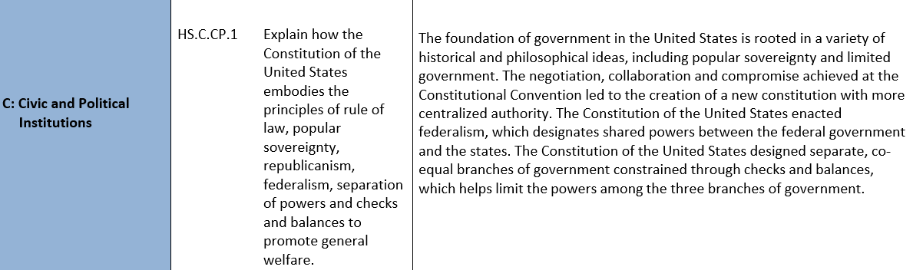
Standards and Clarification Statements
Civics Disciplinary Strand (example)

Slide 11
Micki Marinelli
Chief Academic Officer
Office of Teaching and Learning
Micki.Ray@education.ky.gov
Chrystal Rowland
Director, Division of Academic Program Standards
Office of Teaching and Learning
Chrystal.Rowland@education.ky.gov
Questions?

Slide 12
Read to Succeed:
From Investment to Impact
Micki Marinelli
Chief Academic Officer
Office of Teaching and Learning
Christie Biggerstaff
Director of Early Literacy
Office of Teaching and Learning
Notes:
Micki

Slide 13
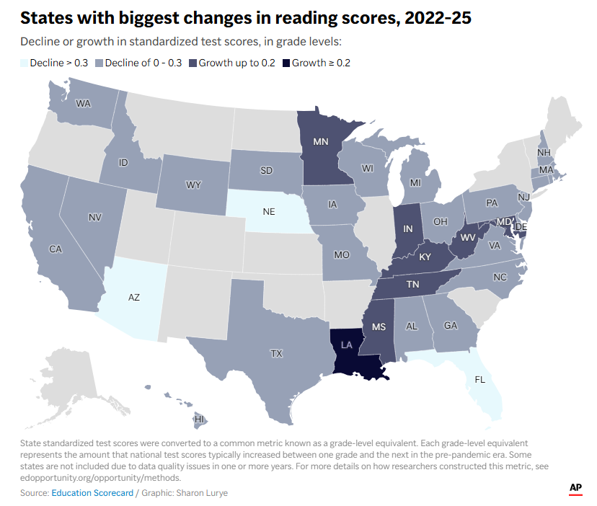
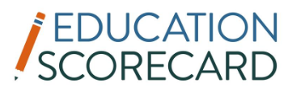
Kentucky Ranks 5th in Reading and 8th in Math Recovery Among States, Among the Top Performers in the Nation
“After the pandemic, national math achievement rebounded immediately, with the annual rate of improvement returning to pre-2013 levels in 2022–2024. In reading, however, national achievement continued to decline through 2024. In 2025, we see the beginnings of a turnaround in reading.”
“The recovery in reading appears to be related to state early-literacy reforms. All of the states which improved in reading between 2022 and 2025 were implementing comprehensive ‘science of reading’ reforms (DC, IN, KY, MD, MN, MS, LA, and TN).”
Education Scorecard
Kentucky Teacher
Notes:
Micki
The Education Scorecard is a collaboration between the Center for Education Policy Research at Harvard University, The Educational Opportunity Project at Stanford University and faculty at Dartmouth College. The latest report provides insight on where students’ academic recovery stands, combining state test results for roughly 35 million grade 3–8 students nationwide with national assessment data to describe changes in local communities.

Slide 14













Office of Teaching and Learning
Division of Early Literacy
Policy
Read to Succeed Act
KRS 158.305
Regional District and School Support
Kentucky Reading Academies
Kentucky Early Literacy Leadership Network (KyELLN)
Regional Principal Support Leaders (RPSLs)
Partnership Schools
Literacy Coaching Model
State Regional Literacy Directors
State Literacy Coaching Specialists
Partnership Schools
Early Literacy Resources
Early Literacy Newsletters
Virtual Office Hours
KY Reads to Succeed Annual Conference
Early Literacy Assessments
Assessment Flowchart
Notes:
Micki
Touchpoints in ALL 171 districts
Supported by Read to Succeed Fund - $11M in each year of the biennium

Slide 15
Investment in Kentucky Educators:
Evidence-based Professional Learning
Notes:
Christie

Slide 16
Kentucky Reading Academies
Investing in Kentucky educators through high-quality, evidence-based professional learning and instructional practices to impact student literacy success
Approximately 7,000 K-5 teachers and administrators participated in Cohorts 1 - 4 of Language Essentials for Teachers of Reading and Spelling (LETRS) training.
Across all cohorts, the LETRS pre-assessment average was 65%; post-test average increased to 95% following completion of all 8 units.
Findings from third-part evaluator, ICF, indicate that LETRS participants reported:
  Increased confidence in literacy knowledge;
  Increased application of strategies across all three tiers of instruction; and
  Increased motivation to implement district-adopted high-quality instructional resources (HQIRs) into classroom practice.
Registration for LETRS Cohort 5 is now open through Aug. 21.
Notes:
Chrisite
Findings from surveys, focus groups and classroom observations of Kentucky Reading Academies participants

Slide 17
Kentucky Reading Academies – KY RRC Data (2026)
Drawing on data from 574 elementary schools across 135 districts, the overall pattern of results indicates that LETRS appears to:
  Move more students toward the “Proficient” level
  Reduce the number of students at the “Novice” level
The study found that schools with more LETRS-trained teachers experienced stronger growth in the share of students reaching the “proficient” level and a greater reduction of the number of students at the “novice” level on the Kentucky Summative Assessment.
What this means for Kentucky
LETRS training is helping move students into reading proficiency. This matters because even modest percentage gains translate into thousands of additional students reading on or above grade level across the state.
Infographic​
Notes:
Micki
Analysis of data between 2021-2022 and 2024-2025 (2021-2025)
Average school has 3.32 LETRS-trained teachers (10.6%) and 0.357 trained administrators (20.1%)
24.9% of the schools do not have any LETRS-trained teachers
11% of schools have at least one out of four teachers (25%) trained in LETRS
71.6% (411 schools) do not have any LETRS-trained school administrators
12.5% (72 schools) have all of their school administrators trained

Slide 18

KSA Level Change by School
Above-Average vs. Below-Average Teachers Trained
(Baseline Year 2022)
Note: Highlighted column indicates the largest percentage change between the two groups.
Group | Novice % Change | Apprentice % Change | Proficient % Change | Distinguished % Change | Proficient + Distinguished % Change
Below Avg <10.6% | -5.18 | 1.62 | 1.43 | 2.10 | 3.55
Above Avg >10.6% | -5.47 | 1.76 | 2.87 | 0.84 | 3.70
(Baseline Year 2023)
Note: Highlighted column indicates the largest percentage change between the two groups.
Group | Novice % Change | Apprentice % Change | Proficient % Change | Distinguished % Change | Proficient + Distinguished % Change
Below Avg <10.6% | -2.40 | 0.977 | 2.90 | -1.52 | 1.39
Above Avg >10.6% | -3.30 | 1.010 | 4.26 | -1.92 | 2.33
Notes:
Micki

Slide 19
KSA Change by Subgroups
Economically Disadvantaged
Strong link between higher LETRS training density and improved reading outcomes
Significant decrease in Novice rates; significant increase in Proficient rates
Hispanic or Latino
Significant reduction in Apprentice-level rates alongside increased Proficient-level rates
Higher LETRS density effectively moves students toward higher achievement
African American
Most dramatic improvements in reading achievement among schools with higher LETRS training rates
As LETRS density increases, Novice rates decrease and Proficient rates increase
English Language Learners
Significant reduction in Novice rates based on 2022/2023 baseline data
Common Thread Across All Subgroups
Across student populations, higher LETRS training density consistently reduces Novice rates and increases Proficient-level achievement — demonstrating that investing in teacher training drives measurable literacy gains for all Kentucky students.
Notes:
Micki
Growth between 2022/2023 to 2024/2025
Will share KBE presentation from the KY Reading Research Center to be delivered June 3, 2026

Slide 20
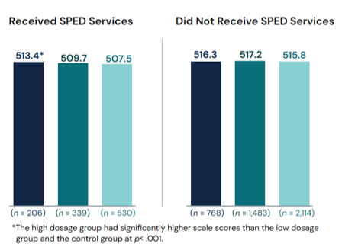
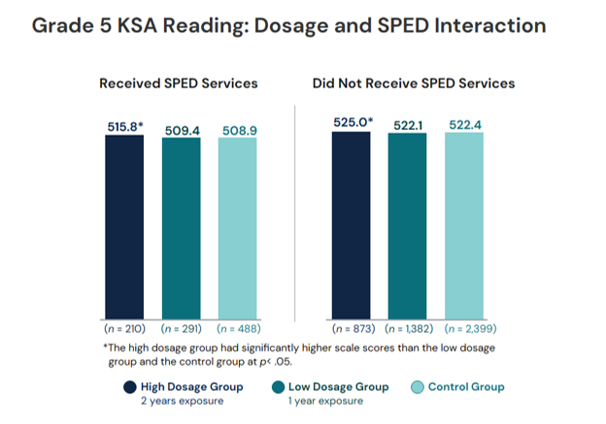
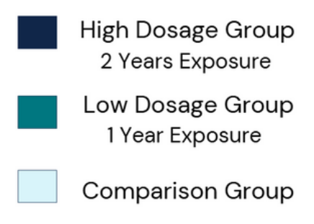
Kentucky Reading Academies – ICF Evaluation (2023-2025)
Grade 5 students taught by LETRS-trained teachers over consecutive years had significantly higher reading scores than other students.
Students with an IEP in grades 4 and 5 who were exposed to two years of LETRS-trained teachers significantly out-performed their peers with less exposure to LETRS-trained teachers.
4th Grade
5th Grade
Executive Summary​
Evaluation Report
Two Years of Outcomes and Impact Infographic
Notes:
Micki
This Year 2 evaluation began to demonstrate positive, statistically significant growth among students who were taught by LETRS-trained teachers.

Slide 21
Next Step: AIMS Pathways
AIM Institute for Learning & Research Pathways courses are evidence-based professional learning experiences designed to build educators’ knowledge of the science of reading and effective literacy instruction. The courses provide flexible, job-embedded learning that combines online modules, application activities, and collaborative discussions focused on classroom practice.
Pathways to Proficient Reading (PPR) - Approximately 55 hours, including asynchronous coursework and six (1 hour) Virtual Community of Practice sessions.
Pathways to Proficient Reading - Secondary (PPR-S) - Approximately 55 hours, including asynchronous coursework and six (1 hour) Virtual Community of Practice sessions.
Pathways to Literacy Leadership (PLL) - Approximately 30 hours, including asynchronous coursework and four (1.5 hour) Virtual Community of Practice sessions.
Pathways to Proficient Writing (PPW) - Approximately 30 hours, including asynchronous coursework and four (1 hour) Virtual Community of Practice sessions.
Pathways to Structured Literacy (PSL) - Approximately 30 hours, including asynchronous coursework and four (1 hour) Virtual Community of Practice sessions.
Specialized Reading Knowledge: English Learners - Approximately 13 hours, including asynchronous coursework and three (1 hour) Virtual Community of Practice sessions.
Demystifying Dyslexia - Approximately 3 hours of asynchronous coursework.
Notes:
Christie
Aligns to HB 253 (SoR PL by 29-30) and writing PL required in HB 257
We will continue providing LETRS, but this provides increased flexibility.

Slide 22
Next Step: KY Learning Hub Science of Reading Courses
Elementary Course: What the Research Says: Effective Reading Instruction for All Students
Asynchronous course designed to deepen educator understanding of reading research and evidence-based literacy instruction.
Eight modules focus on the essential components of skilled reading and connect research directly to effective classroom practice that supports all students.
Secondary Course: Supporting Striving Secondary Readers
Asynchronous course designed to strengthen literacy instruction for students in Grades 5–12.
Fifteen research-grounded modules focused on adolescent literacy, instructional practice, and improving student outcomes.
Both courses, developed in partnership with SchoolKit Group, are designed for use in PLCs, coaching cycles, leadership learning, onboarding, and professional study.
Notes:
Christie
On KDE PLMS: Kylearninghub.org
Approved SoR PL option for HB 253

Slide 23
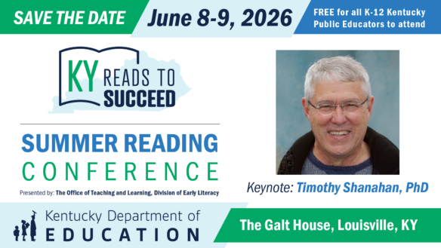
KY Reads to Succeed Summer Conference
The Kentucky Reads to Succeed Summer Conference brings K-12 educators and leaders together to strengthen literacy instruction across the Commonwealth through evidence-based practices aligned to the science of reading.
The conference is designed to build educator knowledge, deepen implementation of high-quality instructional resources, and support systems that improve student literacy outcomes.
 | 2024 | 2025 | 2026
SESSIONS | 43 | 46 | 75
ATTENDEES | 1,391 | 1,509 | Up to 1,600
Notes:
Christie

Slide 24
Investment in Kentucky Educators:
Statewide Literacy Coaching Model
Notes:
Micki

Slide 25
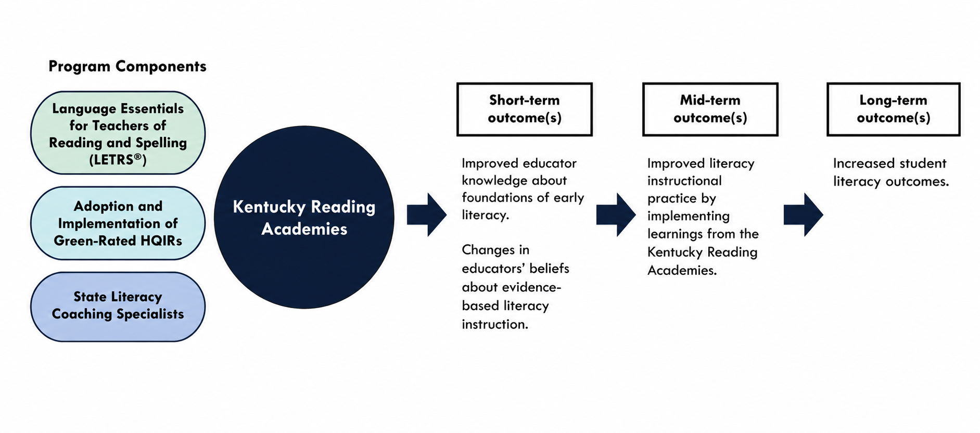
State Literacy Coaching Model Goals
State Literacy Coaching Specialists are placed in schools with the greatest literacy needs to (1) support the effective implementation of evidence-based literacy instruction, (2) strengthen the use of high-quality instructional resources, and (3) improve student reading outcomes through job-embedded coaching and instructional support.
Notes:
Micki

Slide 26
State Literacy Coaching Model
State Regional Literacy Directors oversee the impactful work of the literacy coaching specialists and offer school and district support.
School-based literacy coaches provide personalized support on implementing evidence-based literacy practices and standards-aligned grade-level instruction.
  Coaching cycles contribute to effective implementation of high-quality instructional resources (HQIRs) and improved student learning experiences aligned to grade-level standards.
  Literacy coaches lead PLC coaching and lesson and unit internalization to help educators deeply understand HQIRs, strengthen instructional decision making, and deliver grade level literacy instruction aligned to student needs.
Regional Principal Supports Leaders works alongside school leaders to strengthen literacy leadership, support high quality instructional resource implementation, and build systems that improve teacher and student outcomes across schools.
Notes:
Christie

Slide 27
State Literacy Coaching Model: By the Numbers
2024-2025
23 partnership schools
23 school-based coaches
50+ districts receiving regional director support
2025-2026
31 partnership schools
35 school-based coaches
75+ districts receiving regional director support
8 regional principal support coaches
2026-2027
41 partnership schools
41 school-based coaches
7 regional principal support coaches
85+ districts receiving direct support
Notes:
Christie

Slide 28
Partnership Districts – 32 districts/41 total schools
Anderson
Barren
Boone
Bowling Green Independent
Bourbon
Bullitt
Carroll
Carter
Caverna Independent
Daviess
Erlanger Elsmere
Floyd
Franklin
Grant
Greenup
Henry
Jackson Independent
Jefferson
Jessamine
Knott
Knox
Laurel
Letcher
Marion
Owsley
Perry
Rockcastle
Russellville Independent
Shelby
Washington
Warren
Williamsburg Independent
Notes:
Christie

Slide 29
State Literacy Coaching Data Snapshot 2025-2026
Coaching Activity | Totals Across All State Regional Literacy Director Groups
Classroom observations (both formal and informal) | 4,836
Feedback conversations | 1,219
Coaching cycles executed | 292
Coach-led professional learning communities (PLCs) (focused on lesson/unit internalization) | 904
Coach-led PLCs (focused on other topics) | 641
Coach-led Instructional Practice Guide (IPG) walk-throughs | 310
Notes:
Christie

Slide 30
Literacy Coaching Impact
Per the ICF evaluation (2025), 94% of coached teachers surveyed found coaching effective for improving their literacy instruction and positively influencing student literacy development.
“[Our coach] very much works on alignment [between the HQIR] with what we know from LETRS. And she’s been so deeply trained [in LETRS] that it’s just… her natural language. So when she’s talking to me, I know that it’s what I’m supposed to do.”
– Partner School Principal
Implementation of HQIRs and LETRS strategies led to significant improvements in students’ performance on the district-wide literacy assessments:
  Following students’ completion of the i-Ready assessment, the number of students across the district who had reading improvement plans decreased substantially from approximately 90 to 50.

Slide 31
Next Step: Continued Expansion
Identify literacy experts and high-performing teachers to expand coaching model to more partner schools with great need.
Provide increased HQIR Technical Assistance supported by OTL PL Coordinators and Regional Principal Support Leaders.
Build sustainable district literacy systems by developing local leadership capacity, strengthening instructional coherence, and creating structures that sustain high quality literacy practices beyond direct state support.
Notes:
Christie

Slide 32
Kentucky Early Literacy Leadership Network (KyELLN)
The KyELLN focuses on:
Building sustainable district-level models for implementing early literacy instructional programs connected to HQIRs;
Developing strong systems and structures for early literacy instruction in schools and districts; and
Increasing leadership support of teacher professional learning communities (PLCs) and effective planning practices.
Total of 80 district leadership teams (5-7 members) participating:
33 district leadership teams in Cohort ‘24
19 additional districts teams in Cohort ‘25
30 additional district teams in Cohort ‘26
Notes:
Christie
5-7 members of the team

Slide 33
KyELLN Districts – 80 total districts
Adair
Allen
Ashland Independent
Barren
Boone County
Boyd
Breathitt
Bullitt
Campbellsville Independent
Carroll
Carter
Casey
Christian
Clinton
Crittenden
Cumberland
Daviess
Dawson Springs
Elizabethtown
Erlanger Elsmere
Fayette
Floyd
Frankfort Independent
Franklin County
Fulton County
Fulton Independent
Glasgow Independent
Grant
Graves
Greenup
Hardin
Hart
Henderson
Henry
Hopkins
Jackson
Jackson Independent
Jefferson
Jenkins
Jessamine
Johnson
Kenton
Knott
Knox County
Leslie
Letcher
Livingston
Lyon
Magoffin
Marion
Marshall
Mason
McCracken
McCreary
Menifee
Monroe
Montgomery
Morgan
Nelson
Newport
Nicholas County Schools
Oldham
Owsley
Paintsville
Paris City
Perry
Pike
Powell County
Pulaski
Rowan
Russell Independent
Russellville Independent
Shelby
Spencer
Trimble
Union
Wayne
Whitley
Woodford
Notes:
Christie

Slide 34
KyELLN Impact Survey: Content Knowledge
KyELLN 2025-2026 Impact Survey: Content Knowledge
Percentage shift in number of participants that selected a 4 or 5 before versus now.
+52%
Notes:
Christie

Slide 35
KyELLN Impact Survey 25-26: HQIR Implementation
KyELLN 2025-2026 Impact Survey: HQIR Implementation
Percentage shift in number of participants that selected a 4 or 5 before versus now.
+68.2%
Notes:
Christie

Slide 36
KyELLN Intellectual Prep Survey Data
KyELLN 2024-2025 Impact Survey: Intellectual Preparation
Percentage shift in number of participants that selected a 4 or 5 before versus now.
+65.1%
Notes:
Christie
Better equipped to meet the needs of diverse readers

Slide 37
Next Steps to Maximize Impact
With demonstrated gains across all student subgroups, these next investments build on what the data shows is working — scaling proven strategies to reach more students and deliver greater returns.
Increasing access to Science of Reading professional learning through scalable, Kentucky-specific virtual and self-paced learning opportunities
Expanding family engagement through at-home literacy resources — decodable texts, knowledge-building materials, and hands-on tools — to extend classroom gains into the home
Extending proven training models to grades 6–12 to address adolescent literacy needs and piloting the ROAR assessment to measure impact on student learning
Amplifying demonstrated success stories and high-performing schools to inform statewide best practices
Launching the HQIR repository per SB 207 (2025) to reduce cost variability and increase adoption of approved K-12 Reading and Writing resources across districts
Notes:
Micki

Slide 38
Micki Marinelli
Chief Academic Officer
Office of Teaching and Learning
Micki.Ray@education.ky.gov
Christie Biggerstaff
Director of Early Literacy
Office of Teaching and Learning
Christie.Biggerstaff@education.ky.gov
Questions?

