Slide 1
University of Kentucky College of Agriculture, Food and Environment Supporting Kentucky Farmers Markets
Brett Wolff, Agricultural Economics, Center for Crop Diversification
Lindie Huffman, Cooperative Extension Service, Agriculture and Natural Resources Agent for Pendleton County

Slide 2
Price Reports
81,000 Farmers Market Price Reports Downloaded since January 1, 2016
Producers increase prices; boost sales
Marketing for All Training Program
Marketing 101/201 level discussions for Farmers Market Vendors (social media, digital marketing, customer engagement)
500+ Producers trained since 2018

Slide 3
Sampling and Cooking Demos
Family and Consumer Sciences and other agents support cooking demonstrations
Extension offices conduct sampling certificate training
On-campus demonstrates effective techniques and reasons for sampling
Enhancing KOAP Investments
Trainings help vendors to more effectively use pavilion and other infrastructural investments
Collaboration with KOAP-funded organizations and projects

Slide 4
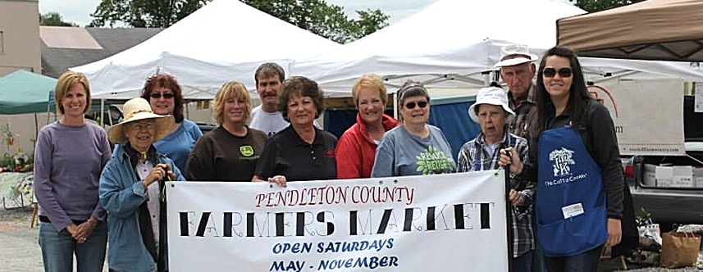
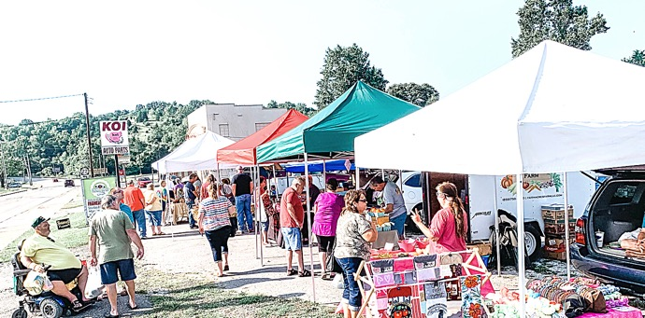
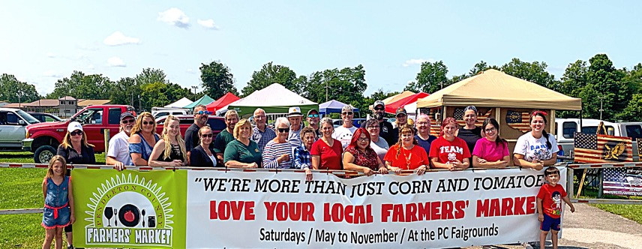
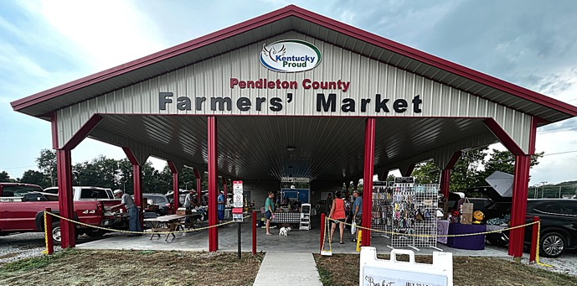
PCFM How It’s Going
Pendleton County Farmers’ Market was established in the late 1980s.
2013
2021

Slide 5
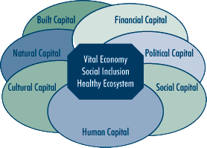
Farmers Markets:
Pendleton County
Farmers' Market
“So much more than corn and tomatoes”
SOURCE: Michigan State University Extension

Slide 6
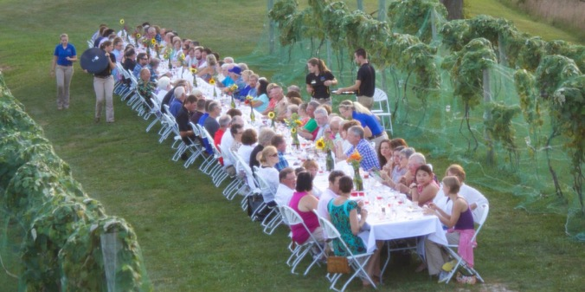
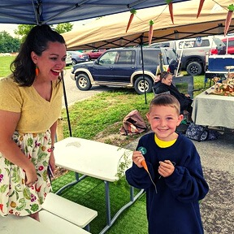
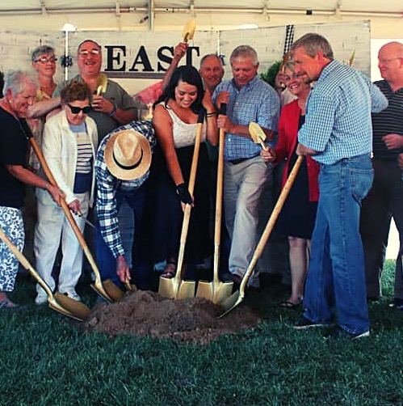
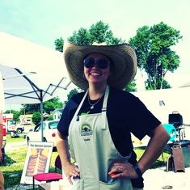
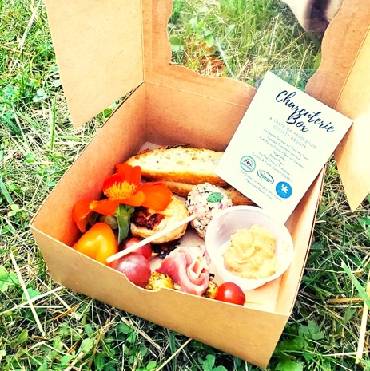
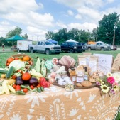
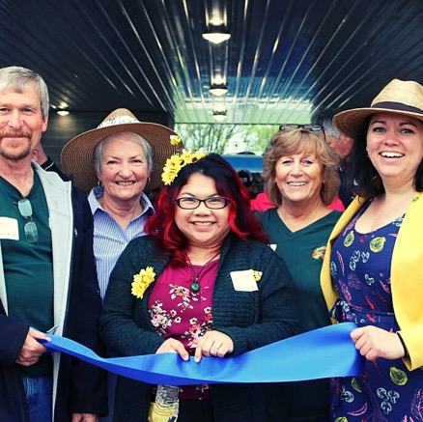
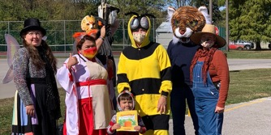
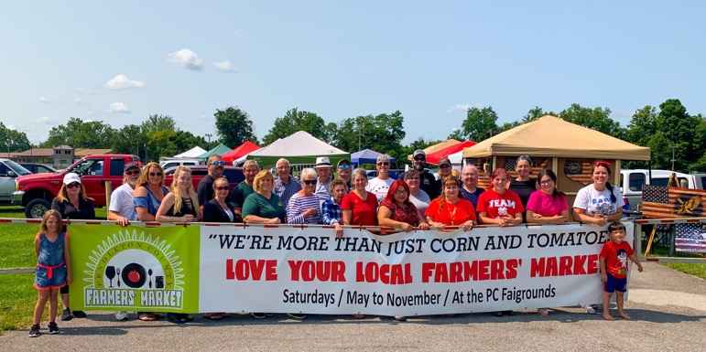
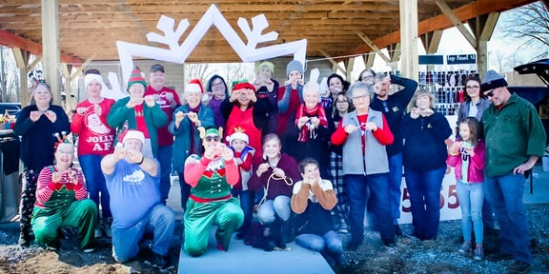
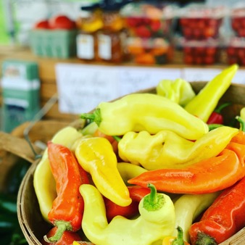
Farmers’ Market & Pendleton County Cooperative Extension

Slide 7
Contact Information
Brett Wolff, Extension Specialist, Agricultural Economics
321 CE Barnhart Building Lexington, KY 40546
859-218-4384
Brett.wolff@uky.edu
Lindie Huffman, Agriculture and Natural Resources Agent, Cooperative Extension, Pendleton County
45 David Pribble Dr. Falmouth, KY 41040
859-654-3395
Lindie.Huffman@uky.edu

