Slide 1
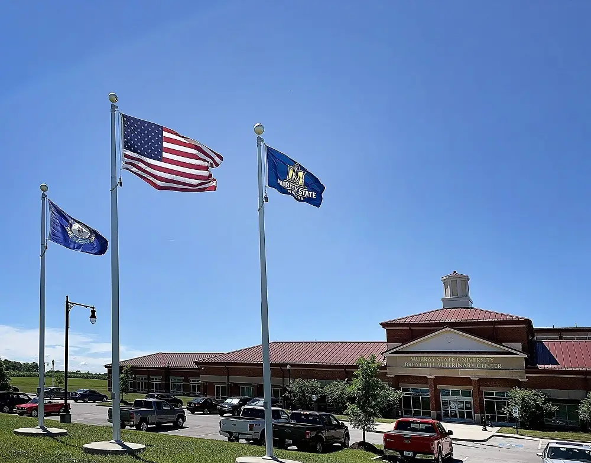
Murray State University School of Veterinary Medicine
2/7/2024
House Agriculture Committee

Slide 2
Feasibility Study- Peake et al.
Murray State University’s Hutson School of Agriculture, which currently serves approximately 1400 students, is perfectly positioned to address the growing need for rural veterinarians in Kentucky.
Well established network across the state through dual credit courses.
Kentucky has a need for rural and large animal veterinarians that has not been met by the current approach to training Kentucky students.

Slide 3
Kentucky Veterinarian Status
- Data from the Board of Veterinary Examiners identify 1,564 practicing veterinarians with addresses in Kentucky and 2,613 licensed veterinarians in total.
- The largest concentration are practicing in urban counties near Louisville and Lexington.
- Just over half of Kentuckians who benefit from the veterinary contract spaces program at that institution return to Kentucky to practice after graduation.

Slide 4
Future Veterinarian Needs Data Sources: AVMA 2023 State of the Profession
Veterinary positions will grow by 19.3% between 2016 and 2026, with 704 total openings during that time.
Veterinary Medicine is a “fast growing” occupation in Kentucky.
The shortage of rural food animal veterinarians available for herd health visits/consultations, surgery and emergency after hour visits is putting Kentucky producer’s herds and flocks at risk.
In the absence of veterinary consultation, producers may use veterinary pharmaceuticals inappropriately, putting a potentially dangerous product into the food chain. (USDA NIFA, 2023,paragraph 10).

Slide 5
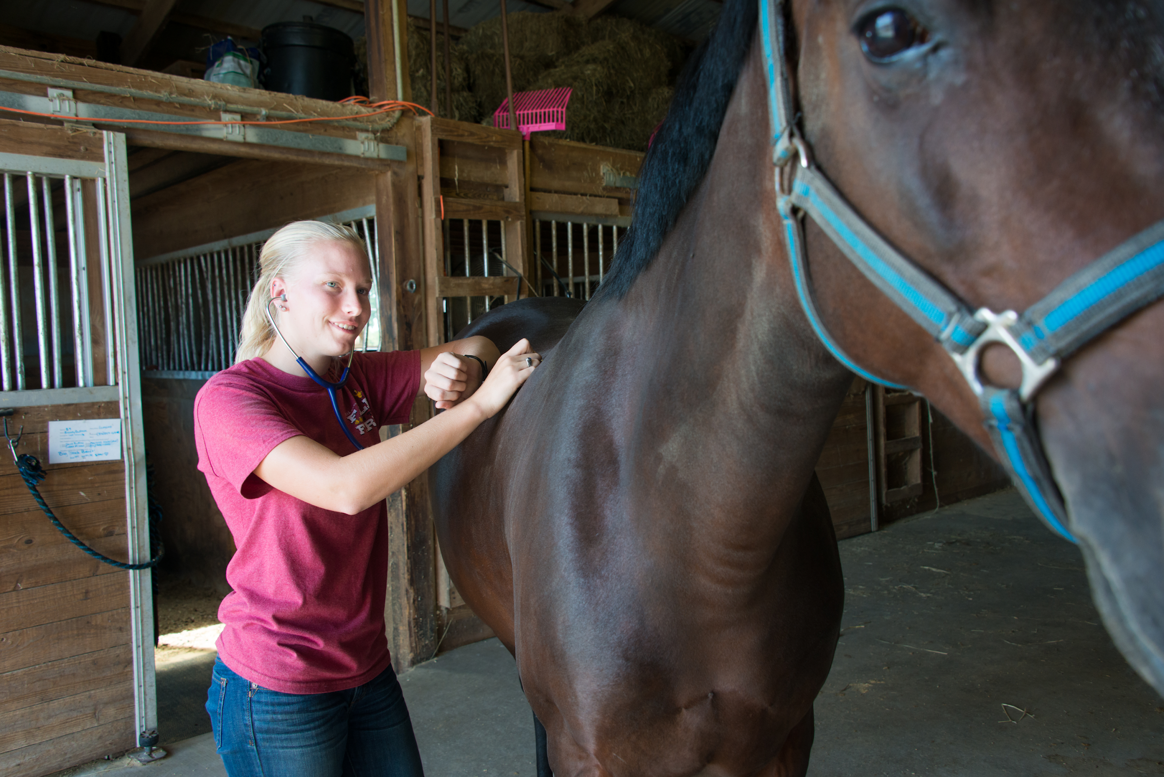
There are currently 32 Colleges/School of Veterinary Medicine in the United States.
22 States do not have veterinary schools and each year there is a shortage of seats for students interested in studying veterinary medicine.

Slide 6
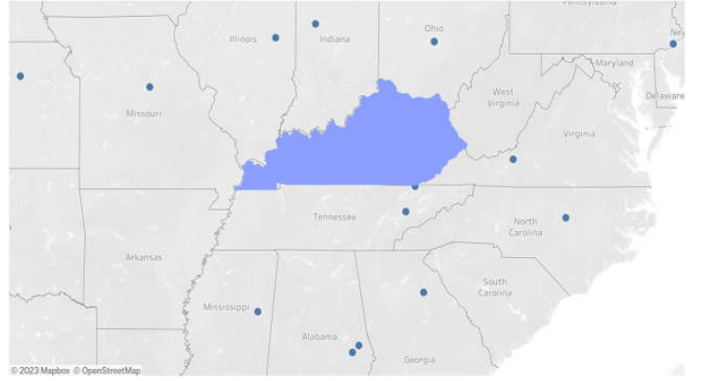

Slide 7
The Clinical/Distributed Model
Distributed learning is an instructional model that allows instructor, students, and content to be located in different, non-centralized locations so that instruction and learning can occur independent of time and place.
Real world immersion – modeled after human healthcare education
Networking & job offers
Tailor student clinical year focus
Student creates their own geography
Industry standard equipment exposure
Clinical partners screen and hire top students
Increased stakeholder engagement in training students
Reduced construction cost (approximately $150 million)

Slide 8
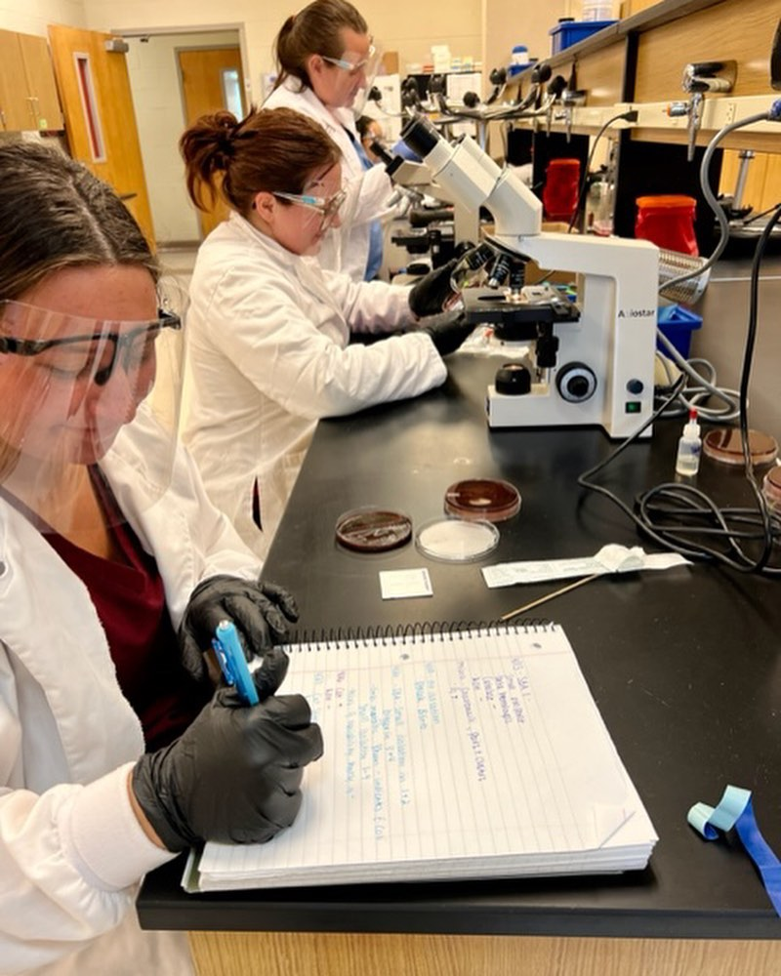
The Clinical/Distributed Model
IMPORTANT –
Accredited same way
Same licensure exam
Selected Current Vet Schools under this model
Texas Tech
Clemson University
University of Arizona
Lincoln Memorial University
Calgary University
Long Island University

Slide 9
VISION OF MSU SCHOOL OF VETERINARY MEDICINE
Curriculum: Clinical/Distributed Model of Veterinary education program; preclinical training at the new Murray facility, clinical partnership training with existing practices, non-profits, and industries
Class Size: up to 70/class with a focus on rural Kentucky and large animal practices
Incentive scholarship endowment

Slide 10
Existing Support Structure at Murray State
Rudolph Equine Education Center
West Farm Complex, which houses the university’s certified Angus herd
North Farm Complex, which houses the university’s swine unit
Breathitt Veterinary Center, a veterinary diagnostic laboratory
Carman Pavilion Pre-Vet/Vet Tech Teaching Facility
Currently employ 11 veterinarians and 40 Veterinary Practice and Diagnostic Technicians
Strong Pre-Vet and Vet Tech program, over 450 students

Slide 11
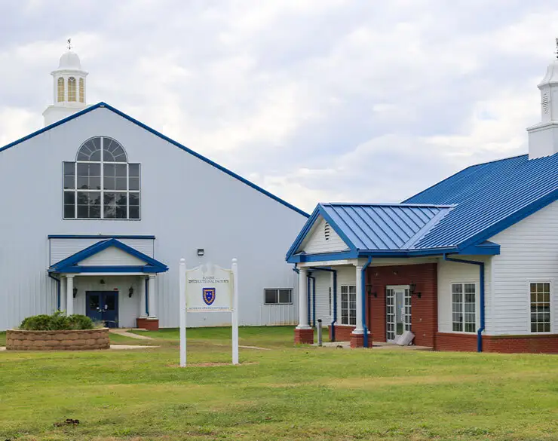
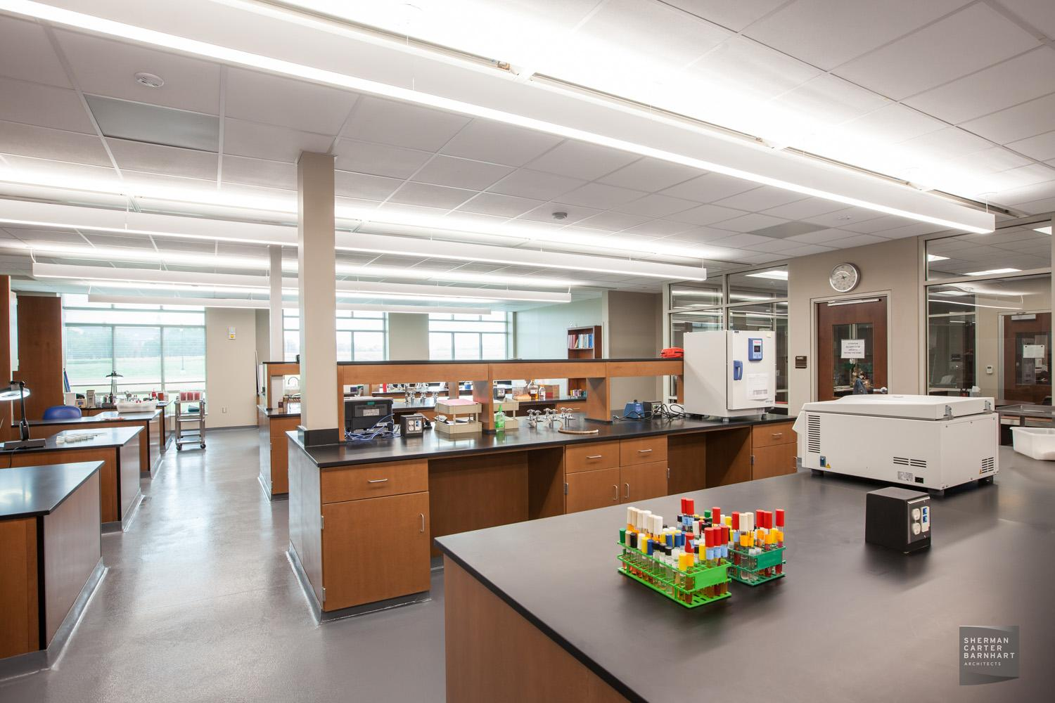
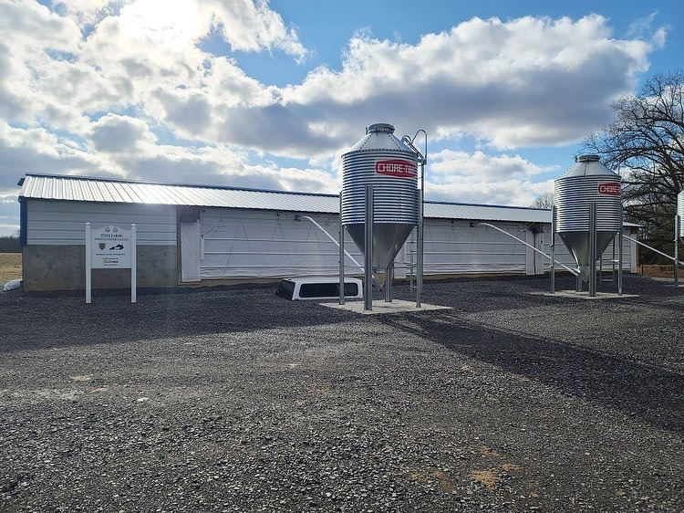
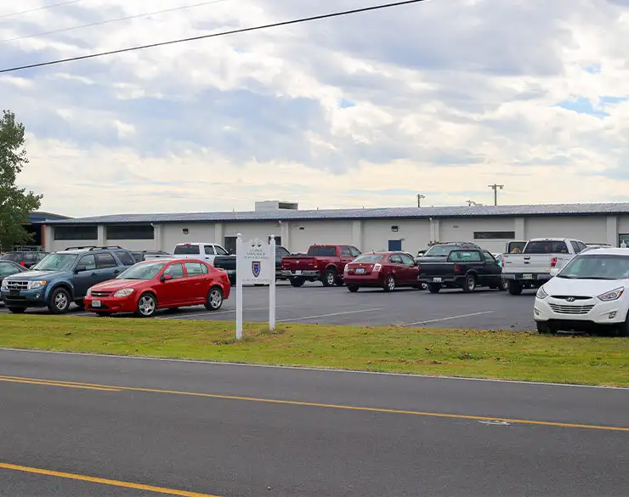
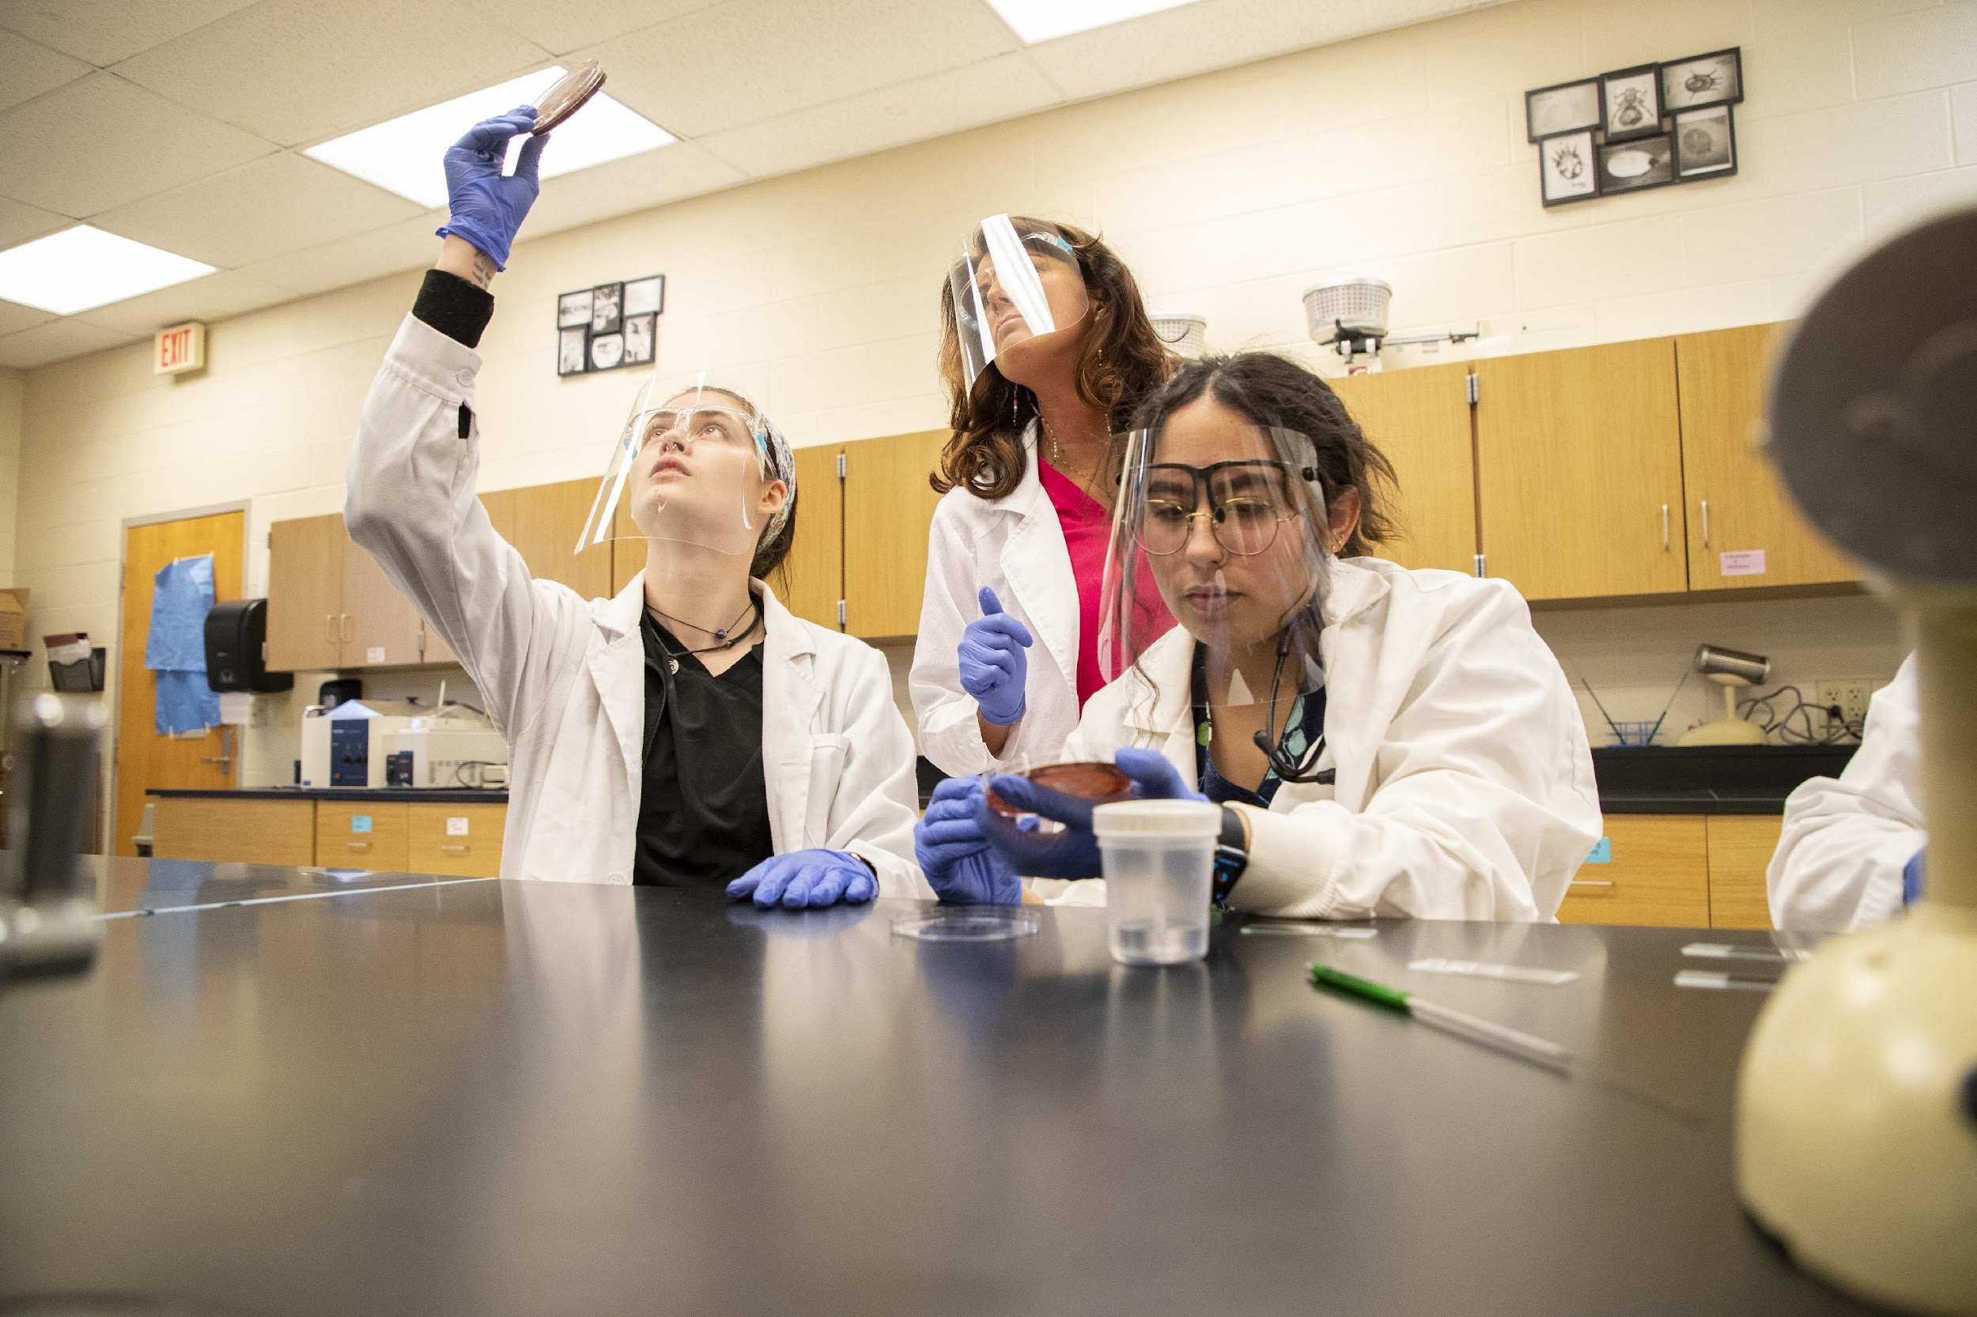
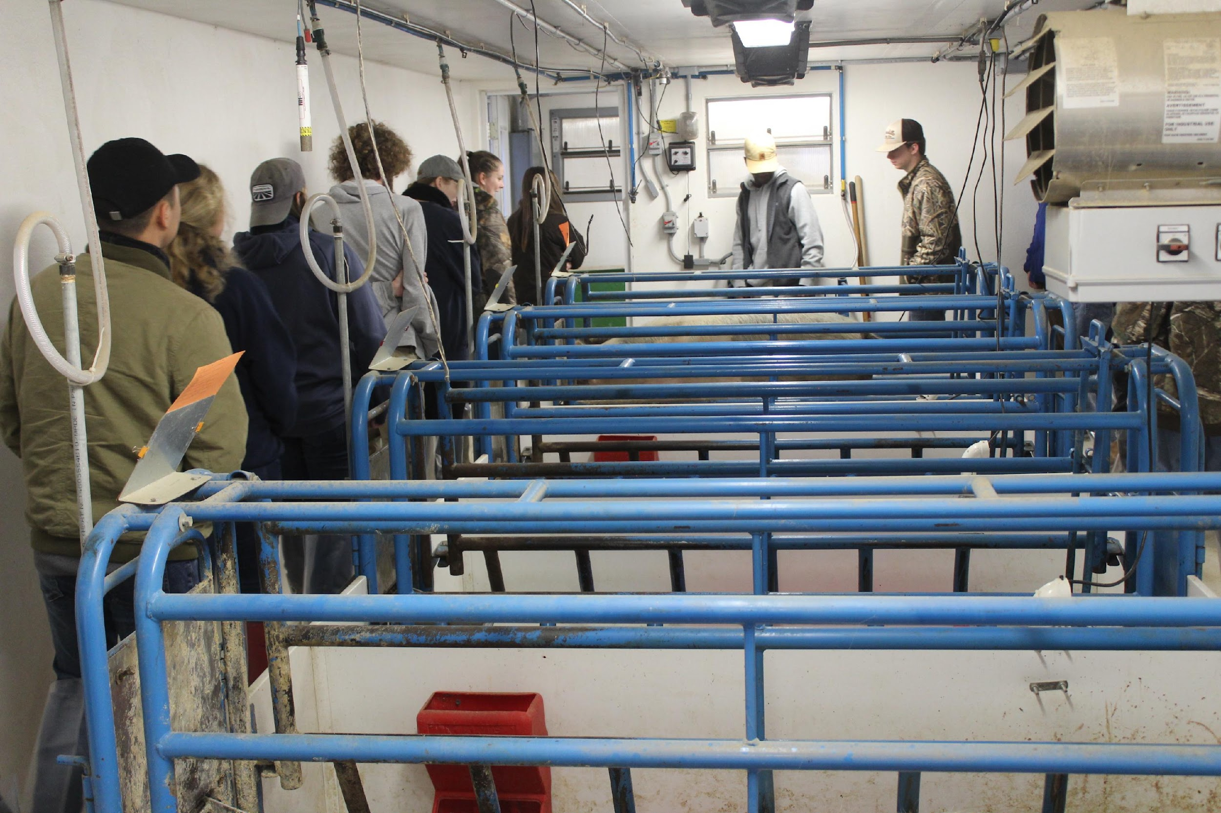

Slide 12
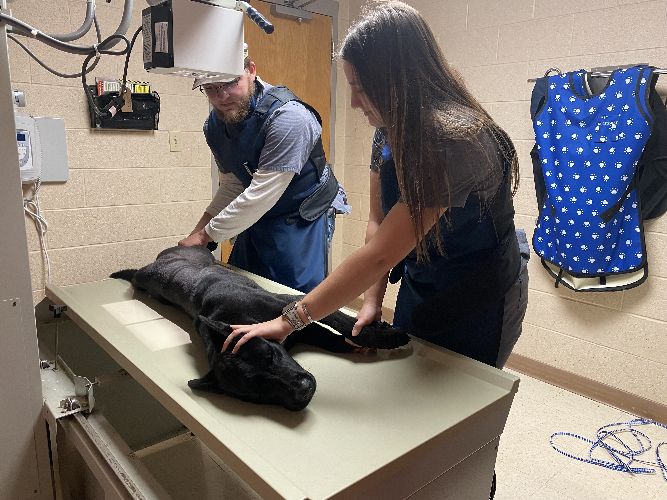
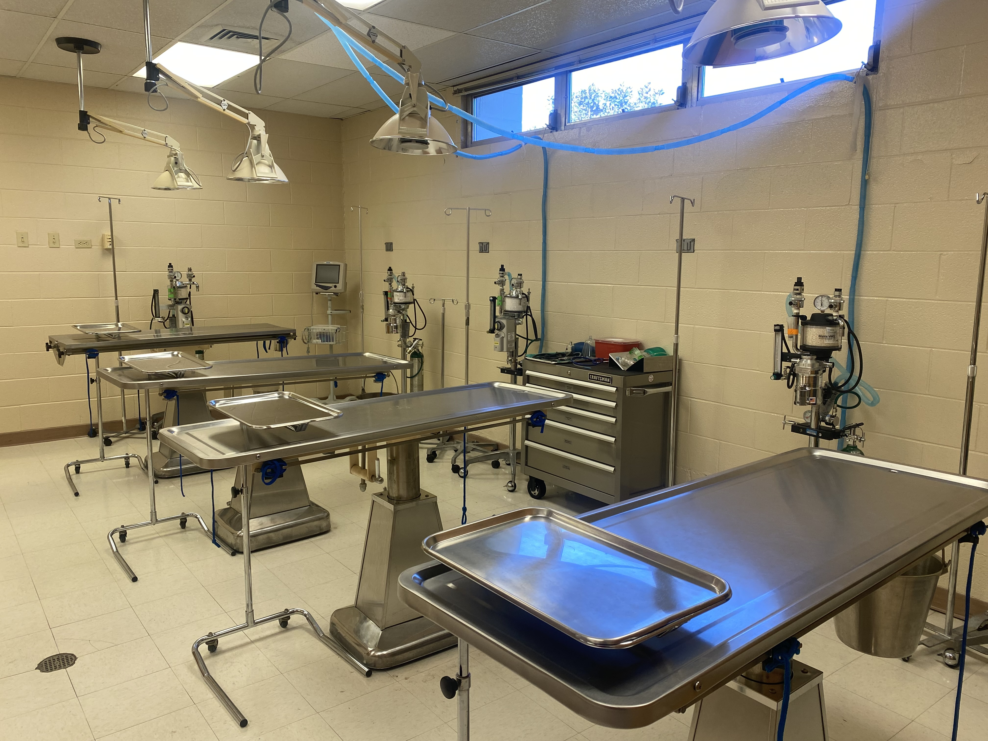

Slide 13
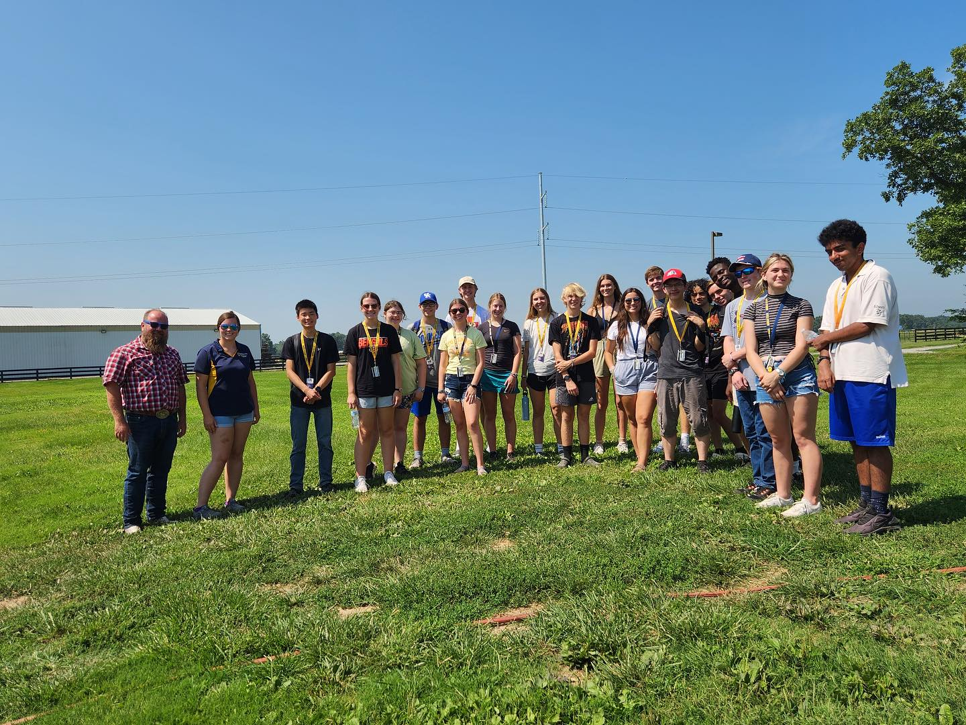
How Do We Get them to Stay in KY and Practice in Rural Areas- The Grassroots Approach
Currently, the Hutson School of Agriculture at Murray State University has dual credit system with high schools in every county of the Commonwealth (this semester ~1000 students) .
We must identify rural youth with desire and potential in 10th grade
Deliver dual credit sciences and support to those students
Bolster the pipeline with capable Vet School applicants

Slide 14
How Do We Get them to Stay in KY and Practice in Rural Areas- The Grassroots Approach?
Provide scholarship incentive to rural pre-vet students who want to return to large animal/mixed practice.- New endowment to support rural students studying veterinary medicine- $4.2 million
Admission to MSU Vet School criteria clearly defined and transparent

Slide 15
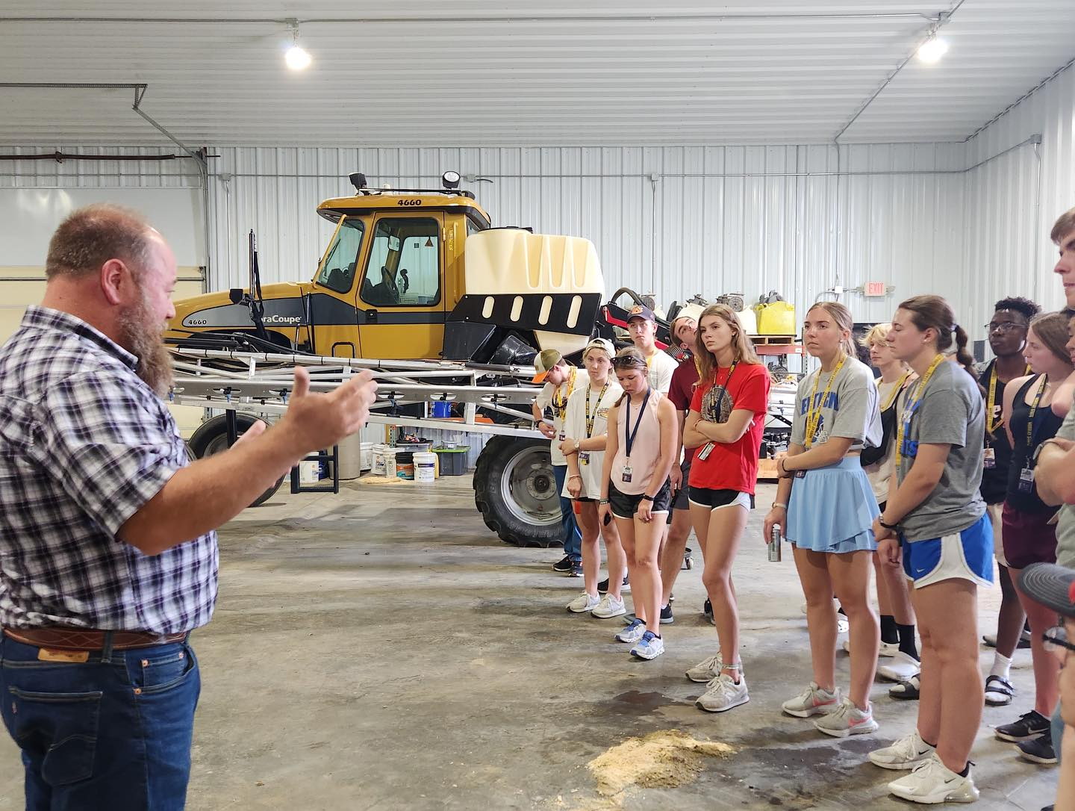
How Do We Get them to Stay in KY and Practice in Rural Areas- The Grassroots Approach?
Reduce the debt burden
Tuition Model - lower tuition and fees than KY students currently pay to attend Auburn.
Considerably less than several private schools

Slide 16
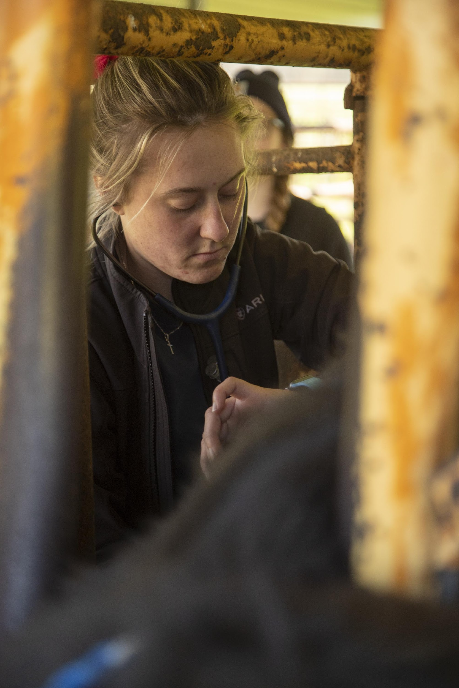
Potential Impact
Job Creation: The new school will help address the shortage of veterinarians in Kentucky.
An estimated 50–70 veterinarians graduate each year with an increased likelihood to remain in Kentucky.
Emergency veterinary care facility
Bolster potential veterinarians from rural areas

Slide 17
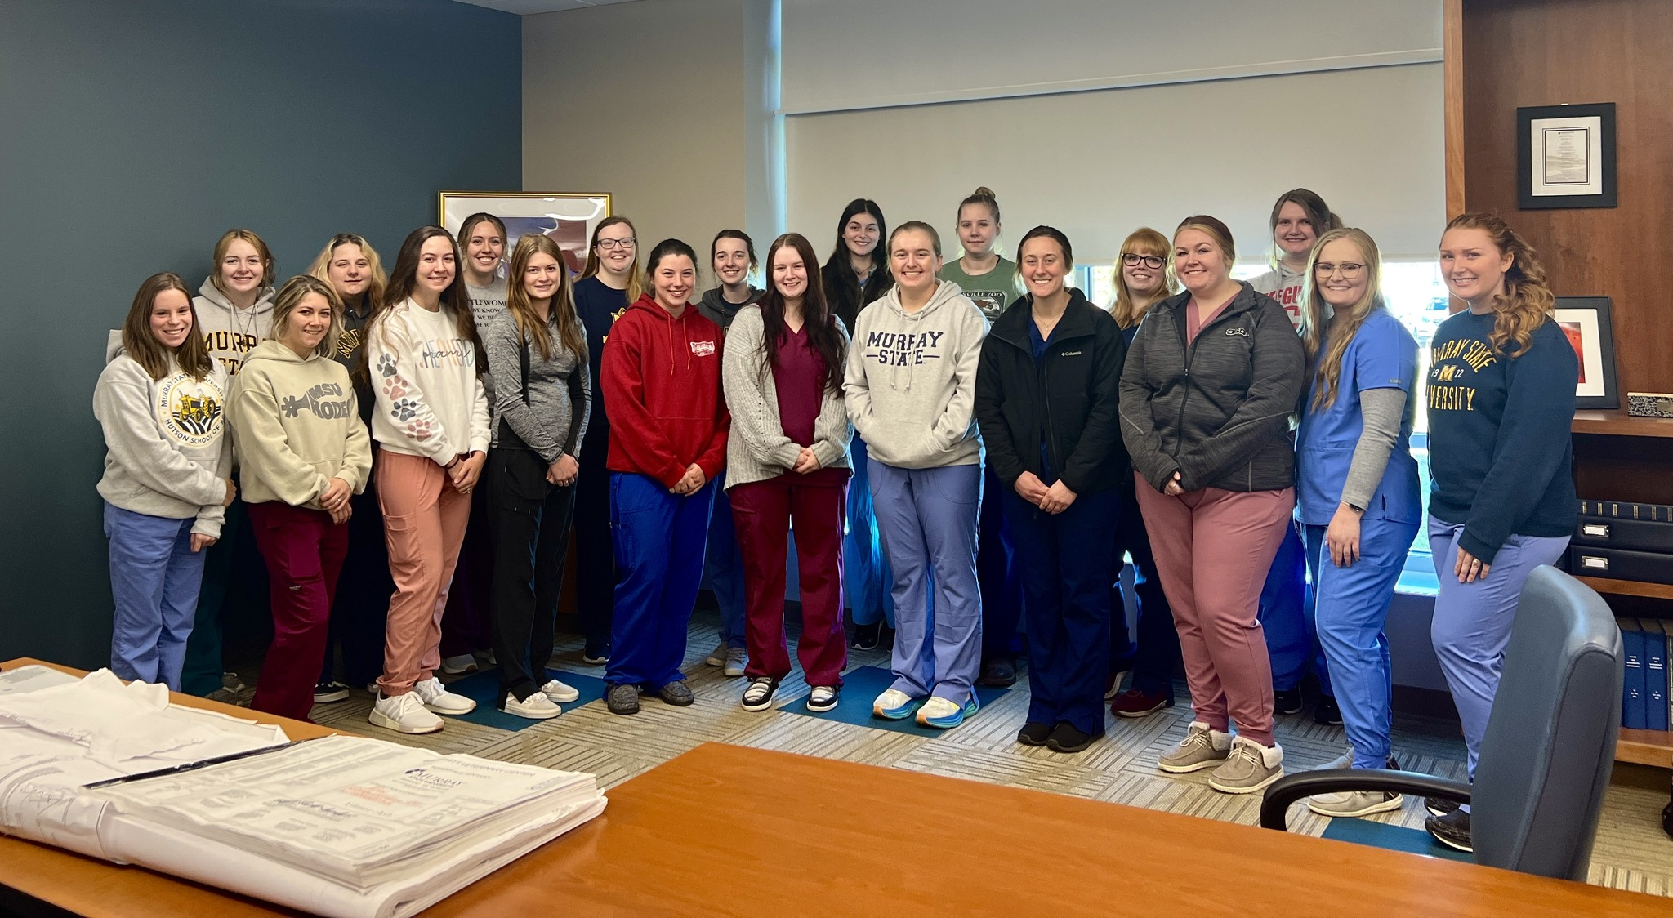
Students are Our Focus!
“It isn't just a passion, it is a dream for most of us. Going through your undergraduate years and spending all the time taking the hard classes and not get accepted into a Veterinary School is very discouraging. Everyone always says, "follow your dreams," however that is not possible unless you get accepted.”

Slide 18
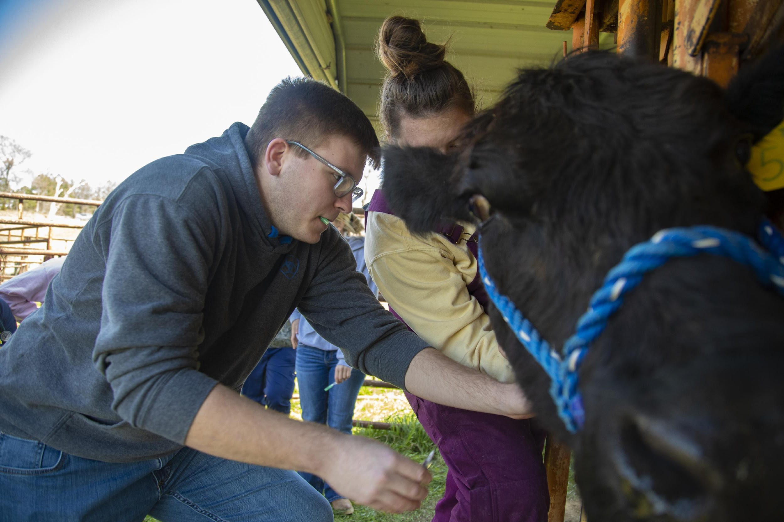
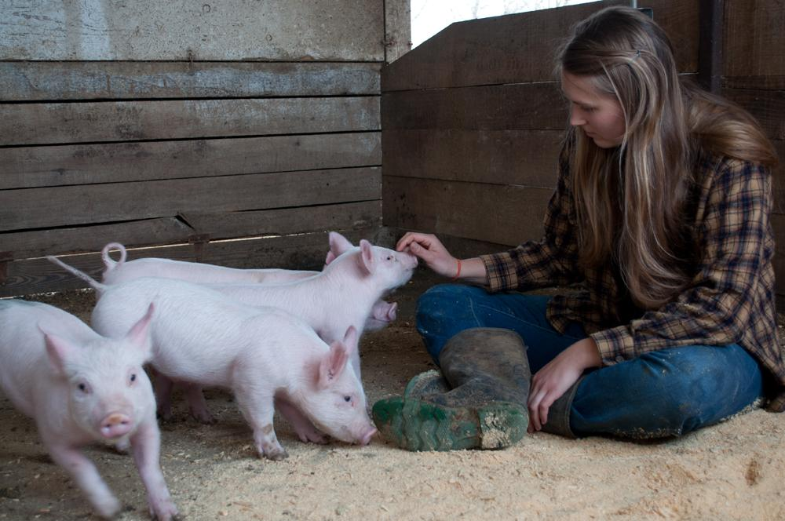
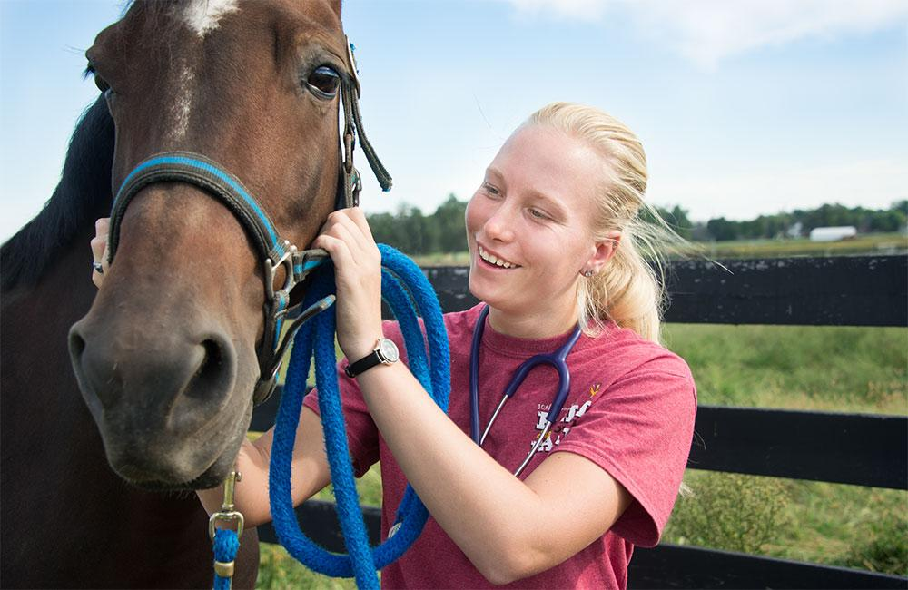
Discussion

