Slide 1
Budget Review Subcommittee on Justice & Judiciary February 10, 2026 Zach Ramsey, AOC Director Charles Byers, AOC Chief Information Officer

Slide 2
AGENDA
Video Arraignment & Conferencing Systems
Implementation
Adoption & Use
Barriers

Slide 3

Appropriations
2021 HB 556 (Judicial Branch):
$10.6M for expansion of video arraignment and addition of video conferencing to all courtrooms
2022 HB 1 (Executive Branch):
$15M for Jails to implement Video Arraignment
Department of Local Government coordinated with Kentucky Jailer’s Association

Slide 4
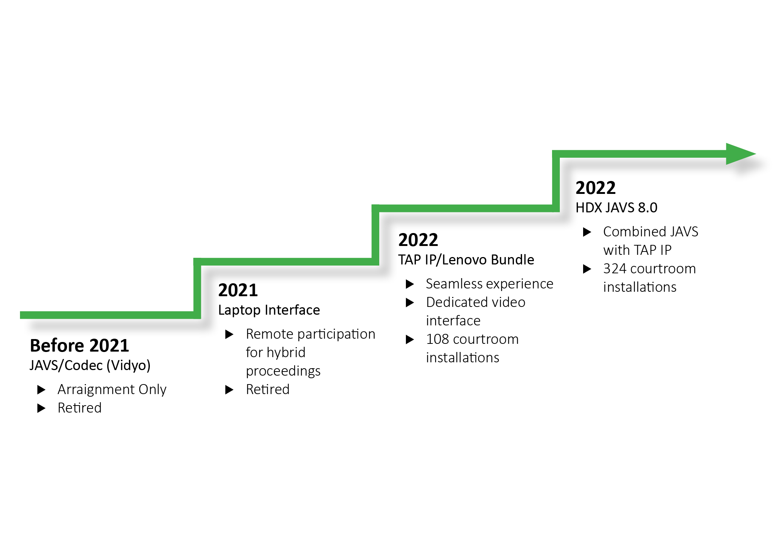
Court Video Arraignment Video Conferencing Technology Evolution ***JAVS and arraignment technology must connect to generate a complete court record.***
All 432 courtroom systems currently support Video Arraignment and Video Conferencing.

Slide 5

Court Video Arraignment Video Conferencing Quick Facts
Implementation – Recurring upgrades are projected to cost $3.8M annually (40-50 JAVS systems per year). The historical refresh cycle for JAVS is 7 years. There will always be multiple versions of JAVS due to rolling upgrades.
Adoption – Court usage of Zoom and remote proceedings continue to increase.
Barriers – Future funding to maintain and upgrade systems, technical currency reliance on vendor.

Slide 6
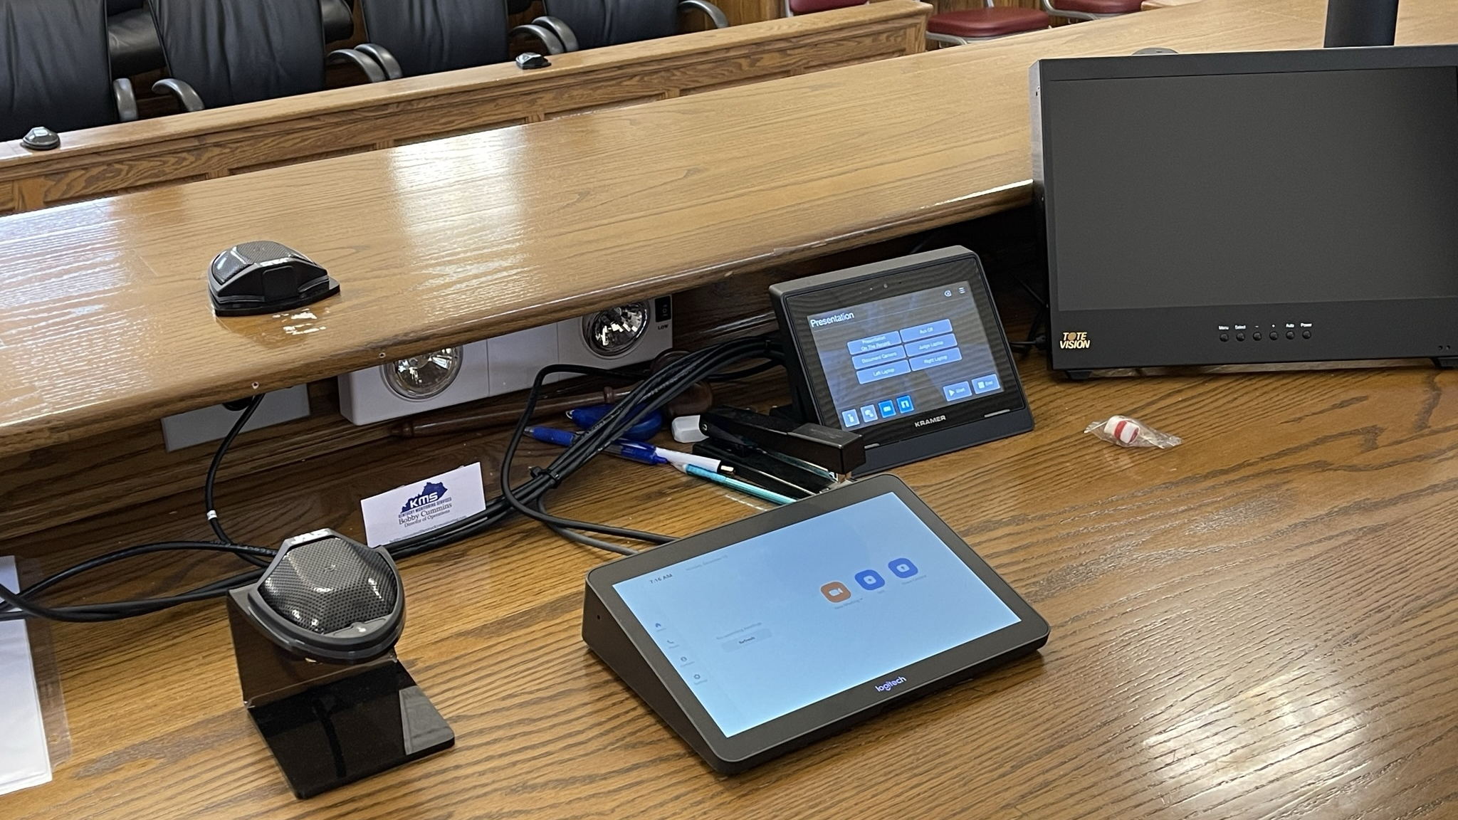
The Bench Device

Slide 7
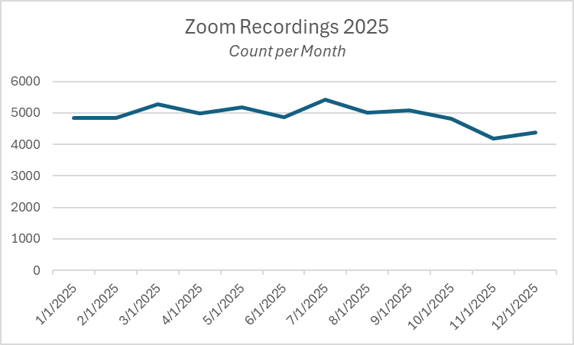
Zoom Recordings One to many events (cases) may be included in a single Zoom recording (docket).

Slide 8
Remote Court Proceedings
Notes:
RCP Events
Submitted monthly by JSS personnel statewide. Does not include RCP for Judges without JSSs. So, the usage numbers are likely higher.

Slide 9
2026 JAVS 8.0 Installation Schedule
46 system upgrades were budgeted for 15 counties in Fiscal Year 2026.
Counties include Kenton, Wayne, Perry, Greenup, Harlan, Jackson, Johnson, Knott, Lewis, Martin, Mason, Metcalfe, Pendleton, Oldham, and Simpson.
76 systems, representing 24 counties, remain. Upgrades are expected to be completed by the end of Fiscal Year 2028, assuming funded.
Evaluation of JAVS 9.0 is underway to determine next steps and transition timeline.

Slide 10

Jailer’s Video Arraignment Solution Quick Facts
Implementation – AOC cooperated with Trace 3 (Jail vendor) to implement a proof of concept and pilot, which included both hardware and software. 77 jail installations were completed in 2023. AOC continues to host the software licenses required to connect Jails with the Court.
Adoption – Usage by Jailers would need to be provided by the vendor and a request has been submitted.
Barriers – No technical barriers. Three entities must align on video arraignment scheduling – Court, Jailers, Sheriffs. Refresh cycle and funding may be issues.

Slide 11
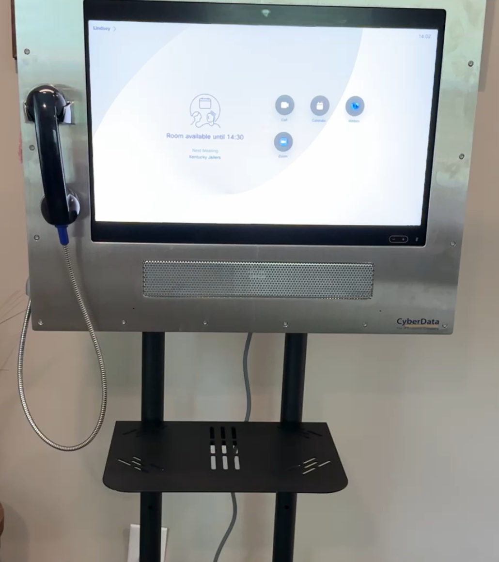
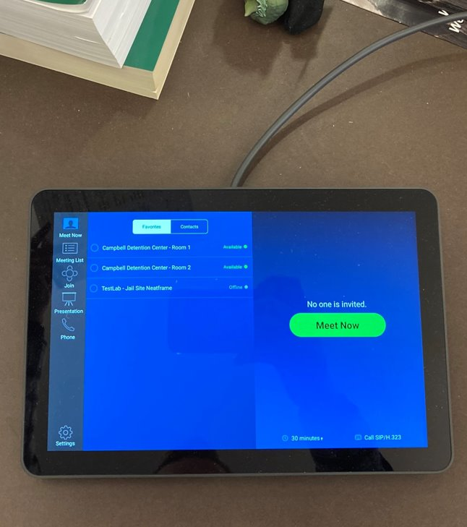
The Jail Device

Slide 12

Questions? zachramsey@kycourts.net charlesbyers@kycourts.net

