Slide 1
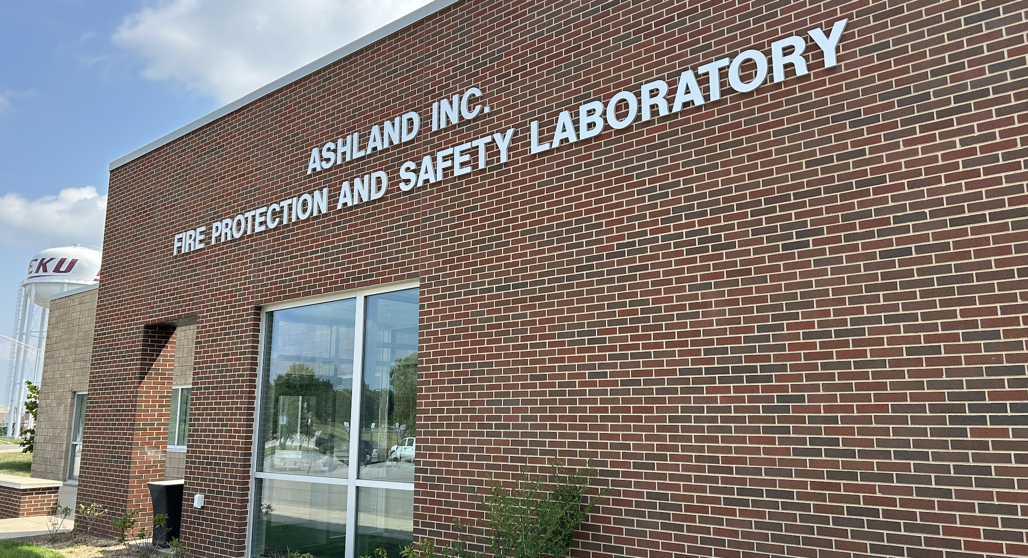
KENTUCKY IS LOSING OUR FUTURE
FIRE PROTECTION ENGINEERS
SUPPORTING HOUSE BILL 306

Slide 2

Pathways to Professional Licensure
Education
Examination (Fundamentals
of Engineering)
Professional Experience
Examination (Principles & Practice of Engineering)

Slide 3
FIRE PROTECTION ACCREDITATION
EKU is one of three ABET accredited programs in the U.S. to offer a BS in fire protection.
EKU’s fire protection degree is growing, and we recruit students from across the world.
Two kinds of ABET accreditation:
  Engineering Technology Accreditation Commission (ETAC) – EKU & OSU
  Engineering Accreditation Commission (EAC) – UM

Slide 4


FIRE PROTECTION ENGINEERS AGREE
Society of Fire Protection Engineers works with ABET to establish curriculum for and accredit both BS degrees in:
    Fire Protection Engineering
    Fire Protection Engineering Technology
In 2022, they stated, “Fire protection engineering technology graduates should be allowed to pursue professional engineering licensure.”

Slide 5
PROBLEM

Slide 6
FUTURE FIRE PROTECTION ENGINEERS
ARE LEAVING KENTUCKY
KRS 322.040 only recognizes EAC/ABET accredited programs for engineering licensure in Kentucky.
EKU fire protection graduates leave Kentucky and get licensed in other states.
  EKU graduates pass the Principles & Practice of Engineering (PE) at the same rate as the national average.
The job market is strong, and Kentucky has openings. Unfortunately, those jobs are filled by non-residents.

Slide 7
SOLUTION

Slide 8
SUPPORT HB 306
HB 306 removes the legislative prohibition for these fire protection engineer graduates to begin the licensure process and take the exam. Applicants will still have to earn licensure. This change gives them the chance to do so.
The goal for HB 306 is to meet the need for fire protection engineers & create more opportunities for Kentuckians to have successful careers in their home state.
SUPPORT HB 306

Slide 9

QUESTIONS?

