Slide 1
Tourism & Outdoor Recreation Committee
February 16, 2023
Tourism, Arts and Heritage Cabinet Secretary Lindy Casebier
Department of Parks Commissioner
Russ Meyer
Department of Parks Deputy Commissioner
Ron Vanover

Slide 2
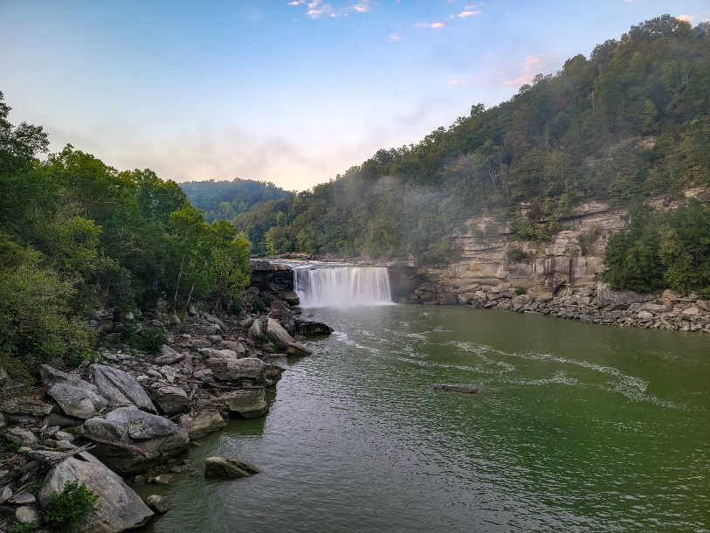
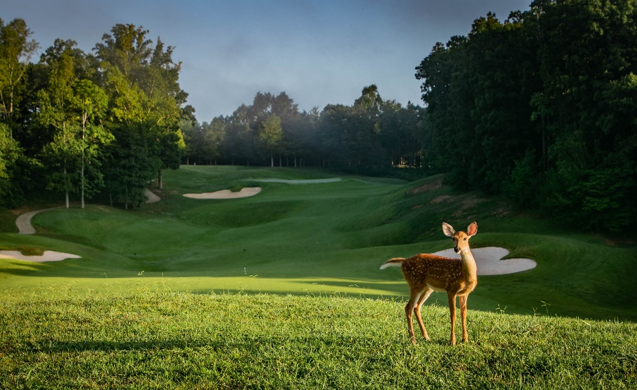
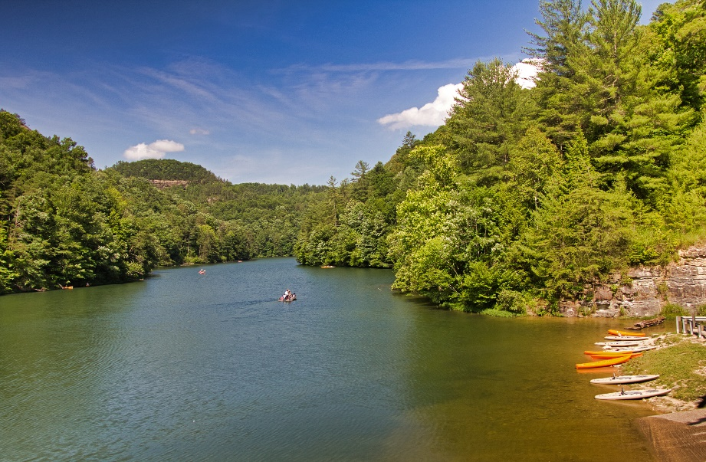
Our Mission
Provide a sustainable system of parks that delivers quality programs, amenities, and services, which create memorable experiences and a sense of place, contributes to the economic growth of the commonwealth, and preserves the historic and natural integrity and traditions of our parks for existing and future generations.

Slide 3
Parks Operations

Slide 4
Vision for Kentucky’s Park System
Promote Kentucky as an inclusive travel experience that welcomes visitors of diverse backgrounds and interests.
Focus advertising efforts on encouraging travelers to take advantage of Kentucky’s outdoor assets.
Build public and private partnerships to ensure that Kentucky State Parks bring both recreational and economic value to the communities that relay on our parks as the primary tourist attraction.
Pursue funding opportunities that will allow Kentucky State Parks to continue to address the continuous maintenance needs at each of state park.
Protect and conserve Kentucky’s natural resources and to be responsible stewards of the “Nation’s Finest” state park system while promoting these opportunities to tourists, sportsmen and sportswomen.

Slide 5
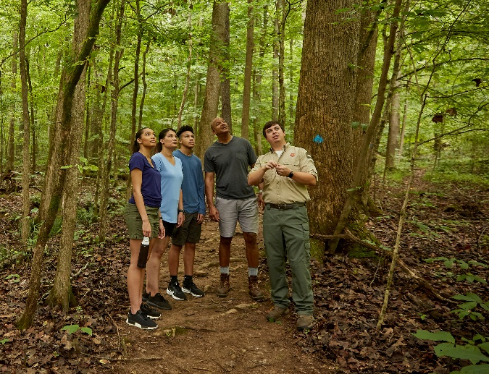
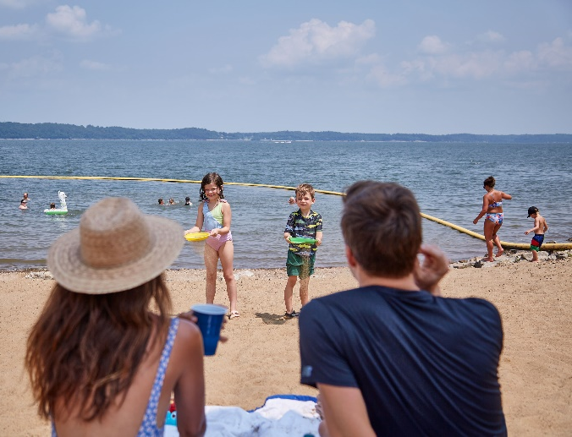
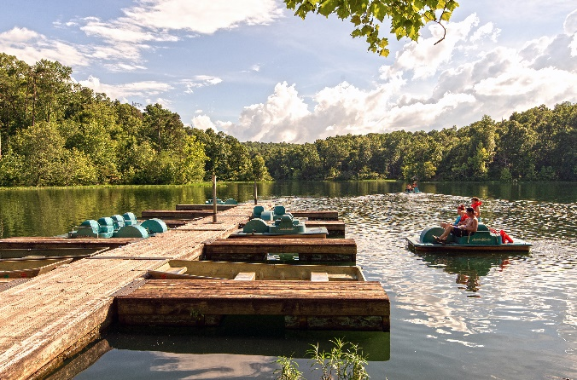
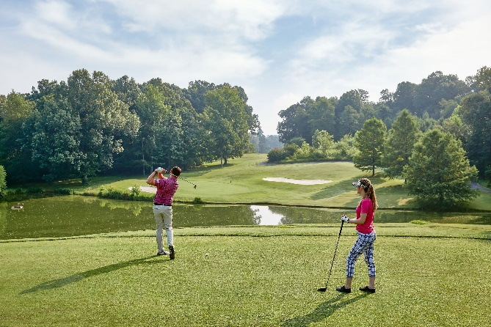
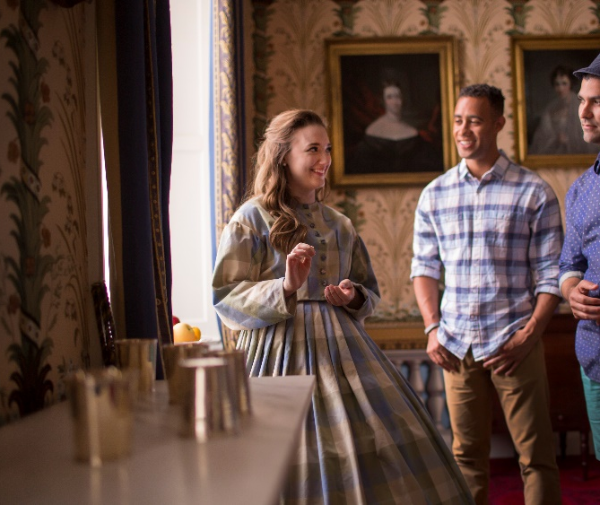
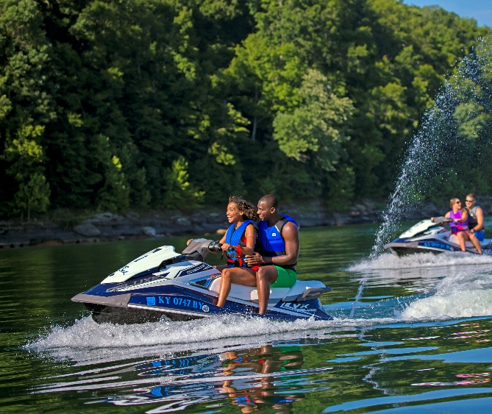
Vision for Kentucky’s Park System continued
Continue to be a leader in Kentucky’s tourism industry and an economic driver for tourism across the commonwealth.
Expand our travel market, becoming a desired destination for out-of-state travelers, groups and other visitors.
Exceed guests’ expectations by creating memorable experiences that complement the incredible natural, cultural and historic attractions found in our State Parks.
Continue to improve facility enhancement initiatives.

Slide 6
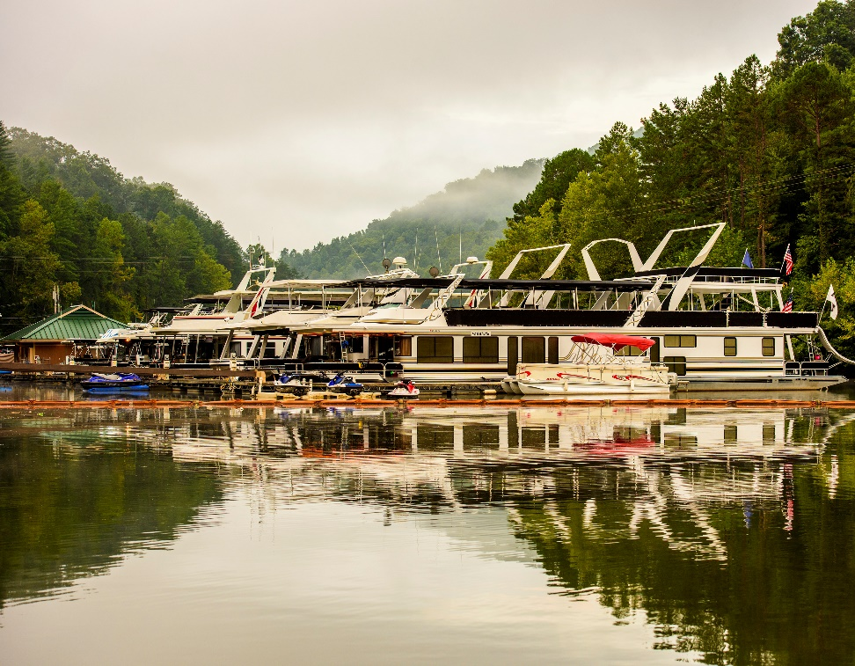
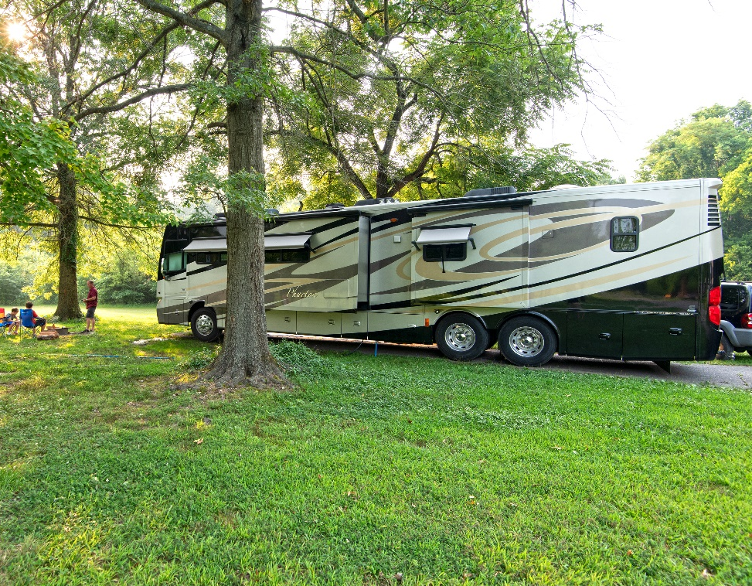
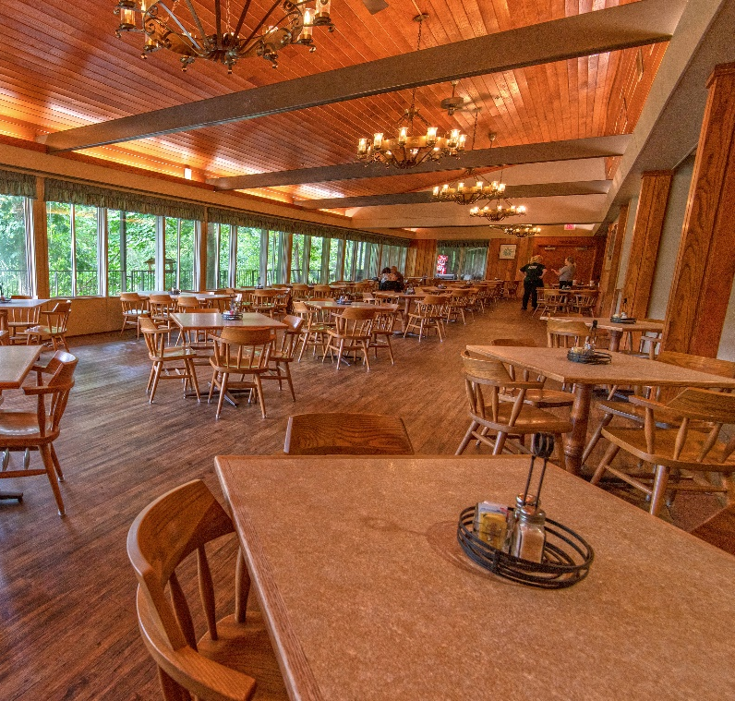
Parks’ $150 Million proposed plan
Address all deferred maintenance issues and bring operations back to pre-covid standards.
Improve all accommodations and facilities to meet guests’ expectations.
Improve recreational amenities.

Slide 7
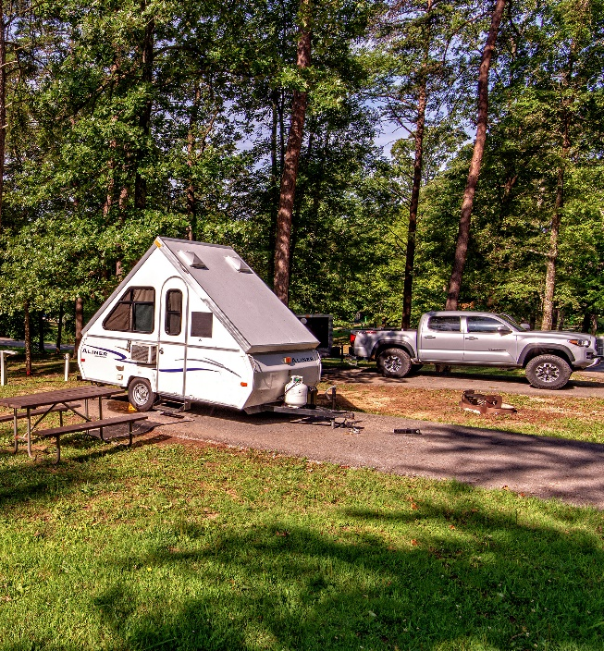
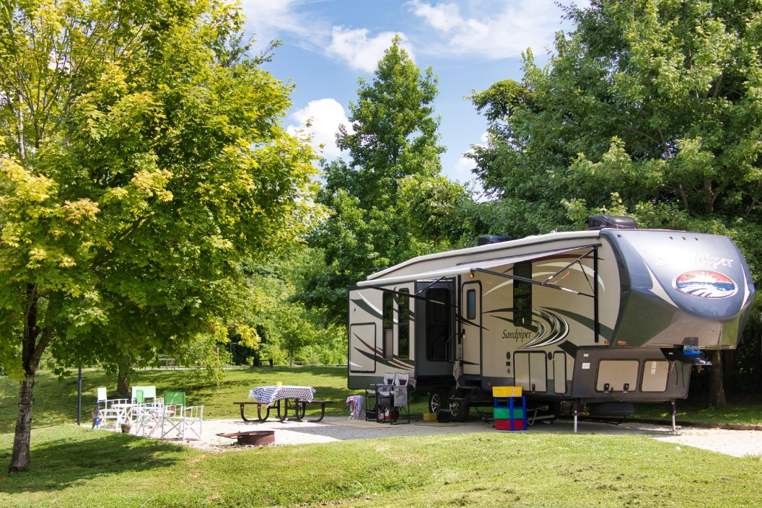
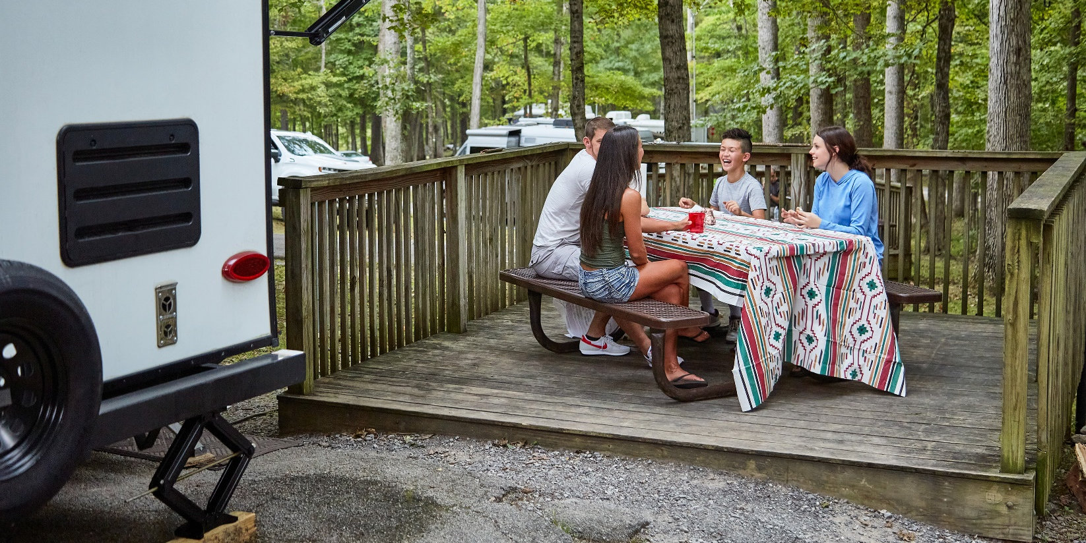
Campgrounds Amenities - $40 Million
Upgrade electric, sewer, and water on approximately 750 campsites.
Increase electrical amperage to 50 at all campgrounds.
Renovate bathhouses to be more energy efficient.
Add sewer connections where feasible.
Add frost-proof hydrants.
Grade and level campsites.
Add camper cabins in various campgrounds.

Slide 8
Technology Infrastructure and Maintenance - $6 Million
Lodge connectivity and guest Wi-Fi: $4.2 million from 2019 Refreshing the Finest.
Campgrounds connectivity and guest Wi-Fi: $6 million from 2023 $150 million in parks funding.
Recreation historic parks, outdoor spaces and cabin connectivity.
Infrastructure and maintenance improvements
High-speed internet at every lodge.
High-speed internet at every campground.
Wi-Fi connectivity in all lodge rooms, common areas (front desk, gift shops, dining areas) and conference areas.
Wi-Fi connectivity at our campsites.

Slide 9
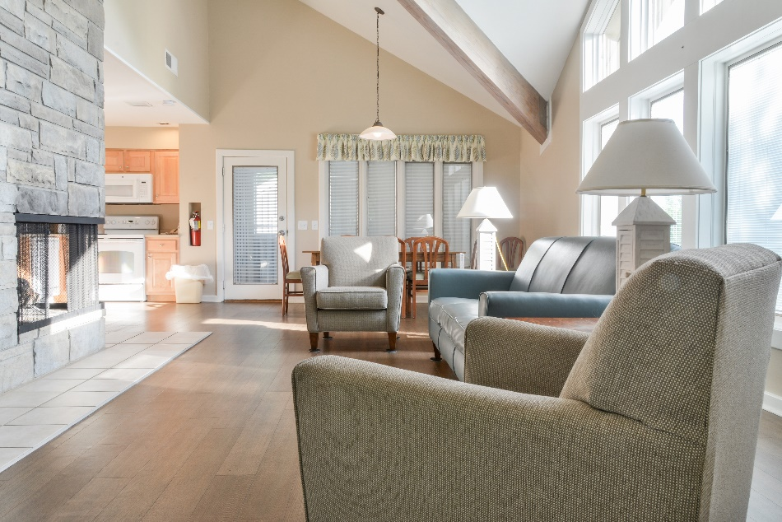
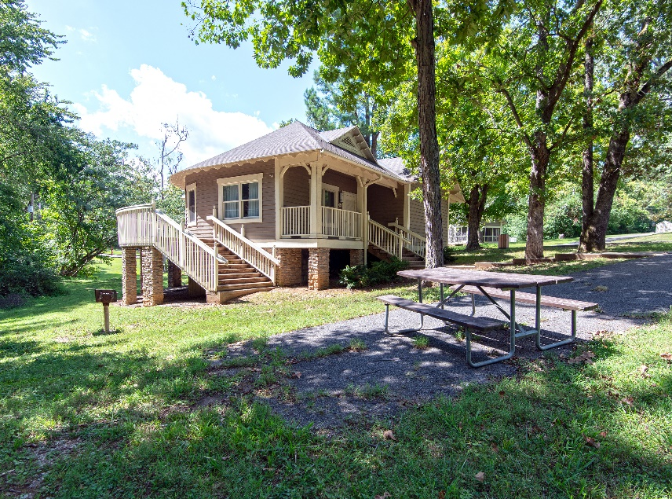
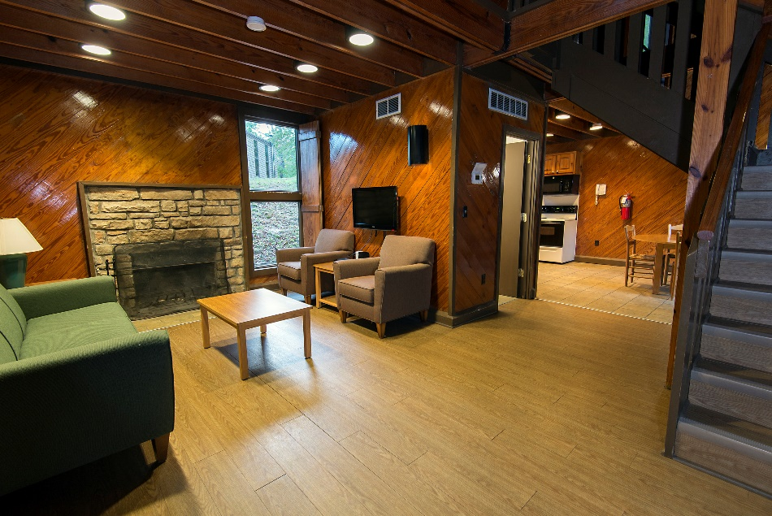
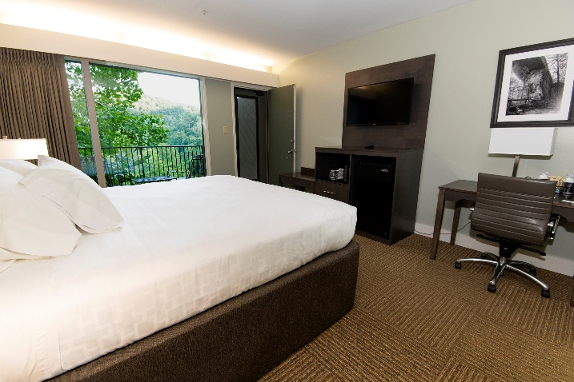
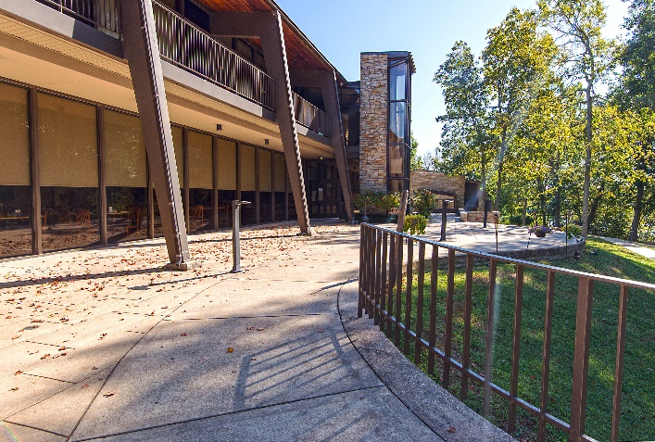
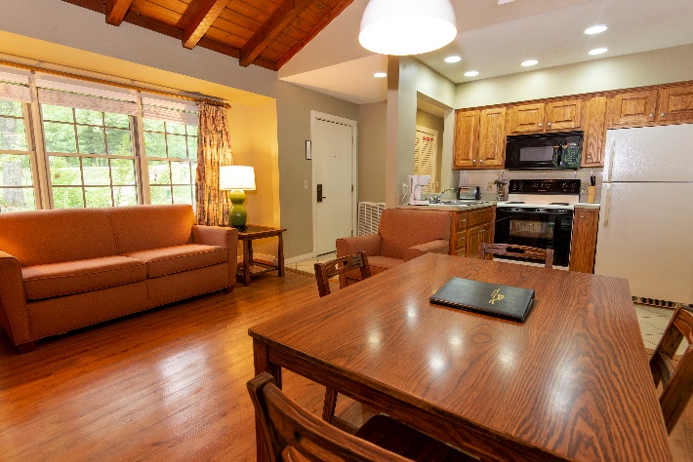
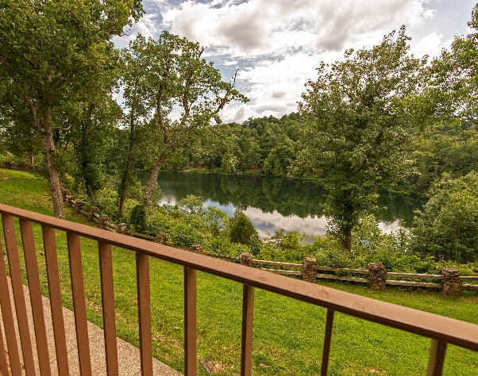
Park Facilities Accommodations - $22 Million
Continued renovation of lodge rooms and cottages annually.

Slide 10
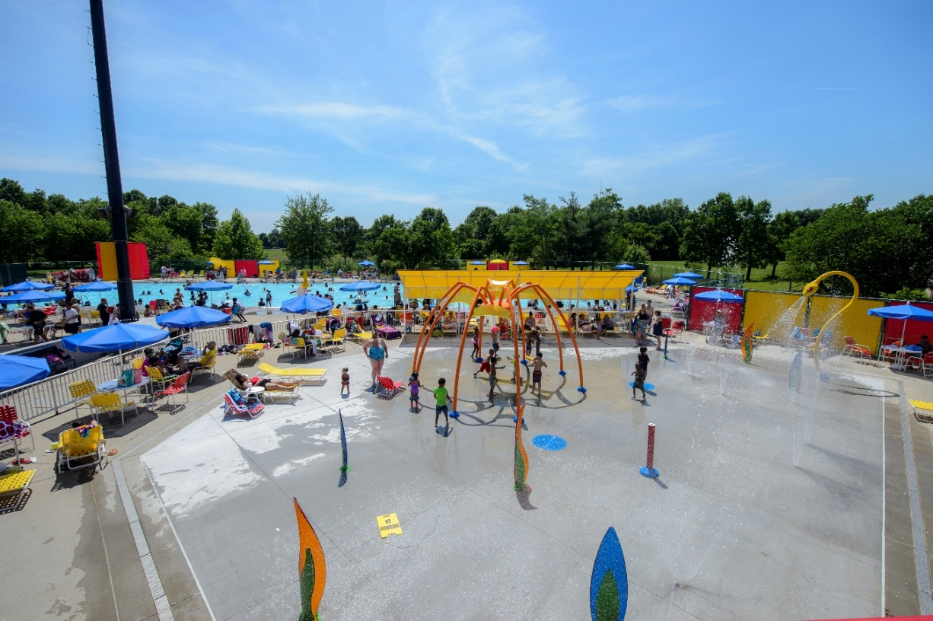
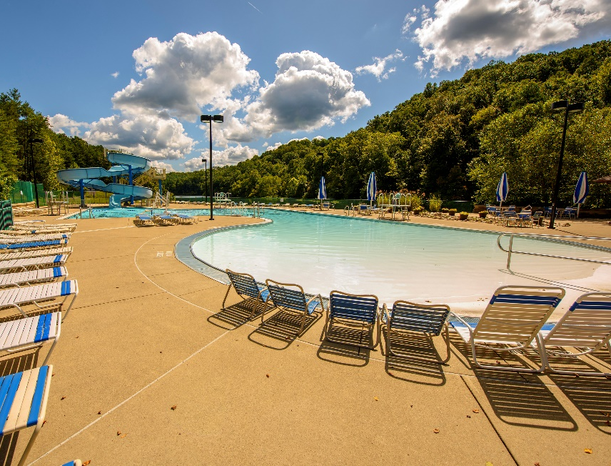
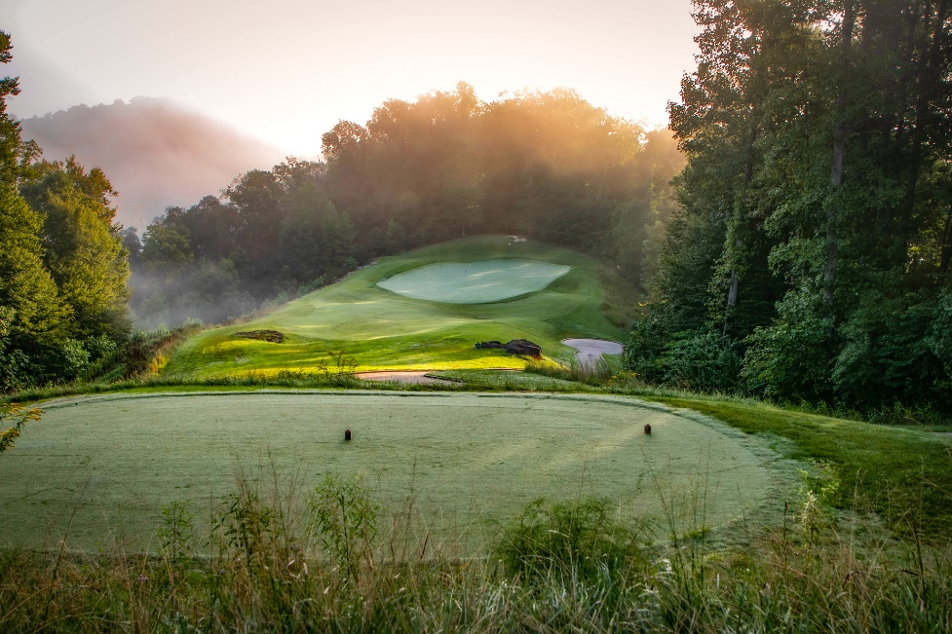
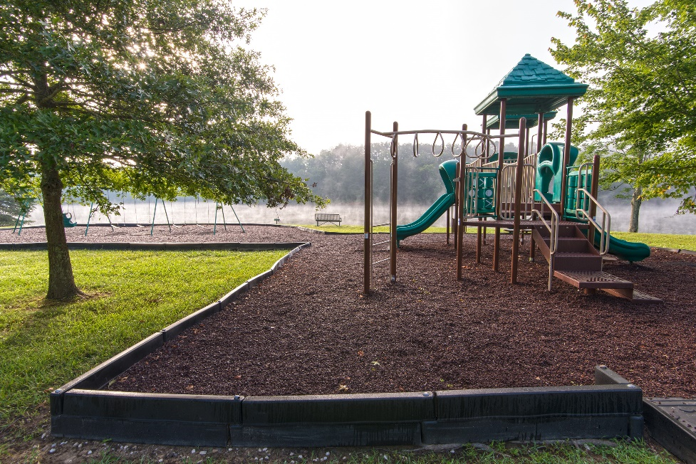
Park Facilities Recreational Amenities - $22 Million
Replace/convert 5 pools to a splash pad.
Renovate or update 10 pools.
Resurface recreational courts.
Add pickleball courts.
Upgrade outdated playgrounds.
Install Better Billy Bunker System at various courses.
Replace the irrigation control systems at various courses.

Slide 11
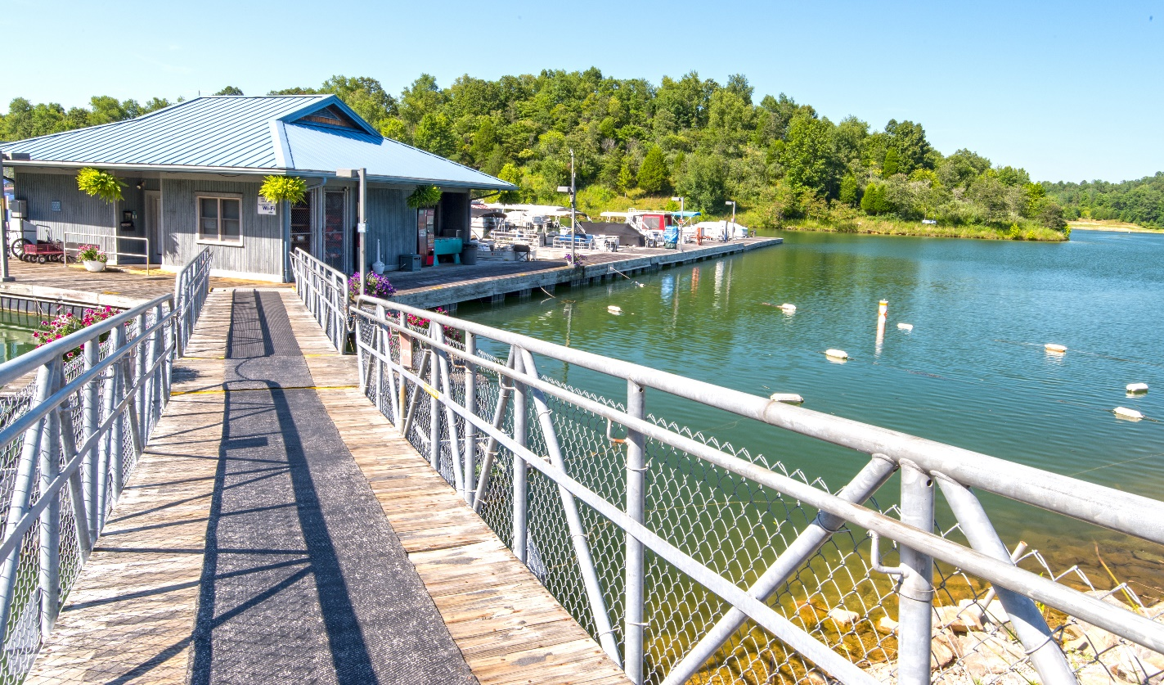
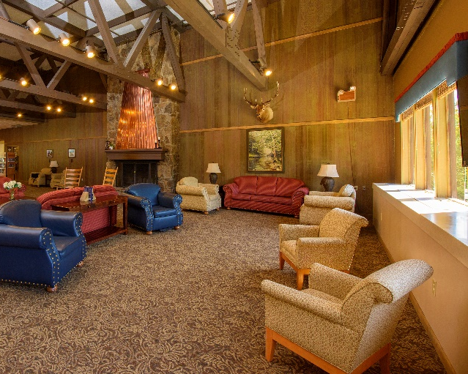
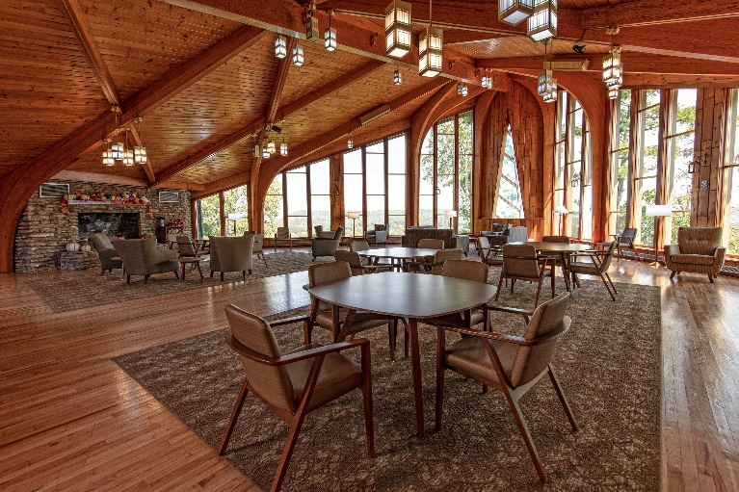
BUILDINGS AND GROUNDS
IMPROVEMENTS
STRUCTURAL/ MECHANICAL - $40 MILLION
Address findings from a Parks-wide structural integrity study:
Mechanical, electrical, and plumbing (MEP) needs.
Foundation repair
Exterior improvements
Fire suppression systems
Elevators
ADA improvements
Doors and windows
Marina electrical
JENNY WILEY

Slide 12
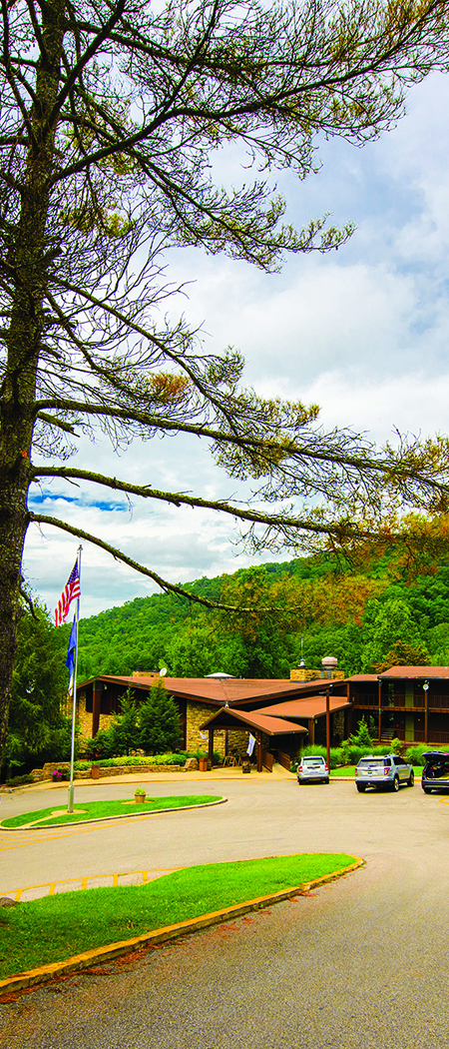
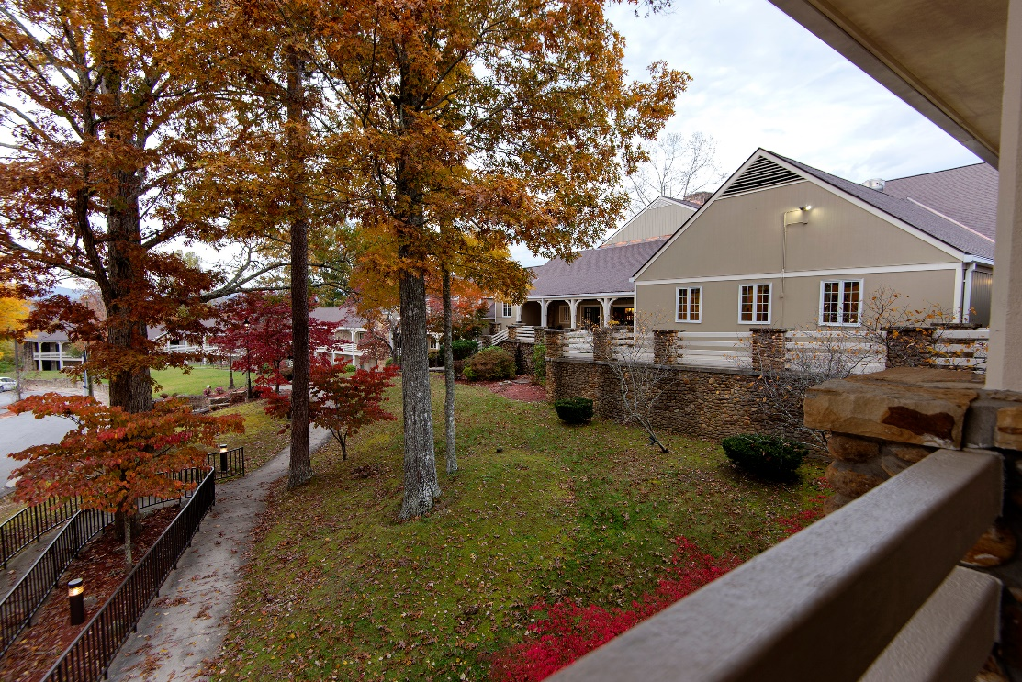
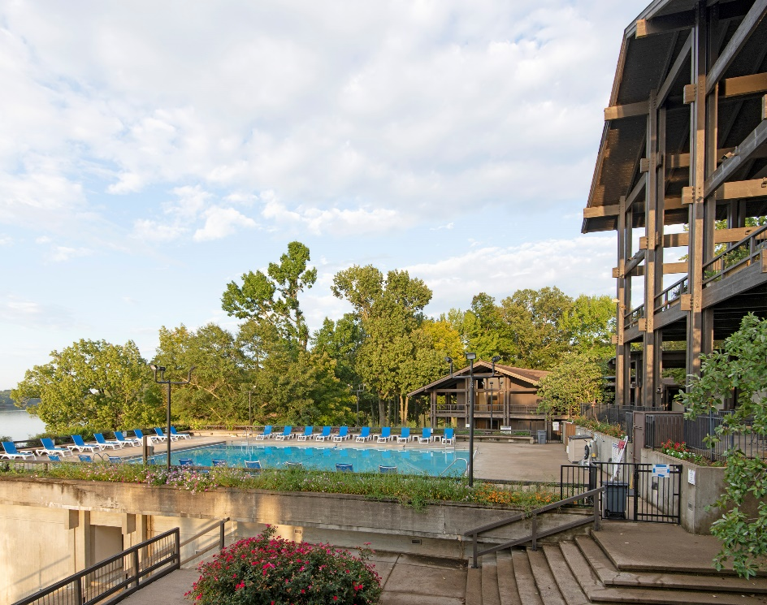
UTILITY IMPROVEMENTS
STRUCTURAL/ MECHANICAL - $20 MILLION
Continue upgrades to wastewater treatment plants under design.
Replace/rebuild pumps in lift stations.
Clear rights-of-way for overhead utility lines.
Upgrade power lines into parks.

Slide 13
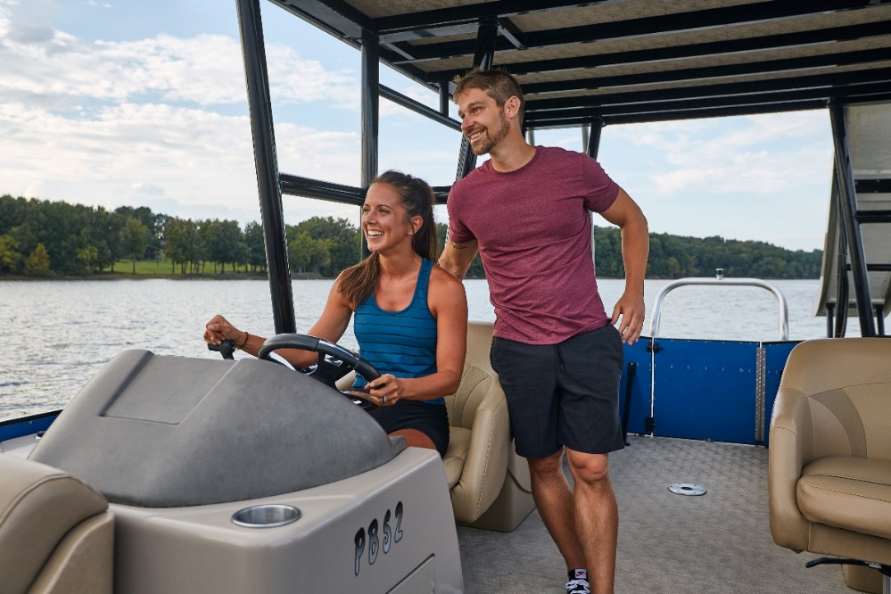
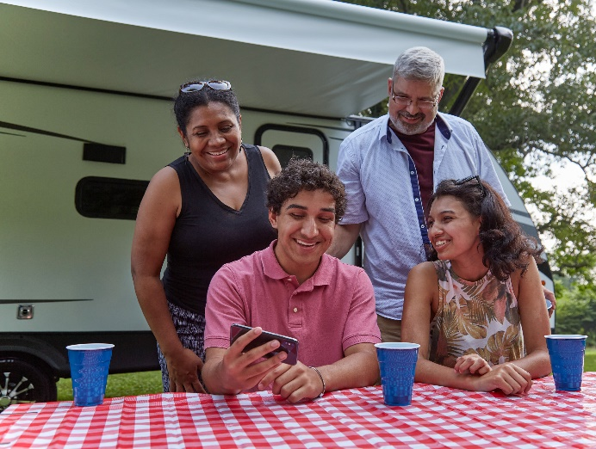
Guest Experiences and Customer Service
Partnership with Medallia to enhance customer engagement.

Slide 14
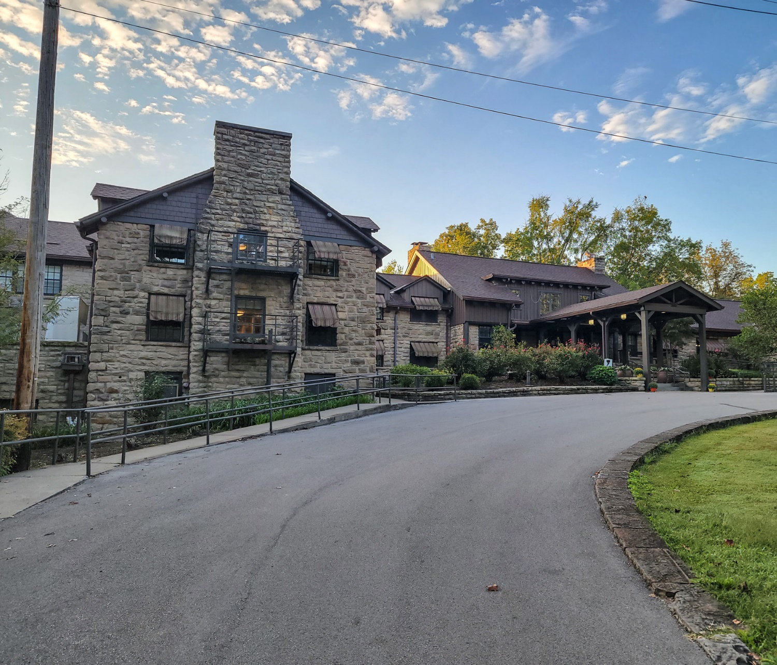
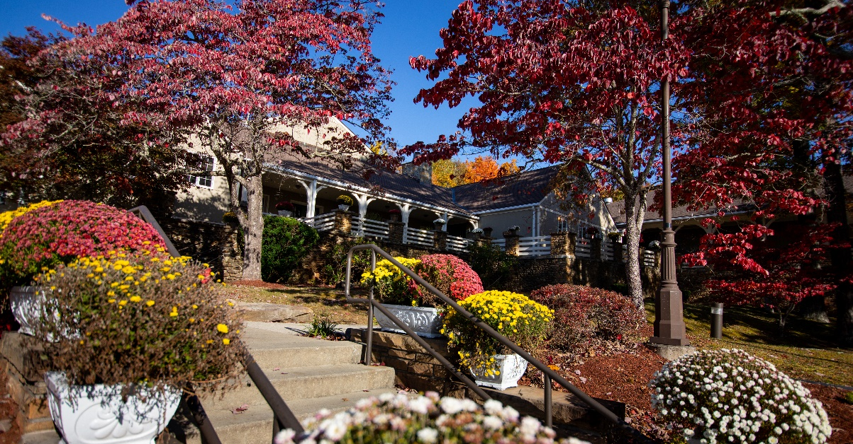
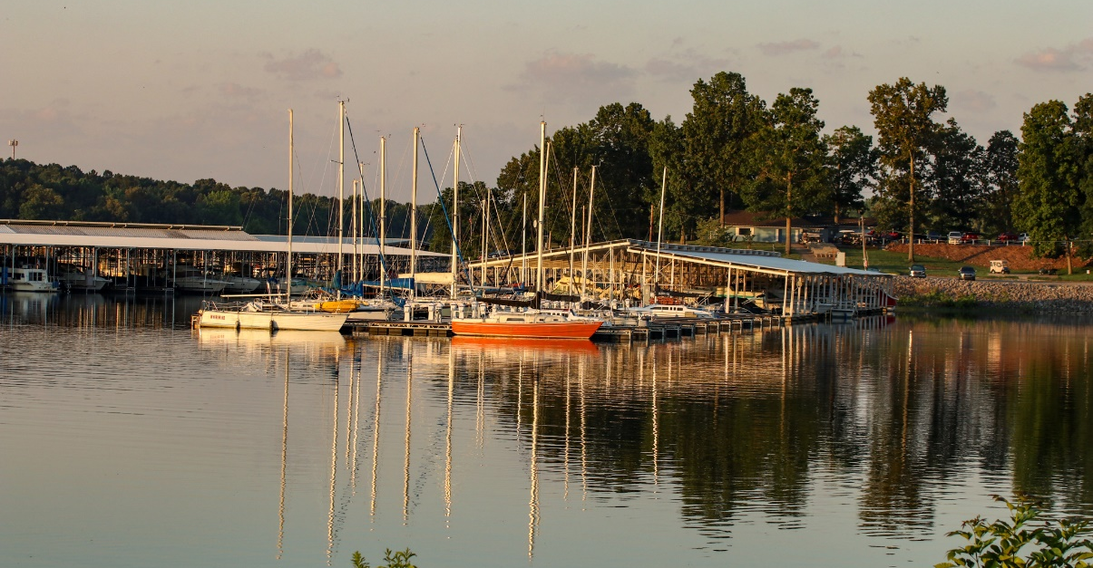
closing

Slide 15
Questions?

