Slide 1
FIRSTNET
Connecting the Public Safety Community

Slide 2

FirstNet is the nationwide public safety broadband network, services and solutions dedicated to first responders and those who support them.
It is more than a network, including advanced services, applications and purpose-built devices.
We are accountable for keeping your lines of communication open – with dedicated mission critical solutions to modernize public safety.

Slide 3




Built for first responders.
Inspired by first responders.
First Responder Network Authority
February 2012
The First Responder Network Authority is authorized to develop and oversee the dedicated nationwide network for first responders.
March 2017
AT&T is awarded the contract to build and maintain FirstNet
March 2018
FirstNet completes the private core network buildout
December 2019
FirstNet hits 1M connections serving over 10,000 public safety agencies nationwide. As of October 2020, over 14K agencies, accounting for over 1.7M connections, are on FirstNet
Today
As of October 20, 2022, 23K+ agencies, accounting for 4M connections, are on FirstNet. With you, we are developing the tools that advance public safety.
Over 100 years in emergency response solutions.
Notes:
AT&T has over 100 years in emergency response solutions.
In February 2012, Congress authorized the First Responder Network Authority to develop and oversee the creation of a dedicated nationwide network for first responders. This was the result of a report after the 9/11 attacks, where first responders could not communicate and lives were lost.
In March 2017, AT&T was awarded the contract to build and maintain FirstNet and we set out to ensure that all 50 states and territories opted in to FirstNet.
In March 2018, we completed the FirstNet private core network buildout and
In December 2019, FirstNet hit 1M connections serving over 10,000 public safety agencies nationwide.
As of October 2021, we had more than18.5K+ agencies, accounting for 2.8M+ connections, on FirstNet. With you, we are developing the tools that advance public safety.

Slide 4
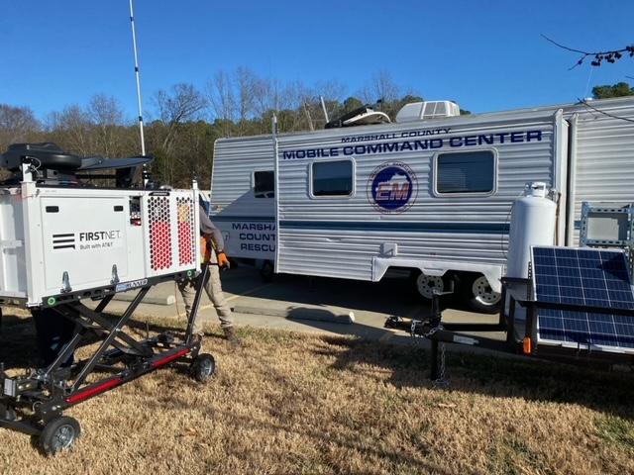
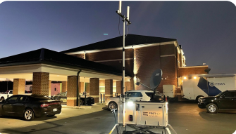
FirstNet Delivers
The only dedicated physically separate network core
24/7 priority and, for first responders, preemption capabilities
FirstNet Band 14 spectrum – now live in over 700 markets
2.81M+ square miles* of LTE coverage nationwide. That’s 50K+ square miles more than commercial networks
Covers more first responders than any other network
Prioritized access on all AT&T LTE bands – across voice, text and data
No throttling for FirstNet subscribers anywhere in the country
A dedicated fleet of 150+ deployable assets, including Satellite Cells on Light Trucks, Communications Vehicles (CVs) and Compact Rapid Deployables (CRDs)
*As of 10/20/2022 Press Release
Notes:
FirstNet delivers the fastest overall network experience … performing faster than any commercial network for two quarters in a row. Moreover, FirstNet offers affordable solutions without the concern of being throttled anywhere in the country.
FirstNet gives public safety access to the only physically separate network core in the country that’s dedicated entirely to you. The FirstNet core encrypts your sensitive communications. It’s also monitored around-the-clock by a dedicated Security Operations Center, and it can only be accessed by a separate FirstNet SIM.
FirstNet enables always-on, 24x7 priority and preemption across voice and data communications – this is unmatched in the industry.
FirstNet is spurring innovation with more than 75 FirstNet Ready™ devices and 50+ unique apps that can help increase your situational awareness.
And FirstNet is increasing your coverage and capacity across the country through the rollout of the FirstNet Band 14 spectrum, which is now live in about 650 markets nationwide. In fact, in 2018, we increased the FirstNet LTE coverage area by more than 50,000 square miles.
Now, I want to stress a few points here.
As a FirstNet subscriber, you get prioritized access on all AT&T LTE bands in addition to Band 14.
This was done for two reasons: to give you immediate access to the early benefits of FirstNet while Band 14 was being rolled out and to ensure you had as much coverage and capacity as possible.
Using all AT&T LTE bands – including other bands in the 700MHz range like Band 12 and Band 17 – FirstNet already covers over 99% of the U.S. population today.
Some providers say spectrum is spectrum. And that their general use commercial spectrum is just as good as Band 14. This is not quite true. Band 14 is very desirable spectrum set aside by the federal government specifically for public safety. Band 14 is an important addition to AT&T’s other spectrum. And AT&T is legally required to clear all commercial traffic off of Band 14 when and where first responders need it, creating a first responder VIP lane.

Slide 5
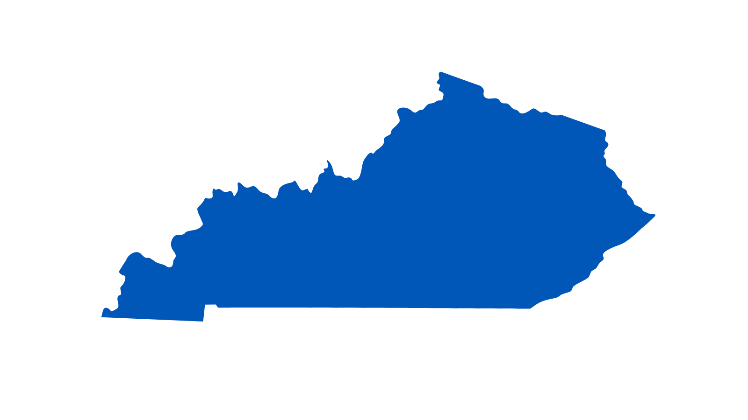
FirstNet By The Numbers
4M+*
FirstNet connections nationwide
23K+
Public safety agencies and organizations on FirstNet
70K+
FirstNet connections in Kentucky
400+
Kentucky public safety agencies and organizations on FirstNet
1K+
Solutions deployed for public safety this year
525+
FirstNet Ready® Devices
*As of 10/20/22 Announcement

Slide 6
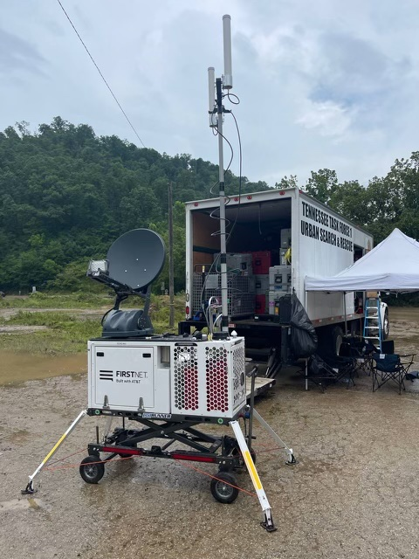

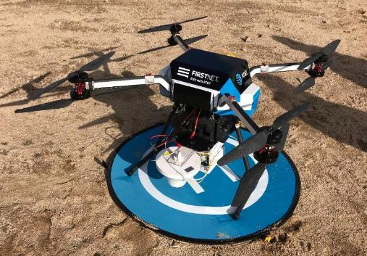
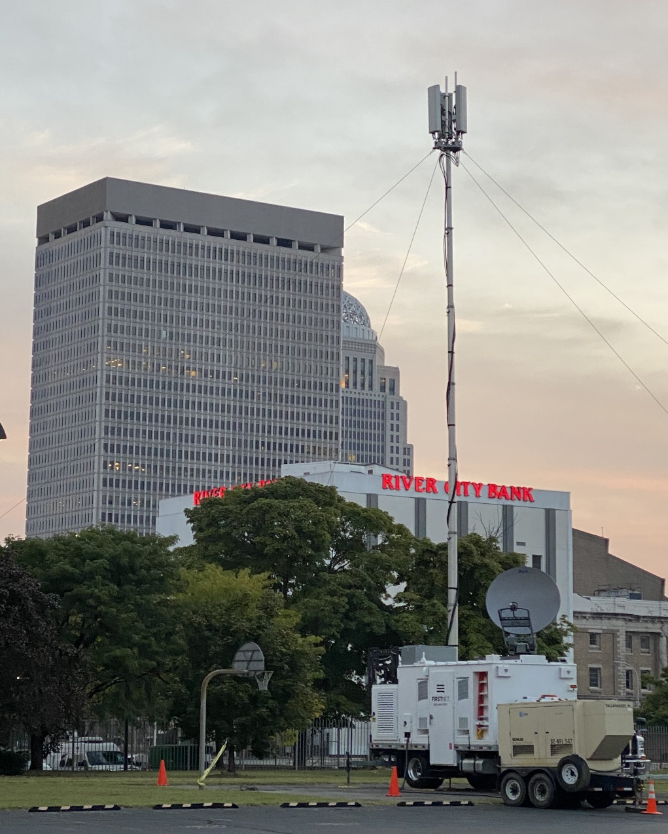
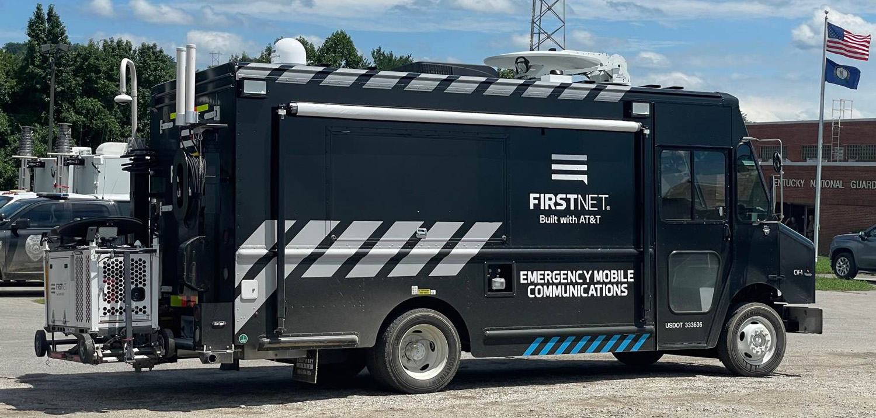
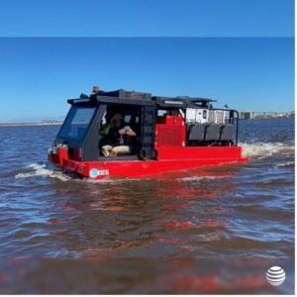
Dedicated Deployables
150+ Dedicated Deployables
FirstNet-dedicated deployables are mobile cell sites that link to FirstNet via satellite. They don’t rely on commercial power availability. They provide first responders with connectivity.
Types of FirstNet deployables include:
SatCOLTs (Satellite Cells on Light Trucks)
CRDs (Compact Rapid Deployable)
FlyingCOWs (Cell on Wings)
Aerostat (55-foot blimp)
Also available is an Emergency Mobile Communications command center and, through AT&T’s National Disaster Recover assets, an amphibious vehicle.
Notes:
“SatCOLT” = Satellite Cell on Light Truck. The 72 deployables will be a “lending library” that adopting FirstNet customer entities can request at no additional charge to support various scenarios and incidents. The fleet is incremental to AT&T’s existing National Disaster Recovery (NDR) assets (COWs/COLTs, portable generators, and other AT&T Emergency Communications Vehicles, etc.).
Deployable systems that utilize satellite backhaul may have more limited capacity as compared to terrestrial sites with fiber backhaul, though satellite-based deployable assets are able to be deployed more rapidly and are dedicated to public safety operations. The deployables currently being developed will be designed to have band 14 capability… voice, data, location, messaging, and First Priority… and are being designed with the capability to deliver up to 25 Mbps downlink and up to 8 Mbps uplink.
Transmission improvement capabilities will continue to be evaluated.

Slide 7
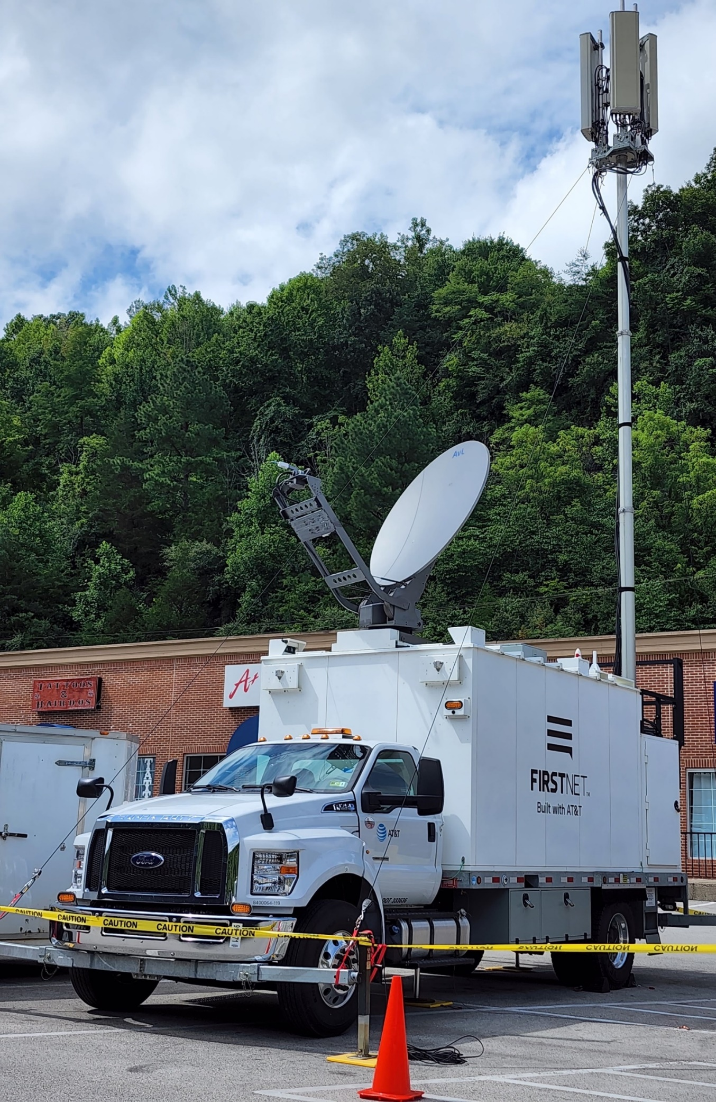
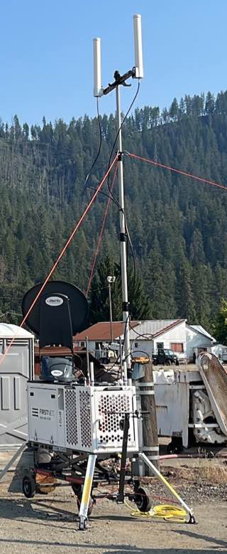
Response Operations Group (ROG) - Kentucky Deployments
Western Kentucky tornadoes - 2021
SatCOLTs (right) provided coverage in areas where permanent sites were knocked off-air, serving communities that included Dawson Springs, Benton, and Mayfield.
The FirstNet Rapid Response Group provided devices and CRDs to support search, rescue and recovery operations in the Kentucky Lakes area.
Eastern Kentucky floods - 2022
Multiple assets, including CRDs (left) provided connectivity for local first responders, FEMA personnel and search & rescue teams from Tennessee, Indiana and Missouri.
A SatCOLT, deployed to Buckhorn Lake State Resort Park, and connected to the “civilian” wireless network to provide service for displaced flood victims who had been relocated to the lodge.

