Slide 1




2018-2020 Budget Overview
House Budget Review Subcommittee on Primary and Secondary Education and Workforce Development
February 13, 2019

Slide 2


Mission & Goals
The mission of the Education and Workforce Development Cabinet (EWDC) is to educate, prepare and train Kentucky's current and future workforce.
Provide employers with a qualified, skilled workforce and Kentuckians with quality employment opportunities, education and training.
Broaden the Kentucky Career Center customer base to increase employment rate and the number of adults earning credentials
Increase Kentucky’s employer engagement rate within the workforce system
Establish statewide performance metrics to measure quality of workforce development systems and programs
Align workforce demand to bridge education and training with employment

Slide 3

Department of Workforce Investment
Connects Kentuckians to employment, workforce resources, education and training
Provides services through 61 Kentucky Career Center locations
Administers unemployment insurance program
Assists individuals with disabilities and visual impairments

Slide 4

KENTUCKY DEPARTMENT FOR LIBRARIES & ARCHIVES
State Library- Maintains collections and provides services to public libraries & state employees
Library Development – Consulting for public libraries, administers
federal and construction funds
Talking Books – Provides material for visually and physically impaired
State & Local Records – Sets record retention and assists with
record management for state and local government
Archival Services – Maintains state archives & operates research room
Terry Manuel – Commissioner/State Librarian

Slide 5



Attached Agencies
KENTUCKY EDUCATIONAL TELEVISION
One of the largest and most respected public broadcasting networks in the nation
Shae Hopkins – Executive Director
COMMISSION ON PROPRIETARY EDUCATION
Regulates professional and technical education to protect students
Misty Edwards – Executive Director
GOVERNOR’S OFFICE OF EARLY CHILDHOOD
Cross-agency coordination of Early Childhood
$42 million Race to the Top Grant
Linda Hampton – Executive Director

Slide 6



Attached Agencies
KENTUCKY CENTER
FOR SCHOOL SAFETY
Professional development for Kentucky educators for safety best practices
“Threat” audits of schools incl. bullying
Jon Akers – Executive Director
KENTUCKY ENVIRONMENTAL EDUCATION COUNCIL
Promotes learning and skills for a sustainable and economically healthy environment
Billy Bennett – Executive Director
COMMISSION ON DEAF AND HARD OF HEARING
Over 700,000 deaf and hard of hearing individuals in Kentucky
Provides cradle-to-grave services to help DHH individuals become productive members of society and obtain employment
Interpreters, equipment (iPads), advocacy and information
Virginia Moore – Executive Director

Slide 7


Schools
GOVERNOR’S SCHOLARS PROGRAM
Established in 1983
Ambition to keep brightest students in KY
1100 students on three campuses
Aris Cedeno– Executive Director
GOVERNOR’S SCHOOL FOR ENTREPRENEURS
Established in 2013
Design thinking, customer discovery, launching
64 students @ Georgetown College
Mac Glidewell- Executive Director

Slide 8

Cabinet Reorganization
Restructure of programmatic and administrative support agencies:
  Registered Apprenticeship
  Consolidation of Office of Vocational Rehabilitation and Office of the Blind
  Adult Education
More effectively aligns workforce resources and programs.
No loss of employment status or funding.

Slide 9


Registered Apprenticeship
Registered Apprenticeship Program transferred by Executive Order on July 17, 2018
Integrated apprenticeship model with other workforce resources and programs
Flexible, employer-driven approach that has benefited 3,715 apprentices in 266 programs in Kentucky
Nearly $1.1 million in federal funding allotted to Kentucky’s apprenticeship initiatives
Kentucky’s apprenticeship program’s impact as of December 2018:
  248 new apprentices
  11 new programs
  3 new occupations

Slide 10

Vocational Rehabilitation &
Office for the Blind Consolidation
Consolidated services for individuals with visual impairments and other disabilities to streamline services and increase efficiencies
Consulted with stakeholders from the Kentucky National Federation of the Blind, Kentucky American Council for the Blind, and Bluegrass Council for the Blind
10 public hearings were held to allow the public an opportunity to comment on the reorganization process
Continues to operate 10 local offices for individuals with visual impairments, and 34 vocational rehabilitation offices across Kentucky
In 2018, OVR served an estimated 23,000 Kentuckians and connected 3,211 with Positive Employment Outcome

Slide 11

Adult Education Reorganization
Kentucky Adult Education transferred to EWDC by Executive Order on Dec. 16. 2018
Reorganization unifies WIOA partners under one agency and increases exposure of adult education to new populations
There are an estimated 347,000 Kentuckians ages 18-64 without high school/GED diplomas
By 2020, 62% of all jobs will require some level of postsecondary education or training
More than 19,000 students were enrolled in adult education programs in Fiscal Year 17-18
Collaborative effort with Justice and Public Safety Cabinet to address academic and career preparation needs of 16,000 inmates without a high school diploma

Slide 12
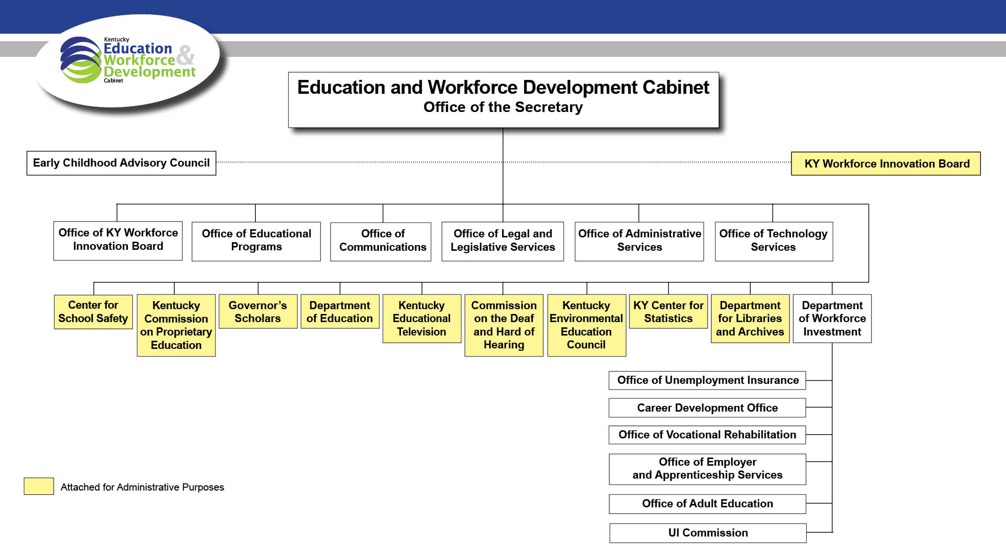
EWDC Organizational Structure

Slide 13
2018 – 2020 Budget & Expenditures
 | 2018-19 | Expenditures Through12/31/18 | 2019-20
General Administration & Program Support | $16,412,600.00 | $8,713,355.46 | $15,883,900.00
Department for Workforce Investment | $601,566,200.00 | $355,334,900.00 | $601,997,000.00
Department for Libraries and Archives | $17,896,300.00 | $7,052,602.21 | $17,802,800.00
Council on Proprietary Education | $320,900.00 | $103,361.18 | $323,900.00
Commission on Deaf and Hard of Hearing | $2,132,800.00 | $934,199.00 | $2,149,700.00
Kentucky Educational Television | $16,566,200.00 | $8,942,500.00 | $16,925,900.00
Environmental Education Council | $648,100.00 | $204,249.05 | $283,700.00
 | $655,543,100.00 | $381,285,166.90 | $655,366,900.00

Slide 14
Source of Cabinet Funds
2018-2020
$70,898,500
$71,446,500
$63,907,000
$63,741,700
$520,737,600
$520,178,700

Slide 15
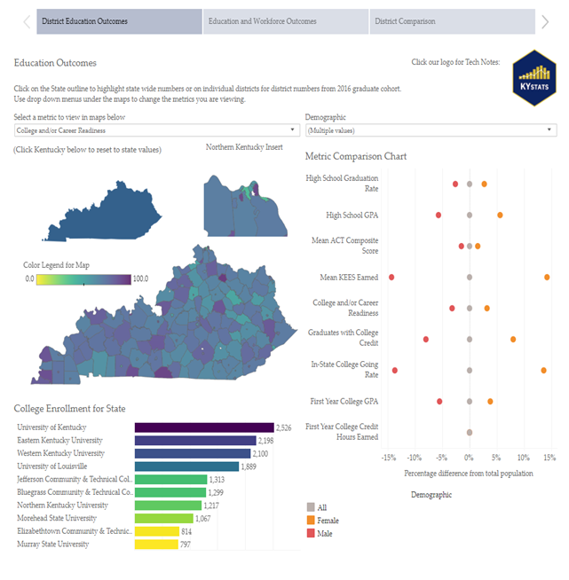

KENTUCKY CENTER FOR STATISTICS
The one-stop shop for longitudinal Kentucky data & reporting on the state of education from early childhood to postsecondary, and workforce outcomes
Measures and evaluates education and workforce programs
Legislatively authorized to collect data from all education and workforce programs
Recognized as one of the best longitudinal data systems in the nation
Key reports include: Kentucky Future Skills Report, High School Feedback Report, Postsecondary Feedback Report, and Work Ready Communities Report

Slide 16

Sustainability of KYStats Funding
Grants make up 88% of KYSTATS funding
  $5.9 million of $6.8 million is federal grant funding
Funds will decrease by 45% in December 2019
  Expiration of $6 million grant
Two grants set to expire in June and September 2020
Two recurring grants will be available to support the Labor Market Information Office operations.
Without additional funding, KyStats will not be able to update existing reports, answer data requests or create new timely reports.

Slide 17

Kentucky Work Ready Scholarship
Due to 2018 expansion of the scholarship, students can now receive:
  Job certification in more than 60 careers in five high-demand industry sectors
  Earn an associates degree in applied science
$20.9 million appropriated to fund the scholarship
An estimated 12,140 Kentuckians have applied for the WRKS
2,364 WRKS applicants (19.5%) have received a WRKS disbursement totaling $5.4 million
Over ¼ of applicants (3,261) received other federal and state grants that fully covered their tuition and fee costs

Slide 18

Unemployment Insurance Modernization
Service Capacity Upgrade Fund (SCUF) enacted July 1, 2018 used solely for the following:
  Upgrade technology through acquisition of new software
  Increase service delivery capacity in support of the programs administered by Unemployment Insurance
Enhancement of program integrity funded by employer contributions at .075% of existing tax
5 year collection with a $60 million cap
$1,860,606.92 collected through January 2019

Slide 19

Kentucky HEALTH PATH
Community Engagement
EWDC is the Community Engagement partner for Kentucky HEALTH.
PATH Community Engagement requirement will be implemented in three phases beginning no sooner than July 1, 2019.
Kentucky HEALTH beneficiaries who will need to meet the Community Engagement requirement include income eligible adults who:
  Do not have a disability;
  Are not the primary caregiver for a child or tax dependent; and
  Are not exempt for another reason.
Community engagement activities include education, job training, employment, substance use disorder treatment, caregiving, or volunteering activities for at least 20 hours a week.
Community Engagement will increase Career Center customers by approximately 300,000 individuals who have been designated as income eligible adults.
EWDC allocated $2.5 million for job training for first two years of implementation and reserved over 60,000 training seats for GED attainment.

Slide 20

Every Student Succeeds Act (ESSA) Preschool Development Grant Birth through Five
  Governor’s Office of Early Childhood collaborated with CHFS, EWDC, and KDE to develop grant submission
  Kentucky was one of six states to be awarded the highest amount – $10.6 million
  Supports young children and caregivers focusing on highly vulnerable, rural or limited accessibility areas.
  Develop career pathway for early childhood and education professionals, and an apprenticeship in early childcare entry-level positions.

Slide 21

KET FCC Channel Repack
Kentucky’s only statewide broadcasting network reaching over 5.5. million people
including 7 surrounding states and 10 media markets
Congressionally-mandated to reassign TV stations to new channels and make
more spectrum available for enhanced mobile services.
16 transmitters are reassigned to new channels.
Implementation requires significant structural modifications to broadcast towers,
transmitters, transmission line, and antennas.
$20 million reimbursable from the FCC for costs of primary replacement equipment
  Tower Reinforcements
  Transmission Line
  Transmitters
  Antennas
$2.1 million appropriation from the Ky. General Assembly for ancillary systems and cost-saving upgrades
  Microwave Radio Interconnect upgrade to internet protocol
  Transmission Line upgrade for energy efficiency
  Antennas upgrade to prepare for the new TV broadcast standard (ATSC 3.0)
  Remote Control, Monitoring, Security
Currently on budget and on time for overall completion by end of year

