Slide 1
KCTCS Career and Technical Education & High School Students
Dr. Larry Ferguson, Acting KCTCS President

Slide 2

At one of the 16 KCTCS Colleges, high school students can build on dual credit general education courses with an Associate in Arts or Associate in Science degree, then transfer to a four-year institution.
If they’ve taken at least four dual credit courses, they can earn a degree in just three semesters and save thousands in tuition by taking courses with us and taking advantage of several transfer scholarship opportunities.
If they take technical courses with KCTCS, they will be able to make a seamless transition to one of our Associate in Applied Science (AAS) career-focused degrees, Diplomas or Certificate Programs. Many of our AAS programs qualify for the Work Ready Kentucky Scholarship, so they may be able to continue their education tuition free.

Slide 3
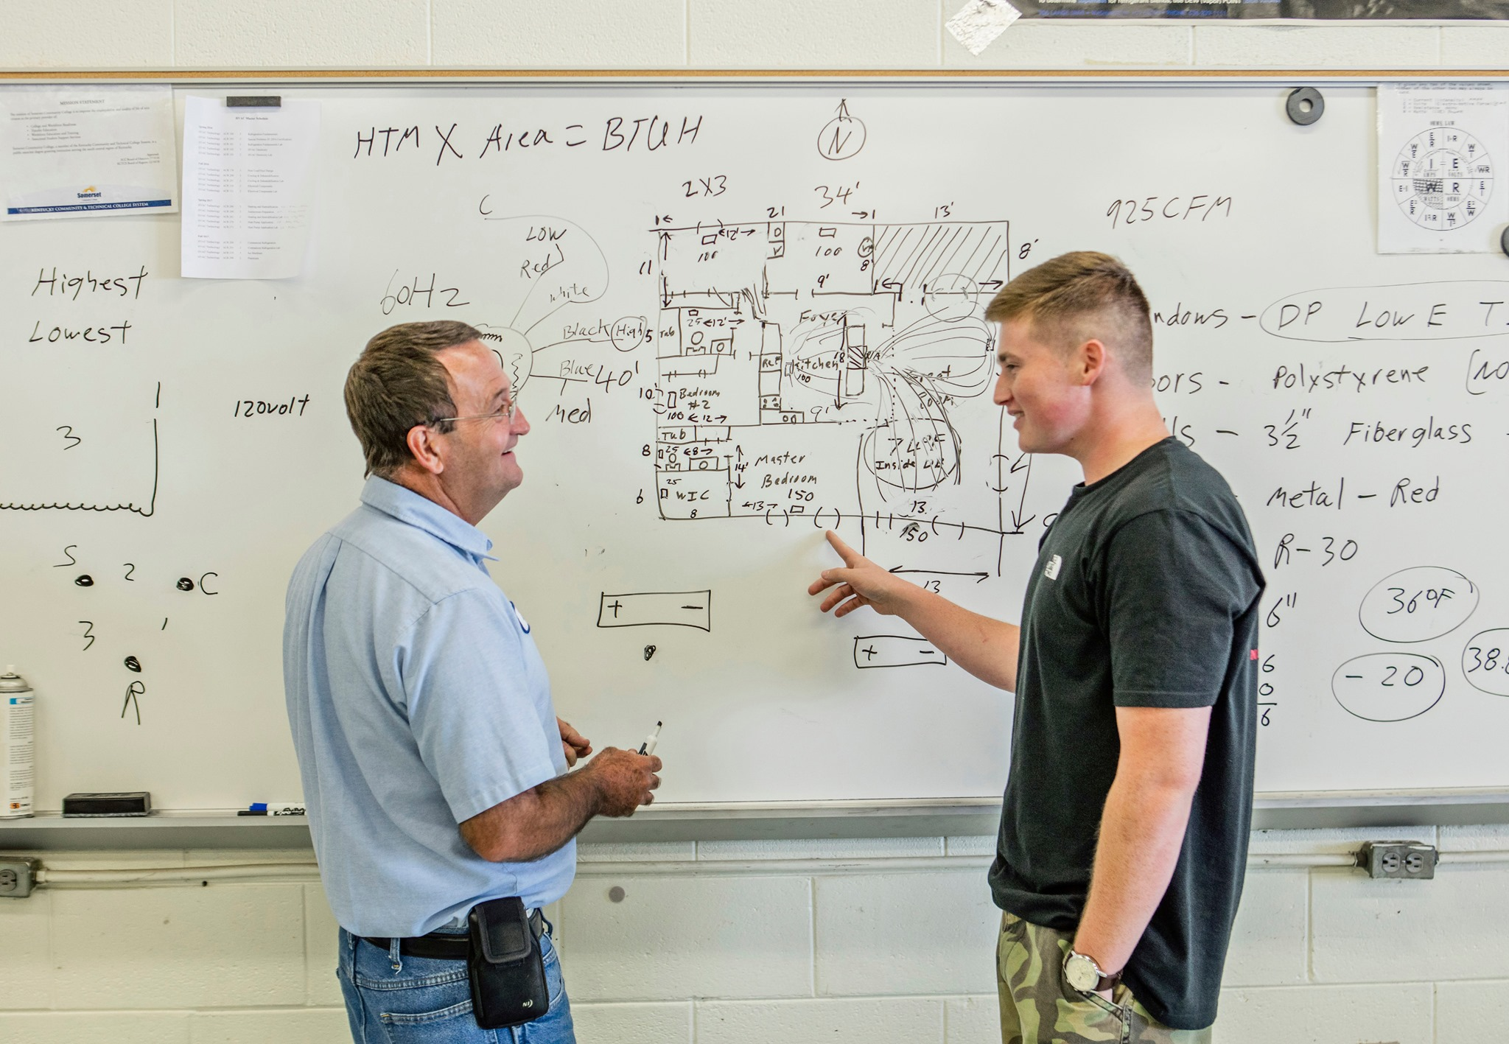
As of February 3, KCTCS was seeing a total KCTCS headcount of 59,586 students (a 7.3% increase compared to last year at this time).
As has been the case in recent years, the majority of the growth in the KCTCS headcount is being driven by increases in dual credit/dual enrollment students.
Compared to last spring at this time, enrollment of dual credit/dual enrollment students is up 22.2%, with high school students now constituting just over 30% of total enrollment at KCTCS (and nearly 19% of total Full-Time Equivalent enrollment).

Slide 4
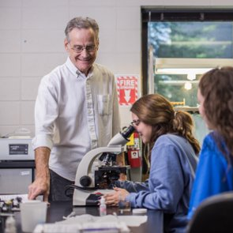
KCTCS is eligible for & receives SEEK dollars for every high school student who takes a technical course taught by a KCTCS-paid instructor.
This is based on seat time in the fall.

Slide 5
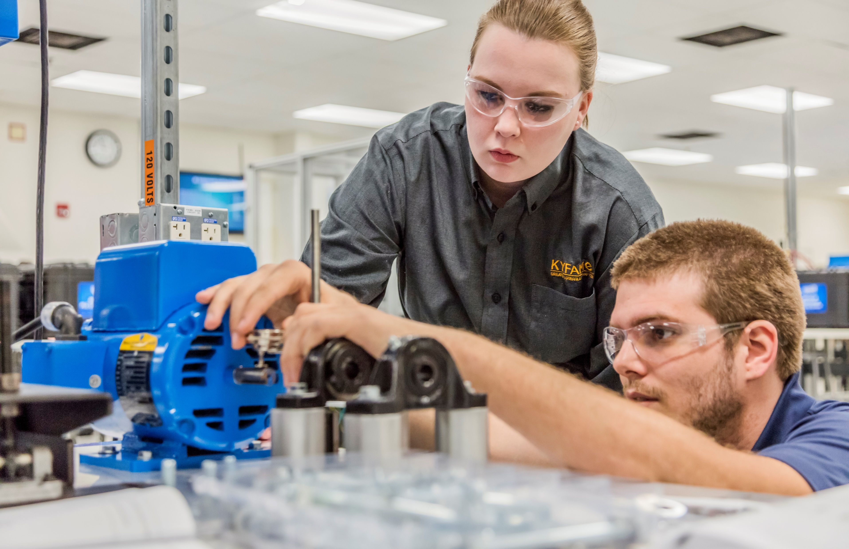
  KCTCS Colleges received about ~$4,014.64 per FTE in FY2021 vs. $2,621.01 in FY2022.
  Despite an increase in FTE of nearly one third, KCTCS received about $160,000 less this year than last due to OCTE’s adjustment over time in the funding per FTE. We anticipate another reduction next year.

Slide 6
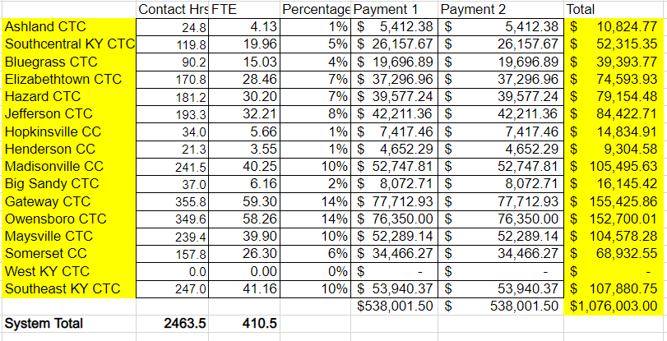
FY 22 SEEK ALLOCATION BY COLLEGE

Slide 7
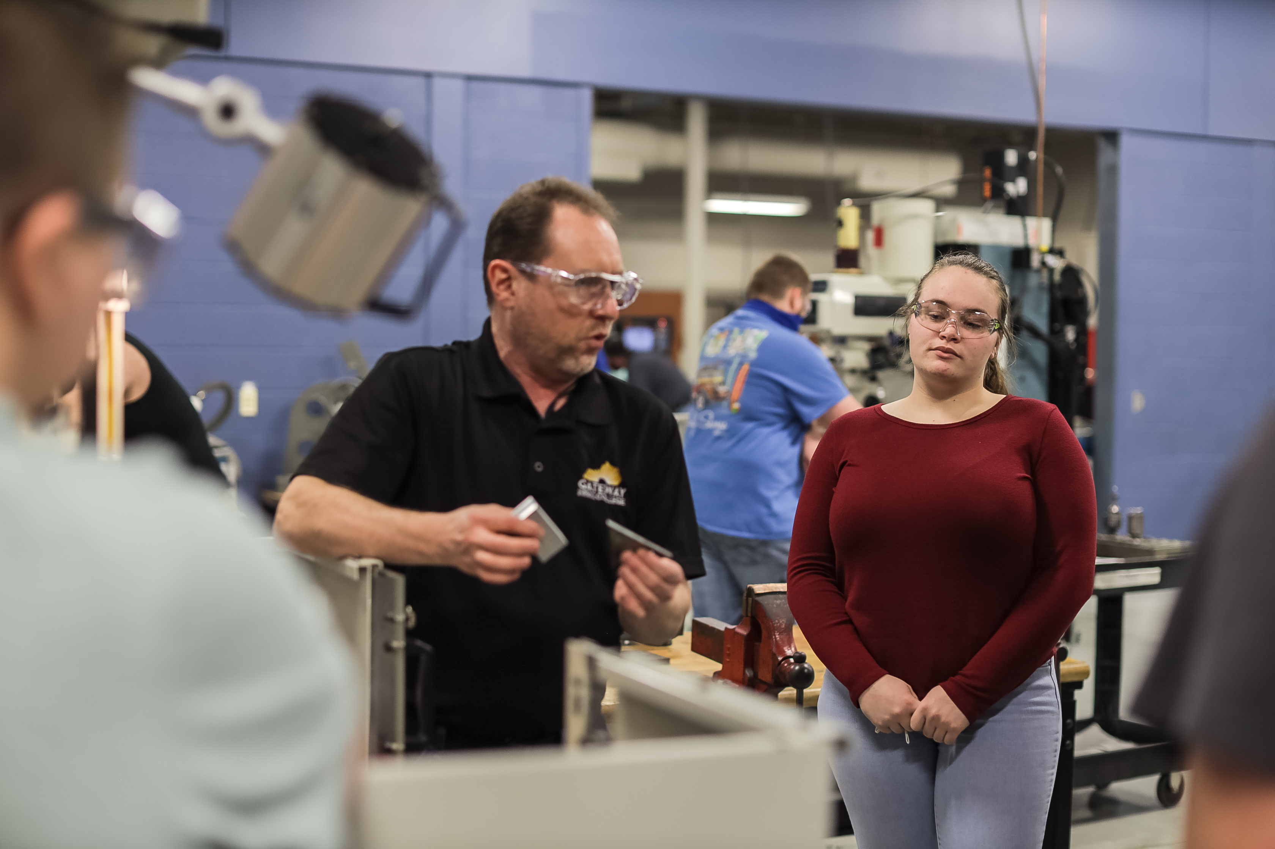
Two state scholarships are available for eligible dual credit courses:
Work Ready Dual Credit Kentucky Scholarship
  Pays for two technical education classes a year, for a total of eight classes
  Available to Kentucky residents attending Kentucky public high schools and some private high schools
Dual Credit Scholarship
  Pays for two general education courses each year for Juniors and Seniors for a total of four scholarships
  Available to Juniors and Seniors at Kentucky public or private high schools or home schools

Slide 8
Construction & Trades
Make Every Credit Count - Pathways
Dual Credit classes and pathways should be meaningful to students in the hopes of them transferring to postsecondary institutions and counting towards their degree. KCTCS, in collaboration with KDE, has made several Technical Pathways in key industry sectors to help students with picking the right courses for their goals. As KCTCS has strong partnerships with the eight public 4-year schools, we have also created transfer pathways for the AA and AS degrees.
Healthcare
Advanced Manufacturing
Transportation Logistics
Business & IT
Transfer Education

