Slide 1
Kentucky’s Secondary Career & Technical Education (CTE) Funding Beth Hargis, Ed. D. Associate Commissioner Regan Satterwhite Executive Advisor Kentucky Department of Education Office of Career & Technical Education

Slide 2
KY CTE Quick Facts
During the 2021-2022 school year:
71% of secondary students were enrolled in CTE
43% of CTE students were concentrators
98% of 12th-grade concentrators graduated
Over 14,000 high school CTE concentrators graduated with at least one recognized postsecondary credential
Over 50,000 CTE students participated in a Career and Technical Student Organization (CTSO)
Source: ACTEonline.org; careertech.org/cte-your-state; Kentucky Department of Education

Slide 3
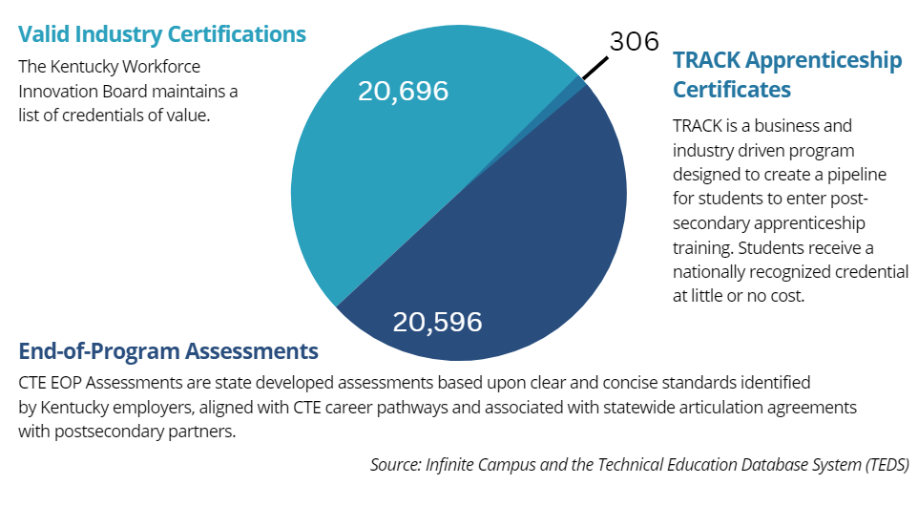
2021-2022 Earned Postsecondary Credentials for CTE
Industry Certification Process
2021-2022 Industry Cert. Report
TRACK: Tech Ready Apprentices for Careers in KY
2022 EOP State Report

Slide 4
Kentucky CTE Reports

Slide 5
Funding Report Recommendations
Base funding for CTE on state goals and business and industry needs;
Convene a committee to explore ways of funding CTCs and ATCs equally;
Provide adequate funding for CTE programs to accomplish state priorities;
Create a proactive, intentional process of funding large equipment purchases and maintaining and/or upgrading current equipment;
Allow locally-operated centers and schools to set a budget for the entire school year;
Consider an additional per-pupil funding formula weight tied to state-prioritized occupational and program areas based on state and regional industry needs; and
Explore CTE performance funding.

Slide 6
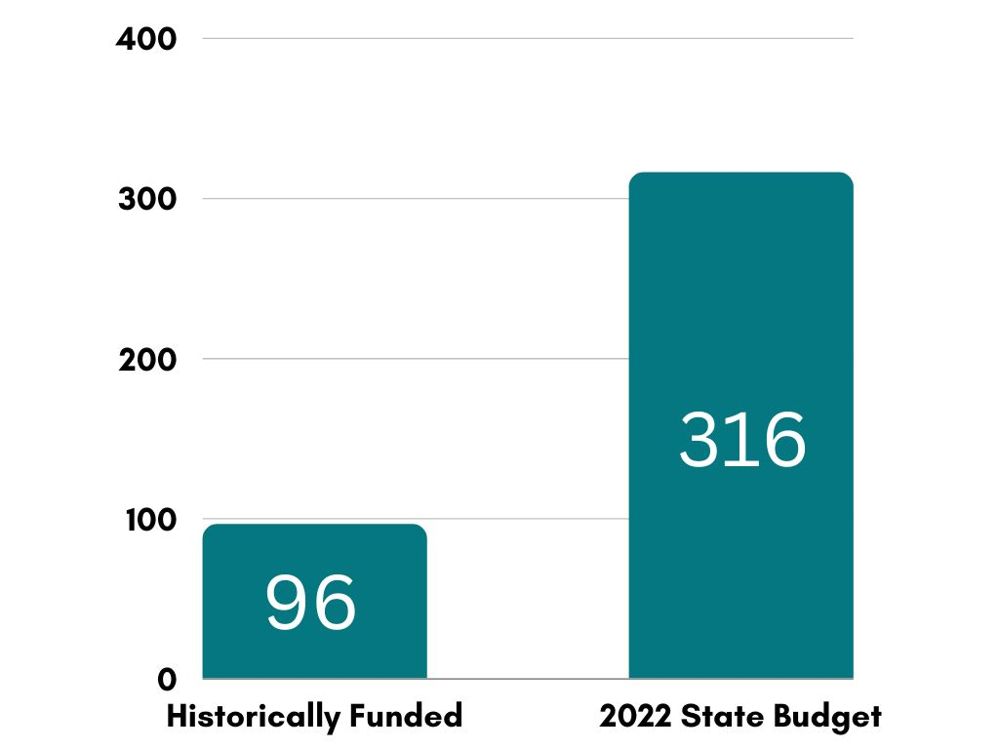
2022 HB 1 (State Budget)
Provided an increase of $58 million to secondary CTE
More than tripled the number of state-funded CTE locations
For the first time ever, ALL CTE programs received funding

Slide 7
 | ATCs | ATCs who transitioned to local control | Local CTE Programs | KDE Central Office | KCTCS
Former SEEK | $3,530,196 (20% to districts that own building) $14,940,890 (Personnel & Operating) | $2,730,385 (Green, Nelson, Knox, Madison) | $597,192 (25% from Green, Nelson, Knox) | $0 | $1,083,237 (for serving secondary students where no ATC/CTC exists) | $22,881,900 TOTAL SEEK
General Fund | $21,946,400 (Personnel) $7,492,600 (Operating) $50,000 (Industry Certifications) |  | $70,063,400 (Grants) $100,000 (Industry Certifications) | $4,215,500 (Central Office Personnel) $120,000 (Central Office / ATC Support) |  | $104,005,900 TOTAL GENERAL FUND
TOTALS | $48,575,278 | $2,730,385 | $70,760,592 | $4,335,500 | $1,083,237 | $126,887,800
2022 Biennium State Budget for CTE

Slide 8
Purchase Examples
Mannequins
EKG equipment
Computers/cameras
Interactive anatomy/physiology table
Blood pressure simulator arm
Laser engraver/cutter with the required software
3D printers
UV 3D printers
VEX robotic equipment/software
Curriculum
Reference materials and textbooks
Consumables/supplies
CTSO travel for students
Industry Certification fees for students
Mig welders
Plasma cutter

Slide 9
In KY CTE classrooms…
Teacher Survey - RE: 2022 State CTE Funding (130 respondents)
This survey aimed to capture the direct perception of
the benefit of funding from classroom teachers,
rather than district administrators.

Slide 10
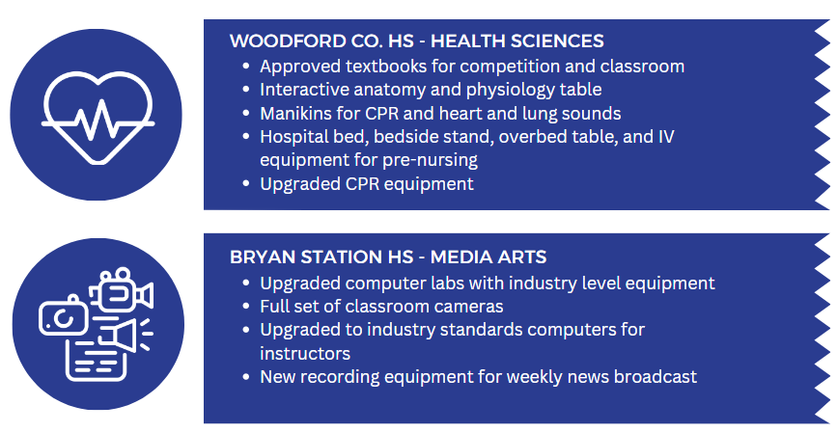
Pathway Enhancements

Slide 11
John Sanders
Principal, Franklin Co. Career and Technical Center (CTC)
CTE Coordinator, Franklin Co. Public Schools

Slide 12
Current Legislative Priorities
Sustain adequate funding and reform for funding distribution
Codify the appropriate amount of funding
Codify a unified formula that funds ALL programs equitably and incentivizes schools to produce high-quality programs

Slide 13
High-Quality CTE Indicators
Standards-aligned and Integrated Curriculum
Sequencing and Articulation
Student Assessment
Prepared and Effective Program Staff
Engaging Instruction
Access and Equity
Facilities, Equipment, Technology, and Materials
Business and Community Partnerships
Student Career Development
Career and Technical Student Organizations
Work-Based Learning
Data and Program Improvement
*Identifies Carl D. Perkins Act Requirement

Slide 14
Notes:
End by inviting them to see HQ pathways…….

