Slide 1
Budget Review Subcommittee on Primary and Secondary Education and Workforce Development
Pandemic Relief Funds Update
February 28, 2023

Slide 2
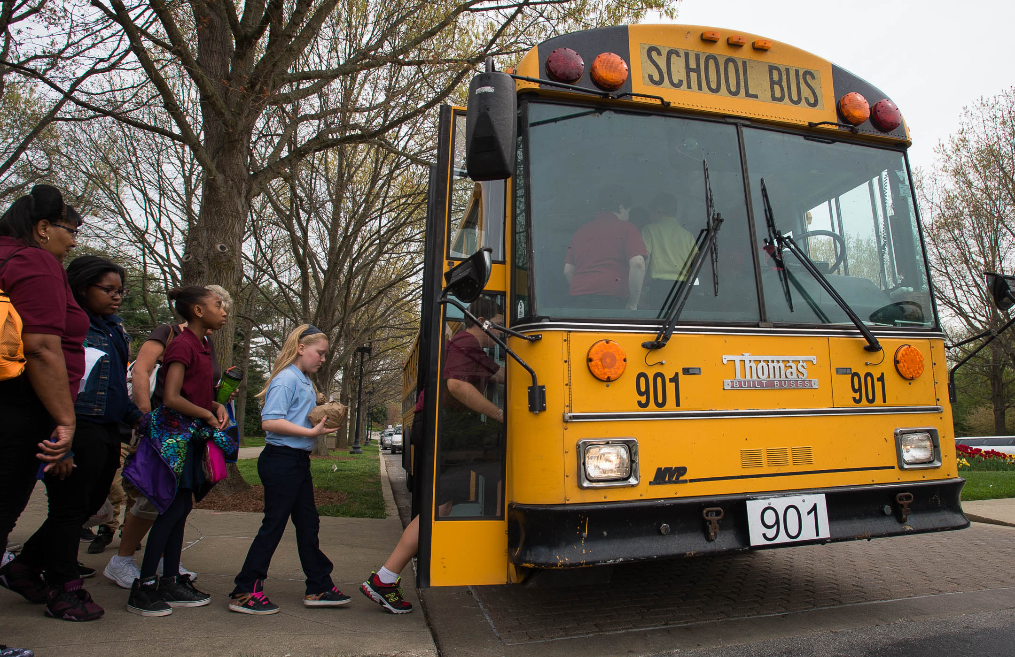

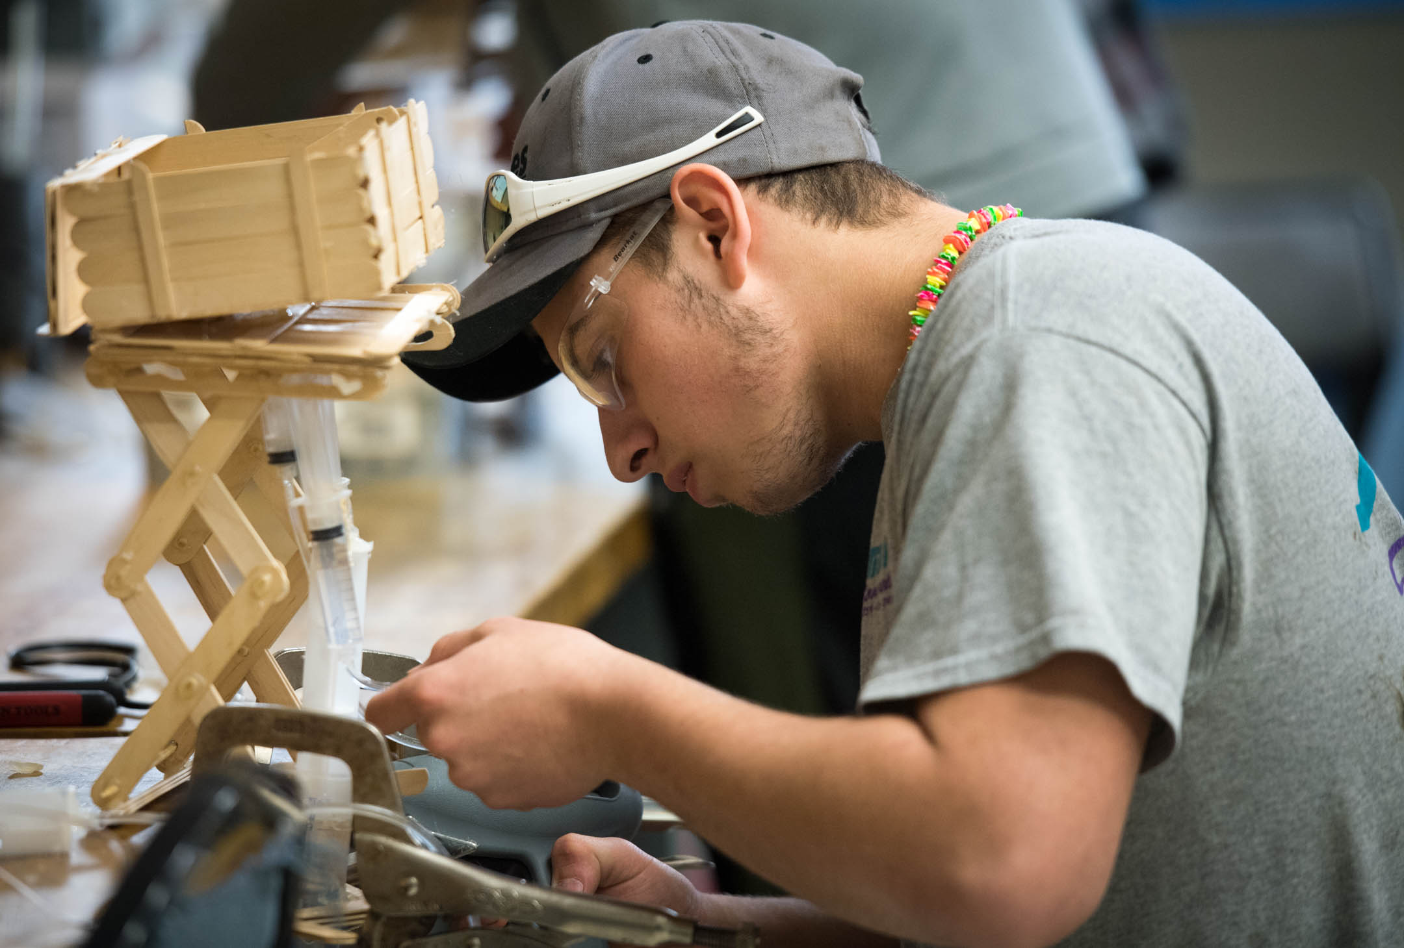
COVID-19 Federal Funds
K-12 Education
EANS I
GEER I
ARP Home-less Children & Youth
EANS II
ESSER I
ESSER II
Coronavirus Relief Fund
ARP IDEA
ARP ESSER

Slide 3
Elementary and Secondary School
COVID-19 Relief
CARES Act (Section 18003 of Division B; Coronavirus Aid, Relief, and Economic Security Act)
  ESSER I - $193,186,874 GEER I - $59,918,047
CRRSA Act (Section 313; Coronavirus Response and Relief Supplemental Appropriations Act)
  ESSER II - $928,274,720 EANS I - $40,817,799
ARP ESSER (Section 2001; American Rescue Plan Act)
  ARP ESSER - $2,001,216,921 EANS II - $42,665,620 (also known as ARP EANS)
CARES Act
End: 9/30/2022
CRRSA Act
End: 9/30/2023
ARP Act
End: 9/30/2024
All can be used for expenses incurred after March 13, 2020

Slide 4
General ESSER Provisions:
Must be necessary and reasonable and used to “prevent, prepare for, and respond to the coronavirus pandemic”
90% of ESSER I, ESSER II, and ARP ESSER must be allocated to local districts
Supplement not supplant provisions do not apply
State-Level Maintenance of Effort must be maintained
Equitable Services provisions apply to districts (ESSER I only), replaced by EANS for ESSER II and ARP ESSER
Notes:
Districts must Maintain Effort for other federal programs (ex. IDEA)

Slide 5
Allowable Uses of ESSER Funds
Activities authorized by the ESEA, Individuals with Disabilities Education Act (IDEA), the Adult Education and Family Literacy Act, the Carl D. Perkins Career and Technical Education Act of 2006 (Perkins V), the McKinney-Vento Homeless Assistance Act (McKinney-Vento)
Provide school leaders with the resources necessary to address the needs of their individual schools
Improve the preparedness and response efforts of districts
Train staff on sanitation and minimizing the spread of infectious diseases

Slide 6
Allowable Uses of ESSER Funds
Address the unique needs of low-income students, students with disabilities, English learners, racial and ethnic minorities, students experiencing homelessness, and children and youth in foster care
Provide supplies to sanitize and clean the district
Provide meals to eligible students, technology for online learning, guidance for carrying out requirements under IDEA and ensuring other education services can continue to be provided consistent with all Federal, State, and local requirements during long-term closures
Purchase educational technology (including hardware, software, and connectivity) for students of the district
Provide mental health services and supports to students

Slide 7
Allowable Uses of ESSER Funds
Conduct summer learning and enrichment activities and supplemental after-school programs
Address the academic impact of lost instructional time
Make school facility repairs and improvements to reduce risk of virus transmission and exposure to environmental health hazards
Improve indoor air quality in school facilities
Implement public health protocols to effectively maintain the health and safety of students, educators, and other staff
Other activities that are necessary to maintain the operation of and continuity of services in the district

Slide 8
ESSER Spending
Through January 31, 2023
ESSER I grant period ended on 9/30/2022

Slide 9
District ESSER I Spending
Through June 30, 2021
Data through June 30, 2022 is due in May 2023

Slide 10
Governor’s Emergency Education
Relief Fund (GEER I)
Authorized in Section 18002 of Division B of the Coronavirus Aid, Relief, and Economic Security (CARES) Act
Grant period was March 13, 2020 through September 30, 2022
$30M allocated to support elementary and secondary education
All Kentucky School Districts were eligible to participate
Equitable Services to non-public schools were required

Slide 11
GEER I Spending
Through January 31, 2023
Uses of GEER I in Kentucky:
  127 districts reported using GEER I funds to support remote learning
  41 districts reported using GEER I funds for food services
GEER I grant period ended on 9/30/2022

Slide 12
Emergency Assistance to Non-Public Schools (EANS I and EANS II)
Every eligible non-public or home school that applied received notices of assistance
133 Schools participated in EANS I
59 Schools participated in EANS II
EANS rules differ from GEER and ESSER programs; KDE maintains administrative control over the program, makes purchases on behalf of the non-public schools, and retains title to items purchased
Notes:
(Note: In Kentucky, home schools are non-profit by nature, so long as they are not charging tuition for services)
(Note: Non-public schools are approved to operate within Kentucky without accreditation, licensure, or certification)

Slide 13
EANS Allowable Uses
Supplies to sanitize, disinfect, and clean school facilities
Personal Protective Equipment (PPE)
Improving ventilation systems, windows, portable air purification systems
Training staff on sanitization, the use of PPE, and minimizing the spread of infectious diseases
Physical barriers to facilitate social distancing
Other materials, supplies or equipment recommended by the CDC
Expanding capacity to administer coronavirus testing to effectively monitor and suppress the virus
Educational technology
Redeveloping instructional plans for remote or hybrid learning or to address learning loss
Leasing sites or spaces to ensure social distancing
Reasonable transportation costs
Support services or assistance for remote or hybrid learning or to address learning loss

Slide 14
EANS Spending
Through January 31, 2023
Ends 9/30/2023
Ends 9/30/2024
Notes:
Has all of the money been allocated? EANS I all $$ was allocated; $90,000 remaining in EANS II.

Slide 15
Contacts
Robin Fields Kinney, Associate Commissioner, Office of Finance and Operations, KDE
  robin.kinney@education.ky.gov
Karen Wirth, Director, Division of Budget and Financial Management
  Karen.wirth@education.ky.gov

Slide 16
SEEK
Support Education Excellence in Kentucky
Budget Review Subcommittee on Primary and Secondary Education and Workforce Development
February 28, 2023

Slide 17
SEEK
Kentucky Education Reform Act
Kentucky Supreme Court declared state’s system of common schools unconstitutional. State failed to provide an efficient, equal, and adequately funded public school system. Rose v. Council for Better Education (1989)
As part of the Kentucky Education Reform Act (KERA), Support Education Excellence in Kentucky (SEEK) was established.

Slide 18
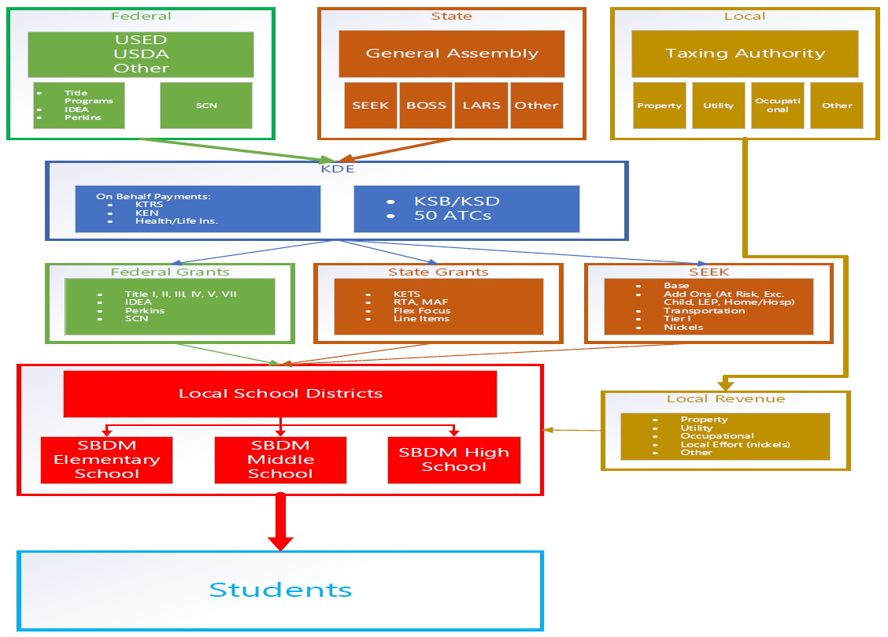
Kentucky Public School Funding

Slide 19
School District Revenue
FUND SOURCE | FY 2020 | FY 2021
Federal Revenue | $1,002,665,565 | $1,349,096,367
State Revenue – SEEK | $2,332,182,069 | $2,297,308,394
State Revenue – On Behalf | $1,925,851,994 | $1,928,267,639
State Revenue – Other State Revenues | $465,908,977 | $500,934,842
Local Revenue – Local Tax and other Local Revenues | $2,989,168,649 | $3,118,831,360
Total Funds | $8,715,777,254 | $9,194,438,602

Slide 20
SEEK Requirements KRS 157.350
Employs and compensates all teachers a minimum of 185 days
Minimum 170 student attendance days or 1,062 hours of instructional time
Compensates all teachers based on a single salary schedule
Includes no nonresident pupils in its AADA, unless the student is a child of a district employee or in accordance with a district nonresident policy
Any secondary school which maintains a basketball team for boys shall maintain the same for program for girls

Slide 21
SEEK Guaranteed Base
KRS 157.320 and KRS 157.360
General Assembly sets the per pupil amount.
Multiply by the prior year aggregate average daily attendance (AADA), adjusted for growth.
For 2022-2023, set at $4,100 per AADA
For 2023-2024, set at $4,200 per AADA
  Per pupil base amount x AADA
  22 RS HB 1/VO in Part (Budget Bill)

Slide 22
SEEK Add-ons Based on $4,100 per pupil
Add on | Description | Rate/Per Pupil | Statewide Count | Per Student | FY 23 SEEK Statewide Total
At Risk | ADM of Free Lunch | 15% | 372,515 | $615 | $229 million
Exceptional Child | Low Incidence (Severe) Moderate Incidence High Incidence (Speech) | 2.35% 1.17% .24% | 18,891 53,836 23,980 | $9,635 $4,797 $984 | $464 million
Home/Hospital | ADA for H/H Students | Per Pupil Base less $100 | 2,489 | $4,000 | $10 million
Limited English Proficiency (LEP) | Count of LEP students | 9.6% | 35,807 | $394 | $14 million

Slide 23
Local Effort
Districts must levy at least 30 cents per $100 in assessments to be eligible for SEEK. KRS 160.470(9)
Increase in per pupil property assessment raises 30 cents local effort in SEEK. Alternatively, a decrease in per pupil property assessment lowers 30 cents local effort in SEEK.
Districts must levy an additional ‘nickel’ equivalent to participate in FSPK (Facilities Support Program of Kentucky). KRS 157.440(1)(b)
Additional ‘nickels’ may be targeted for construction.

Slide 24
Local District Taxes
County school districts and independent school districts are tax-levying authorities. KRS 160.455
School districts tax real estate, tangible property and motor vehicles. KRS 160.470
Districts may also levy taxes on utility gross receipts, occupational, excise, aircraft and watercraft.

Slide 25
Local District Taxes

Slide 26
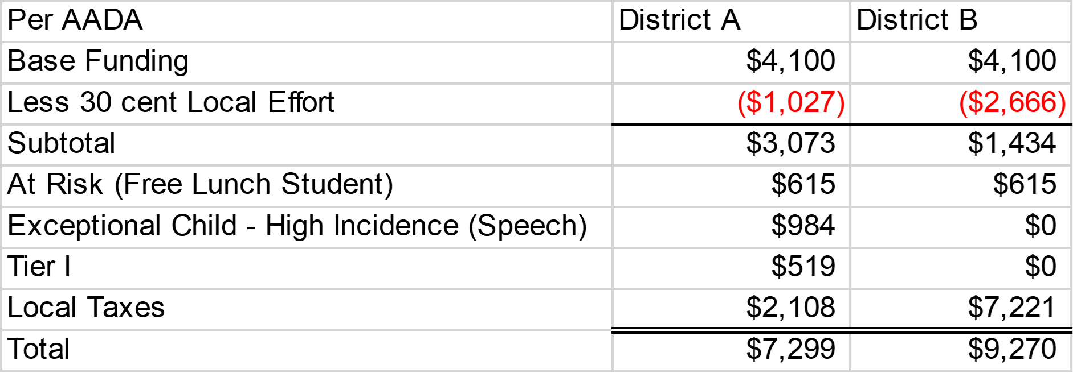
Two Students – Different Districts

Slide 27
SEEK Shortfalls or SEEK Excess
When the calculated cost of funding SEEK exceeds the SEEK budget appropriations, a shortfall exists.
Per 2022 Budget Bill any unexpended SEEK funds in FY 23 or FY 24 shall lapse to the General Fund.
SEEK Shortfall or SEEK Excess is determined by March 1st of each school year.

Slide 28
Some History …
Some shortfalls have been “covered” by other appropriations/reserve funds (FY 2015)
Some shortfalls are paid for in the following fiscal year (FY 2016)
Some surplus years have been transferred to the SEEK transportation appropriation (FY 2019)

Slide 29
Where we are now…
School district attendance data was frozen by the General Assembly during the pandemic for the calculation of SEEK in school years:
  2020-21
  2021-22
  2022-23
School district attendance is being recorded during current school year for FY 2024 funding.
School districts are reporting higher number of absences due to historic levels of illness.

Slide 30
Impact
Loss of enrollment
Decrease in ADA
Natural disaster districts
Growth districts during the pandemic
Property assessments
ESSER funds

Slide 31
Helpful Resources and Websites
Budget Bill (HB 1/VO in Part): HB 1 2022 Budget
SEEK and SEEK Payments: SEEK website
SEEK Taxes: Local District Tax Levies
  For further questions……
  Robin Kinney, Associate Commissioner, Office of Finance and Operations
  (502) 564-1976 ext. 4302 Robin.Kinney@education.ky.gov
  Chay Ritter, Director, Division of District Support
  (502) 564-3846 ext. 4453 Chay.Ritter@education.ky.gov

