Slide 1
Overview of the FY 2022 – 2024 Budget
Presented for the Budget Review Subcommittee on Health and Family Services
February 2, 2022
Eric Friedlander, Secretary

Slide 2
Who We Are The Cabinet for Health and Family Services is the primary state agency responsible for protecting and promoting the well-being of Kentuckians through the delivery of health and human services.
Department for Public Health
Department for Medicaid Services
Department for Aging and Independent Living
Department for Income Support
Office of Health Data and Analytics
Department for Family Resource Centers and Volunteer Services
Department for Community Based Services
Office for Children with Special Health Care Needs
Department for Behavioral Health, Developmental and Intellectual Disabilities
General Administration and Program Support which includes:
Office of the Secretary
Office of the Ombudsman and Administrative Review
Office of Legal Services
Office of Inspector General
Office of Public Affairs
Office of Administrative Services
Office of Application Technology Services
Office of Finance and Budget
Office of Human Resources Management
Office of Legislative and Regulatory Affairs

Slide 3
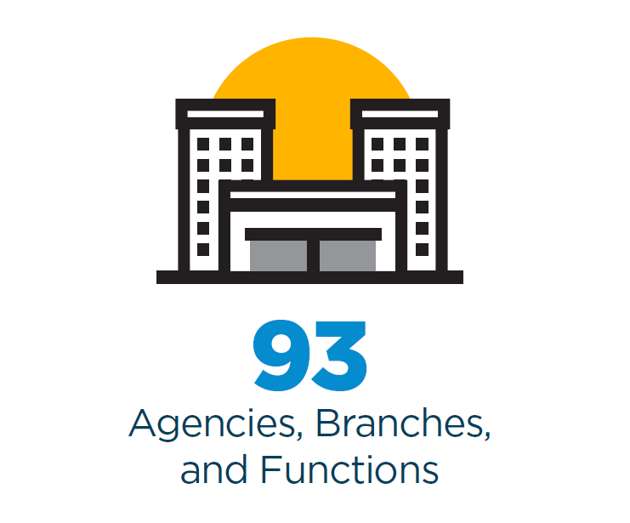
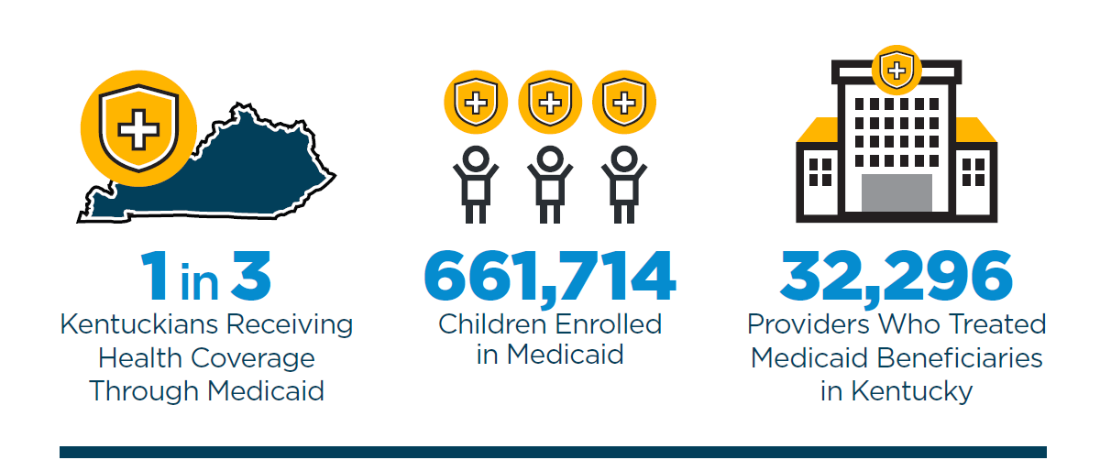
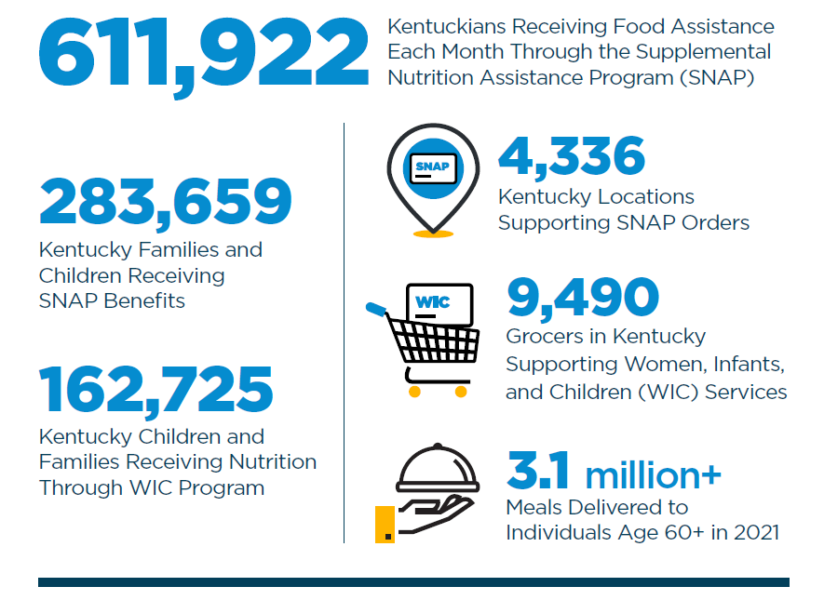
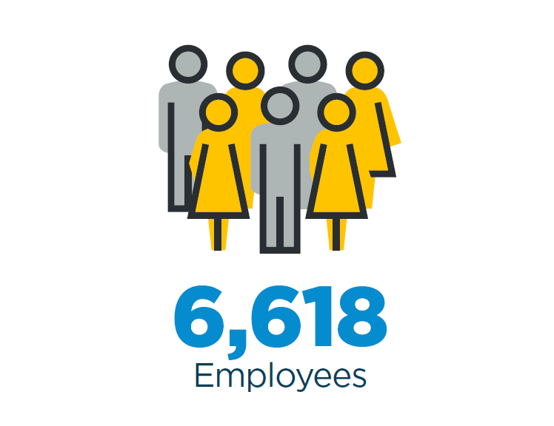
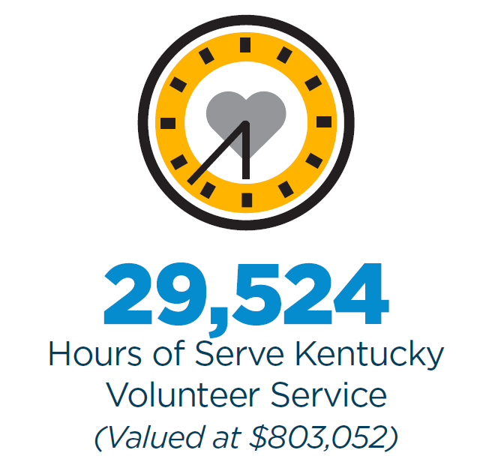
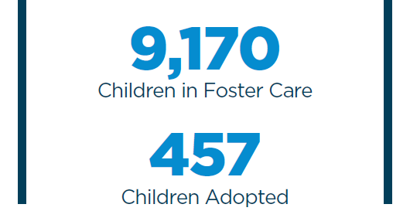
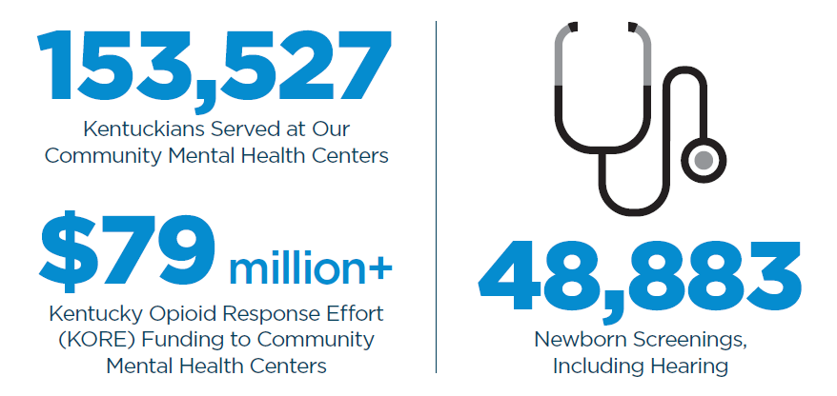

Slide 4
Cabinet for Health and Family Services FY 22 Budget $18,875,288,700

Slide 5
Cabinet Fund Sources
General Fund 15%
Tobacco Funds .2%
Restricted Agency Funds 11%
Federal Funds 73%

Slide 6
Cabinet for Health and Family Services FY 22 General Fund Budget $2,869,446,200

Slide 7
How are Cabinet Funds Spent?

Slide 8
Funded Initiatives in both House Bill 1 and House Bill 285
Employee Cost of Living Adjustments | Special Olympics
Senior Meals | Income Support Additional Staffing
Public Health Transformation | Area Health Education Centers
HANDS Multigravita | Mobile Crisis Services/988 Implementation
Tim’s Law Pilot Expansion | Facility COVID Testing
FRYSC Per Pupil Funding | Additional Social Workers
Residential & Therapeutic Foster Care Rate Increase | Prevention Services

Slide 9
Funded Initiatives in both House Bill 1 and House Bill 285 - Continued
Child Care Rate Increase | Domestic Violence Shelters
Rape Crisis Centers | Child Advocacy Centers
Medicaid IT Systems Cost | Medicaid Benefits Growth
Supports for Community Living Waiver Slots | Michelle P Waiver Slots
HCBS 10% FMAP Reinvestment | Basic Health Plan
Nursing Facility $29/Day Reimbursement | OCSHCNs Operating Costs

Slide 10
Governor’s Initiatives not included in House Bill 1
Public Health State Lab Replacement | Office of Dementia Services
Behavioral Health Restricted Fund Increase | Hart Supported Living Program
COVID Mitigation | Family Caregiver Program
Pediatric Cancer Research Trust Fund | Psychological Evaluations
Health Benefit Exchange | National Core Indicators Survey

Slide 11
Questions

