Slide 1
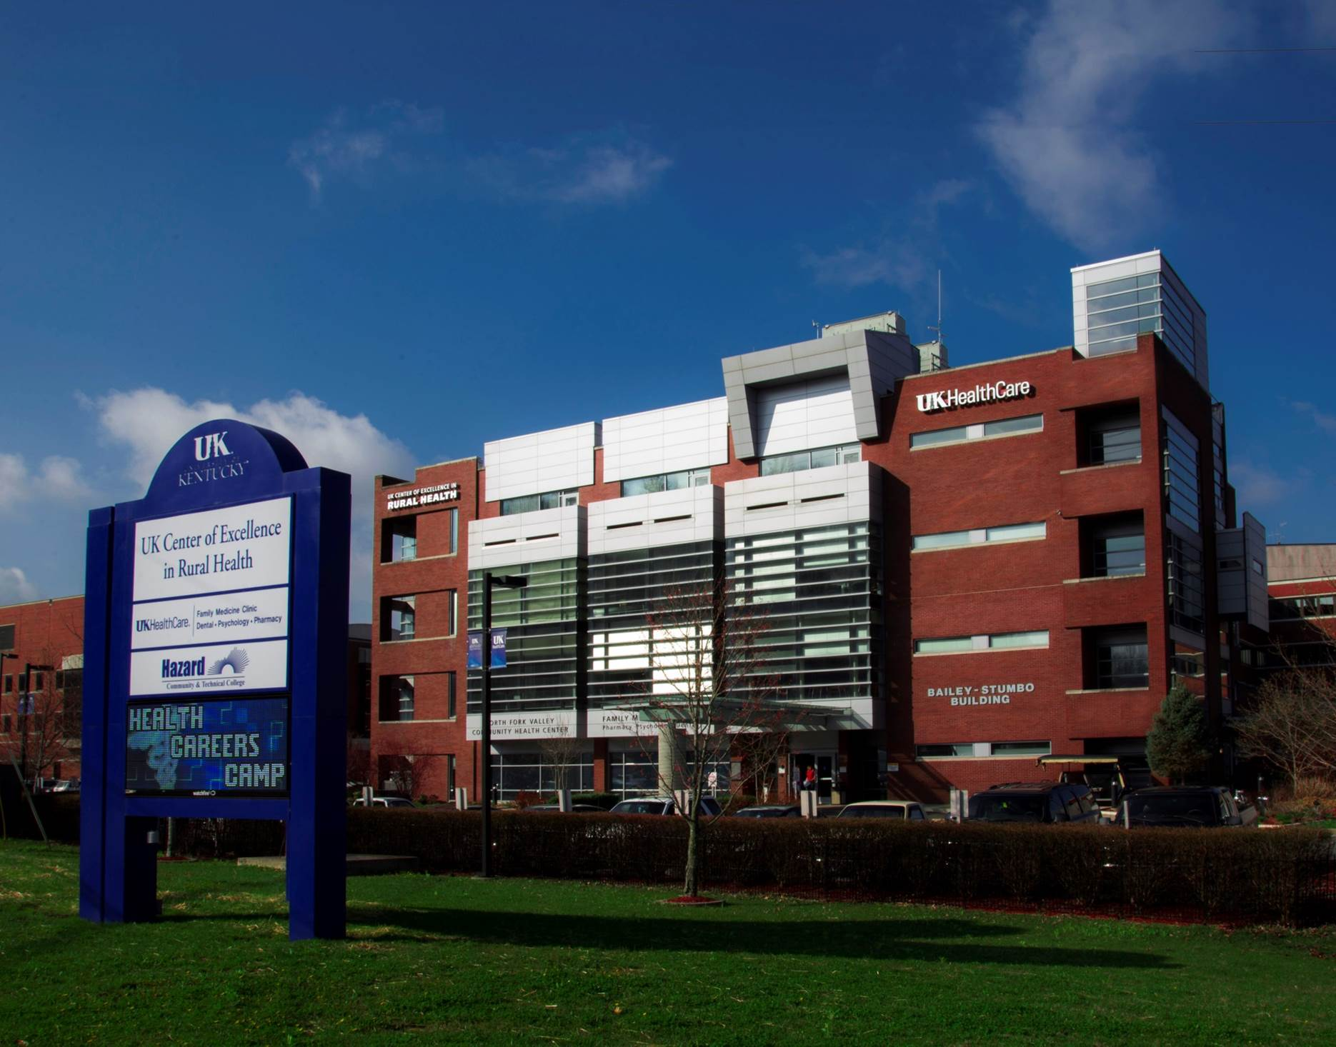
UK Center of Excellence in Rural Health
Established in 1990 to address health disparities in rural Kentucky and serves as the Federally Designated Kentucky Office of Rural Health

Slide 2
Kentucky Office of Rural Health Ky State Loan Repayment Program Overview
The Budget Review Subcommittee on Health and Family Services
February 2, 2022

Slide 3
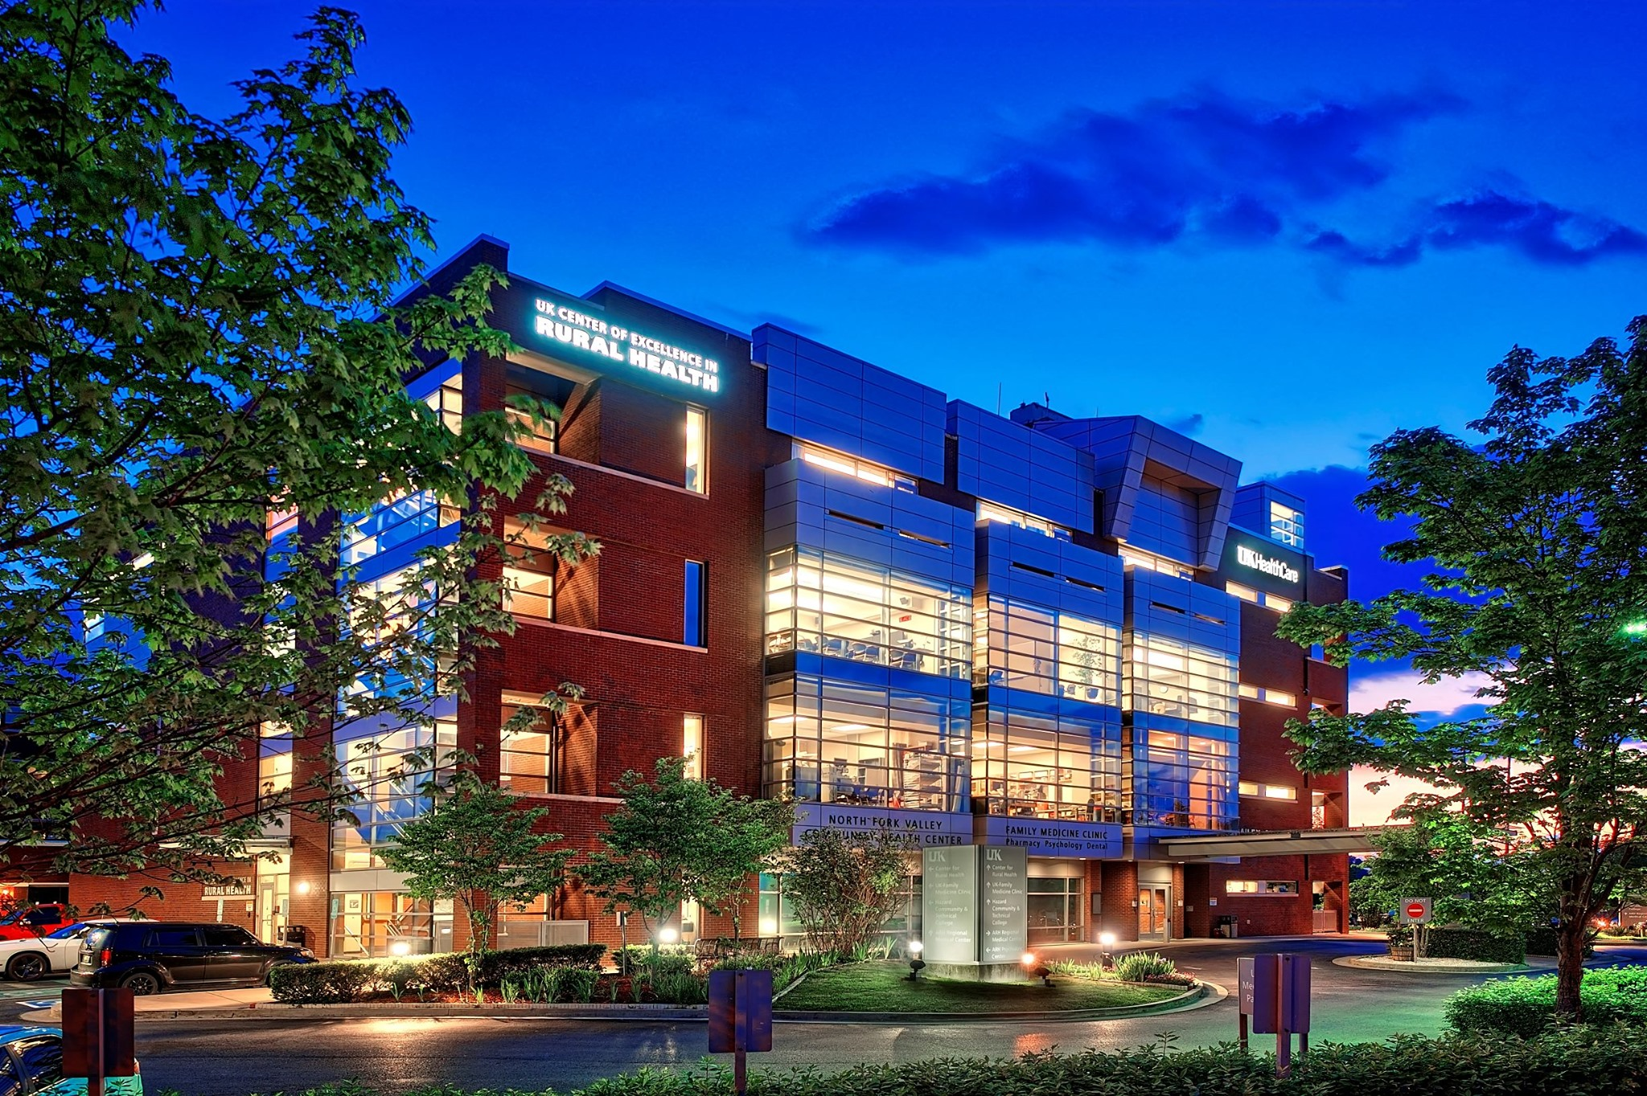
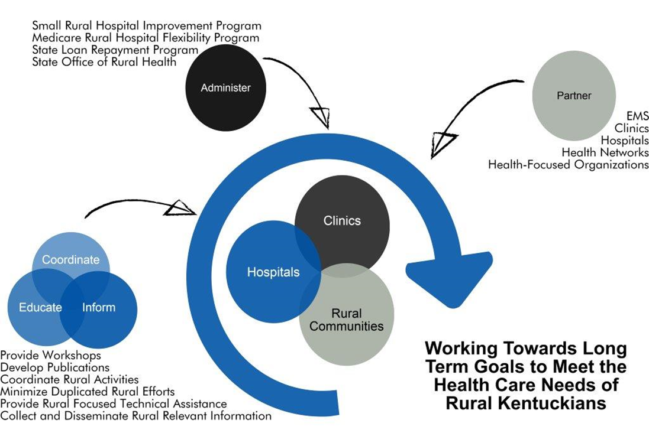
Kentucky Office of Rural Health (KORH)
The mission of KORH is to support the health and well-being of Kentuckians by promoting access to rural health services.

Slide 4
Kentucky State Loan Repayment Program (KSLRP)
Established in 2003
171 Primary Care Professionals
Service Commitment: 2 years Full Time at Eligible Site
Tax Free Student Loan Repayment
Required 50/50 Match

Slide 5
KSLRP PROVIDER ELIGIBILITY
MD-Allopathic Medicine
DO- Osteopathic Medicine
DDS/ DMD- General and Pediatric Dentistry
ARNP- Nurse Practitioner
CNM- Certified Nurse-Midwife
PA- Physician Assistant
RDH- Registered Dental Hygienist
HSP- Health Service Psychologist (Clinical and Counseling)
LCSW- Licensed Clinical Social Worker
PNS- Psychiatric Nurse Specialist
LPC- Licensed Professional Counselor
MFT- Marriage and Family Therapist
RN- Registered Nurse
Pharm- Pharmacist
Alcohol and Substance Abuse Counselors (licensed/credentialed/certified
in Kentucky that meet educational requirements and master’s degree requirement)

Slide 6
Kentucky State Loan Repayment Program (KSLRP)
 | Number of Years (Full-Time) | Sponsor Contribution Up to | KSLRP Match Up to | Total Amount Awarded Up to
MD-Allopathic Medicine DO-Osteopathic Medicine | Two-Year | $40,000 | $40,000 | $80,000
DDS/DMD-General and Pediatric Dentistry | Two-Year | $40,000 | $40,000 | $80,000
ARNP-Nurse Practitioner CNM-Certified Nurse-Midwife PA-Physician Assistant | Two-Year | $20,000 | $20,000 | $40,000
RDH-Registered Dental Hygienist | Two-Year | $10,000 | $10,000 | $20,000
HSP-Health Service Psychologist (Clinical and Counseling) LCSW-Licensed Clinical Social Worker PNS-Psychiatric Nurse Specialist LPC-Licensed Professional Counselor MFT-Marriage and Family Therapist | Two-Year | $20,000 | $20,000 | $40,000
RN-Registered Nurse | Two-Year | $10,000 | $10,000 | $20,000
Pharm-Pharmacist | Two-Year | $40,000 | $40,000 | $80,000
Alcohol and Substance Abuse Counselor | Two-Year | $10,000 | $10,000 | $20,000

Slide 7
KSLRP SITE ELIGIBILITY
Federally Qualified Health Centers
FQHC Look-Alikes
CMS Certified Rural Health Clinics
Other Health Facilities
Community Outpatient Facilities
Community Mental Health Facilities
State and County Health Department Clinics
Free Clinics
Mobile Units
School-based Programs
Critical Access Hospitals affiliated with a qualified outpatient clinic
Long-term Care Facilities
State Mental Health Facilities
State or Federal Correctional Facilities
Private Practices (Solo or Group public or private non-profit entity)

Slide 8
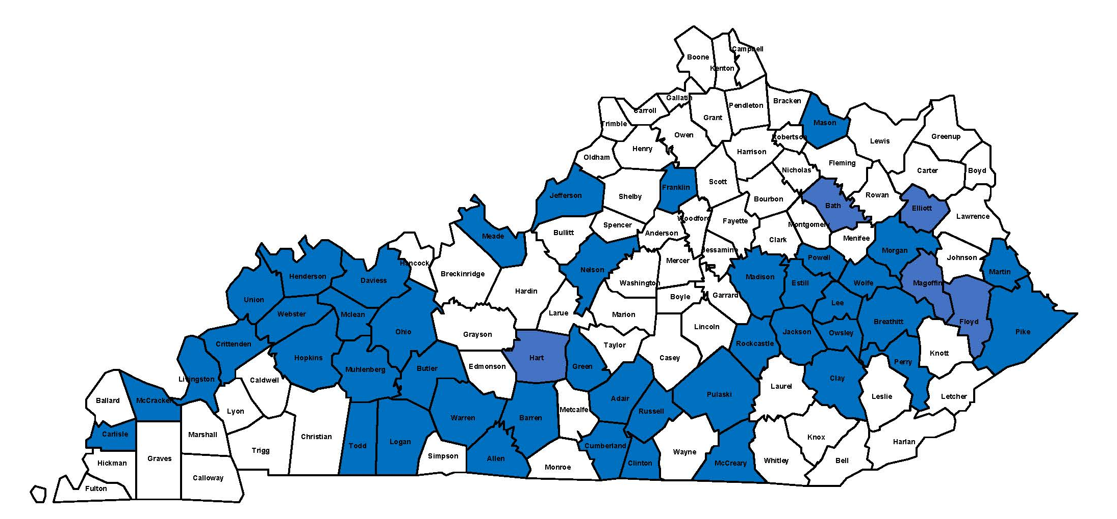
KSLRP IMPACT
171 Primary Care Professionals since 2003
48 Kentucky counties during the past 12 years
Recent report for January 2017 – January 2021
84% remain employed in a Kentucky HPSA
Currently funded $382,500 in federal funds annually
100% of the funds assigned annually
1:1 match requirement fully met

Slide 9
KSLRP OPPORTUNITY
Average of 24 applications remain unfunded each year
Smaller practices often unable to provide 1:1 match
2022-2026 SLRP funding RFA
24/43 current SLRP grantees possess “State Funded” match
State Appropriated Match would allow for:
Further Development/Expansion of KSLRP
Increase Competitiveness for additional Federal Funds
Impact to Workforce Shortages

Slide 11
Contact Us
Frances J. Feltner, DNP, MSN, RN
Director
University of Kentucky Center of Excellence in Rural Health
College of Medicine Adjunct Assistant Professor Family and Community Medicine Adjunct Faculty, College of Nursing Adjunct Faculty, College of Health Science 750 Morton Blvd.
Hazard, KY 41701
P: (606) 439-3557 F: (606) 435-0392
frances.feltner@uky.edu
Ernie L. Scott
Director
Kentucky Office of Rural Health
University of Kentucky Center of Excellence in Rural Health
750 Morton Blvd.
Hazard, Kentucky 41701
P: (606)439-3557 Ext. 83689
ernie.scott@uky.edu
kyruralhealth.org

