Slide 1
HB 379: Attracting Hyperscale Data Centers
to Benefit Kentucky
Steve DelBianco former Director of Virginia Economic Development Partnership, and president of NetChoice

Slide 3
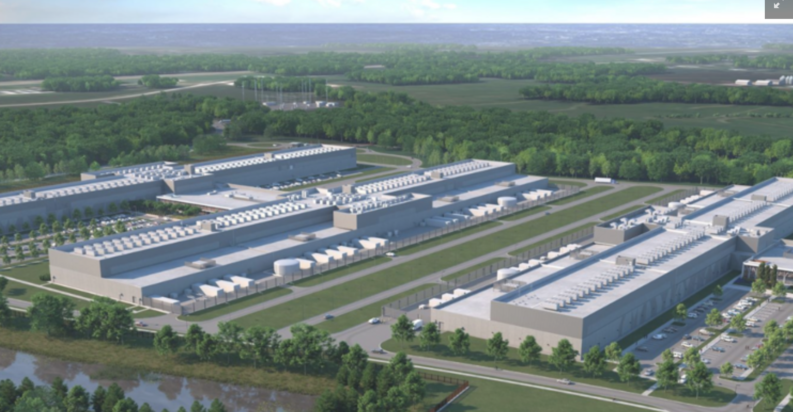
The Goal: Attract a large-scale, enterprise data center to Kentucky
example: Facebook’s new data center in New Albany, Ohio
About 1 million SF
$ 750 million cost over 2-year construction period
$ 244 million in local construction spend
1,200 construction workers earned $ 78 million in wages
Across the street, Google is planning a $ 600 million, 275,000 SF data center on 440 acres.

Slide 4
Data Centers bring Incremental Economic Benefits
Incremental economic benefits of data centers | Here | Not here
Income & spending by construction workers & contractors | + | 0
Income & spending by data center employees | + | 0
Revenue for local suppliers, contractors, lodging, and restaurants | + | 0
High-tech training and experience for workforce | + | 0
Make the state more attractive for tech business and education | + | 0
Diversify local economies | + | 0
7

Slide 5
Data Centers bring Incremental Tax Benefits
Incremental tax revenue from data centers | Here | Not here
Income taxes paid by employees and contractors | + | 0
Corporate income taxes from data center operators & contractors | + | 0
Taxes on electricity & telecommunications | + | 0
Sales taxes on non-exempt equipment and supplies | + | 0
Lodging taxes for visits by contractors and workers | + | 0
Local real estate & personal property taxes | + | 0
8

Slide 6
Data Centers may locate Here, or Not here
at least 17 other states offer the sales tax exemption for server equipment, and if Idaho does not offer an equivalent exemption, these businesses will very likely locate in states other than Idaho that do provide the exemption.
Accordingly, there is no loss of tax revenue from businesses that would not locate in Idaho without the exemption, and there is likely an increase in revenue from taxes related to the growth these businesses would promote.
Fiscal Note for HB 279, Idaho Legislative Services
9

