Slide 1
OFFICE OF FEDERAL GRANTS
(OFG)

Slide 2
Community Development Block Grants (CDBG)
Public Services
Recovery KY
Provide operational financing
Recovery Housing
Rehab & reconstruction, rent, lease, utilities
Public Facilities
Installation/rehab of water lines, water storage water/sewer upgrades, stormwater separation, lead pipe elimination
Economic Development
Creation/retention of jobs
Community Projects
Senior/community centers, public libraries, volunteer fire departments, health departments
Housing
Rehab of homes, relocation of households, acquisition of dilapidated structures
Conversion of vacant buildings to low-income apartments

Slide 3
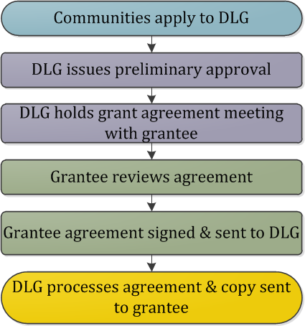
CDBG Application Process

Slide 4
National Objectives
Each project activity must meet one of three (3) federally mandated national objectives
Benefit to low and moderate income (LMI) persons
Prevention or elimination of slums or blight
Urgent Need

Slide 5
Acceptance of Applications
One emailed copy of the standard application form to:
DLG.OFG@ky.gov
Activities described in application will be checked to determine if they meet fundability criteria as established in the Housing and Community Development Act.

Slide 6
Office of Federal Grants Staff
Community & Housing Projects Staff
Travis Weber, Branch Manager-Travis.weber@ky.gov
Cathy Figlestahler, Local Government Advisor- Cathy.figlestahler@ky.gov
Public Facilities
Jennifer Peters, Branch Manager, Jennifer.Peters@ky.gov
Olivia Clark, Local Government Advisor, Olivia.Clark@ky.gov

Slide 7
Office of Federal Grants Staff
Economic Development
Gabe Nickell, Branch Manager, Gabe.Nickell@ky.gov
Trey Greenwell, Local Government Advisor, Trey.Greenwell@ky.gov
Public Services
Mark Williams, Branch Manager, MarkP.Williams@ky.gov
Cole Sutton, Local Government Advisor, ColeC.Sutton@ky.gov
Lee Nalley, State Clearinghouse, Lee.Nalley@ky.gov

Slide 8
Recreational Trails Program
Land & Water Conservation Fund
Administered by the Department of Transportation, Federal Highway Administration.
Purpose: provide funding for the development and maintenance of recreational trails, and trailside and trailhead amenities for both non-motorized and motorized trails.
Grants are provided to cities and counties on a matching basis for up to eighty percent (80%) of the total project costs.
The maximum grant amount is $250,000.
Administered by the U.S. Department of the Interior, National Park Service.
Purpose: provide funding for the acquisition and development of public outdoor recreation sites and facilities.
Grants are provided to cities and counties on a matching basis for up to fifty percent (50%) of the total project costs.
The maximum grant amount is $250,000.
Notes:
Eligible projects for Land & Water: Basketball/Tennis/Pickleball courts, Football/Soccer/Ball fields, Picnic areas, Pool/Splash pads, Campground, Trails, Playgrounds, Amphitheaters, Passive Parks, Docks/Fishing piers, Restrooms, parking, lighting
Eligible projects for Rec Trails: maintenance and restoration of existing recreational trails, development and rehab of trailside and trailhead facilities, purchase and lease of rec trail construction and maintenance equipment, acquisition of easements and property for recreational trails.

Slide 9
LWCF & RTP STAFF
Jessica Hill, Program Manager, JessicaM.Hill@ky.gov
Travis Weber, Branch Manager, Travis.Weber@ky.gov

Slide 10
Appalachian Regional Commission (ARC)
And
Delta Regional Authority (DRA)

Slide 11
Appalachian Regional Commission (ARC)
ARC is a federal-state economic development program designed to assist in the economic development of Appalachia through a diversity of projects in the areas of public infrastructure (water, sewer, solid waste, housing, and telecommunications), human resource development (education/workforce development, affordable/accessible healthcare, and leadership development) and business/entrepreneurial development.
ARC is led by a Commission composed of the Governors from each of the Region’s 13 states, and a Federal Co-Chair who is appointed by the President and confirmed by the Senate. (ARC States: Alabama, Georgia, Kentucky, Maryland, Mississippi, New York, North Carolina, Ohio, Pennsylvania, South Carolina, Tennessee, Virginia, and West Virginia)
Kentucky’s ARC Region is comprised of 54 Counties in Eastern and South-Central Kentucky that are in 9 Area Development Districts (ARC ADD’s: All Counties-Big Sandy, Buffalo Trace, Cumberland Valley, Gateway, FIVCO, KY River, and Lake Cumberland; Some Counties- Bluegrass, and Barren River.

Slide 12
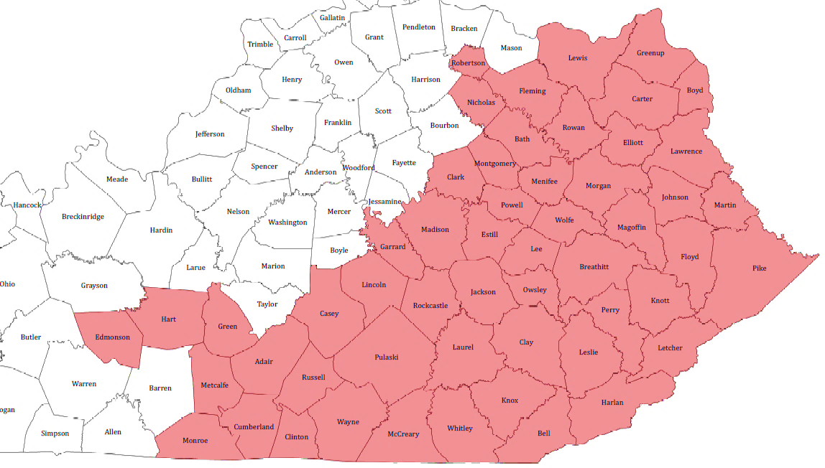
Appalachian Regional Commission (ARC)

Slide 13
Delta Regional Authority (DRA)
Established in 2000 by Congress, the Delta Regional Authority makes strategic investments of federal appropriations into the physical and human infrastructure of Delta communities.
DRA Board is comprised of the Federal Co-Chairman, appointed by the President and confirmed by the U.S. Senate, and the governors of the eight states (Alabama, Arkansas, Illinois, Kentucky, Louisianan, Mississippi, Missouri, and Tennessee)
DRA Region in KY consists of all the Counties in the Purchase and Pennyrile ADD’s, and 4 Counties in the Green River ADD (Henderson, McLean, Union and Webster).

Slide 14
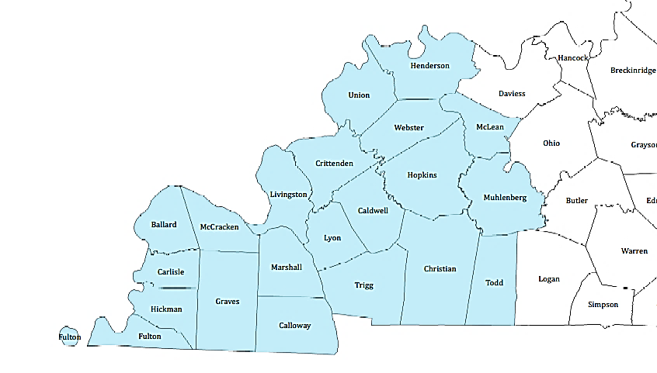
DRA Region in KY
Notes:
Eligible projects: basic public infrastructure, transportation infrastructure, business development (focus on entrepreneurship) and workforce development

Slide 15
Applying for DRA
Potential Applicants should start by contacting/working with their respective Area Development District. The Area Development Districts will assist applicants with the development of their project application and submit directly to DRA.
ADD Contacts:
Purchase ADD: Jeremy Buchanan, Executive Director, Phone 270-251-6132 purchaseadd@purchaseadd.org
Pennyrile ADD: Jason Vincent, Executive Director, Phone 270-886-9484, jason.vincent@ky.gov
Green River ADD: Joanna Shake, Executive Director, Phone: 270-852-1324 JoannaShake@gradd.com

Slide 16
ARC & DRA STAFF
Scott Sharp, ARC & DRA Program Manager, Scott.Sharp@ky.gov
Sheri Mahan, Executive Assistant, SheriK.Mahan@ky.gov

Slide 17
100 Airport Road 3rd Floor
Frankfort KY, 40601
502-573-232
Website: kydlgweb.ky.gov

