Slide 1
AREA DEVELOPMENT DISTRICTS
Notes:
Introduce ourselves, (Jason Vincent) (Eric Sexton). We thank you for the opportunity to be here today to discuss Area Development Districts. (Click)

Slide 2
SEEING PROJECTS FROM DEVELOPMENT TO COMPLETION
Notes:
One of our primary goals as regional agencies are to see community projects from development to completion. (click)

Slide 3
BRIEF HISTORY OF AREA DEVELOPMENT DISTRICTS
“There is no power for change greater than a community discovering what it cares about.”
-Margaret J. Wheatley
FEDERAL GRANTS AT A GLANCE
APPLICATION DEVELOPMENT & PROJECT MANAGEMENT
SUCCESS STORIES
ADDITIONAL AREA DEVELOPMENT DISTRICT SERVICES
CONTACT INFORMATION
Notes:
We do this in a variety of ways. Today we will focus mainly on how our work connects to federal funding opportunities. (Jason insert your thank you for support in the last legislative session). (Click)

Slide 4
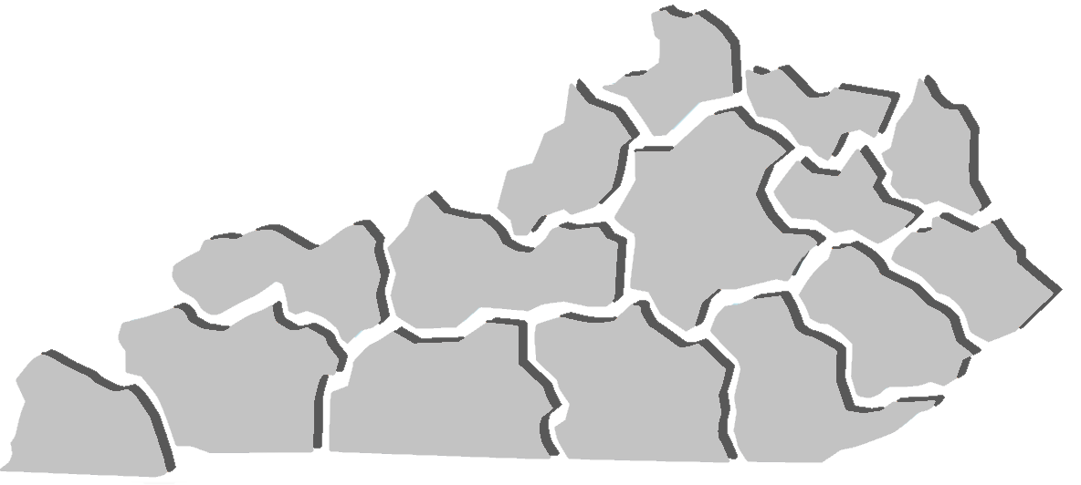
BRIEF HISTORY OF AREA DEVELOPMENT DISTRICTS
Notes:
The Area Development Districts have been around since the late 1960s but thanks to the General Assembly, in 1972, KRS 147A brought the ADDs officially into existence as public agencies. Today we have 15 Area Development Districts covering all 120 Kentucky Counties.
History if needed:
1967 – Executive Order 67-233 established the Area Development District Boundaries
1971 – Executive Order 71-1267 established the Area Development Districts as official planning and development agencies for districts
1972 – KRS Chapter 147A, enabling legislation passed establishing Area Development Districts as public agencies and creating the organizational structure

Slide 5
BRIEF HISTORY OF AREA DEVELOPMENT DISTRICTS
REGIONAL PLANNING
Notes:
Our focus across the Commonwealth is to provide regional planning and (click)

Slide 6
BRIEF HISTORY OF AREA DEVELOPMENT DISTRICTS
REGIONAL PLANNING
REGIONAL GUIDANCE
Notes:
Regional Guidance (Click)

Slide 7
BRIEF HISTORY OF AREA DEVELOPMENT DISTRICTS
BOARD OF DIRECTORS
JUDGES
MAYORS
CITIZENS
ADVISORS
Notes:
We are governed by a board of directors and special advisors. County Judge-Executives and Mayors of incorporated cities are members of our board per statute. Each board additionally elects citizen members across their region from various backgrounds to produce a well-rounded board of directors. Special advisors from areas such as education, workforce and the General Assembly also contribute to our regional boards.

Slide 8
BRIEF HISTORY OF AREA DEVELOPMENT DISTRICTS
BOARD OF DIRECTORS
BUDGETS
POLICIES
COMMITTEES
OVERSIGHT
Notes:
Our board of directors are responsible for setting policy and approving budgets. With their oversight we operate many regional initiatives and even work through committees to improve quality of life.

Slide 9
BRIEF HISTORY OF AREA DEVELOPMENT DISTRICTS
REGIONAL PLANNING
FISCALLY ACCOUNTABLE
Notes:
As part of our planning efforts we maintain financial accountability to federal, state and local funders (Click)

Slide 10
BRIEF HISTORY OF AREA DEVELOPMENT DISTRICTS
REGIONAL PLANNING
FISCALLY ACCOUNTABLE
NON-PARTISAN
Notes:
While our boards contain elected officials, we operate in a non-partisan manner. (click)

Slide 11
BRIEF HISTORY OF AREA DEVELOPMENT DISTRICTS
REGIONAL PLANNING
FISCALLY ACCOUNTABLE
NON-PARTISAN
TECHNICAL ASSISTANCE
Notes:
All while providing technical assistance to our local governments and communities. (Click)

Slide 12
COMMUNITY DEVELOPMENT BLOCK GRANT
FEDERAL GRANTS AT A GLANCE
Notes:
As our friends at DLG may have mentioned, the ADDs provide technical assistance with several federal and state grants. We inform our communities when grant opportunities become available and offer to assist them in the technical writing and administration of the grant, from start to finish. One opportunity we provide certified grant writing staff for is the Community Development Block Grant. (Click)

Slide 13
COMMUNITY DEVELOPMENT BLOCK GRANT
ECONOMIC DEVELOPMENT ADMINISTRATION
FEDERAL GRANTS AT A GLANCE
Notes:
Another funder of many federal grant opportunities is the Economic Development Administration or EDA, who is also the ADDS federal cognizant agency. Many of our planning dollars flow from EDA to DLG via the Joint Funding Agreement. (Click)

Slide 14
COMMUNITY DEVELOPMENT BLOCK GRANT
ECONOMIC DEVELOPMENT ADMINISTRATION
DELTA REGIONAL AUTHORITY
FEDERAL GRANTS AT A GLANCE
Notes:
In the western part of the Commonwealth we have the Delta Regional Authority which allows us to work directly with the federal government to improve regional economic opportunity. (click)

Slide 15
COMMUNITY DEVELOPMENT BLOCK GRANT
ECONOMIC DEVELOPMENT ADMINISTRATION
DELTA REGIONAL AUTHORITY
FEDERAL GRANTS AT A GLANCE
APPALACHIAN REGIONAL COMMISSION
Notes:
Similarly, we have the Appalachian Regional Commission in the eastern part of the state that benefits 43 Kentucky Counties with that same mission of improving economic outcomes through project development and planning. (click)

Slide 16
COMMUNITY DEVELOPMENT BLOCK GRANT
ECONOMIC DEVELOPMENT ADMINISTRATION
DELTA REGIONAL AUTHORITY
FEDERAL GRANTS AT A GLANCE
APPALACHIAN REGIONAL COMMISSION
FEMA: AFG, PDM, HMGP, & HOMELAND SECURITY
Notes:
And while we provide assistance for several other federal and state grant programs from the transportation cabinet and others, another agency we work with closely is FEMA and our state KY Emergency Management office. Through our regional hazard mitigation planning we help leverage opportunities for pre-disaster mitigation, hazards and flood mitigation funding. And we also work with the Homeland Security Office on an array of programs benefiting firefighters, police and others. (Click)

Slide 17
APPLICATION TO IMPLEMENTATION
Idea
Scope
$$$
Apply
Procure Firms
Public Input
Admin
Monitor
Keep Records
Right-fit
APPLICATION DEVELOPMENT
& PROJECT MANAGEMENT
Notes:
The main thing to know is the ADDS can assist our communities by providing technical staff to help develop, apply for and administer project funding. (Click)

Slide 18
EXAMPLES FROM ACROSS THE COMMONWEALTH
Notes:
And now we’d like to briefly turn it over for a couple examples of how ADDs bring about project funding and ask our friends Judge Henry & Judge O’Nan to speak about a couple of successful projects involving the ADD. (Click)

Slide 19
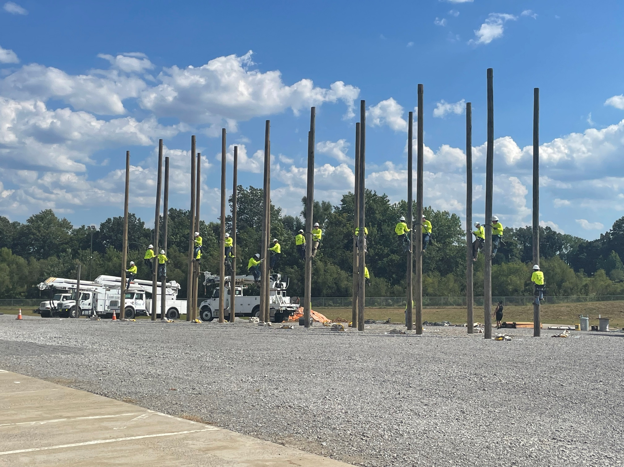
LISMAN WORKFORCE CENTER
JUDGE-EXECUTIVE
STEVE HENRY
(WEBSTER COUNTY)
Notes:
Judge Henry: Further introduce yourself and then speak on your Project Success (5 Minutes). Turn it over to Judge O’Nan.

Slide 20
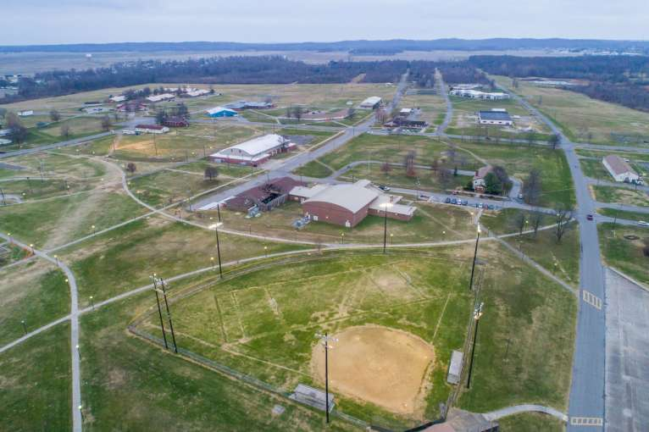
JOB CORPS SANITARY SEWER
JUDGE-EXECUTIVE
ADAM O’NAN
(UNION COUNTY)
Notes:
Judge O’Nan: Further introduce yourself and speak to your projects success. (5 minutes). Turn it back to Jason & Eric

Slide 21
AREA AGENCY ON AGING & INDEPENDENT LIVING
WORKFORCE DEVELOPMENT BOARD
ADDITIONAL AREA DEVELOPMENT DISTRICT SERVICES
REVOLVING LOAN FUND
Notes:
We also should briefly mention the Area Development Districts are involved in some other key regional service areas.
We house the Area Agency on Aging & Independent Living, many of us house the Workforce Development Boards and several of us operate Business Services through a federal Revolving Loan Fund.

Slide 22
KY Council of Area Development Districts
501 Capital Ave
Frankfort, KY 40601
502-875-2515
www.kcadd.org
CONTACT US
Notes:
Lastly, we do have a central office and unified voice of the ADDs through our KY Council of Area Development Districts, based here in Frankfort. The KCADD office, staffs an executive director and support staff. (Click)

Slide 23
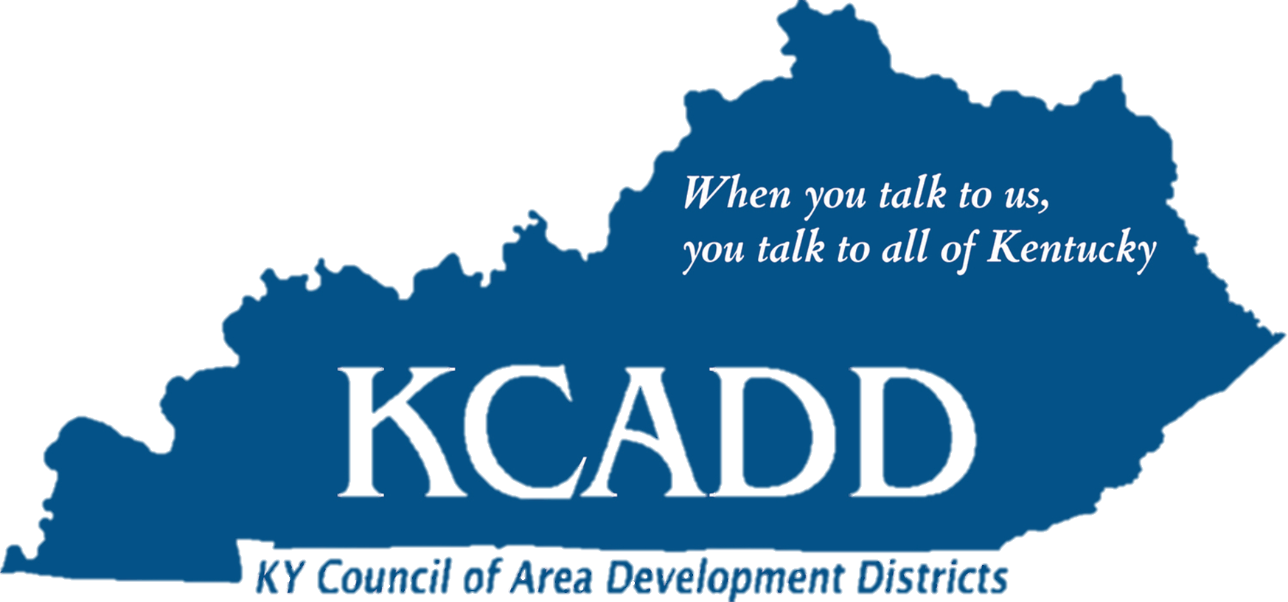
Notes:
At this time we’d be glad to entertain any questions.

