Slide 1
BR Subcommittee on General Government
Michael G. Adams
Kentucky Secretary of State
@KYSECSTATE
KYSECOFSTATE

Slide 2
Office of the Secretary of State
Office of Administration
Executive Journal
Summons
Enacted Legislation
Fiscal
Personnel
Public Documents
Legal Affairs
Special Projects
Commissions
Land Office
Office of Business Services
Business Entity Filings
UCC Filings
Business Records
Trademarks
Service Mark
Notary appointments
Apostilles
Office of Elections
Assist SOS as Chief Election Official
Candidate Filings
Collection of Filing Fees

Slide 3
Budget Summary
 | FY 2020 | FY 2021 | FY 2022 | FY 2023 | FY 2024
General Funds | $2,252,500 | $0 | $0 | $0 | $0
Federal Funds | $221,400 | $221,400 | $0 | $0 | $0
Restricted Funds | $2,681,200 | $5,177,600 | $5,248,300 | $6,410,200 | $6,424,600
Total | $5,155,100 | $5,399,000 | $5,248,300 | $6,410,200 | $6,424,600

Slide 4
Fund Transfers
FY 2020 - $1,500,000
FY 2021 - $2,000,000
FY 2022 - $2,000,000
FY 2023 - $0
FY 2024 - $0

Slide 5
Revenues
 | FY 2020 | FY 2021 | FY 2022
Business Filings | $4,428,031 | $5,408,916 | $5,865,656
Elections | $93,340 | $25,442 | $152,025
Slogan & Essay |  | $1,250 | $3,000
Address Confidentiality | $2,835 | $1,996 | $8,279
AGENCY REVENUE | $4,524,206 | $5,437,604 | $6,028.960
GENERAL FUND REVENUE | $3,559,846 | $3,657,442 | $3,973,774
TOTAL COLLECTED REVENUE | $8,084,052 | $9,095,047 | $10,002,735

Slide 6
Expenses
FY 2020 | FY 2021 | FY 2022
$4,439,469 | $4,742,373 | $4,756,624

Slide 7
Personnel
31 full-time personnel @ $156,000 per pay period ($3,744,000 yearly)
4 IT Contractors

Slide 8
Companies in Active Status and Good Standing
319,256
* This does not include Assumed Names, Name Cross References, Name Registration or Name Reservation Company records

Slide 9
Candidate Filings
2020: 462
2021: 815
2022: 36

Slide 10
Additional Funding for 2023-2024
Additional Administrative Specialists: Land Office & Office of Business Services
IT Contractor
IT Upgrades

Slide 11
Looking forward to 2025-2026
Continue infrastructure upgrades
Safe at Home program

Slide 12
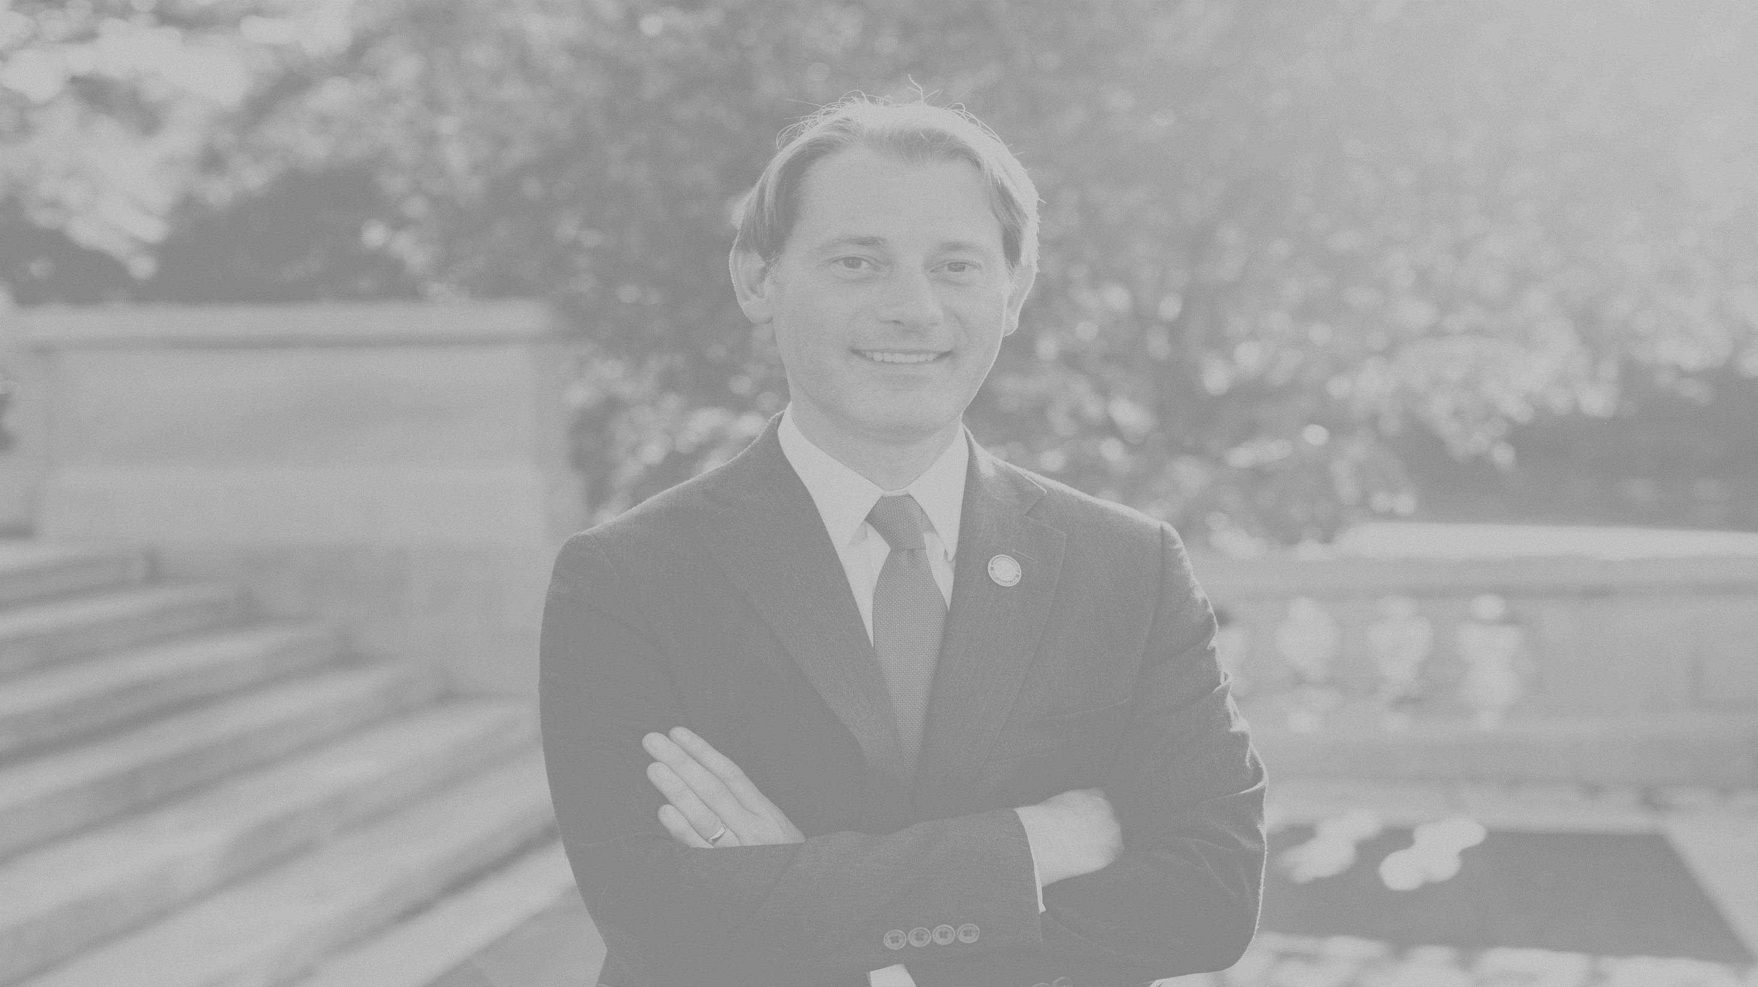
Questions? Concerns? Contact us
Office of the Secretary of State
Kentucky State Capitol, Suite 152
Frankfort, KY 40601
(502) 564-3490
sos.secretary@ky.gov
@KYSECSTATE
KYSECOFSTATE

