Slide 1
Mike Harmon Auditor of Public Accounts
Presentation to Budget Review Subcommittee on General Government, Finance, Personnel & Public Retirement
February 16, 2023

Slide 2
What We Do
APA conducts more than 600 audit engagements each year, including:
Audit of the Commonwealth’s Annual Comprehensive Financial Report and Statewide Single Audit of Kentucky - financial, IT, and federal compliance audits of state agencies
County Clerks & Sheriffs
Fiscal Courts
Special Examinations

Slide 3
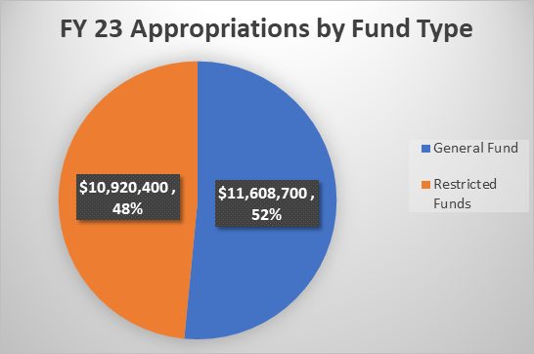
Current-Year Appropriations

Slide 4
APA Expenditure Summary
Expenditure | FY 19 | FY 20 | FY 21 | FY 22
Salaries | $6,912,814 | $7,309,848 | $7,400,659 | $7,340,054
Retirement Contribution % | 83% | 83% | 84% | 84%
Total Personnel | $13,916,725 | $14,775,958 | $15,453,676 | $15,176,095
Total Operating | $1,171,692 | $977,879 | $799,640 | $913,366
Total Expenditures | $15,088,417 | $15,753,837 | $16,253,315 | $16,089,461

Slide 5
APA Expenditures
Expenditure Type | FY 19 | FY 20 | FY 21 | FY 22
Personnel | 92% | 94% | 95% | 94%
Operating | 8% | 6% | 5% | 6%
Personnel costs – primarily salary, pension, and other benefits – account for the vast majority of APA spending.
Like many agencies, APA has a high turnover rate, particularly because our auditors are often recruited to other jobs in state and local government, or the private sector.
Recruitment and retention are crucial to ensure APA continues to be an effective guardian of transparency and accountability.

Slide 6
Billing
APA is, by statute, a “shall bill” agency.
Exceptions:
General fund support
Line-item general fund support
Billing percentages set by statute

Slide 7
Billing generates APA restricted funds, presented below by major category

Slide 8
General Fund Support
For FY 2023 and FY 2024, the General Assembly provided an additional $2.25 million in General Fund dollars to APA.
These dollars are to support the move to 50% billing for clerks and sheriffs. It is important to maintain this funding in the next biennium to continue holding down the costs that are passed on to local governments and other agencies.
We want to thank the General Assembly for providing this support!
APA would not object to a statutory revision to the billing percentage so long as replacement funding is maintained.

Slide 9
Savings on County Clerk and Sheriff AUPs
2018 SB 144: APA proposal that provided option for Agreed-Upon Procedures for County Clerks & Sheriffs.
First year of implementation produced cost savings for counties that were even better than expected.
County Clerk AUP costs averaged 65% less.
Sheriff AUP costs averaged 68.5% less.
Total savings to County Clerks & Sheriffs of $1,611,000 over 4 years.
AUP Participants | County Clerks | Sheriffs
2018 | 45 | 19
2019 | 39 | 26
2020 | 33 | 43
2021 | 12 | 32

Slide 10
Sheriffs’ Tax Settlement Consolidation
2020 HB 265: APA proposal to reduce audit costs for counties by ensuring only one tax settlement audit is required annually for each sheriff in Kentucky.
Before this, sheriffs in many counties had multiple audits in one year because they use different time periods to collect different types of property tax (e.g. unmined coal, gas & oil).
The first year of implementation of this change is for the audits of the 2021 tax collections.

Slide 11
Expanding Transparency – ADDs
In 2017, the General Assembly passed HB189 to increase transparency as to Area Development Districts and gave APA a right of first refusal & right to review workpapers on the required annual audits of ADDs.
Since then, we’ve worked with the ADDs and their CPA firms to get all ADDs using a more consistent form of financial reporting.
Over the past two years, we exercised our authority to perform four ADD audits with APA staff: Barren River, Green River, Pennyrile, and Cumberland Valley.

Slide 12
Expanding Transparency – County Attorneys
Our 2020 special examination of certain county attorney offices identified a number of issues and led to federal indictments in two different counties.
Boyd County Child Support Office Manager pled guilty.
Lawrence County Attorney and wife convicted as to six-figure illegal personal payments.
In May of 2020, we began working with the County Attorneys Association on a pilot program to begin more routine reviews of county attorney offices around the state.
This partnership led to a successful joint request for legislation including the requirement that the offices individually generate financial statements, with centralized online publication of those reports by the Attorney General beginning with the close of FY 23.
Financial reviews have begun with AUPs being finished and reported.

Slide 13
Outlier Audit Assistance Program
APA bills for audit costs based on hours required to complete the audit.
Counties often asked for discounts, but APA doesn’t have legal authority to offer discounts.
Last year, the General Assembly appropriated $750,000 over the next 2 years to establish the Outlier Audit Assistance Program: $500,000 for FY 23 and $250,000 for FY 24.
Once a county pays 150% of the average cost for sheriff and clerk audits, the fund will pay the remainder, up to the limit of appropriations.

Slide 14
Goodbye
This will be my final report to you as Auditor.
I would like to thank my fellow Kentuckians for the opportunity to serve the Commonwealth as Auditor, and to work with the General Assembly. It has truly been an honor to hold this office, and I believe we all have worked together during my time in office to make government better for those we serve, the citizens of Kentucky.
Remember this ethos:
#FollowTheData
No free passes
No targeting

