Slide 1
Kentucky State Treasurer Allison Ball

Slide 2
Overview of the Treasury
Unclaimed Property
Watchdog for spending
Disbursements and Accounting
Record, verify, and pay all federal, state and local withholding taxes for state employees
Make timely deposits of incoming revenues from state agencies
Record, monitor, and reconcile all transactions in state’s depository and checking accounts

Slide 3
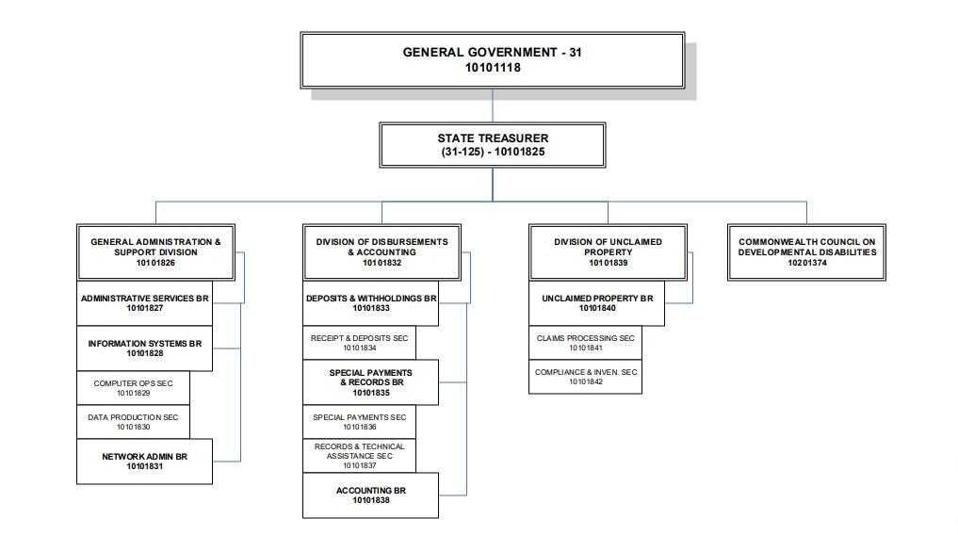
Organizational Chart of the Treasury

Slide 4
Boards and Commissions
Deferred Compensation Authority
KY Financial Empowerment Commission
KY Lottery Board
KY Teachers’ Retirement System
KY Higher Education Assistance Authority
KY Higher Education Student Loan Corporation
Opioid Abatement Advisory Commission
State Investment Commission

Slide 5
Unclaimed Property: Kentucky’s Financial Lost and Found
Administer Kentucky’s Unclaimed Property Fund
Returned more than any Treasurer in KY History: Over $150M
Unclaimed Property consists of financial property, including:
Payroll checks
Unclaimed safety deposit boxes
Old life insurance policies
Vendor checks
Unclaimed Property contains assets with a total value of nearly half a billion dollars
New Holder Reporting Tool & New Online Claims Tool

Slide 6
New Initiatives and Responsibilities
Transparency.ky.gov
STABLE Kentucky Accounts
Kentucky Financial Empowerment Commission
Kentucky Financial Empowerment Coalition and Database
Restricted Financial Institutions List (SB 250)
Unclaimed Property Trust Fund

Slide 7
Commonwealth Council on Developmental Disabilities (CCDD)
Each FY, a State DD Council receives federal grant funds from the US Dept. of Health & Human Services
Funding for CCDD added to Treasury General Fund but only available to CCDD
CCDD is mandated by federal law to engage in advocacy, capacity building, and systemic change activities that support people with developmental disabilities to live in homes and communities in which they can exercise their full rights and responsibilities as citizens while pursuing meaningful and productive lives.

Slide 8
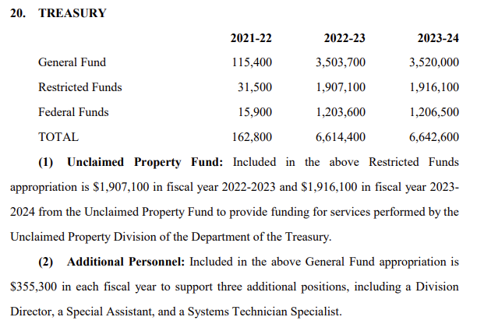
Budget At A Glance: Current Biennium

Slide 9
For Consideration
State Airplane Approval Function
Unclaimed Property Trust Fund
Allow greater use of Unclaimed Property Restricted Funds

Slide 10
Questions?

