Slide 1
Kentucky Office of Broadband Development
Meghan E. Sandfoss, Executive Director

Slide 2
Status of the Office of Broadband Development
Since September
Meeting with stakeholders
Managing Round 1 Grants
Pole Replacement grant opened in September
Created a website – broadband.ky.gov
Staffing & contracting
Currently have 2 FT employees, additional positions in progress
Contracted with Connected Nation for planning, mapping, and staff augmentation

Slide 3
Office of Broadband Development Activities
BEAD Initial Planning funds awarded
U.S. Treasury Capital Projects Fund Plan approved
$182M for deployment projects
FCC Map challenge
15,432 fixed availability challenges submitted to FCC in early January to meet NTIA deadline
Data collection for statewide broadband map underway
Completed map anticipated in early May
Statewide Broadband Plan in progress

Slide 4
Status of Funding in the Commonwealth
Broadband Deployment Fund
Round 1
Better Internet Grants
Broadband Deployment Fund
BEAD
Rural Infrastructure Improvement Fund
Fiscal Recovery Funds $117.2M Available $89.6 M Awarded $204.4M Investment 47 projects 34,000+ new locations | Pole Replacement Grant Opened September 1 $20M Available 50% / $5,000 per pole Unserved areas Accepting Applications | Capital Projects Fund Open November 21 – February 6, 2023 $206M available “No service” priority Challenge Process Ongoing | BEAD Allocation Expected in June 2023 Estimated at >$700M

Slide 5
Better Internet Program Grants
Program designed to meet U.S. Treasury Capital Projects Fund requirements and statutory requirements of KRS 224A.1121, including:
Priority for “no service” locations and higher grant percentage for more rural projects
Projects will meet or exceed 100/100 Mbps symmetrical speed
Preference for fiber and last-mile projects
Participation in the Affordable Connectivity Program
Competitive grant program
Projects operational by December 31, 2026

Slide 6
Better Internet Program Grants
Applications closed on February 6
Challenge process began February 13
Challenge determinations will be completed by April 21
Application Statistics
103 applications received from 19 providers in 77 counties
99 Fiber to the Home (FTTH) applications, 4 combined FTTH and cable
Total funds requested over $483M

Slide 7
BEAD Program Overview
Broadband Equity, Access, and Deployment program
$42.45B allocated through IIJA for broadband deployment nationwide
Each state will receive $100M minimum, with remainder distributed based on a formula that considers the number of unserved and high costs locations in each state
Estimates for Kentucky’s allocation range between $700M and $1.3B

Slide 8
BEAD Program Overview
Each state must develop a plan and proposal of how BEAD funds will be used
Plan must identify local and regional broadband service needs and gaps
Must set an “extremely high cost per location threshold” where “best available technology” can be used as an alternative to fiber
Funds to be distributed to subrecipients through a competitive process

Slide 9
BEAD Timeline
Planning funds were awarded November 15, 2022
Allocation expected from NTIA June 30, 2023
5 Year Action Plan due August 12, 2023
Initial Proposal due to NTIA in late 2023
20% of allocation will be released upon approval of initial proposal
Projects must be completed by the end of 2027

Slide 10
BEAD Action Plan
BEAD Initial Planning Grant awarded in November 2022
Will support short-term planning and mapping projects
Staffing and office capacity through 2027
Alignment of outreach and planning with Digital Equity Plan through Education & Labor Cabinet
Holding local coordination meetings statewide – opportunities to engage (link)

Slide 11
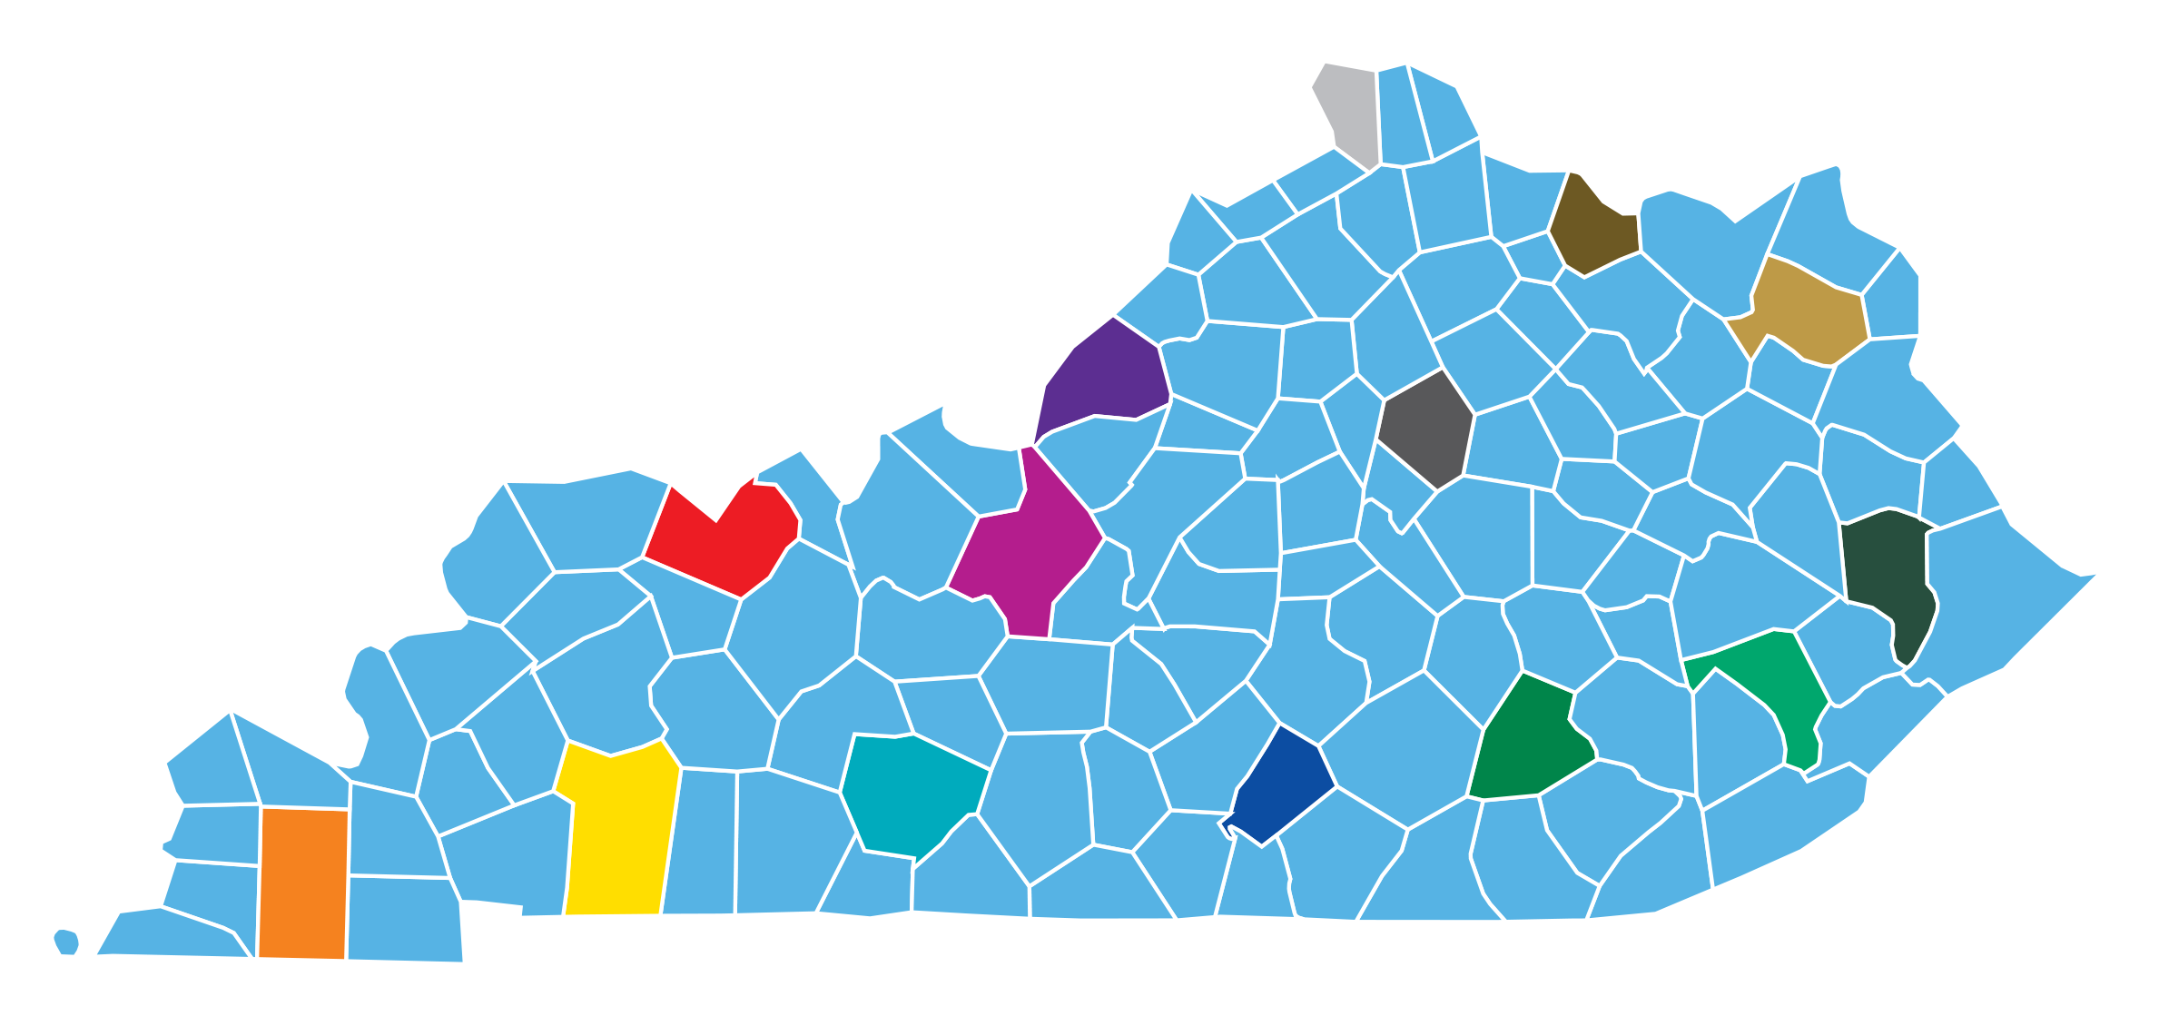
BEAD Local Coordination
14 meetings to be held around the state to collect input on high-speed internet needs through March 23
Additional input will be solicited from stakeholder focus groups such as industry, workforce development, healthcare, and state and local government

Slide 12
Contact
Meghan E. Sandfoss
Executive Director
Office of Broadband Development
100 Airport Road, 3rd Floor
Frankfort, KY 40601
Email: meghan.sandfoss@ky.gov
Office: 502.892.3002
Mobile: 502.330.8713
Web: broadband.ky.gov

