Slide 2
STITCH KENTUCKY
Liberty, Kentucky

Slide 3
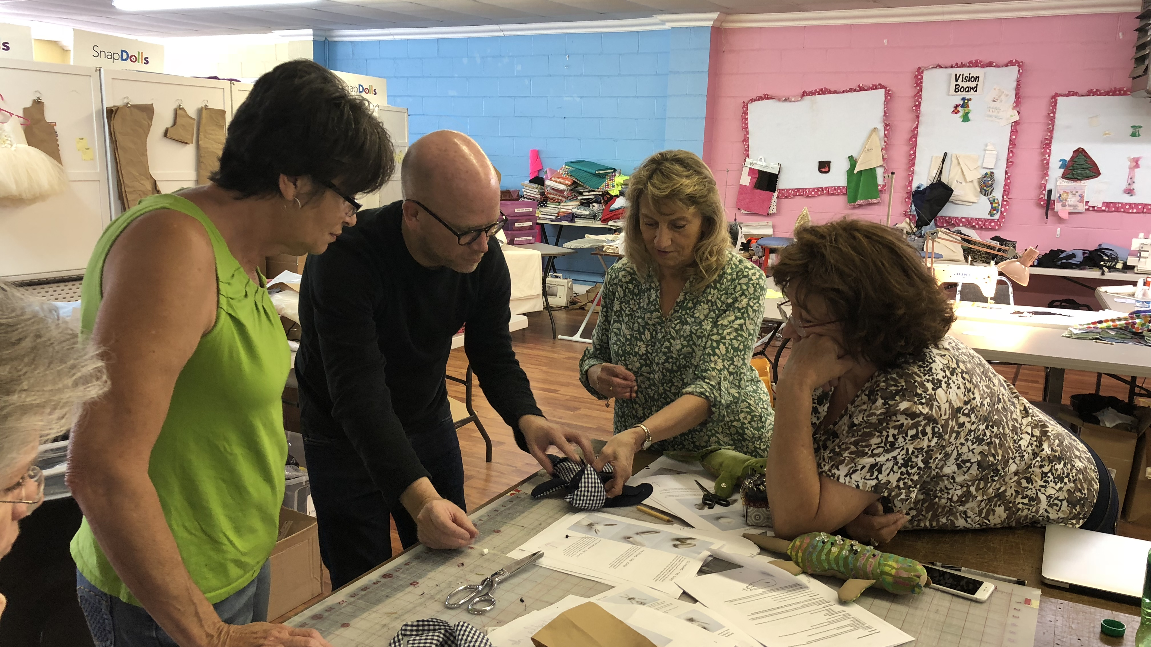
Prototyping

Slide 4
Cut & sew

Slide 5
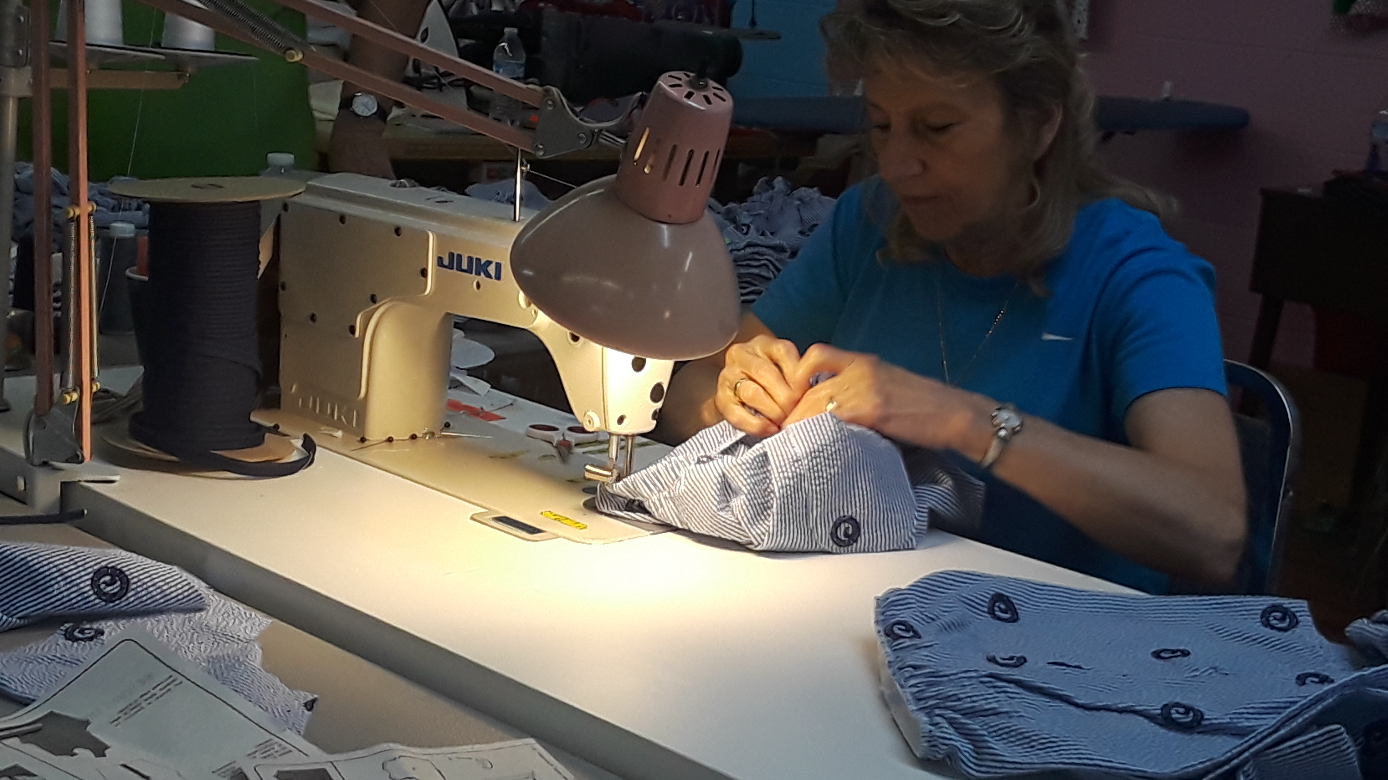
Production:
Small & large runs

Slide 6
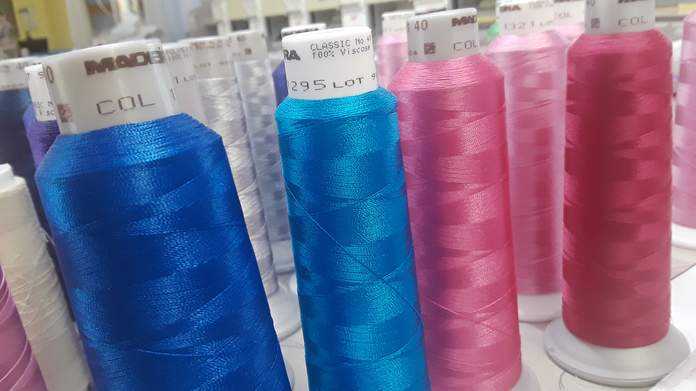
sourcing

Slide 7
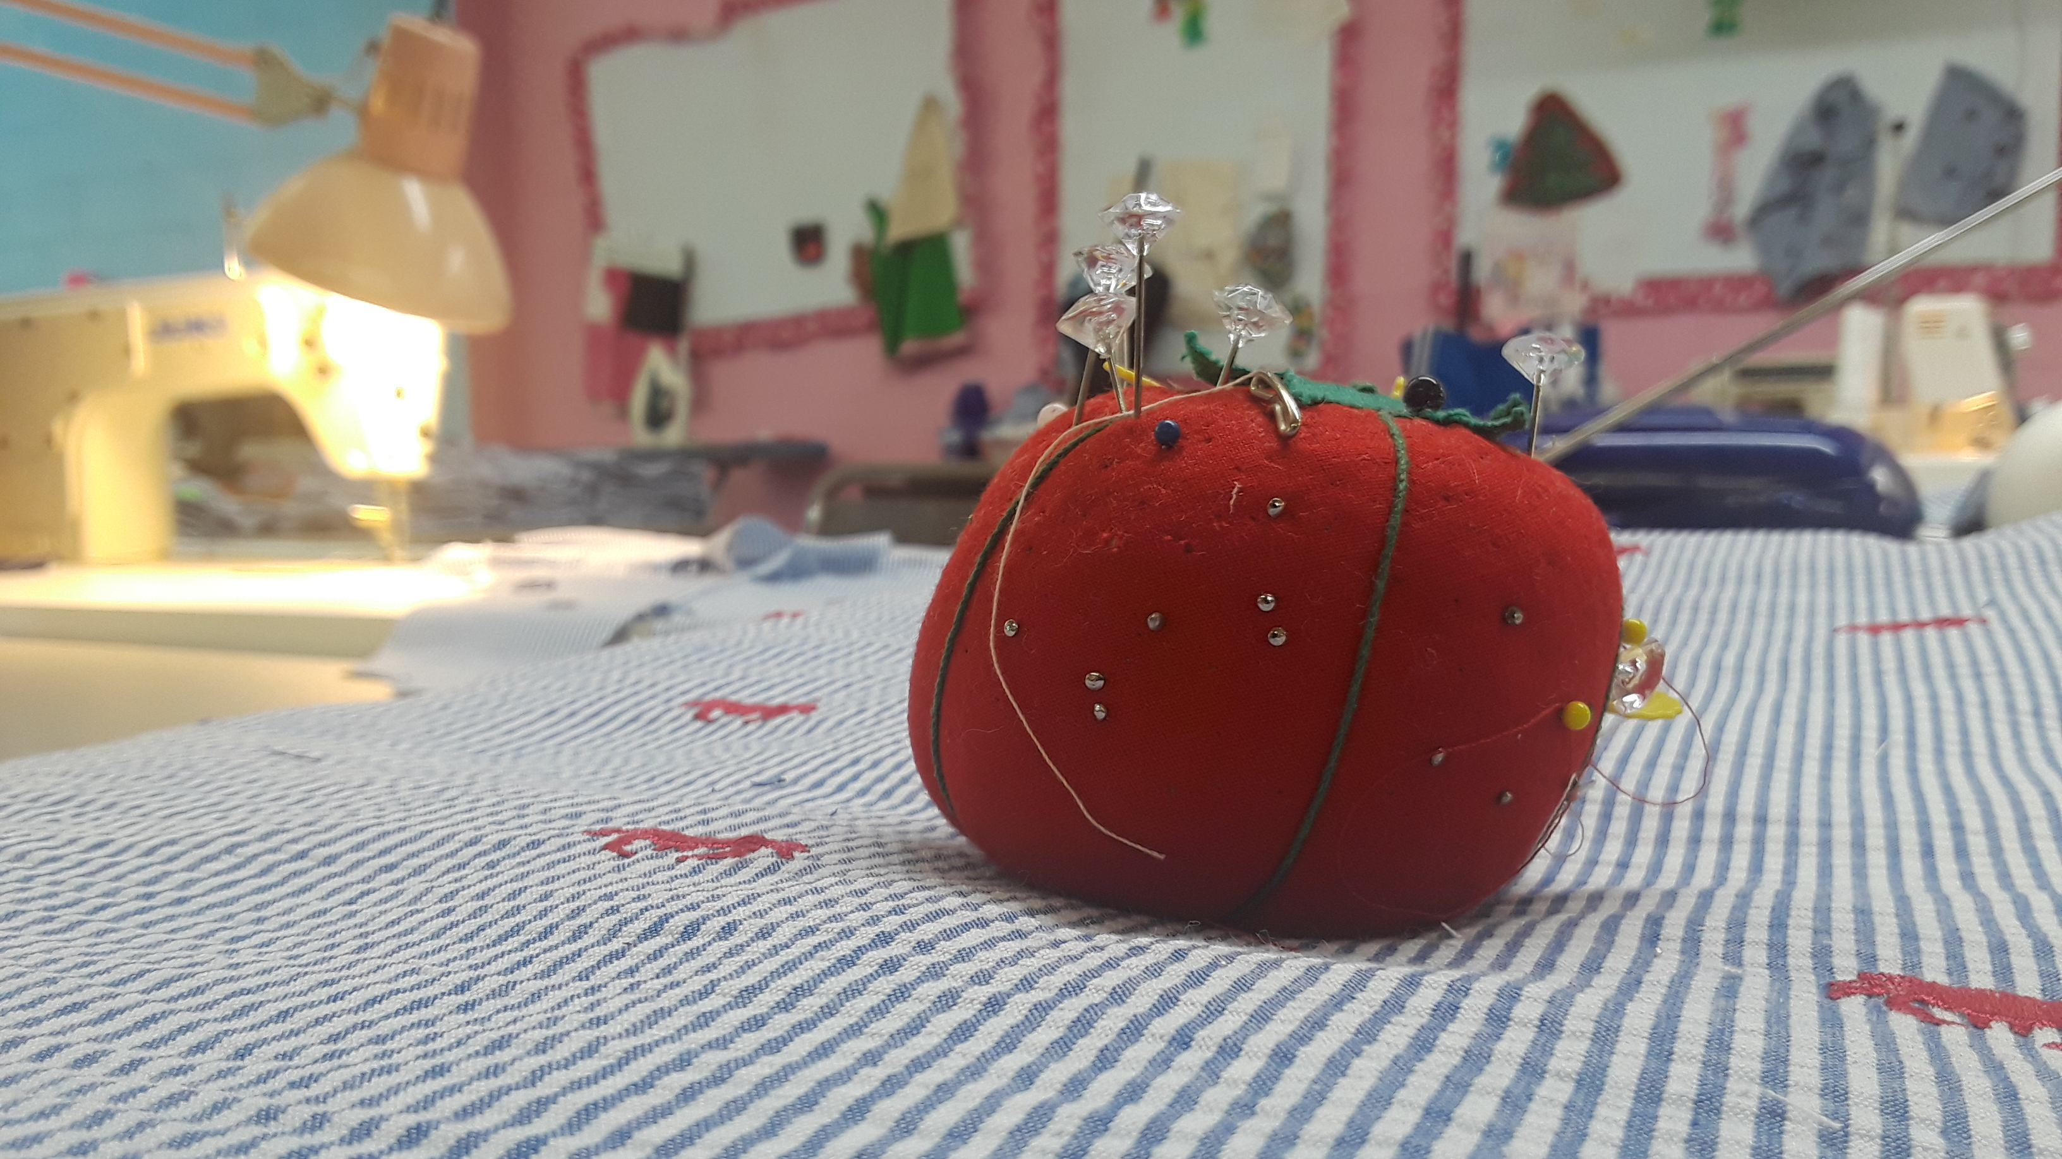
fulfillment

Slide 8
Future opportunities

Slide 9
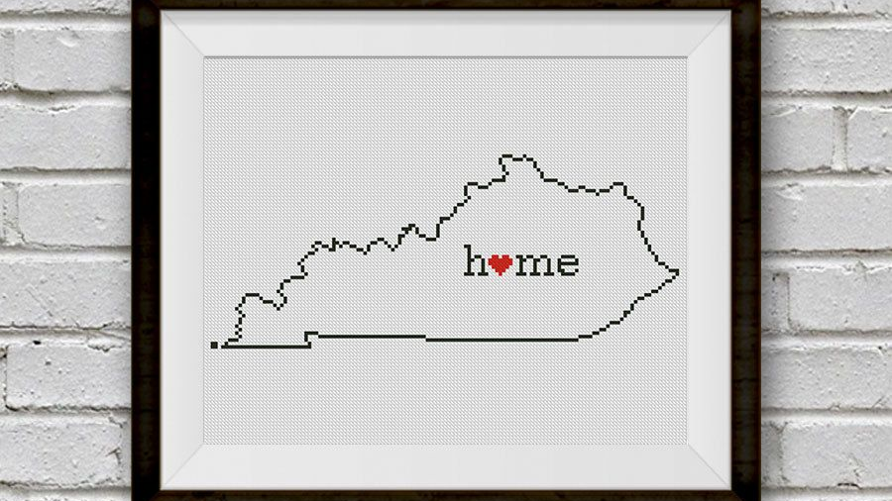
Expanding stitch Kentucky

Slide 10
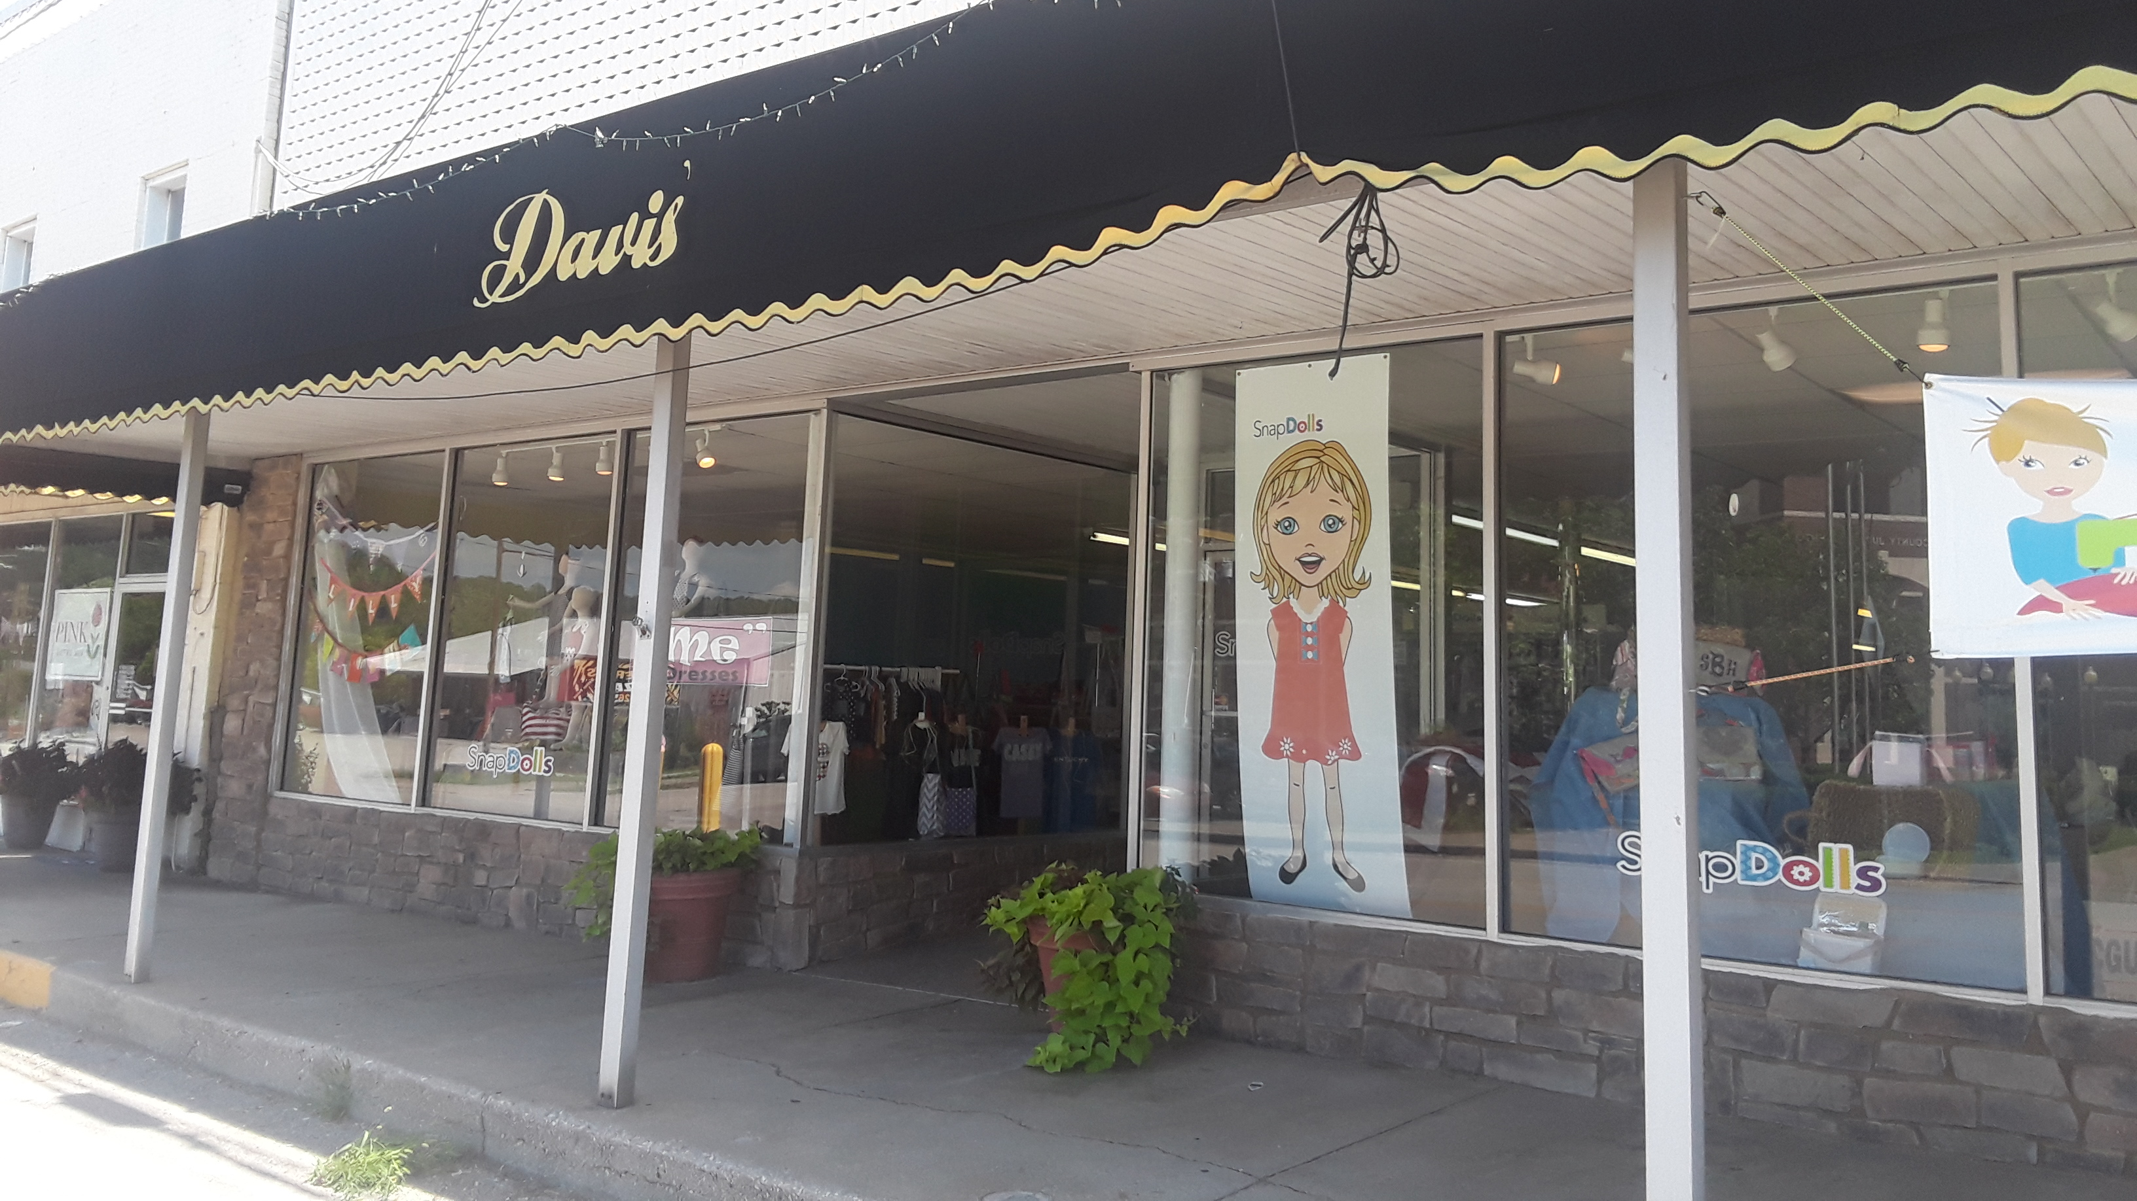
LIBERTY, KENTUCKY

