Slide 1
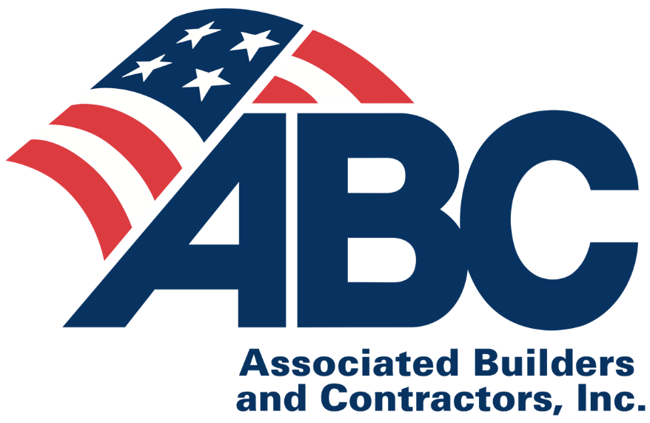
In Support of Fair and Open Competition via
HB 471
Interim Joint Committee on Economic Development and Workforce Investment
Thursday, Nov. 15, 2018
Ben Brubeck, Vice President of Regulatory, Labor and State Affairs
Associated Builders and Contractors

Slide 2
Rep. DeCesare’s HB 471 is a win-win for taxpayers and the economy
Inclusive policy benefitting all of Kentucky’s construction industry
Increases fair and open competition
Ensures taxpayer dollars are spent effectively
Helps small businesses compete and grow
Results in more of the best possible construction projects built at the best possible price

Slide 3
What is a government-mandated project labor agreement (PLA)?

Slide 4
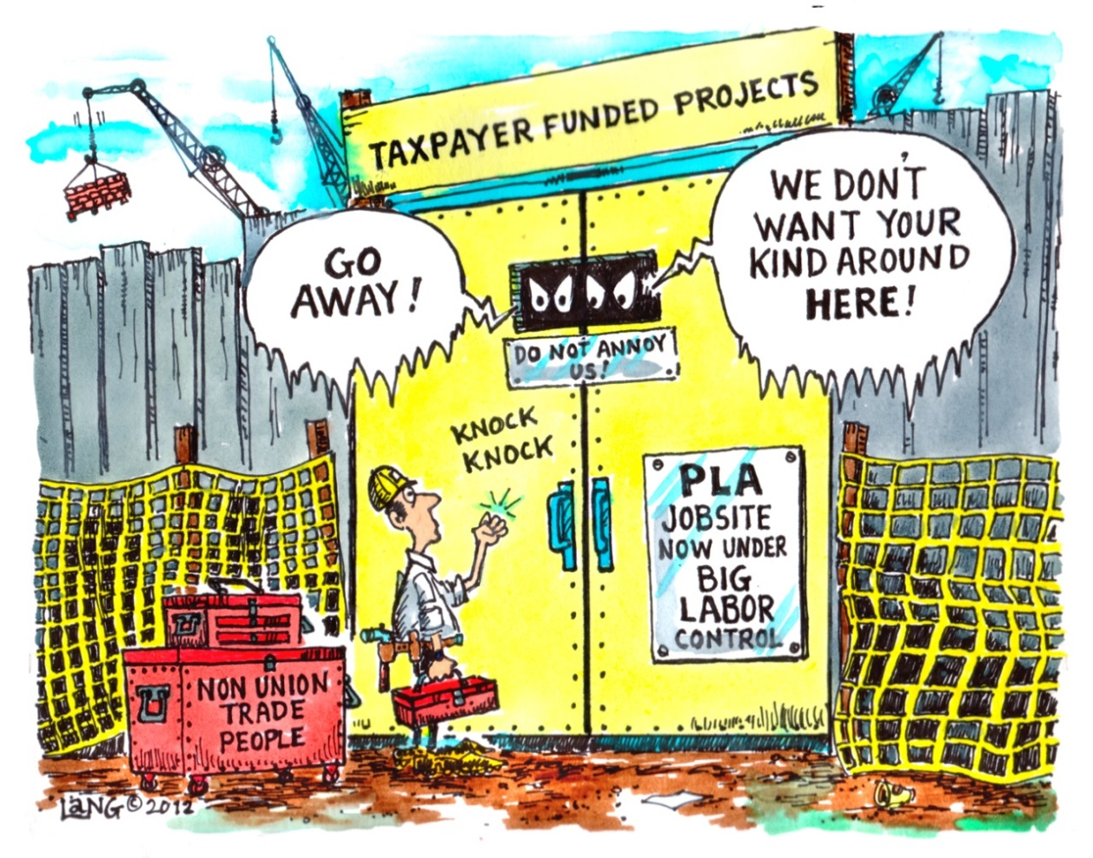
Government-mandated PLAs reduce competition
A PLA mandate is a tool to artificially create a union monopoly on taxpayer-funded construction jobsites by reducing competition from quality contractors and local construction professionals not affiliated with unions
Typical provisions in government-mandated PLAs discourage most merit shop contractors from bidding because PLAs can harm a company’s existing workforce that chooses not to belong to a union.

Slide 5
How does a PLA discourage competition?
PLAs require contractors to obtain most or all employees from union hiring halls and union apprenticeship programs
PLAs force contractors and employees to follow inefficient and counterproductive union job classifications and work rules contained in local union collective bargaining agreements. This adds additional costs because it eliminates multiskilling, and it is a source of bureaucratic frustration for employees and contractors
PLAs force contractors to pay into union benefit plans, including multi-employer union pension plans that can put merit shop contractors at risk of huge pension withdrawal liabilities, especially if the plans are underfunded
Multiple Union Collective Bargaining Agreements Contractors Must Obey Via A PLA

Slide 6
How does a PLA harm nonunion employees?
PLAs force existing employees to accept union representation as a condition of employment, without a union representation election
Nonunion employees are required to pay non-refundable union dues and/or join a union in order to work on a PLA project and receive benefits
PLAs require non-signatory contractors to pay their employees’ health and welfare fringe benefits to union benefit funds, even if they have existing plans. Increased costs.
Nonunion employees lose these benefits and money unless they join a union. Reduced pay.

Slide 7
How does a PLA mandate exacerbate the construction industry’s skilled workforce shortage?
Union membership in 2018 for Kentucky’s private construction workforce
Union membership in 2017 for the US private construction workforce
Notes:
Updated state-specific union membership information for various industries, including the construction industry, is available at www.unionstats.com (see table II
See: https://thetruthaboutplas.com/2018/01/19/bls-just-14-percent-of-u-s-construction-industry-is-unionized/
Almost nine out of ten construction workers in KY will be harmed by a PLA mandate
KY’s construction union density information from www.unionstats.com was updated at the end of January 2018 to reflect 2017 raw data published by U.S. DOL’s Bureau of Labor Statistics.

Slide 8
What is the PLA cost premium?
Government-mandated PLAs increase costs between 12% and 18%, on average
Studies conducted in MA, CT, NY, NJ, CA and OH on hundreds of school construction built with and without PLA mandates
Studies available at TheTruthAboutPLAs.com
Notes:
https://thetruthaboutplas.com/2012/12/28/plastudies/

Slide 9
How do PLAs increase costs by 12% to 18%?
Compliance costs
Attorney costs & delays complying with PLA
Lost nonunion worker wages and benefits
Competitive costs
Economic theory in competitive bidding
Correlation between less competition & higher labor and construction costs
Labor costs
Inefficient union work rules & lost productivity
Double health & pension costs to any nonunion contractors who pursue PLA projects
Notes:
A variety of studies on the cost of PLAs can be found at http://thetruthaboutplas.com/tag/anti-pla-mandate-study/
Beacon Hill Institute (BHI) at Suffolk University in Boston, Mass., conducted four studies analyzing the effect PLAs have on school construction projects in Massachusetts, Connecticut, New York and Ohio. The studies determined PLAs add 12 percent to 18 percent to construction costs and also inflated construction bid costs. A similar July 2011, study released by the National University System Institute for Policy Research (NUSIPR), found California school construction projects built using government-mandated PLAs experienced increased costs of 13 percent to 15 percent, or $28.90 to $32.49 per square foot, compared to projects that did not use a PLA.
Employees who don’t belong to a union don’t benefit from PLAs. An October 2009 report by Dr. John R. McGowan, "The Discriminatory Impact of Union Fringe Benefit Requirements on Nonunion Workers Under Government-Mandated Project Labor Agreements," finds that employees of nonunion contractors that are forced to perform under government-mandated PLAs suffer a reduction in their take-home pay that is conservatively estimated at 20 percent. PLAs force employers to pay employee benefits into union-managed funds, but employees will never see the benefits of the employer contributions unless they join a union and become vested in these plans. Employers that offer their own benefits, including health and pension plans, often continue to pay for existing programs as well as into union programs under a PLA. The McGowan report found that nonunion contractors are forced to pay in excess of 25 percent in benefit costs above and beyond existing prevailing wage laws as a result of “double payment” of benefit costs as a result of a PLA.
Recent example of federal U.S. DOL project in Manchester, N.H., that had increased competition, reduced costs and a local workforce after PLA was removed following a round of bidding with a PLA:
https://thetruthaboutplas.com/2015/10/26/u-s-department-of-labor-job-corps-center-opening-demonstrates-value-of-open-competition/
More projects bid with and without PLA mandates:
http://thetruthaboutplas.com/2013/04/18/great-scott-projects-bid-with-and-without-pla-mandates-show-plas-increase-costs-and-reduce-competition/
Responses to critiques of research showing added costs of PLA mandates:
http://thetruthaboutplas.com/2014/05/01/the-truth-about-project-labor-agreement-research/

Slide 10
Key arguments in PLA debate
Pro-PLA arguments
The truth about the Fair and Open Competition Act (HB 471)
HB 471 outlaws all PLAs
False: HB 471 ensures government neutrality so firms can still voluntarily use a PLA if they want
Ensures fair & open competition by prohibiting government-mandated PLAs
Applies to all state projects, state-funded/assisted projects and local public agencies, as defined by KRS 61.870
HB 471 bill will hurt KY construction workers and lead to out-of-state contractors taking work
Bill simply allows government to deliver the best product at the best price by encouraging competition from all of KY’s qualified contractors & hard hats
HB 471 is inclusive of 83.3 percent of KY construction workforce that chooses not to join a union
HB 471 allows participants in nonunion workforce development and apprenticeship programs, promoting an “All of the Above” local workforce development strategy
Inclusive of MWDBE contractors and minority and women construction workers, who are predominantly not affiliated with unions
KY FOCA bill is illegal
Similar legislation prevailed in all legal challenges in other states (23 states have passed Fair and Open Competition Act (FOCA) measures since 2011)
Government is acting like a market participant rather than a labor regulator (this is a procurement bill and not a labor regulation)
PLAs used in private sector
Taxpayer-funded construction projects are subject to different regulations and require fair and open competition for contracts that can be awarded to the lowest responsible bidder.

Slide 11
24 states ensure fair and open competition
WA
NH
ME
2012
1999
MN
VT
2013
OR
2017
NY
2011
MA
WY
2014
RI
CA
2017
PA
CT
2015
NE
IL
OH
NJ
1995
IN
DE
2015
CO
2017
2012
MD
2012
KY
2013
2011
2011
AK
NM
2012
2015
TX
2013
2014
2014
2013
No policy prohibiting or encouraging use of PLAs
2011
2017
Enacted pro-PLA bill or EO encouraging government- mandated PLAs
Enacted bill or EO prohibiting government-mandated PLAs
Notes:
24 states have passed legislation restricting government mandated project labor agreements.
There are a number of FOCA targets in 2019, depending on the 2018 midterm election outcomes.
There are a number of states that may promote pro-PLA measures following Dem Trifectas and/or larger Dem. Majorities in the House or Senate.

Slide 12
Voters prefer fair and open competition
Question asked: If you had to choose, which policy would provide a better value for taxpayers?
Notes:
89 percent think requiring a fair and open competitive bidding process for all contractors, regardless of whether or not their workers are in a union, can provide a better value for taxpayers.
11 percent think requiring contractors to sign a union contract to work on a construction project provides better value for taxpayers.

Slide 13
Fair and open competition via Rep. DeCesare’s HB 471 is a win-win for taxpayers and the economy
Inclusive policy benefitting all of Kentucky’s construction industry
Ensures fair and open competition
Reduces costs, ensures taxpayer dollars are spent effectively
Helps small businesses compete and grow
Results in more of the best possible construction projects built at the best possible price
Allows firms to voluntarily utilize PLAs. Government simply can’t mandate PLAs
Will not exacerbate Kentucky’s skilled workforce shortage

