Slide 3
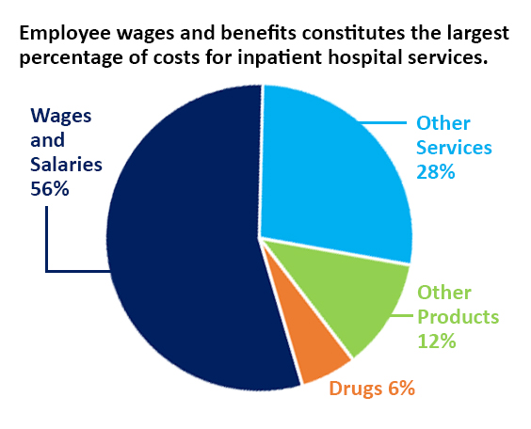
Many factors affect the cost of care.
Notes:
A range of factors affect the cost of care -- wages, prescription drugs, food, medical devices, utilities and professional insurance. This chart reflects the national breakdown of expenses in a hospital.
You can see that about 75% of a hospital’s expenses are for labor, drugs and supplies.
Steep increases in these costs can undermine hospitals’ efforts to maintain access to care . We are seeing hospitals across the country lay off staff and curtail services. As a rural state where much of our population is already underserved, these actions would be devastating to the communities we serve.

Slide 4
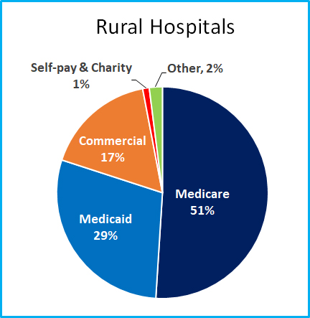
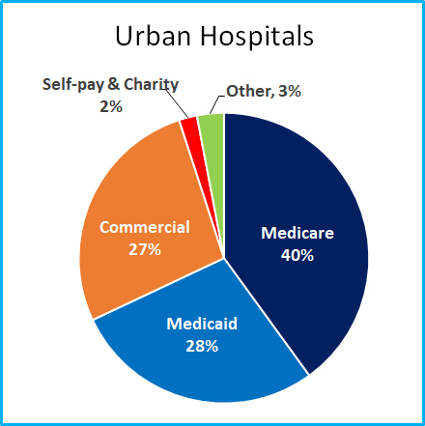
Hospitals Simply Can’t Raise Prices
70 - 80% of hospital patients are governmental
Medicare pays 90% of Cost
Medicaid pays 95% of Medicare (85% of cost)
Governmental payment rates are NON-NEGOTIABLE
Rural hospitals have fewer commercial and more Medicare and Medicaid patients
Notes:
Even though 50% of the population is commercially insured, the majority of patients served by hospitals are on a government program – Medicare being the largest 40-50%, followed by Medicaid at about 30%
Rural hospitals have a larger share of government patients
This puts a strain because both pay below cost

Slide 5
Fuel for the Economic Engine
An Outpatient HRIP program is needed
NO COST to the State
Infrastructure already in place
Will particularly assist rural hospitals
Will be tied to quality outcomes
Must be federally approved

Slide 6
Thank you for having us. Are there any questions?

